Slide 1
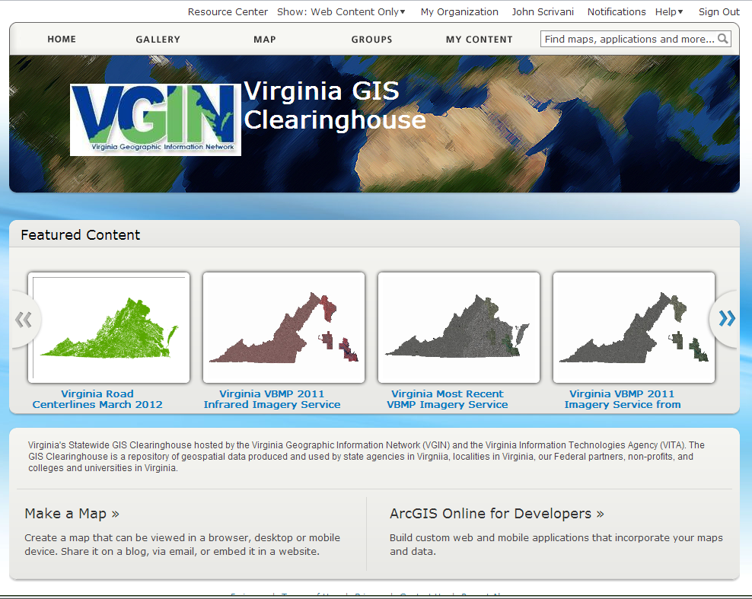
Clearinghouse Update
ArcGIS Online for Organizations selected as the platform for the clearinghouse
VDEM Grant Funding for a one-year subscription made this possible

Slide 2
ArcGIS Online for Organizations- AGOLO
Cloud-hosted document management system for geospatial data
Secure system for sharing with authorized state, local, federal and private sector partners
Selected items can also be made available to the general public
Content includes downloadable data, links to external web services, hosted services, and apps
Total solution a blend of locally hosted services and ESRI services.

Slide 3
The VGIN AGOL Organization
User accounts will be pre assigned
Initially, one general user per entity (local government, state agency, others) upon request (e.g. VGIN.Chesterfield)
Will allow the user to post geospatial content to the clearinghouse
User can choose to share their data with
All others in the organization
Select groups within the organization
Select groups outside the organization
The general public

Slide 4
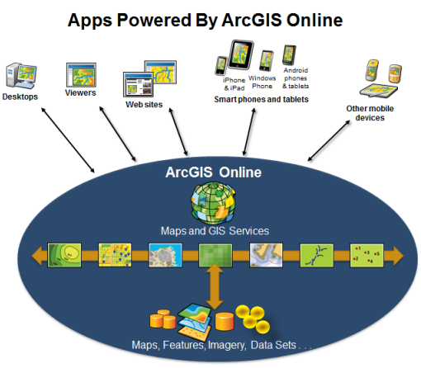
Content can be used in many apps
Desktop software
Web map viewers
Embedded maps
Smart phones/tablets
Other mobile devices

Slide 5
AGOLO Subscription Limits
Currently limited to 250 users
137,500 service credits
Credits are consumed by storage costs, downloads, and hosting services

Slide 6
Clearinghouse Usage Guidelines
Sharing of data by download - use freely
Layer packages
Map packages
Shapefiles (w/o feature service)
Register services published by your ArcGIS Server
Use freely
Hosted Services (coordinate with VGIN before using)
Feature services
Tiled cache services
Geocoding

Slide 7
Clearinghouse User Guidelines
Hosted Services
coordinate with VGIN before using
Feature services
Tiled cache services
Geocoding

Slide 8
Questions or Comments?
John Scrivani – VGIN
John.scrivani@vita.virginia.gov

