Slide 1
IOT NETWORK SECURITY & MACHINE LEARNING
Encrypted IoT Device Fingerprinting
Passive hardware identification via inter-packet timing rhythms
5 Smart Devices • 99.34% Accuracy • Zero Payload Decryption
Notes:
Welcome everyone. Today I'm presenting our project on Encrypted IoT Device Fingerprinting.
In modern smart homes, dozens of connected devices operate simultaneously—from smart speakers to security cameras. While nearly all of their traffic is encrypted to safeguard user privacy, the physical hardware, operating systems, and firmware of these devices transmit packets according to distinct, repeatable timing rhythms.
In this work, we demonstrate how a gateway can accurately recognize five distinct IoT devices with over ninety-nine percent accuracy using purely inter-packet arrival times—without decrypting, inspecting, or storing a single byte of application payload.

Slide 2
PROBLEM & MOTIVATION
The Smart Home Blind Spot
Why traditional network security fails on modern consumer IoT
Encrypted Payloads
TLS/HTTPS encryption blinds deep packet inspection tools.
Spoofed Headers
MAC and IP addresses are trivially faked in software.
Zero Visibility
Gateways cannot verify what physical hardware is connected.
Notes:
Why is IoT device identification so difficult?
First, modern privacy standards encrypt traffic end-to-end. Traditional firewalls and intrusion detection tools that rely on Deep Packet Inspection are completely blind.
Second, network-layer identifiers like MAC and IP addresses are easily spoofed by malicious software.
Finally, consumers rarely patch or configure smart appliances, leaving home gateways with zero visibility into what hardware is actually running on their local network.
We need a passive, physical-layer-adjacent method to verify identity without breaking encryption.

Slide 3
TECHNICAL FOUNDATION
Timing Leaks Hardware Identity
How encrypted streams reveal their physical source
Hardware Rhythms
Microcontrollers, polling loops, and firmware emit distinct packet delays.
The Footsteps Analogy
Identifying devices by packet timing is like recognizing footsteps in the dark.
Notes:
The foundational premise of our project is that timing leaks identity.
Even when payloads are strongly encrypted and randomized, the underlying hardware cannot hide when it transmits.
A camera encoding H.264 video streams packets in dense bursts driven by frame rates. A smart plug queries local sensors on a fixed microcontroller clock cycle. A smart speaker bursts network traffic only when audio processing buffers fill.
Think of it like recognizing someone walking down a hallway purely by the rhythm and cadence of their footsteps, even in total darkness.

Slide 4
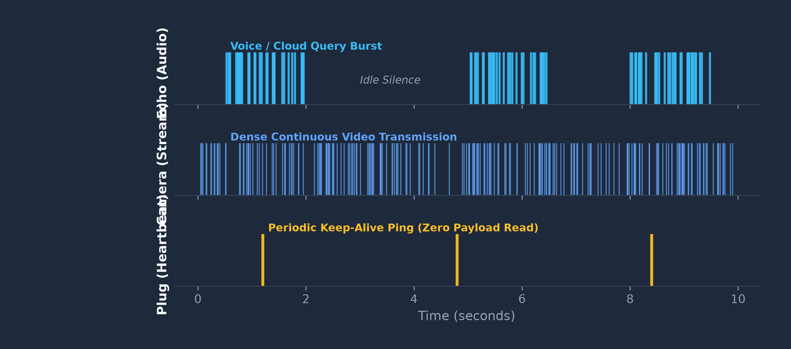
BEHAVIORAL PROFILES
How Devices Differ in Time
Direct comparison of real packet arrival timelines
Hardware tasks emit distinct packet rhythms across idle, streaming, and query states.
Notes:
Here we see real packet timeline traces illustrating the stark differences between device profiles.
Notice the top trace: an Amazon Echo sits completely quiet until voice interaction triggers a dense burst of cloud requests.
In the middle trace, a Samsung security camera streams continuous, dense packets to maintain real-time video feeds.
At the bottom, a TP-Link smart plug operates on a barebones microcontroller, emitting sparse, periodic heartbeat pings every few minutes.
These timing rhythms are physically coupled to hardware function and cannot be concealed without adding deliberate, latency-inducing traffic padding.

Slide 5
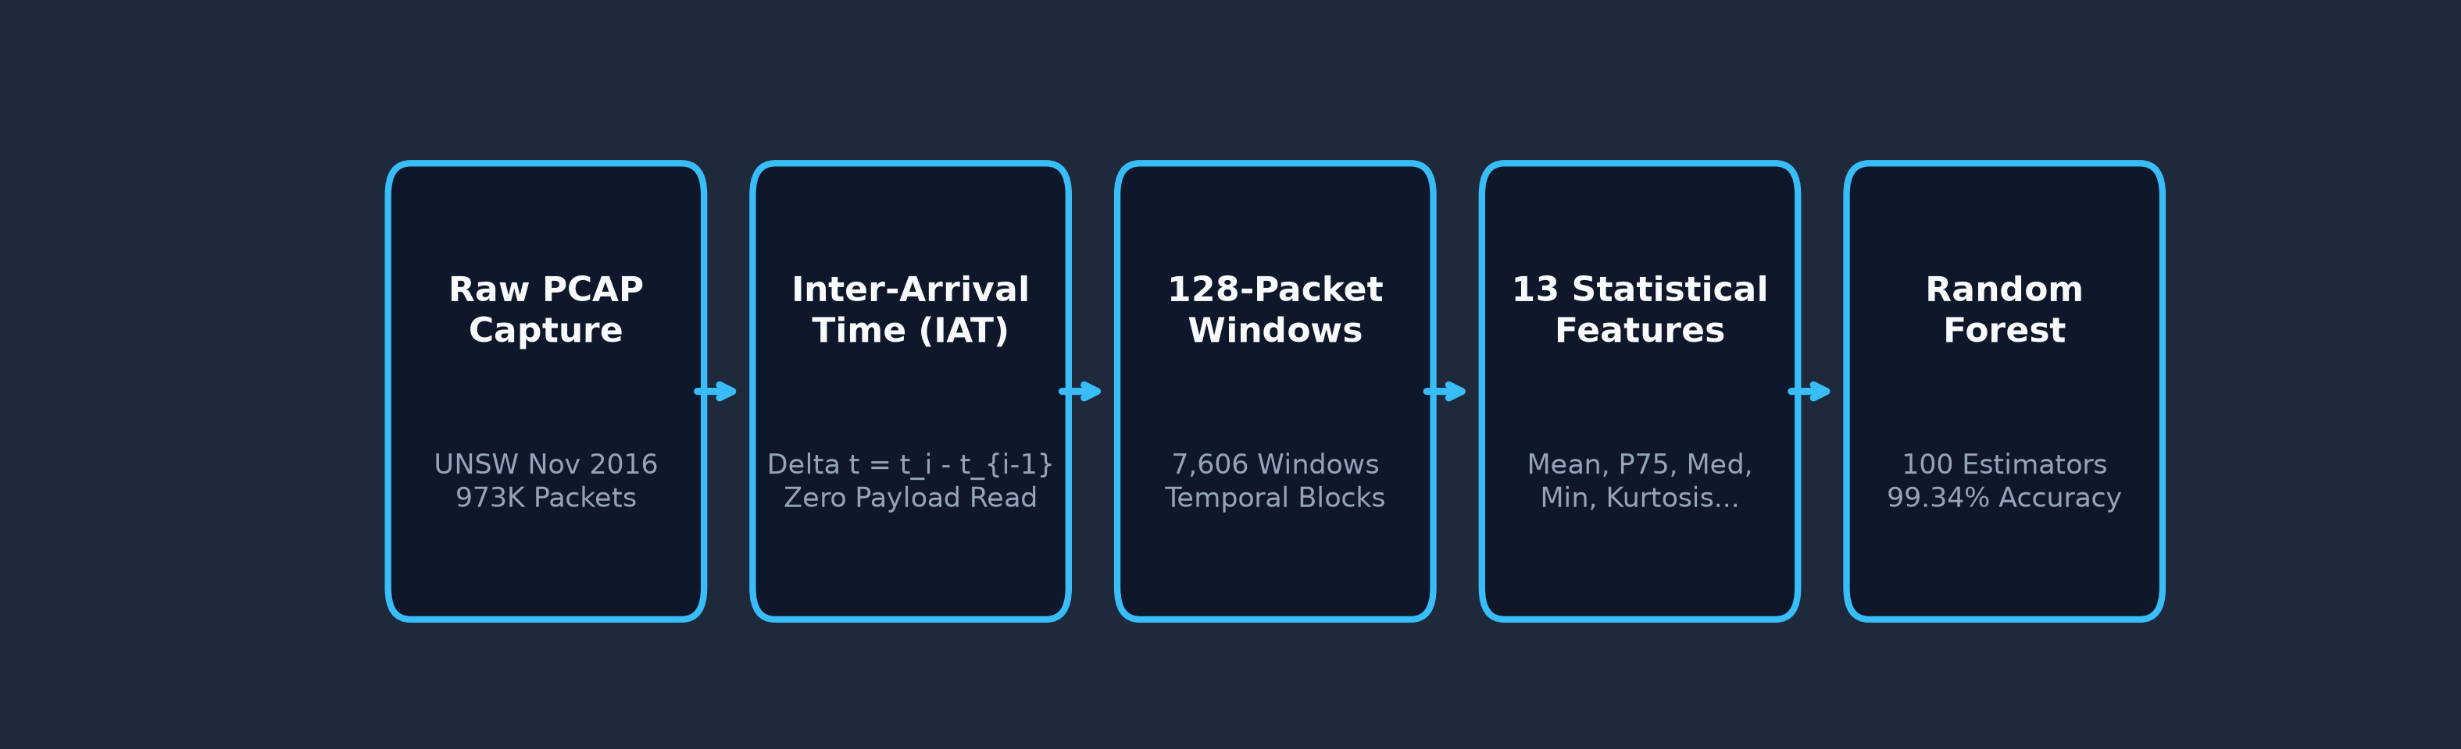
SYSTEM ARCHITECTURE
End-to-End Traffic Pipeline
A lightweight, passive 5-stage inference flow
Passive Gateway Processing
Fast user-space pipeline extracting summary statistics with zero decryption overhead.
Notes:
Here is our complete processing pipeline. It consists of five streamlined steps.
First, we capture raw network traffic from the gateway interface.
Second, we compute Inter-Arrival Time deltas between successive packets for each IP stream.
Third, we segment these deltas into non-overlapping windows of 128 packets.
Fourth, we calculate thirteen lightweight summary statistics per window.
Finally, a Random Forest classifier evaluates the feature vector and outputs the device identity.
The entire feature extraction requires simple arithmetic operations that can run natively on consumer router hardware.

Slide 6
DATASET SPECIFICATION
UNSW Real-World IoT Dataset
Empirical benchmark traffic captured over 3 continuous days
973K Packets
Captured across 3 continuous days in a live smart home.
7,606 Windows
Segmented into non-overlapping 128-packet temporal blocks.
5 Devices
Amazon Echo, Belkin WeMo, Philips Hue, Samsung Camera, TP-Link Plug.
Notes:
Our empirical evaluation is grounded in the benchmark UNSW Smart Home dataset, collected over three continuous days in a live testbed environment.
The capture contains nearly one million raw packets across five popular consumer devices: the Amazon Echo smart speaker, the Belkin WeMo motion sensor, the Philips Hue smart lighting bridge, a Samsung smart security camera, and a TP-Link smart plug.
Segmenting into 128-packet chunks yielded 7,606 feature windows, giving us a robust distribution across both high-bandwidth streaming and low-power telemetry devices.

Slide 7
FEATURE ENGINEERING
13 Statistical Timing Moments
Compact mathematical summaries of packet inter-arrival times (IAT)
Spread & Center
Mean, Median, Min, Max, and Standard Deviation.
Clock Quantiles
25th, 75th, 95th, and 99th percentiles capture hardware timers.
Shape & Energy
Skewness, Kurtosis, Signal Energy, and Shannon Entropy.
Notes:
Rather than using complex wavelets or heavy deep learning that would struggle on embedded routers, we extract thirteen statistical timing moments for each window.
These include standard measures like mean, standard deviation, min, and max to capture baseline bandwidth and idle gaps.
More importantly, percentiles—specifically the 25th, 75th, and median—capture the fixed clock cycles of device microcontrollers.
Kurtosis and skewness capture sudden traffic spikes versus steady streaming. Finally, signal energy and entropy quantify burst irregularity without inspecting a single byte of payload.

Slide 8
METHODOLOGY & EVALUATION
Model Architecture & Rigor
Preventing temporal data leakage through block-level splitting
Random Forest
100 trees provide sub-millisecond, robust multi-class inference.
1-Hour Blocks
70% Train, 15% Validation, and 15% Held-Out Test.
Method Rigor
Zero temporal leakage; test split evaluated exactly once.
Notes:
For classification, we use a Random Forest ensemble with 100 decision trees.
But our primary focus was methodological rigor. Standard random cross-validation leaks temporal patterns because packets from the same session appear in both training and testing.
To avoid this fatal flaw, we implemented contiguous one-hour block splitting: the first 70% of chronological time blocks formed our training set (5,468 windows), the next 15% formed our validation set (1,071 windows), and the final 15% formed our held-out test set (1,067 windows).
The test set was touched exactly once after all hyperparameters were locked.

Slide 9
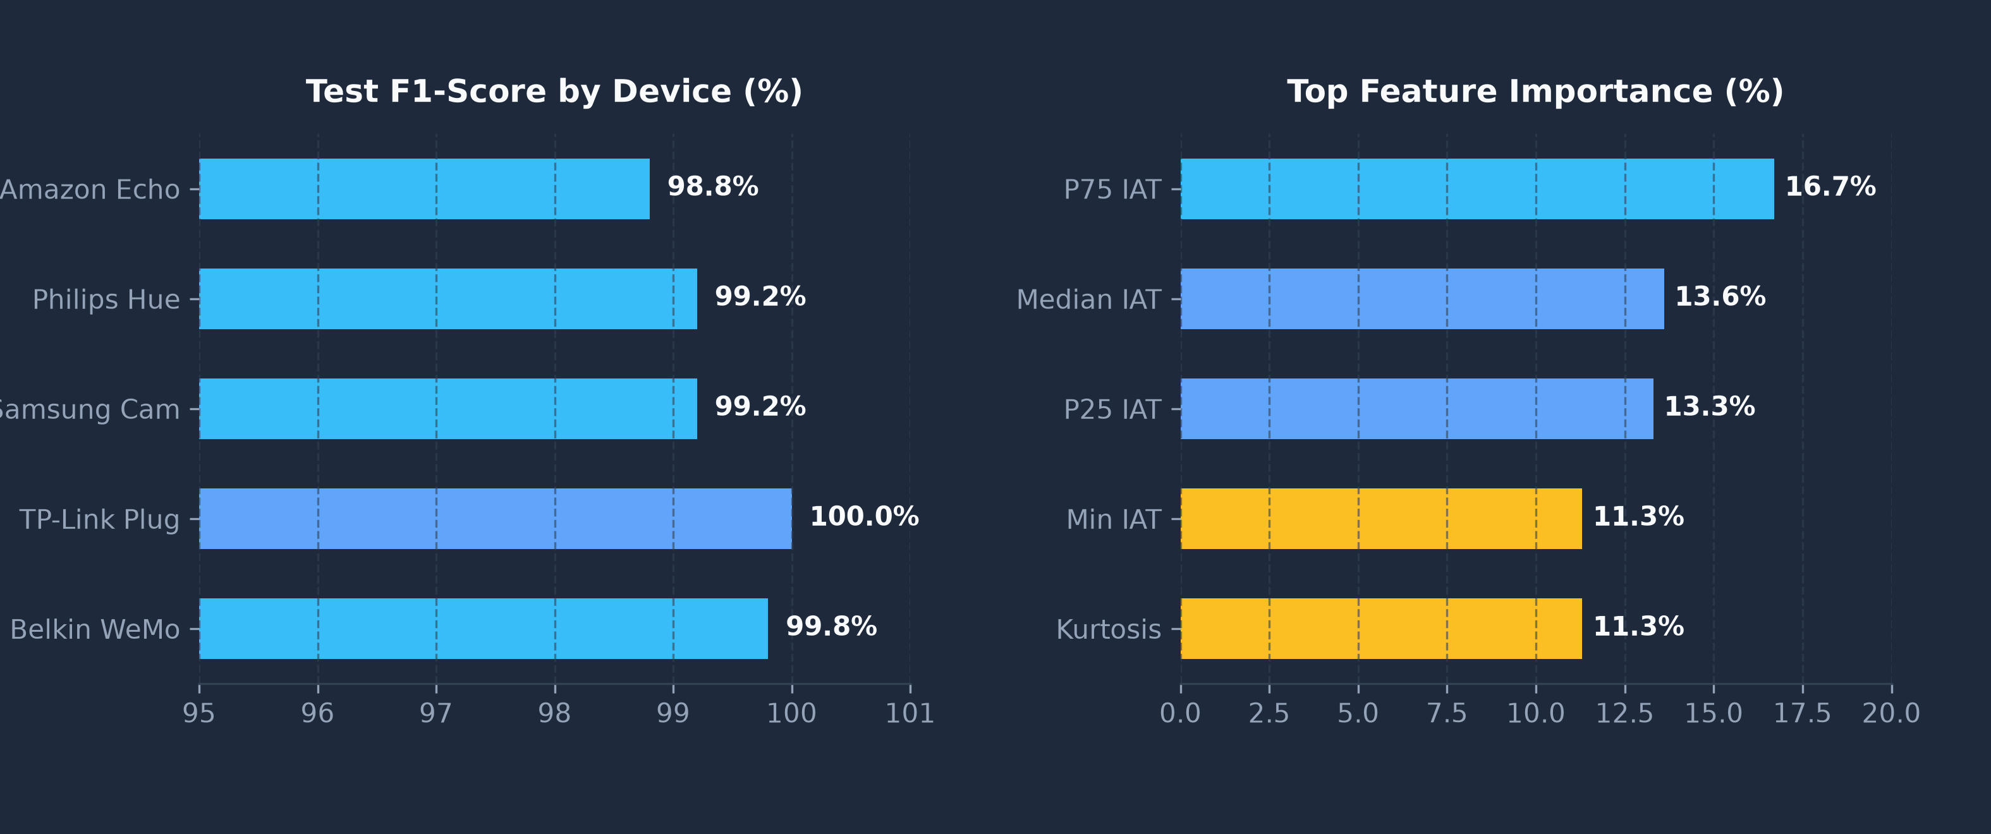
EXPERIMENTAL RESULTS
99.34% Classification Accuracy
Empirical performance across 1,067 held-out test windows
99.34% Test Accuracy • 99.38% Macro F1 • P75 and Median drive 30.3% of splits.
Notes:
Here are our final test results on the held-out temporal partition.
The model achieved 99.34% overall test accuracy and a 99.38% macro F1-score across all 1,067 test windows.
Looking at the per-device chart on the left, four of the five devices scored over 99% F1, with Belkin WeMo at 99.8% and TP-Link Plug at 100%.
On the right, our feature importance analysis reveals that the 75th percentile and median IAT account for over 30% of decision tree splits.
This confirms our hypothesis: fixed microcontroller polling intervals provide the strongest fingerprint for device identification.

Slide 10
SYSTEM ANALYSIS
Capabilities & Constraints
Real-world trade-offs in passive traffic fingerprinting
System Strengths
• Zero payload decryption preserves user privacy.
• Sub-millisecond router inference resists spoofing.
Real-World Limitations
• Severe Wi-Fi jitter distorts packet delays.
• Identical hardware models share timing signatures.
Notes:
Let's honestly assess what the current system can and cannot do.
On the capability side, it operates entirely without payload decryption, preserving end-to-end user privacy. Feature extraction and tree inference take less than a millisecond per window, easily fitting within router CPU and memory budgets.
However, real-world constraints exist: extreme Wi-Fi congestion or latency jitter can distort inter-arrival intervals.
Furthermore, two identical hardware models running the same firmware emit identical fingerprints.
Finally, standard classifiers assume a closed world, classifying every unseen packet as one of the known five.

Slide 11
PROJECT SCOPE
Project Status & Roadmap
Clear distinction between implemented work and planned future work
[DONE] Implemented & Verified
• 13 IAT statistical feature pipeline.
• 5-device Random Forest classifier (99.34% accuracy).
• Interactive Streamlit demonstration dashboard.
[PLANNED] Future Milestones
• Open-set unknown rejection via anomaly thresholds.
• Automated router firewall isolation (iptables).
• Dynamic quarantine VLAN for unverified hardware.
Notes:
To be crystal clear about project status:
The completed, fully validated portion is our 13-feature timing extractor and 5-device Random Forest classifier, along with our interactive presentation dashboard.
What remains as planned future work is two-fold: first, robust open-set unknown device detection to reliably reject rogue hardware, and second, automated router-level enforcement using Linux iptables or OpenWrt firewall rules to quarantine unverified devices onto an isolated VLAN.

Slide 12
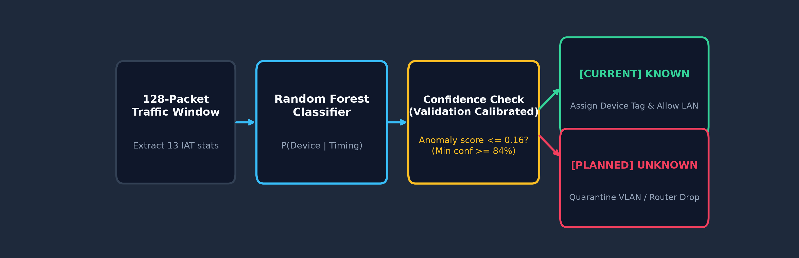
FUTURE ARCHITECTURE
Planned: Gateway Unknown Isolation
Automated anomaly thresholding and router-level quarantine
Decision Thresholding
Confidence >= 84% allows verified LAN access; lower confidence routes to quarantine.
Notes:
This diagram outlines our planned gateway interceptor architecture.
When an active device transmits 128 packets, the gateway extracts its timing fingerprint and queries the Random Forest.
We calibrated an anomaly threshold on the validation split: if tree agreement falls below 84%, the traffic is flagged as an unknown anomaly.
In preliminary leave-one-out experiments, this threshold successfully flagged 89.6% of unseen device windows while maintaining a 4% false alarm rate on known devices.
Future router integrations will automatically redirect flagged traffic to a captive quarantine VLAN.

Slide 13
SECURITY & ETHICS
Privacy & Ethical Considerations
Balancing network defense against behavioral side-channels
Defensive Privacy Benefit
• Secures local networks without decrypting private user data.
• Automatically inventories connected smart appliances.
Surveillance Risk (Dual-Use)
• Timing side-channels can leak occupant presence and sleep.
• Mitigations require device-level random traffic padding.
Notes:
Whenever we discuss traffic fingerprinting, privacy and ethical implications must be front and center.
From a defensive perspective, this approach is privacy-preserving because network administrators can inventory smart devices without decrypting sensitive personal messages, health data, or video streams.
However, the exact same timing side-channels present a surveillance risk: an external eavesdropper passively monitoring home Wi-Fi can infer when occupants wake up, leave home, or sleep, purely from device traffic bursts.
Defending against such side-channel leaks may require deliberate traffic shaping at the device level.

Slide 14
SUMMARY & OUTLOOK
Key Takeaways & Conclusion
Summary of contributions and next steps
Timing Works
99.34% accuracy identifying 5 devices without decrypting payloads.
Clocks Matter
Median and 75th percentile IAT capture physical polling hardware.
Next Frontier
Harden open-set unknown rejection and implement router blocking.
Notes:
To conclude our presentation:
First, packet timing is a remarkably robust fingerprint for IoT hardware, achieving 99.34% accuracy without touching encrypted payloads.
Second, statistical quantiles like median and 75th percentile IAT capture hardware clock cycles most effectively.
Third, our next steps will focus on moving beyond the closed-set model to harden unknown device rejection and implement automated gateway isolation.
Thank you for your time, and I am now happy to open the floor to any questions.

