Slide 1

PROJECT 1
CRYPTO
Interrupted
Traditional Portfolio
Fintech_Bootcamp
Date: 2021/04/12
Group Member: Omotara Ajayi; Greg Buiter; Jimmy Tarika; Chrishan de Almeida; Vincent Xin Wen
Notes:
Title Slide
Include the name of the project, title of course, group members, and date.

Slide 2

CONTENT
01
02
03
04
Motivation
&
Background
Assumptions
Methods
Data Sources
Analysis
Presentation
Discussion
Notes:
Motivation & Summary Slide
Define the core message or hypothesis of the project.
Describe the questions that were asked, and why they were asked.
Describe whether the questions were answered to your satisfaction, and briefly summarize the findings.

Slide 3

Motivation
Performance differences between traditional and hybrid portfolios that contain cryptocurrency
Determine the optimum allocation of cryptos to maximize returns while not allowing risk to exceed an acceptable threshold.
Part
01

Slide 4



BACKGROUND
Traditional portfolio are widely invested
Cryptocurrency market is well established
More institutional investor will bring a stable market
Notes:
Traditional portfolio are widely invested,
Mutual fund, REIT, trust. Hybrid Portfolio contains crypto
Cryptocurrency market is well established,
consider the Market size, trading volume. There are derivatives for Crypto. Crypto is widely used in our daily life.
More institutional investor will bring a stable market
Even though, there are still question regarding this pricing, but as the percentage of retail investor shrink, there will be more logic behind the buys and sell. Hybrid portfolio will have better abilities to hedge risk from crypto and achieve an efficiency

Slide 5



02
Assumptions
Simplified Portfolio
Stock -> SPDR S&P 500 ETF Trust
Bond -> Schwab US Aggregate Bond ETF
Crypto -> Bitcoin
Cryptocurrency is a new asset type
and it is comparable to a stock with high volatility
Risk free rate -> 0%
Notes:
10-year yield 1.7% is less than inflation so choose 0% instead

Slide 6

01
Method
Portfolio is not balanced over holding period
Focus on the macro factors
Alpaca API /
Substitution of Crypto based on the asset allocation of traditional portfolio
Used 1000 days of historical data
Sharpe ratio used as risk / reward
80%/20%
Growth Portfolio
50%/50%
80% Stock
20% Bond
Hybrid (6% Crypto Substitutions)
20%/80%
Balanced Portfolio
Income Portfolio
50% Stock
50% Bond
Hybrid (4% Crypto Substitutions)
20% Stock
80% Bond
Hybrid (2% Crypto Substitutions)

Slide 7


Standard financial data
Data sources are standard financial data, no additional data clean up
needed
SPDR S&P 500 ETF Trust
Data
Source
Bitcoin
CSV – Yahoo Finance
API - Alpaca
Schwab US Aggregate Bond ETF
API - Alpaca
Notes:
Questions & Data
Provide more detail on the questions posed, including what kind of data was needed to answer them, and where it was found.

Slide 8
Part
Analysis Presentation
03
Notes:
Data Cleanup & Exploration
Describe the exploration and cleanup process.
Discuss any insights you had while exploring the data that you didn't anticipate.
Discuss any problems that arose after exploring the data, and how they were resolved.
Present and discuss interesting figures developed during exploration, ideally with the help of Jupyter Notebook.
Data Analysis
Discuss the steps taken to analyze the data, and answer each question that was asked in your proposal.
Present and discuss interesting figures developed during analysis, ideally with the help of Jupyter Notebook.

Slide 9
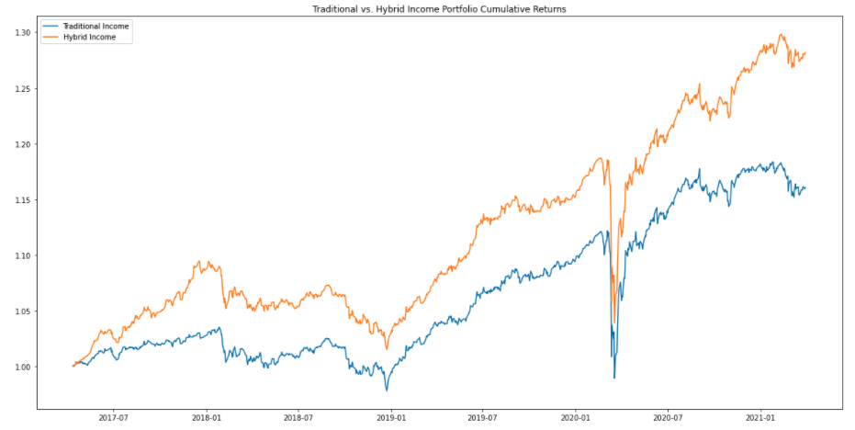
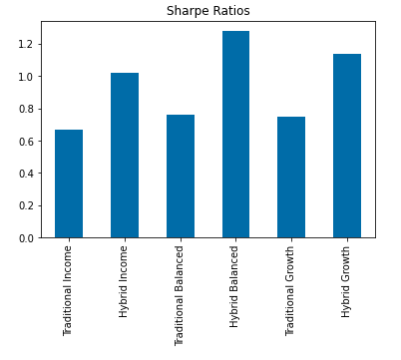

49%
12%
6%
2%
Crypto
in
Income
Portfolio
4%
Crypto
in
Balanced
Portfolio
6%
Crypto
in
Growth
Portfolio
Sharpe Ratio
2% Crypto in Income Portfolio
Notes:
Discuss the steps taken to analyze the data, and answer each question that was asked in your proposal. Present and discuss interesting figures developed during analysis, ideally with the help of Jupyter Notebook.
1.16/1.28
1.35/1.41
1.55/2.04

Slide 10
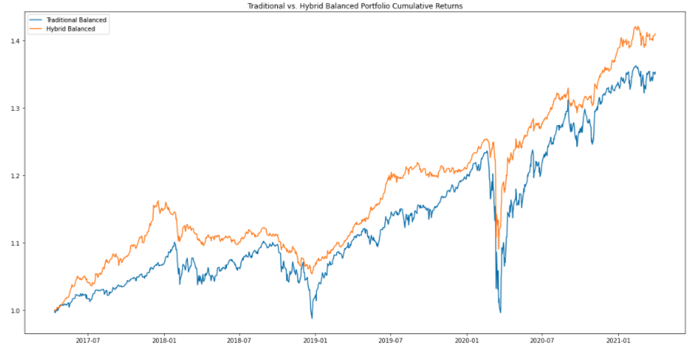
49%
12%
6%
2%
Crypto
in
Income
Portfolio
4%
Crypto
in
Balanced
Portfolio
6%
Crypto
in
Growth
Portfolio
Sharpe Ratio
4% Crypto in Balanced Portfolio
Notes:
1.16/1.28
1.35/1.41
1.55/2.04

Slide 11
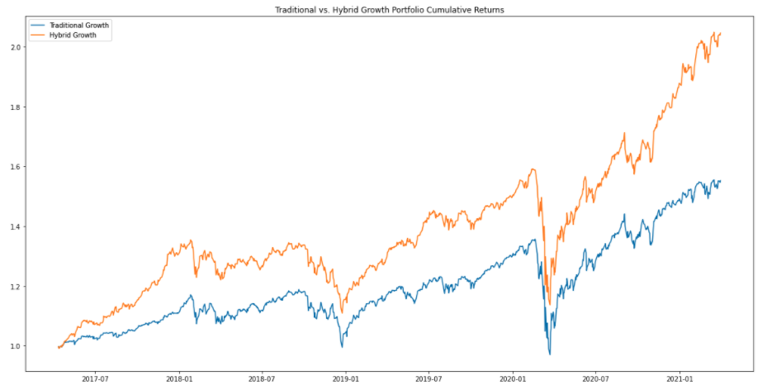
49%
12%
6%
2%
Crypto
in
Income
Portfolio
4%
Crypto
in
Balanced
Portfolio
6%
Crypto
in
Growth
Portfolio
Sharpe Ratio
6% Crypto in Growth Portfolio
Notes:
1.16/1.28
1.35/1.41
1.55/2.04

Slide 12

01
Discussion
Expectation
Suboptimal Sharpe Ratio for Crypto ( less than 1.0 )
Expected higher return with higher ratio of Crypto
Higher risk expectation from the hybrid portfolio
Results
Acceptable Sharpe Ratio for Crypto (Greater than 1.0)
Asset substitution affect portfolio returns
Notes:
Discussion
Discuss your findings. Did they meet your expectations, and if not, why? What inferences or general conclusions can be drawn from your analysis?
Post-mortem
Discuss any difficulties that arose, and how they were handled.
Discuss any additional questions that arose, which couldn't be answered due to time constraints.
What would you research next if you had two more weeks?

Slide 13


Portfolio is not balanced over holding period
01
Given two more weeks
02
Worse case scenario
Broader range of asset
Increase the data entries
Correlation and beta of the portfolio in data
Monte Carlo analysis
Postmortem
Difficulties
03
Limited historical crypto data
Coding issues
Establishing the right scope
Investigate more on micro factors

Slide 14
Q&A

Slide 15
THANKS

