Slide 1
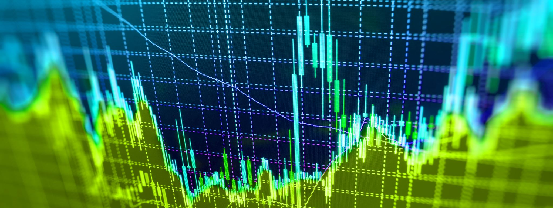
FinTech Project_2 Crypto Trading Algo
Justin Gouin
Kai Ning Liu
Jimmy Tarika
Greg Buiter
June 12, 2021
Notes:
Greg intro

Slide 2
Motivation & Summary
Original
To create an Algorithmic trading strategy based on short-term BTC buy and sell signals incorporating sentiment analysis to predict BTC price movement, taking into consideration variables such as Bollinger bands, Sharpe Ratio, SMA, and Volume
Current
Created an Algorithmic trading strategy based on VWAP, volume, RSI, SMA, Bollinger Bands, and used Random Forest Regression to create “Buy, Hodl, Sell” signals for superior returns vs. a simple SMA crossover strategy
Notes:
Greg – Motivation & Summary

Slide 3
Data Clean-up & Model Training
Imported BTC Data from Kraken API (limited requirement for Data cleaning)
Created DF with Close, VWAP, Volume, Tradecount, Returns, Change in Price
Generated Quantitative Trading Signals
SMA, Bollinger, RSI, VWAP
Identified Feature Importance
VWAP, RSI, Volume & Tradecount
Notes:
Jimmy to present

Slide 4
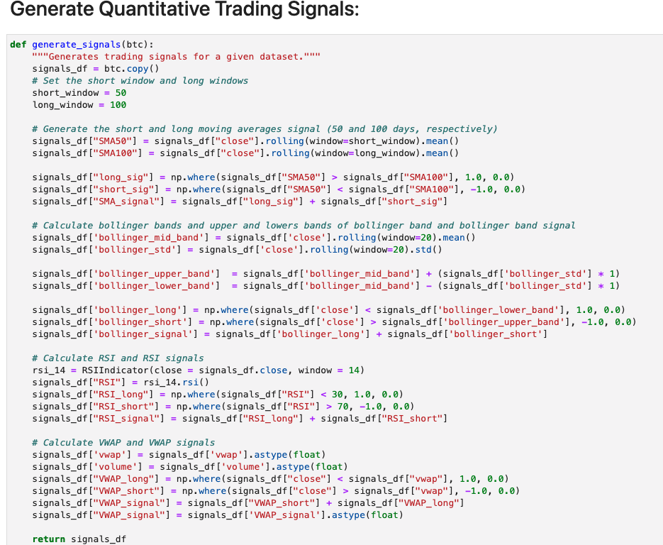
Signal Generation
Notes:
Jimmy to present

Slide 5
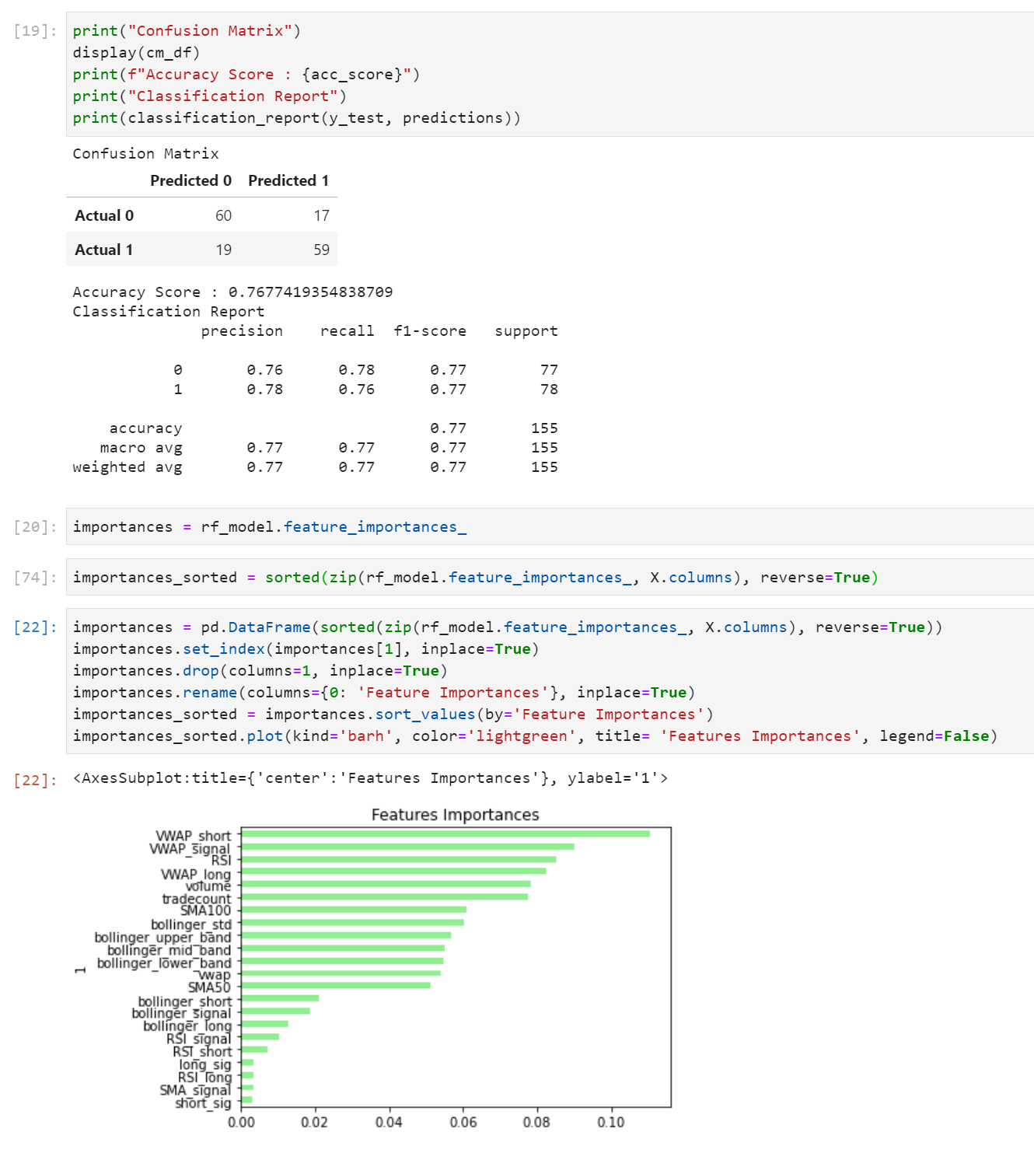
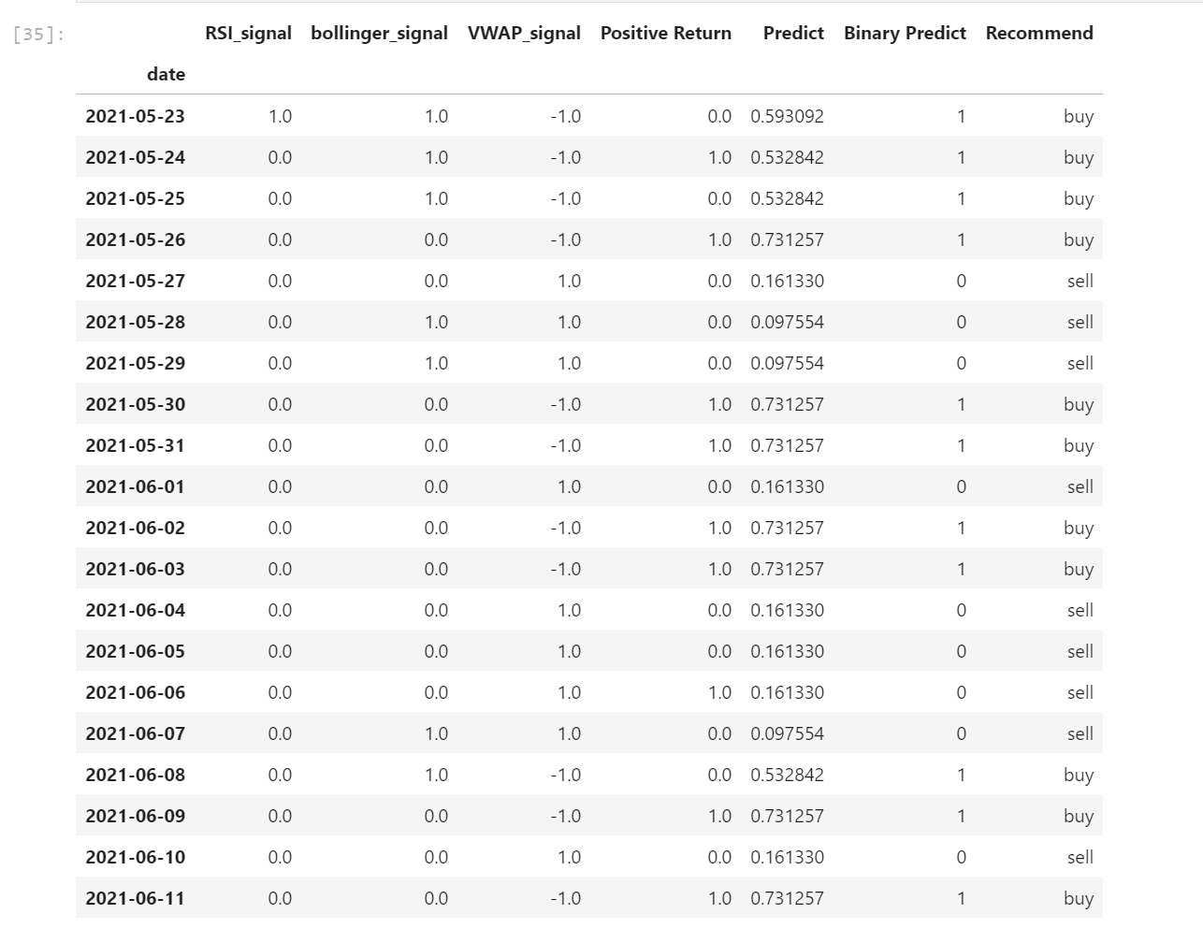
Model Summary
Ran RF Classifier with RAW variables
Accuracy Score of 0.7677
Ran RF Regressor on 3 Most Significant Signals
”Sell” threshold of <0.2 to create “Sell”
“Hold” between 0.2 and 0.5
“Buy” > 0.5
Notes:
Justin to present

Slide 6
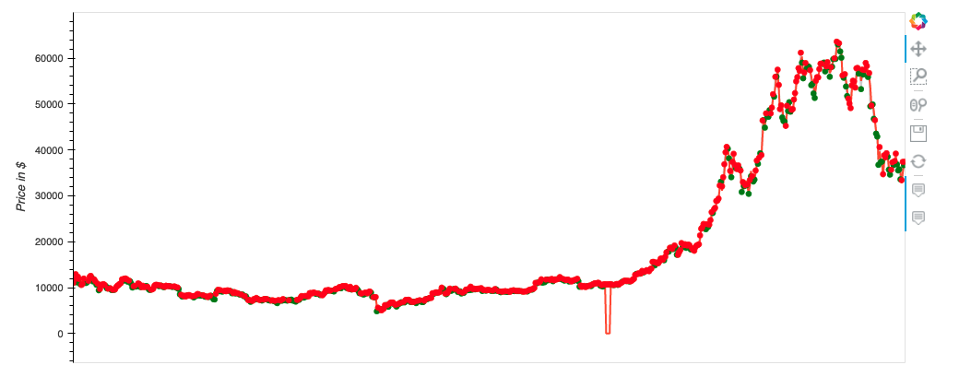
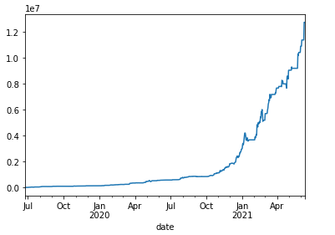
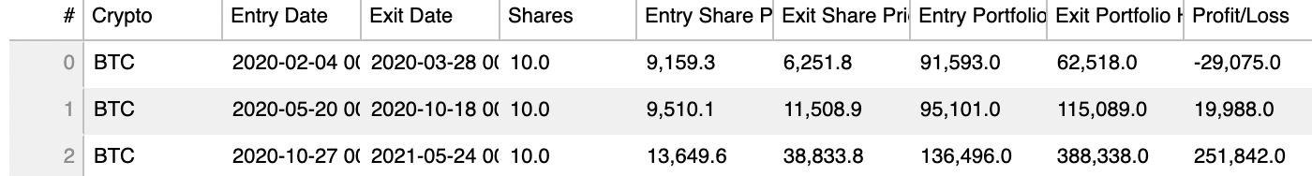
Model Evaluation
Algo strategy $100k initial investment in July 2020 returned ~$1.3M in cumulative returns
Notes:
Kai to present

Slide 7
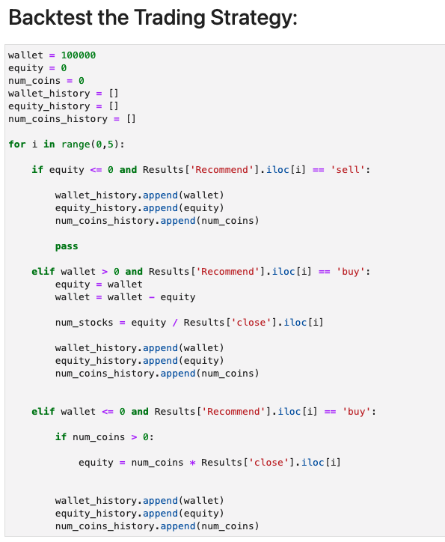
Model Evaluation (Trading Strategy 10% Buy/Sell)
Items for further consideration:
Optimize 10% buy/sell strategy
Tuning the thresholds beyond the 0.2 and 0.7
Notes:
KAI to present
Additional items would be to remove the RSI

Slide 8

Discussion/ Predictions
Open Jupyter lab and run code

Slide 9
Post Mortem
Needed additional trading days to fully test the RF Regressor Model
(Kraken provided only 2year history – would consider alternative data source on future implementation)
Focused solely on BTC, could look at other more volatile Cryptos to see if performance is similar
Backtesting on high volatility stocks (non-crypto) would be interesting to investigate
Notes:
Greg to present

Slide 10

Questions??

Slide 11
Appendix

Slide 12
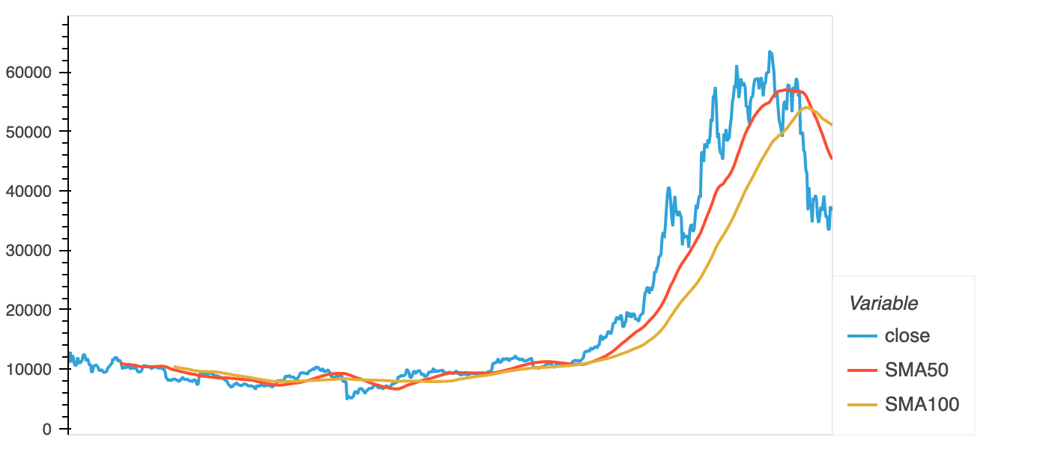
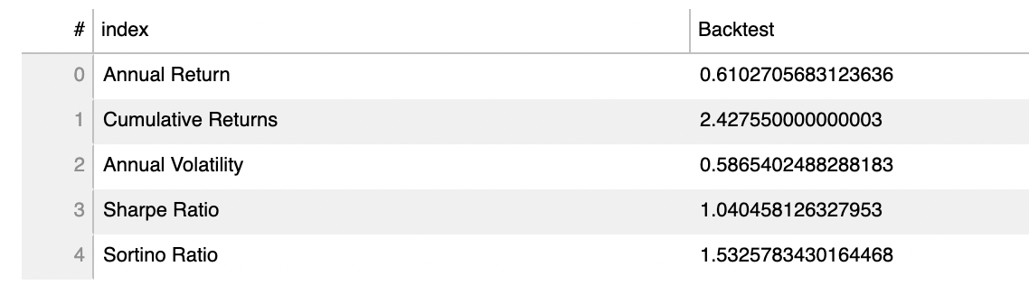
SMA Crossover & BTC Metrics

Slide 13
