Slide 1

DWDM Project
Heart Disease Classification
Our Project focuses on creating a classifier for predicting if the patients might get any heart disease. We are only predicting the absence or presence of heart disease.
The original dataset consists of 4 prediction outputs which are
0 = indicating absence
1 = Type 1
2 = Type 2
3 = Type 3
4 = Type 4

Slide 2

Dataset Description
age
sex
cp = chest pain type (4 values)
trestbps = resting blood pressure
chol = serum cholestoral in mg/dl
fbs = fasting blood sugar > 120 mg/dl
restecg = resting electrocardiographic results (values 0,1,2)
thalach = maximum heart rate achieved
exang = exercise induced angina
oldpeak = ST depression induced by exercise relative to rest
slope = the slope of the peak exercise ST segment
ca = number of major vessels (0-3) colored by flourosopy
thal = 3 = normal; 6 = fixed defect; 7 = reversable defect
target = Classification`

Slide 3
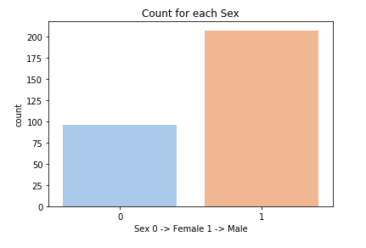
Data Visualization
Count of category of people based on sex.

Slide 4
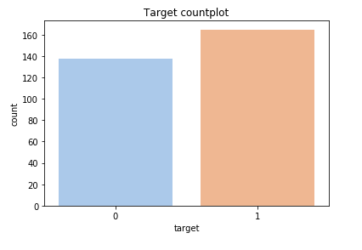
Frequency of the people affected and Not affected by any Heart Disease.
0 = Not Affected
1 = Affected

Slide 5
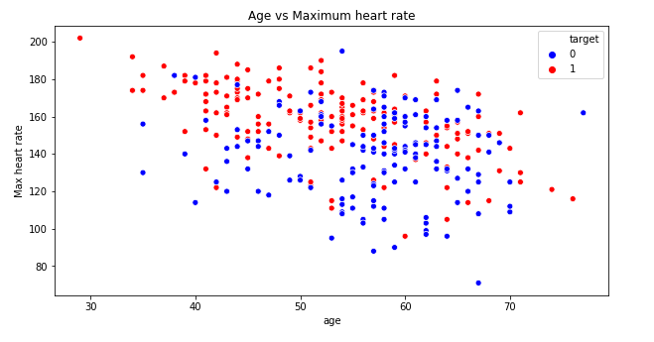
Scatter Plot of Age vs Max Heart rate separeated with people
Affected and Not Affected.

Slide 6
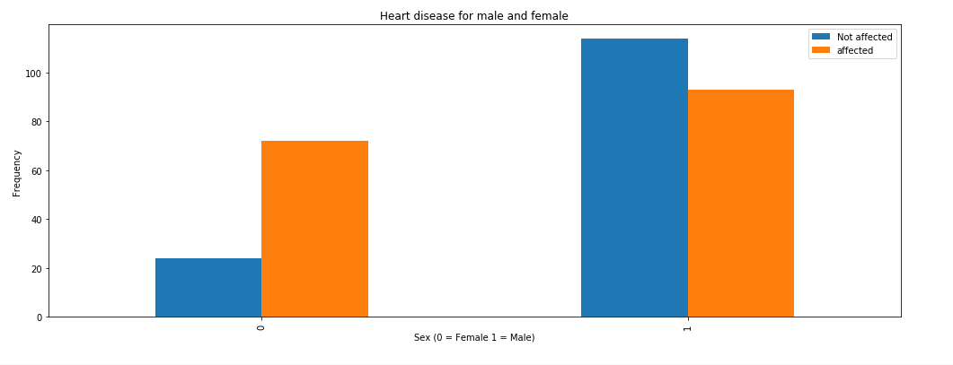
Sex affected with heart disease as well as not affected with heart disease

Slide 7
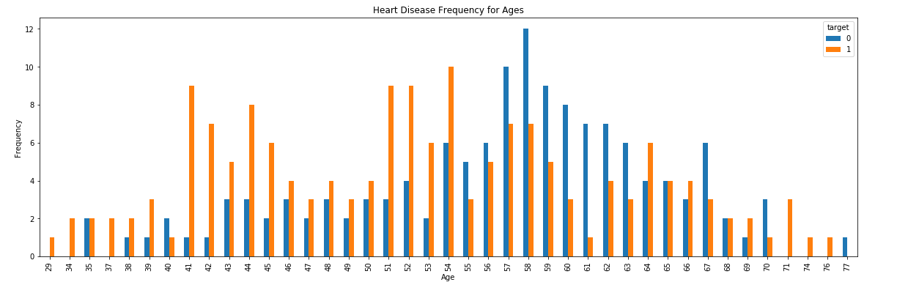
Age category of people affected with and without heart disease.

Slide 8
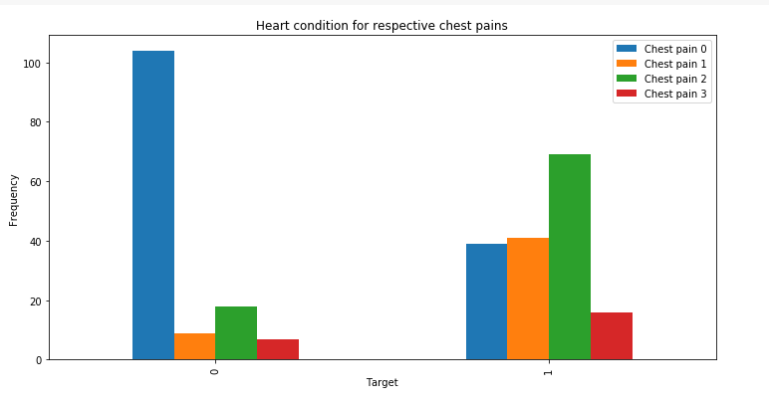
Type of chest pain experienced by patients.

Slide 9
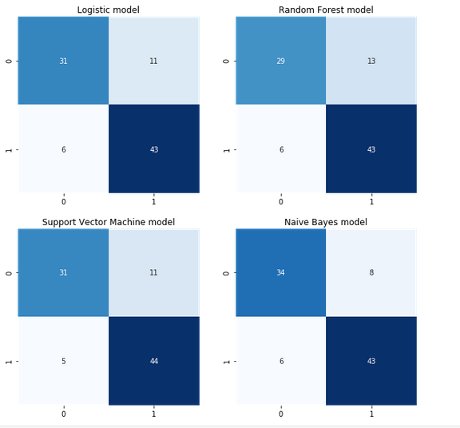
Confusion Matrix

Slide 10
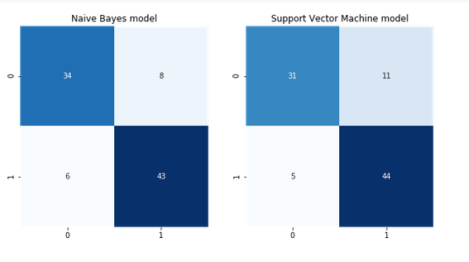
Choosen Model
Confusion matrix of random forest classifier with 200 trees has got the maximum accuracy for prediction, but we choose support vector machine model as it has got few number of false negatives and classifying a person as having heart disease and actually doesnt have a heart disease is not a issue. But classifying a person as not having any heart disease but actually having a heart disease is actually a major concern. Hence we choose the model having least number of false negatives that is support vector machine model with radial bias function model.

Slide 11
Prepared By :
Mohan Madame PF 03
Suyash Ladda PF 15
Mandar Kulkarni PF 24
Viraj Pandit PF 57

