Slide 1
🍔
Food Delivery Application
A Full-Featured Restaurant Management & Delivery System
Built with Python & Flet Framework

Slide 2
Project Overview
👥 Multi-Role System
  Customer, Restaurant Owner, and Administrator roles with distinct capabilities
🔐 Enterprise Security
  Advanced authentication with lockout protection and session management
📱 Modern UI
  Material Design interface with dark theme and gradient styling
⚡ Real-Time Updates
  Live order tracking and status updates with automatic polling

Slide 3
Core Features
🛒 Customer Features
  • Browse menu with search & filters
  • Shopping cart with quantity control
  • Order placement & tracking
  • Order history with status filters
  • Cancel orders (placed/preparing)
  • Profile customization
🍽️ Owner Features
  • Menu item CRUD operations
  • Image upload (3MB limit)
  • Category management
  • Order status updates
  • Order filtering & search
  • Real-time order monitoring

Slide 4
👨‍💼
Administrator Dashboard
User Management
  Create users (all roles); Enable/disable accounts; View login history; Monitor failed attempts; Search & filter users
System Oversight
  Monitor all orders; Update order statuses; View audit logs; Track user activity; System-wide analytics
Security Controls
  Password policy enforcement; Account lockout management; Session timeout control; Real-time validation
User Filters
  Filter by role/status; Search by name/email; View locked accounts

Slide 5
🔒
Security Architecture
Password Security
  bcrypt hashing (12 rounds); Min 8 chars; Upper/lowercase, number, special; Common password blocking; Strength indicator
Account Protection
  Max 5 failed logins; 30-min lockout; Visual countdown; Auto unlock; Admin controls
Session Management
  15-min inactivity timeout; 2-min warning; Activity tracking; Graceful termination
Input Validation
  Email RFC validation; Real-time validation; Visual error indicators; Sanitization; SQL injection prevention

Slide 6
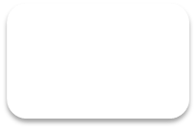
📦
Order Status Workflow
Placed → Preparing → Out for Delivery → Delivered
Placed: Can move to Preparing, Out for Delivery, or Cancelled
Preparing: Can move to Out for Delivery or Cancelled
Out for Delivery: Can move to Delivered or Cancelled
Delivered: Final state (no further changes)
Cancelled: Final state (no further changes)
✓ Per-customer order numbering for easy reference
✓ Real-time status updates (30-second polling)

Slide 7
⚙️
Technology Stack
🐍 Python 3.8+
  Core Language
🎨 Flet 0.28.3
  UI Framework
🗄️ SQLite
  Database
🔧 SQLAlchemy 2.0
  ORM
🔐 bcrypt 5.0
  Password Hashing
📝 Material Design
  UI Components

Slide 8
📊
Database Schema
Table | Key Features | Relationships
Users | Email, password (bcrypt), role, profile pic, lockout status, failed attempts | Has many Orders, MenuItems, AuditLogs
MenuItems | Name, description, price, image (file path), category, availability | Belongs to User (creator)
Orders | Customer info, delivery address, items (JSON), status, total amount | Belongs to User (customer)
AuditLogs | User ID, action type, details, timestamp | Belongs to User
Key: SQLAlchemy ORM with declarative base
Indexing: Auto-incrementing IDs, email uniqueness

Slide 9
🔑
Default User Accounts
Role | Email | Password | Capabilities
👨‍💼 Admin | admin@fooddelivery.com | Admin@123 | Full system control, user management, all orders
🛒 Customer | customer@fooddelivery.com | Customer@123 | Browse menu, place orders, view history
🍽️ Owner | owner@fooddelivery.com | Owner@123 | Menu management, order fulfillment

Slide 10
📁
Project Architecture
Core Modules
• auth.py - Authentication & RBAC
• database.py - CRUD operations
• session_manager.py - Timeout handling
• datetime_utils.py - Time formatting
• models.py - SQLAlchemy models
UI Screens
• login.py - Authentication
• signup.py - Registration
• browse_menu.py - Menu catalog
• cart.py - Shopping cart
• order_history.py - Order tracking
• profile.py - User settings
• owner_dashboard.py
• admin_dashboard.py
Models
• models.py - SQLAlchemy models
User, MenuItem, Order, AuditLog

Slide 11
🎯
Advanced Functionalities
🔍 Smart Filtering
  Multi-level filtering on users, orders, and menu items; Real-time search; Dynamic result counting
📸 Image Management
  File-based image storage with UUID naming; Limits: 3MB menu, 1MB profile; JPG/PNG/GIF
📝 Audit Logging
  Comprehensive action tracking: user creation/deletion; login attempts; order status changes; menu modifications
✅ Real-time Validation
  Live input validation with visual feedback; green/red borders; password strength indicator

Slide 12
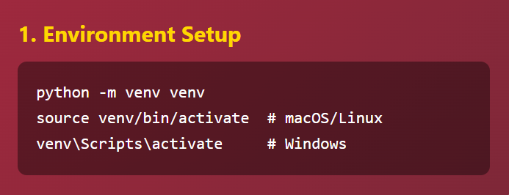
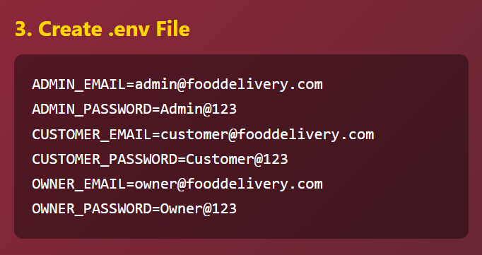
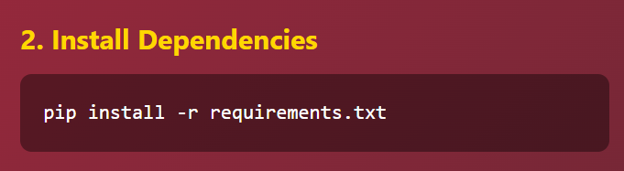
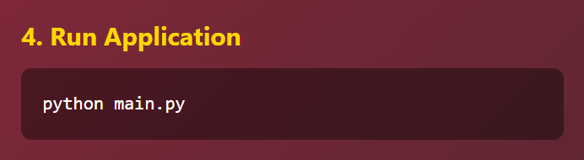
🚀
Installation & Setup

Slide 13
🎨
UI/UX Design
Design Principles
• Material Design components
• Dark theme for reduced eye strain
• Gradient backgrounds
• High contrast text (white on dark)
• Consistent spacing & padding
• Rounded corners (border-radius: 10px)
• Shadow effects for depth
• Responsive icon buttons
#9A031E - Primary Red
#6B0113 - Dark Red
#3D000D - Very Dark Red

Slide 14
🚀
Future Enhancements
💳 Payment Integration
  Stripe/PayPal
📍 GPS Tracking
  Real-time delivery location
⭐ Rating System
  Customer reviews and ratings
🔔 Push Notifications
  Order status updates via notifications
📊 Analytics Dashboard
  Sales reports and metrics
🎫 Coupon System
  Discount codes and promotions
🌐 Multi-language Support
  Internationalization (i18n)
📱 Mobile App
  Native iOS/Android applications

Slide 15
🙏
Thank You

