Slide 1
Modflow – Practical 2

Slide 2
Structure
Brief note on GitHub
EXTRA SESSION - Introduction to Pandas (45 min demo)
From next two weeks this extra session will be OPTIONAL
Come if you are interested. You might find a way to incorporate what you learn, you might not!
Next week stats analysis– RPy2 (R based modelling using Python) and statsmodels
Week after is Machine Learning – SciKit learn
Shame we don’t have more practicals (a mon avis). If you like these practicals please relay this and feedback! It’s super costly and brand-new. Also if you don’t like it (or elements thereof) and think its useless please say so and the powers that be can cut it before it spirals out of control…
Issues with Week 1’s practical
Week 2’s practical

Slide 3
GitHub notes
Separation of the ‘Homework’ from the ‘Lecture Notes’
I updated folder ‘InstallInstuctions’ about 3 times since the last practical
Each week idea is to have a repo with notes from the class which I may add over the next few days to as things ‘become clear’ – I’ll push changes to your repo’s so you can then pull the changes
E.g. our anonymous hero who helped out with the Windows instructions last week – sent me updates to slides – I incorporated into the presentation – pushed the changes – you guys pulled the changes
What you guys didn’t then have was ‘FloPy Presentation’…‘FloPy Presentation Version 2’….‘FloPy Presentation Version 3’…
Second repo will contain the homework - I will not to make any changes to this (but just incase…)
Clone the homework repo
Duplicate the folder
Work in the duplicate folder
Copy the finished work into the original repo with a new name
Push the changes to your repo (and submit to blackboard)
No marks for GitHub proficiency – If really struggling to push changes to your repo don’t worry about it – just submit through blackboard
Point is – this is how large parts of the ‘real’ world actually works. If you put it on your CV ‘GitHub familiarity’ might need to demonstrate some proficiency at some stage!

Slide 4
This week’s Repo Structures
Clone the following as usual;
Pandas Tutorial – https://github.com/UoBHydro/PandasTutorial
This has the Pandas tutorial I am about to give
Lecture notes -
The lecture notes and practical instructions for this week
Week 1 Practical
Base code for this week’s practical incase you don’t already have it

Slide 5
Pandas
“Python data analysis library”
Data wrangling/munging - process of transforming and mapping data from one "raw" data form into another format with the intent of making it more appropriate and valuable for a variety of downstream purposes such as analytics
Developed in 2008 at AQR Capital Management out of the need for a high performance, flexible tool to perform quantitative analysis on financial data – subsequently open sourced- probably the library
Lots of features – particularly well supported in terms of time series data
Super popular in real world –Financial organizations mention it in job adverts etc
Active real-time development (last update was <2 days ago) – Unlike Matlab ‘stable release’ format

Slide 6
What’s good about it
MATLAB/NumPy(basis of pandas) – often you need to manipulate the data (dictionary, list, variables etc) with fairly repetitive coding – lots of custom scripts with loops, functions etc
Takes data (CSV, SQL, TXT files etc) – creates python object – dataframe - with rows and columns
Dataframe has lots of intrinsic very high-level functions
Split/subset
Merge/groupby
Filter
Matplotlib functionality
NAN-friendly statistics
Date/Time functions
I’ve used about ~15 functions
Feels a lot like Excel…but actually works on stuff over say 1000 rows!
Except unlike Excel – you can alter your working clearly (Sheet32 syndrome) – no more screw ups!
Be careful if numerically modelling (constantly reading and writing to a dataframe) – can be slow in a limited number of scenarios
Your Anaconda distribution will have Pandas and I believe comes with all the dependencies
Lets do some live coding! – follow along here

Slide 7
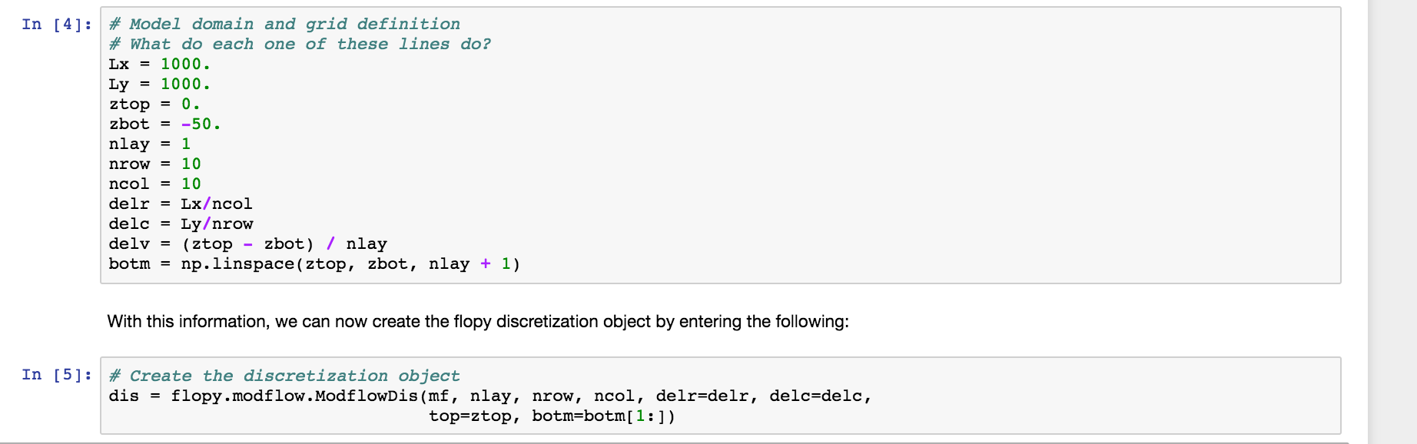
Practical 1 Script questions – answered for the class
I personally thought I’d get a few more…seems like everyone else completely understood what was going!
Discretization – “what does zbot and ztop define, do they define the top and bottom array of the aquifer?”
Lets go to http://modflowpy.github.io/flopydoc/mfdis.html

Slide 8
Practical 1 Script questions – answered for the class
Its defining the model dimension – so yes the aquifer!
Its looking for an array or just a single float
Lets have a little look at what its doing – Live coding
dis.gettop() or .getbotm() seems like a fairly useful function in future to investigate issues

Slide 9
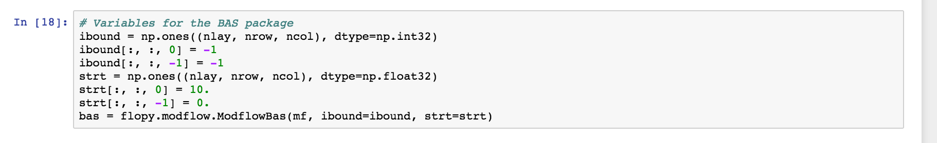
Practical 1 Script questions – answered for the class
Basic Package – “I don't understand np.ones((....),dtype=np.int32). I understand that it's setting up an array of ones where the start and end values have been changed, and an ibound array contains a value for each cell in the grid defining the type of the cell as constant head and strt defines their starting heads. but I can't get my head around what dtype=np.int32 means”
https://docs.scipy.org/doc/numpy-1.13.0/reference/arrays.dtypes.html

Slide 10
Practical 2
Hydrologically - 1st week was a steady state confined aquifer
This week we convert to an unconfined, transient flow model with time varying boundaries
I trust everyone knows what that is…?

Slide 11
Review of confined vs unconfined

Slide 12
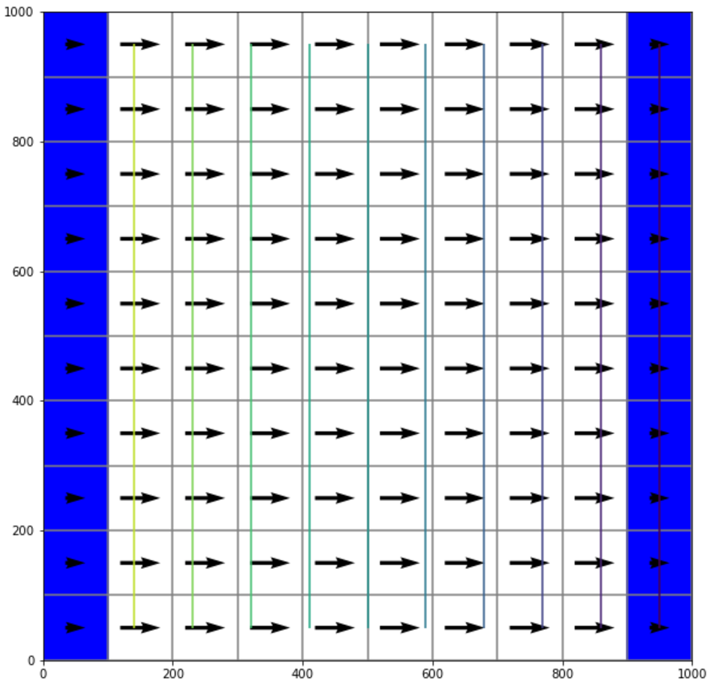
Week 1- Confined steady state aquifer
10
0
10
Head (m)
10
1
0
0
10
0
1x10x10 grid
Fixed heads at 10m and 0m on left and right boundaries
1m in all other cells
End result was nice linear profile end to end
Cells were marked as confined – layer type = 0
Simulate confined conditions
Transmissivity of each cell remains constant for the entire simulation
i.e. rate at which groundwater able to flow is constant
Specific storage - the volume of water that a unit volume of aquifer (or aquitard) releases from storage under a unit decline in head – remains constant

Slide 13
Week 2 - Unconfined model
Same grid
10m initial head all over
Cells were marked as unconfined – layer type = 1
Simulate unconfined conditions
Transmissivity of each cell varies as saturated thickness of the aquifer changes through the simulation
Need to include a value for specific yield – why?
Lowering of the water table in an unconfined aquifer leads to the release of water stored in interstitial openings by gravity drainage.
Contrast to confined aquifer water release by aquifer compression and water expansion
10

Slide 14
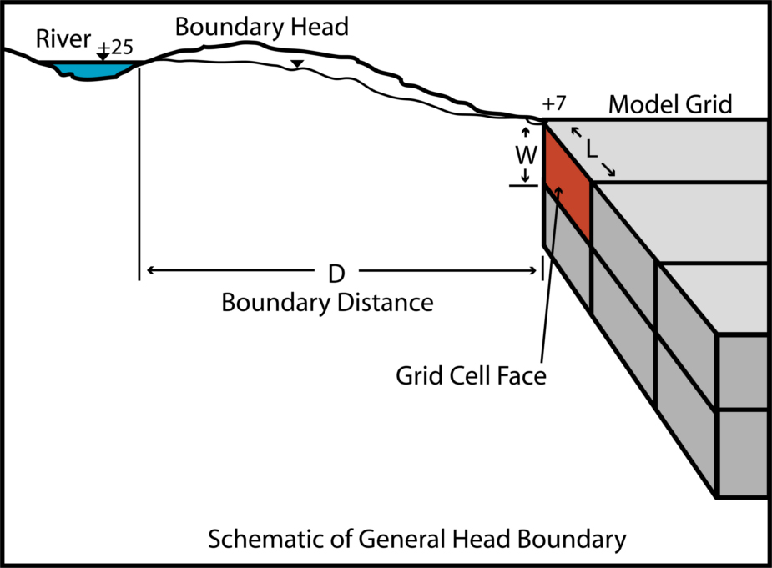
Week 2 - Unconfined transient model with time varying boundaries
Model results will vary over time
Initial conditions – head is 10.0 everywhere
Use general head boundaries at edge of model – idea is a fixed head far from model
Period 1 (1 day) – steady state with left and right GHB stage = 10.
Period 2 (100 days) – left GHB with stage = 10., right GHB with stage set to 0.
Period 3 (100 days) – pumping well at model center with rate = -10., left and right GHB = 10., and 0.
So what do we expect to happen?
10
10
10
10
0
-10
10
0

Slide 15
This weeks requirements
Modify the tutorial using the instructions provided
Answer the following questions in notebook and upload the notebook to your GitHub repository
How does varying the following affect the model?
Specific yield
Specific storage
Hydraulic conductivity/Vertical hydraulic conductivity
Show this with various figures or tables with 2-3 sentence descriptions
SUPER BONUS POINTS – Modify the code with a time-varying pumping rate

