Slide 1
RNN Images

Slide 2
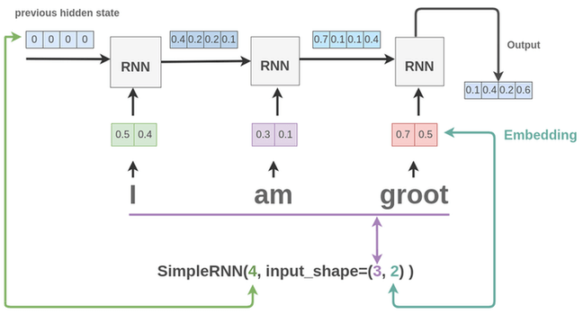
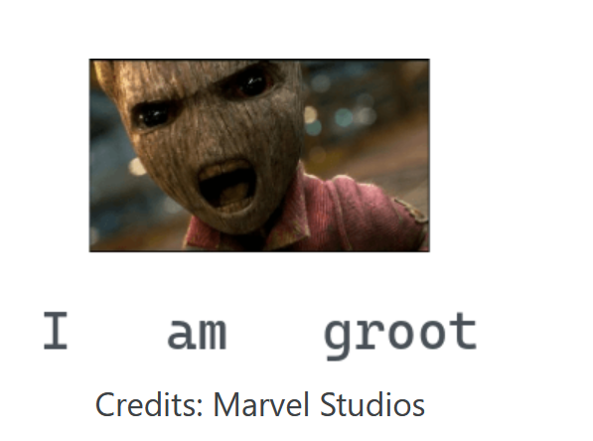
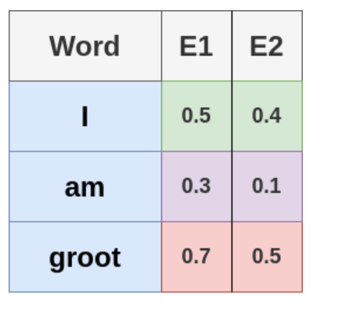
Classic (https://amitness.com/2020/04/recurrent-layers-keras/) and https://subscription.packtpub.com/book/big_data_and_business_intelligence/9781788629416/1/ch01lvl1sec09/recurrent-neural-networks-rnns

Slide 3
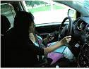
Our problem
 | 1 | 2 | … | N-1 | N (cols)
1 | Greyscale | …
2 | Greyscale | …
… |  | …
N-1
N (rows)

Slide 4
Classic (https://amitness.com/2020/04/recurrent-layers-keras/)
Output
Output
Output
Dense
Dense
Dense
0
0
0
0
0
0
0
0
0
0
0
0
0
0
0
0
0
0
0
0
0
0
0
0
RNN
RNN
RNN
Input: 128 timesteps, each timestep gets one row with 128 elements as input
SimpleRNN(Units, input_shape = (128,128)) (only greyscale)

Slide 5
Our problem
Grayscale instead of RGB -> input shape
Variation of model parameter (number of units, etc.)
Variation of training parameter (learning rate, etc.)
Overview in Excel sheet

