Slide 1

PYTHON PROGRAMMING FOR BEGINNERS
The Basics, Data Structures, Logic and Flow Control Week 1 – August 29th 2017
IACC Plano

Slide 2
Post Messa
2017 – Phython Programming for Beginners
- About Instructor
- Date : 7/29 to 9/9 (Saturdays Only)
Timing : 11:00am to 1:30pm
- Tuition Fees : $149.
WiFi: Tech_Class , Password: Classes@pl@n0masjid
Google Group for class related questions:
IACC2017_Python@googlegroups.com
Contact :
professional-training@planomasjid.org

Slide 3
Logistics
All communication with the instructor should be through Google group.
Coffee break at 12:00pm for 20 minutes.
- No shoes allowed in classroom.
- Be in the class on time and do not miss any class.
- Access to Internet is allowed only for class work.
Do not use cell phone in the class.
- Do not share copy-righted material such books, corporate logos, manuals,
software, etc. in class, on WebEx or on Google group.

Slide 4
Todays Training Agenda
 Introductions
 Loops
 Conditional Operators
 Why Python?
 Comparison Operators
 Installation
 IDE/Text Editors
 Data Structures

Slide 5
INTRODUCTIONS

Slide 6
WHY PYTHON?
History
Why Python?
Applications
Created by Guido Van Rossum in Netherlands in early 1990’s
Python is implemented in C
Python was named after the BBC TV show Monty Python
Multipurpose
Simple and Reliable
Easy to learn
Supports interactive programming
Suitable for mathematical and Scientific computing
Extensive collection of official and community developed libraries
Supports Object Oriented Design
Supports Functional Programming
Web Development
API’s
Mobile Applications
Big Data
Artificial Intelligence
Machine Learning
Cyber Security
Automation
DevOps
Used in almost all fortune 500 companies
Ethical Hacking

Slide 7
INSTALLATION
Python 2.7
2.7 released in 2010
Python 3.3
Latest Version of python
Default version in major OS
Very large user community
Extensive collection of libraries and frameworks
Isn't the go to version in most organizations
Growing user community
Growing collection of libraries and frameworks but not as big as 2.7
VS
Installs
PyCharm IDE
Python 2.7

Slide 8
IDE/TEXT EDITORS
IDE’s
Text Editors
IDLE – Default IDE
PyDev on Eclipse
PyCharm
Spyder
Wing IDE
Komodo IDE
Notepad
Interactive Programming
Notepad++
Sublime Text
Atom
Jupyter
Zeppelin
Beaker
Documentation - https://docs.python.org/2/index.html

Slide 9
THE BASICS
The Print Statement :
print is python command to write something to the console or terminal window where the command is being executed
Usage : print “something”;
Something could be any data type
Example :
print “Strings within quotes will be printed”
print “Numbers do not have to be in quotes”
print 12
Comments :
Comment in Python is a text block in the code which will not be executed.
Comments in Python start with the hash character,#, and extend to the end of the physical line
# this is the first comment
text = "# This is not a comment because it's inside quotes.“
Multiline comments can be created by triple quoted strings
‘’’ here is a
Multi line comment
‘’’
Exercise :
Print your name print ”Zain”;
Print the current year print 2017;
Print todays full date print ”07/31”

Slide 10
THE BASICS
Variables :
A variable is a symbolic name for (or reference to) information
They are called variables because the represented information can change
Example :
height_in_centimeters = height_in_inches * 2.54;
height_in_inches = 6;
Height_in_inches = 5.8;
Exercise :
Create a height variable :
height_in_inches = 6;
Print height_in_inches variable print height_in_inches;
Create a formula to convert height in inches to height in centimeters : height_in_centimeters = height_in_inches * 2.54;
Print the height in centimeters print height_in_centimeters
Exercise :
Create variable to hold name of the training class : class_name = “Python”;
Create variable to hold todays date todays_date = “07/29/2017”
Create variables to hold number of students: no_of_students = 40;
Print the sentence ‘On 07/29/2017, the Python class had 40 students’ print “On ” + todays_date + “the Python class had ” + no_of_students + “ students”

Slide 11
THE BASICS
Numbers and Math :
Do not use quotes to hold numbers
Common Math Symbols :
+ Plus
- Minus
/ Division
* Multiple
% Modulus
< Less Than
> Greater Than
<= Less Than or Equal to
>= Greater Than or Equal to
Types of Numbers :
Integers – Positive or negative whole numbers ( examples : 10, -10 ). Represented by int
Long – Integers of unlimited size ( example : 535633629843L ). Represented by long
Floats – Real numbers with a decimal point ( Examples : -123.45E ). Represented by float
Complex – Real and imaginary numbers ( Examples : pi – 3.14j ) Represented by complex
Exercise :
Print “The value of 2+3-1-4 is :”; Print 2+3-1-4;
Print “is 5 greater than 2??”, 5>2
Print “Is 2 greater than equal to 2??”, 2>=2;
Print “How much percent is 40% of 200??”,(40*200)/100
If x is 250 and y is 700, how much percentage of y is x..?
x = 250;
y = 750;
z = (100 * x ) / y;
print z;
https://docs.python.org/2/library/stdtypes.html#numeric-types-int-float-long-complex

Slide 12
THE BASICS
Strings
Strings are always enclosed within quotes
Strings without quotes are considered variables
Strings can be concatenated using + symbol
Sample String Methods :
Capitalize – capitalizes the first letter of the string
Isalnum - Returns true if string has at least 1 character and all characters are alphanumeric.
Isalpha - Returns true if string has at least 1 character and all characters are alphabetic
Isdigit - Returns true if string contains only digits
String Functions :
Len – returns the length of the string
Exercise :
Create a string to hold a phone number with only numbers
phone_number = ‘1276512341’;
Print phone_number;
Verify if the phone number has only numbers
is_a_number = phone_number.isdigit();
print is_a_number;
3) Find the number of digits in the phone number
no_of_digits = len(phone_number);
print no_of_digits;
Comparision operators :
< Less Than
> Greater Than
<= Less Than or Equal to
>= Greater Than or Equal to
== equal to
!= not equal to
https://docs.python.org/2/library/stdtypes.html#string-methods

Slide 13
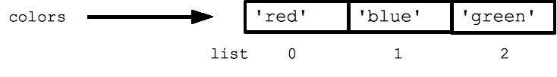
DATA STRUCTURES - Lists
Lists
List is a collection of 0 or more items or objects.
Square bracket is used to represent a list
Item position numbers are called index
Index starts from 0
[ ] – Empty List
[“Plano”] – A list of 1 string
[“Plano”,”Frisco”] – a list of 2 strings
[“Plano”,”Frisco”,75070] – a list of 2 strings and a number
[“Plano”, “Frisco”, 75070,[“Allen”,”McKinney”]] – a list with a nested list
Common list methods :
Append : add to the end of the list
Insert : add at a specific location of the list
Pop : remove and return item from the list
Remove : remove an item from the list
Extend : add list of elements at the end
Sort : sort the list
Reverse : reverse the list
Index : return the lowest index where a item appears
Count : Count the number of times an item appears in the list
Functions:
Len : Get the number of items in the list
Max : get the item with the max value
Min : get the item with the lowest value
Colors = [“red”,”blue”,”green”]
Accessing items in the list :
colors[0] -> This will represent “red”
Colors[1] -> This will represent “blue”
Colors[:] -> [“red”,”blue”,”green”]
Colors[1:2] -> [“blue”,”green”]
Colors[:1] Colors = [“red”]
Items can be inserted, removed or replaced in a list using standard methods provided by python
Python provides built in functions for lists
https://docs.python.org/2/library/stdtypes.html#sequence-types-str-unicode-list-tuple-bytearray-buffer-xrange

Slide 14
DATA STRUCTURES - Lists
Exercise :
Create a list of major cities cities in the US and name it cityList
cityList = [“New York”,”Chicago”,”LA”]
2) Print cityList
print cityList
3) Print the first city from the list
print cityList[0]
4) Print last city from the list
print cityList[-1]
5) Add Houston and Dallas to the list and print the new list
cityList.append(“Houston”);
cityList.append(“Dallas”);
print cityList;
6) Add Boston after LA in the list and print it
cityList.insert(3,”Boston”)
print cityList;
7) Find the rank of Houston in the list
print cityList.index(“Houston”);
8) Add Toronto to the end of the list and print it
cityList.append(“Toronto”)
print cityList;
9) Totonto is not a city in the US, lets remove it and print the list
cityList.remove(“Toronto”);
print cityList;
10) Find the number of cities in the list
print len(cityList)

Slide 15
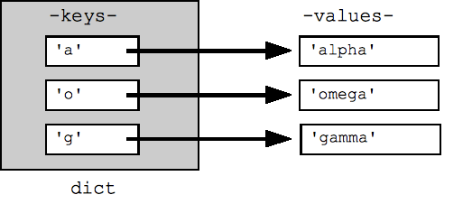
DATA STRUCTURES - Dictionary
Dictionaries :
Dictionary is a collection of 0 or more items.
Each item concists of a unique key and a corresponding value separated by a colon
Example : ‘state’:’Texas’
Set of braces are used to represent a list
{ } – Empty Dict or Dictionary
{‘state’:’Texas’, ‘city’:’Plano’} – Two items or two key value pairs
{‘state’:’Texas’, ‘city’:’Plano’, ‘seasons’:[‘Summer’,’Spring’]}– a list of 3 items where the last value is a list
Common dict methods :
Clear : remove all elements from the dict
Has_key : Returns true if the specified key exists in the dict
keys :returns a list of keys in the dict
values : returns a list of values in the dict
Functions:
Len : Get the number of items in the dict
str : get the string representation of the dict
sample = {‘a’:’alpha’,’b’:’omega’,’g’:’gamma’}
Accessing items in the dict :
Sample[‘a’] -> This will return the value ‘alpha’
Sample[‘d’] = “delta” -> This will add ‘d’:’delta to the dict’

Slide 16
DATA STRUCTURES - Dict
Exercise :
Create a dictionary of a restaurant menu with 3 items as keys and their prices as values
menu = {‘Cheese Burger’ : 10, ‘Caesar Salad’ : ‘8’, ‘Fries’ : 3.25}
2) Print the menu
print menu
3) Print the price of a Cheese Burger
print menu[‘Cheese Burger’]
4) Print all items in the menu
print menu.keys()
5) Does the restaurant have ‘Lemonade’ in the menu..?
print menu.has_key(‘Lemonade')
6) How many items are in the menu
print len(menu);
7) Add ‘Lemonade’ to the menu and set the price to 2.5
menu['Lemonade'] = 2.25;
8) Update the price of ‘Cheese Burger’ to 9
menu['Cheese Burger'] = 9;
9) Print the new menu
print menu;

Slide 17
DATA STRUCTURES – Sets & Tuples
Sets :
Set is a collection very similar to lists but with no duplicate items.
Braces are used to represent a set
Set() -> creates a new empty set
{‘apple’,’orange’,} – set of 2 unique items
Set supports almost all methods and functions we discussed in Lists
Tuples :
Tuples are also similar to Lists but they cannot be updated or changed unlike Lists.
Parenthesis are used to represent tuples
() -> empty tuple
(‘python’,) -> A single element tuple
(‘python’,’java’, ‘dotNet’) -> Tupe with 3 items
Tuples supports all functions from Lists but any method which update or change the List like append, pop etc..

Slide 18
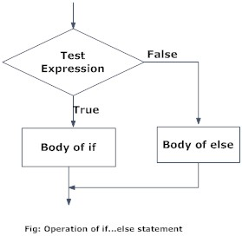
CONDITIONAL STATEMENTS
Conditional Statements :
if expression :
Execute this if expression is true
else
Execute this if expression is false
if expression a :
Execute this if expression a is true
elif expression b :
Execute this if expression b is true
elif expression c :
Execute this if expression c is true
else :
Execute this if none of the above a, b or c are true
Examples :
If 10 > 9:
print ’10 is greater than 9’
Else:
print ’10 is less than 9’
X = 5;
Y=10
If x >y:
print X, ‘ is greater than ‘, Y;
Elif x<y:
print x, ‘ is less than ‘, Y;
Else:
print x, ‘ is equal to ‘, Y;
Logical Operators :
x or y if x is false, then y, else x
x and y if x is false, then x, else y
not x if x is false, then True, else False

Slide 19
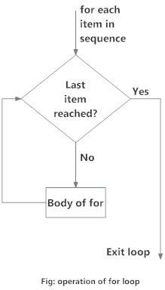
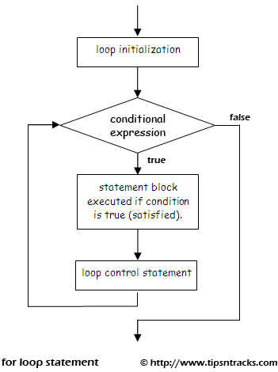
FLOW CONTROL - LOOPS
Loops :
While Loop :
Repeats a group of statements while a given condition is TRUE. It tests the condition before executing the loop body.
Usage :
While expression:
statements;
Else:
This is executed if expression becomes false
Example :
count = 0
while count < 5:
print(count)
count = count + 1
The above example will print 0 to 4
For Loop :
Repeats or iterate over the items of any sequence, such as a list or a string.
Usage :
For item in list
statements;
Else:
This is executed if list runs out of items
Example :
numList = [0,1,2,3,4];
For num in numList:
print num;
The above example will print 0 to 4

Slide 20
Hands On Exercises
Exercise :
1) Write a program to determine if a given number say 5 is odd or even
num = 5;
mod = num % 2;
if mod > 0:
Print num, ‘is an odd number’;
else:
Print num, ‘is an even number’;
2) Given a list of numbers( numList) find all the numbers in the list which are less than 10 and put them in a new list ( newList )
numList = [1,12,5,7,8,9,12,4,8];
newList = [];
for num in numList:
if num < 10:
print num;
newList.append(num);
print newList;
3) Write a program to determine if a given word is a palindrome :
word = 'abc'
letters = list(word)
is_palindrome = True
for letter in letters:
if letter == letters[-1]:
letters.pop(-1)
else:
is_palindrome = False
break
print is_palindrome
4) Write a python program to sum all the items in a list
5) Write a python program to merge two lists into a dict
Example
fruits = [‘oranges‘, ‘apples’,’peaches’]
quantity = [’12,14,15’]
result = {‘oranges’:12,’apples’:14,’peaches’:15}
6) Write a python program to determine if a given number is a prime number

