Slide 1
Social Change

Slide 2
Learning Objectives
Articulate the meaning of social change, its significance, and its various manifestations in society.
Explain the major theories of social change, including evolutionary, cyclical, and dialectical.
Analyze the factors influencing social change.
Explain relationship between social change and modernity.
Evaluate the impact of social change on businesses

Slide 3
Social Change
Significant alteration over time in behavior patterns and culture, including norms and values.
According to Fair child “Social change means any change or reform or amendment in the form and structure of society”.
According to Gillin and Gillin Social changes are variations from the accepted modes of life , whether due to alterations in geographical conditions in cultural equipment, composition of the population or ideologies and whether brought about by diffusion or inventions within the group.”

Slide 4
Theories of Social Change
Evolutionary Theory
Cyclical Theory
Dialectical Theory
Functionalist Theory
Conflict Theory
Modernization Theory

Slide 5
Evolutionary Theory
Societies undergo a gradual and continuous process of development and improvement over time.
Social change is viewed as a natural and inevitable progression towards higher levels of complexity and organization.
Societies evolve from simple to complex forms through stages of growth and adaptation.

Slide 6
Cyclical Theory
Societies go through repetitive cycles of growth, decline, and renewal.
Social change is a pattern of recurring phases, where societies rise and fall in a cyclical manner.
The cycle may be influenced by cultural, economic, or political factors.

Slide 7
Dialectical Theory
Social change occurs through the clash of opposing forces (thesis and antithesis) leading to a synthesis.
The process of change continues with the new synthesis becoming the new thesis.
Conflict and contradictions play a central role in driving historical development.

Slide 8
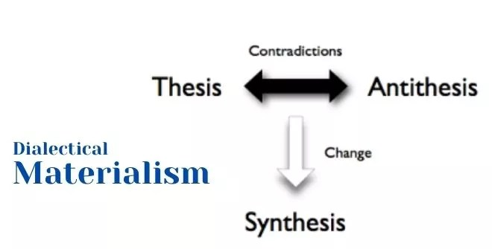
Dialectical Materialism

Slide 9
Functionalist Theory
Society is viewed as a complex system of interconnected parts working together to maintain stability and harmony.
Social change is a process of adjusting and adapting to maintain equilibrium.
The focus is on the functions and dysfunctions of social institutions during the change process.

Slide 10
Conflict Theory
Social change results from conflicts between dominant and subordinate groups seeking to advance their interests and gain control over resources and institutions.
Inequality and power struggles play a central role in driving social change.
The focus is on the disruptive and transformative nature of conflict.

Slide 11
Modernization Theory
Societies progress and develop as they adopt modern technologies, institutions, and values.
Modernization is a linear process leading to increased economic growth, industrialization, urbanization, and social transformation.
Traditional values and practices are replaced by modern ones during this process.

Slide 12
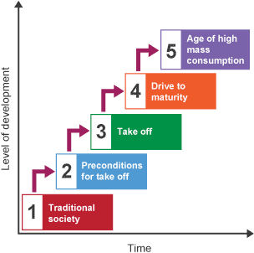

Slide 13
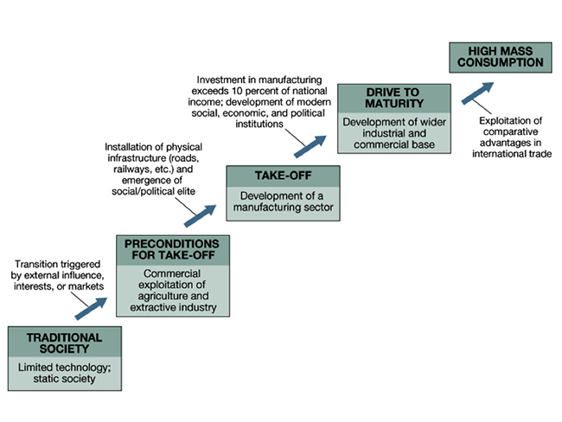
Walt Rostow’s 5 stages of Growth

Slide 14
Factors of Social Change
Change Producing Factors
Discoveries
Inventions
Diffusion
Media
Means of Transportation
Industrialization
Globalization
Modernization

Slide 15
Factors of Social Change
Education
Democracy
War
Migration

Slide 16
Resistance to Social Change
Primitive Societies
Social Values
Vested Interest
Psychological Reasons etc.

Slide 17
Impact of Social Change on Business
The impact of social change on businesses is multifaceted. Social change can influence various aspects of a business.
Consumer Behavior
Market Trends
Organizational Strategies
Corporate Social Responsibility (CSR)
Brand Identity

Slide 18
Activity
Group Activity
Sit in groups
Use internet resource
Research and present various aspect of social change in the modern world
Technological advancement
Economy
Demographic
Cultural
Political
Educational
Globalization
Modernization

