Slide 1
Social Interaction and Social Structure

Slide 2
Learning Objectives
Define and differentiate various forms of social interaction. Cooperation, Competition, Conflict, and Accommodation and their significance in social dynamics.
Describe the concepts of status and role in business settings and their impact on organizational behavior.
Investigate social inequality in business, including social stratification and social class.
Explain the concept of the social construction of reality and its relevance to how individuals perceive and interpret the world.
Comprehend the social construction of brands
Apply the concepts of impression management and dramaturgy to real-life situations, such as job interviews, negotiations, and public speaking.

Slide 3
Social Structure
The distinctive, stable arrangement of institutions whereby human beings in a society interact and live together.
OR
Social structure is the organized set of social institutions and patterns of institutionalized relationships that together compose society.

Slide 4
Elements of Social Structure
Social Interaction
Social Status & Role
Social Group
Social Institutions
Social Inequalities (Including social stratification & social class)
Social Change

Slide 5
Social Interaction
Social interaction refers to the methods in which people interact, communicate, and share information. Social interaction is often referred to as social processes.
Social processes involve the ways in which individuals and groups influence each other, cooperate, compete, communicate, and form relationships.
These processes are essential for upholding social order, the transmission of culture and norms, and the development of social institutions.

Slide 6
Forms of Social Interaction (Social Processes)
Cooperation
Competition
Conflict
Accommodation

Slide 7
Forms of Social Interaction
Cooperation: A form of social process in which two or more individuals or groups work together jointly to achieve a common goal. In which all participants are benefitted. (e.g. teamwork, international aid)
Competition: Competition may be called as a struggle between the two or more individuals or groups, who strives to get something which is relatively limited. ( e.g. business competition, sports competition, brands competition, academic competition)
Conflict: Conflict is the social process in which individuals or groups seek their ends by directly challenging the antagonists by violence or threat of violence. (e.g. labor strikes, political protests)
Accommodation: Accommodation is a process through which individuals or groups make adjustment to the changed situation to overcome difficulties faced by them. The accommodation may last for only short period of time. (e.g. Ceasefire, Peace treaty, conflict resolution)
Assimilation: The only process through which conflicts between groups may be eliminated permanently is through assimilation. It is a gradual and long social process.

Slide 8
Significance of Cooperation, Competition, Conflict and Accommodation in social dynamics
Cooperation: It creates social bonds and promotes a sense of belonging, which enhances social cohesion and stability.
Competition: Competition drives innovation and progress. Competition often results in more choices for consumers and better-quality goods and services.
Conflict: Conflict can be a catalyst for social change, as it highlights existing inequalities, injustices, and areas that need improvement. It can lead to reforms and the transformation of social structures.
Altogether social processes foster social change and lead to progress and development in society.

Slide 9
Status & Role
Status: Status refers to the social position which an individual enjoys in his group or society whether ascribed or achieved.
Status are of two types:
Ascribed: It is inherited, given by birth. (e.g. age, sex, caste)
Achieved: It is acquired through personal effort or by chance. (education, prestige, wealth)
Role: Role is the expected behavior associated with a social position of an individual or group in a given society.
Example of status: (student, citizen, teacher, doctor, politician, mother, son etc.)

Slide 10
Social Inequality
Social inequality refers to the unequal distribution of resources, opportunities, and privileges among individuals or groups within a society.
It is a condition where certain individuals or groups have more advantages, power, and access to resources than others, leading to disparities in various aspects of life, such as income, education, healthcare, and social status.

Slide 11



Slide 12
Social Stratification
Social stratification is a society's categorization of people into socioeconomic strata, based upon their occupation and income, wealth and social status, and derived power (social and political). Social stratification means division of society into different strata or layers. The system of status differences which has developed in a society.

Slide 13
The factors which determine social stratification
Income
Wealth
Power
Prestige

Slide 14
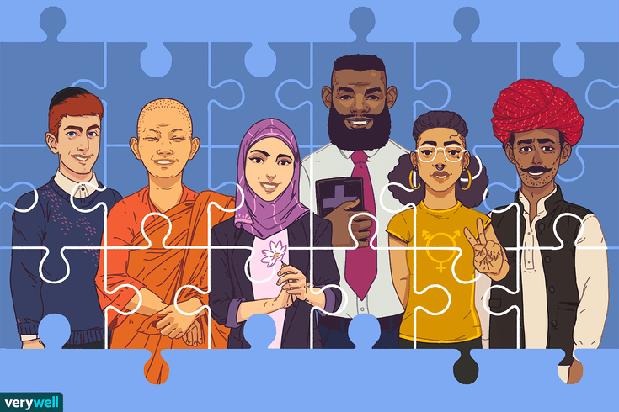
In what ways are societies stratified?
By Caste
By Class
By Gender
By Race and Ethnicity

Slide 15
Stratification by Class
Karl Marx defined class as: “A group of people having more or less equal economic resources and indicating similar standard of living in a society”.
Marx believe that throughout human history only two classes have appeared
Lord-slave Ancient society
Landlord-peasant Feudal and Agrarian society
Bourgeois-proletariat Capitalist and Industrial society
Feudal and agrarian society
ndustrial society

Slide 16
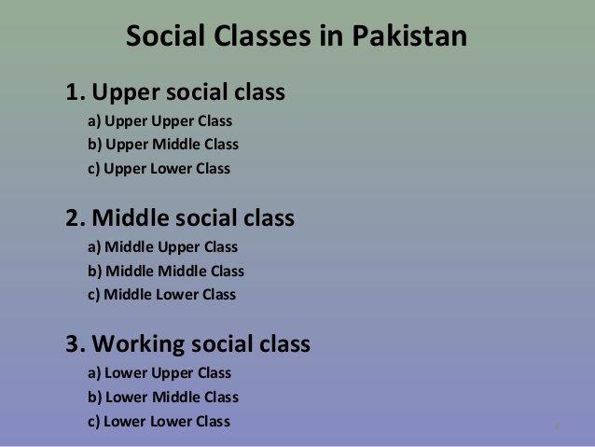
How many classes are there?

Slide 17
Social Construction of Reality
The social construction of reality is a sociological concept arguing that people's reality is created and shaped by their interactions. Reality is not an objective, 'natural' entity, it is rather a subjective construction that people develop.
Reality is not an absolute, fixed concept .
Think of aftaar parties, football games, political rallies, and even nations. These are all social realities
What individuals consider to be real, true, or significant is influenced by the social context they belong to and the culture they are a part of.
For example: Your university exists as a university and not just as a building because you and others agree that it is a university.

Slide 18
What are the 3 stages in the social construction of reality?
The three steps involved in reality construction are:
Externalization: Society is a human product.
Objectivation: Society is an objective reality.
Internalisation: Man is a social product.
The term social construction of reality refers to the theory that the way we present ourselves to other people is shaped partly by our interactions with others, as well as by our life experiences.

Slide 19
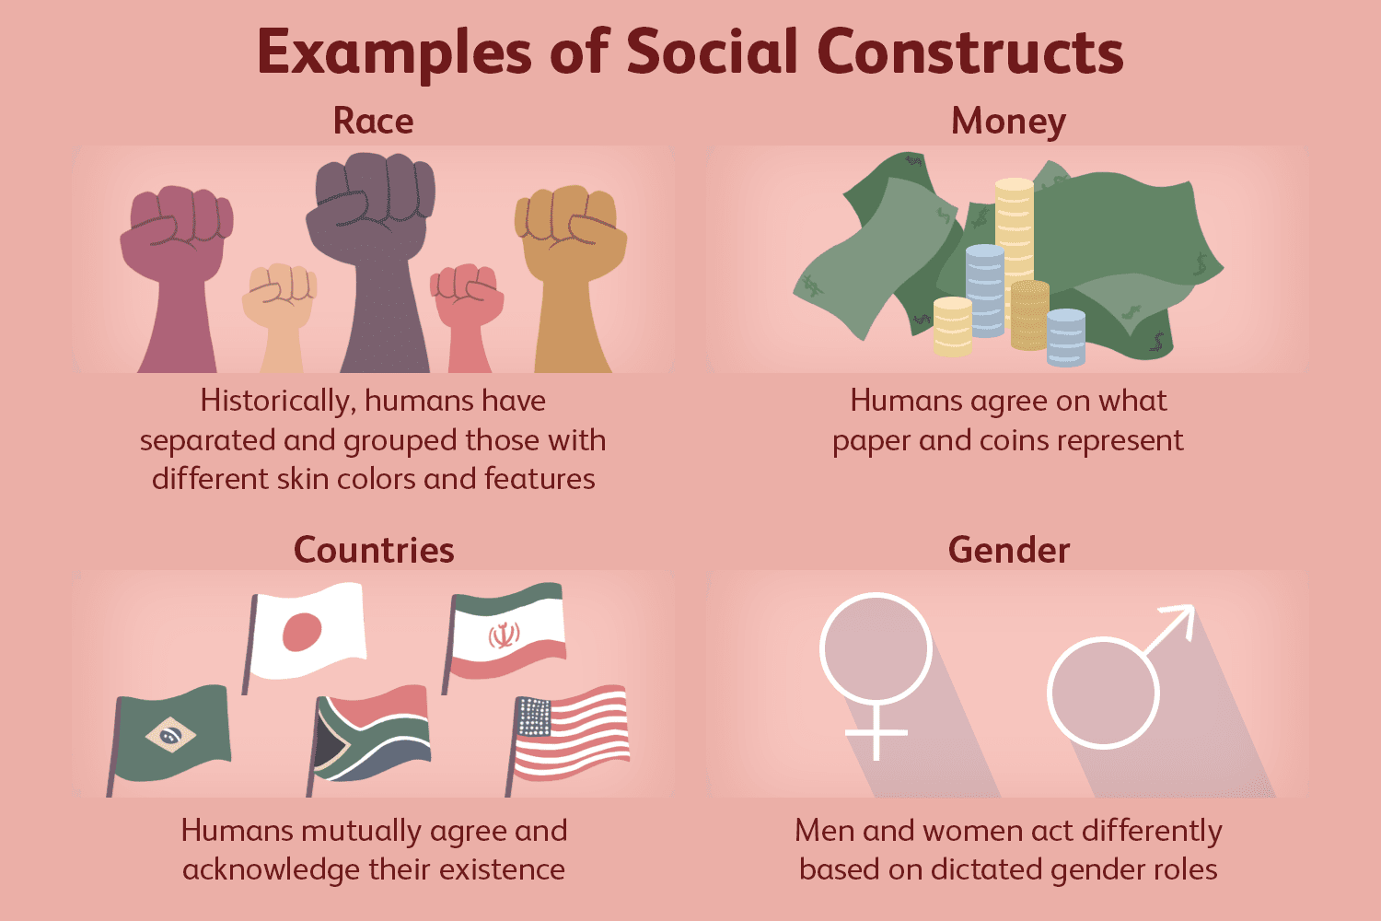
Social Construction of Reality

Slide 20
Social Construction of Brands
The flow of effect of social construct is directly to purchase intention or through brand attitude.
The social construction of a brand refers to the process by which a brand's meaning and significance are created and shaped through social interactions, cultural influences, and collective perceptions.
In other words, a brand is not just a product or a logo; it is a complex entity that is co-created and interpreted by individuals and society at large.

Slide 21
Social Construction of Brands
Role of culture
Cultural norms, values, beliefs, and symbols play a significant role in shaping how people perceive and interpret a brand.
Advertisement and marketing
The messages, visuals, and advertising campaigns put forth by a brand can shape public perception and associations with the brand.
Role of Influencers and celebrities
The endorsement of a brand by influencers or celebrities can significantly impact how the brand is socially constructed, especially among their followers.

Slide 22
Activity
Classroom task
List your favorite brands
Explain why you prefer them? What association & symbolic meaning you have with those brands?
Group activity assignment (Home task)
Select a brand
Research the brand you selected on social media platforms
Analyze how the brand is presented and discussed by consumers, influencers, and other stakeholders
Prepare 4-5 ppt slides on that.
Explain how does the social construction of reality influence the perceptions and success of a brands identity? (the values attached with that brand)

Slide 23
Impression Management
Impression management, also known as self-presentation or impression management theory, is a sociological and psychological concept
That refers to the conscious or subconscious strategies individuals use to shape the perceptions others have of them.
The term "impression management" was first introduced by sociologist Erving Goffman in his 1959 book "The Presentation of Self in Everyday Life."
Goffman's theory of impression management highlights that people are constantly engaged in impression management to maintain their self-esteem, gain social acceptance, or achieve specific goals in their interactions with others.

Slide 24
Impression Management
Impression management is an active self-presentation of a person aiming to enhance his image in the eyes of others (Sinha)
OR
Impression management is the process by which people attempt to control how they are perceived by others. Also known as self presentation.
It is is a goal-directed conscious or unconscious attempt to influence the perception of people about a person, object or situation
Learnt through socialization
Strategic self-presentation

Slide 25
Techniques of Impression Management
Flattery
Association
Conformity
Excuses
Apologies
Self Promotion
Favors

Slide 26

Impression Management

Slide 27


Slide 28
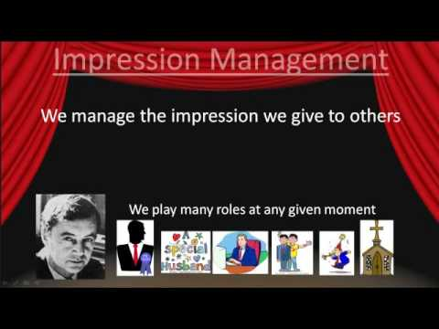

Slide 29
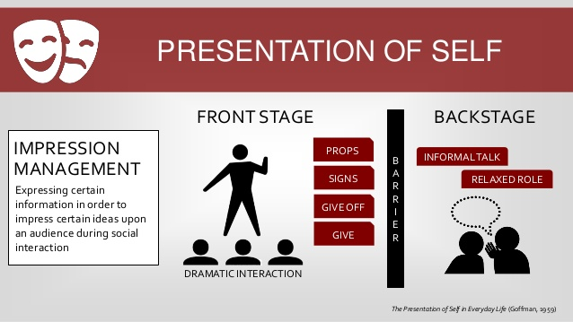

Slide 30


Slide 31
Dramaturgy
The term "dramaturgy" draws upon theatrical metaphors to explain how individuals perform their social roles and manage their impressions in various social interactions.

Slide 32


Slide 33


Slide 34
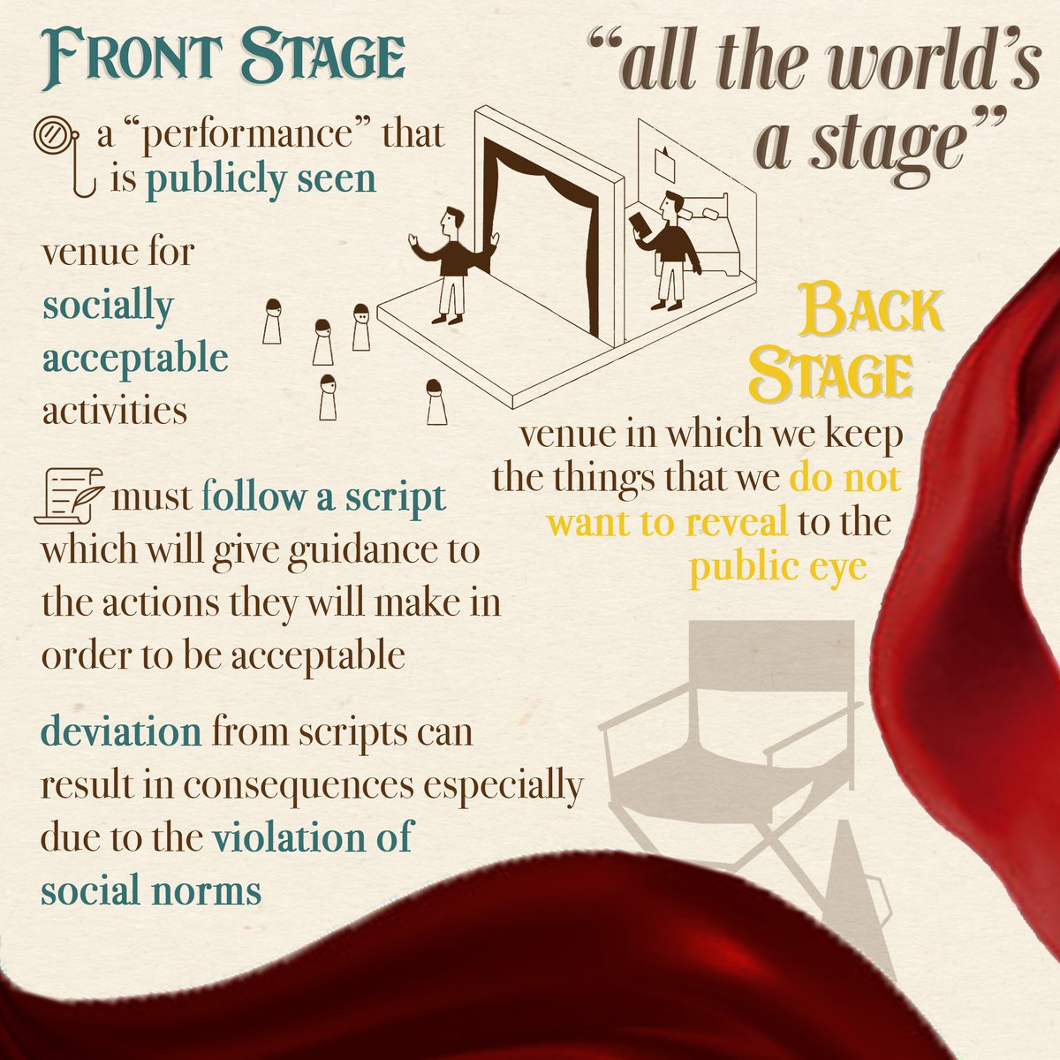

Slide 35


Slide 36
Activity
Give an example of “Impression management” and “dramaturgy” each from your daily life.

