Slide 1


Design Studio
Project name: Charcoal
“The Art of Ash and Ambition’’
PRESENTED BY: HAMNA KASHIF
COURSE: BS.ARCH

Slide 2


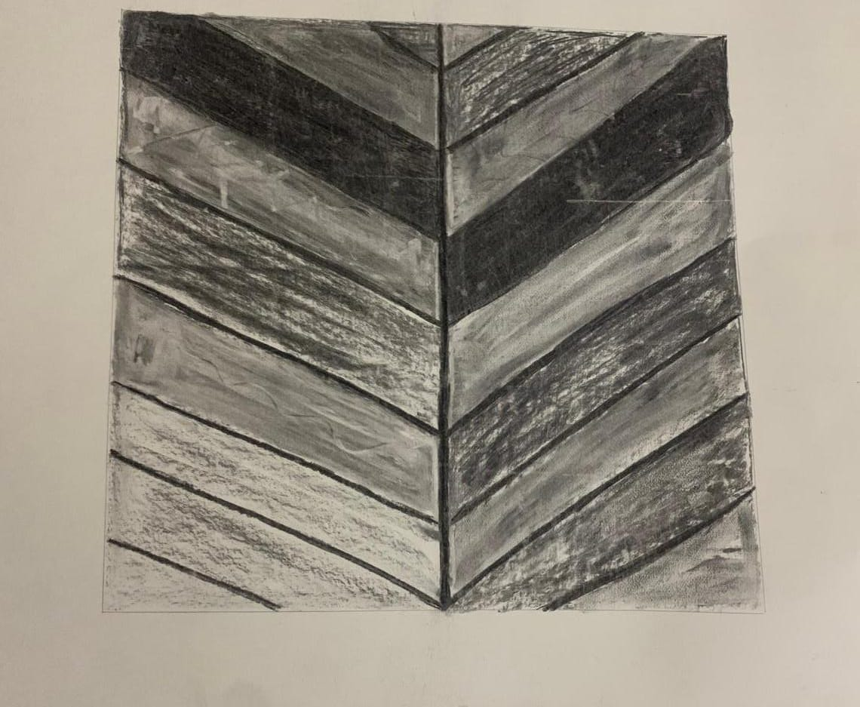
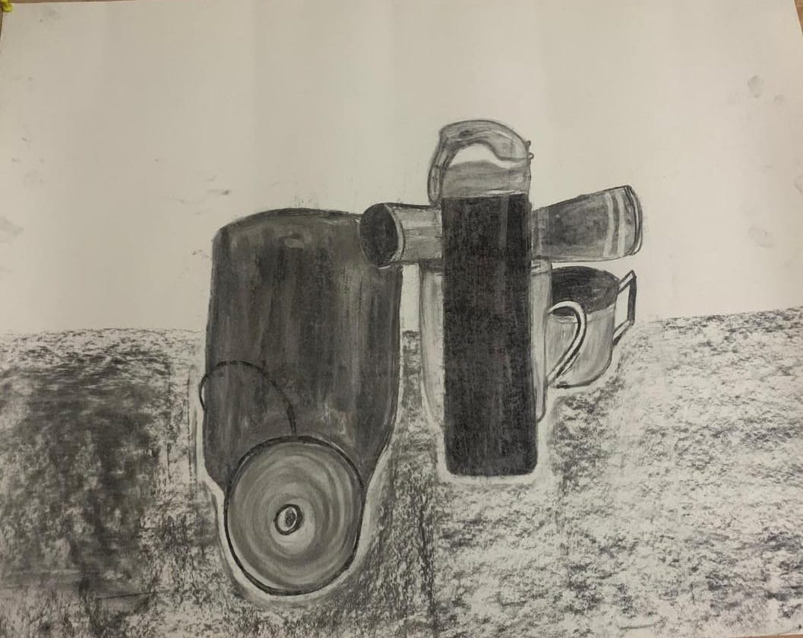
Charcoal
Charcoal enhance creativity and allows for spontaneous and expressive mark-making.

Slide 3

THANK YOU

