Slide 1
Mean Value Theorem
Understanding MVT with Concepts and Visualization

Slide 2
Mean Value Theorem
At some point, the function's actual slope matches its average slope over the interval.

Slide 3

Concept
Imagine you're on a road trip. You start at Point A and drive to Point B. Your total journey takes, say, 2 hours, and you traveled 120 kilometers.
Your average speed for the trip is:
The Mean Value Theorem says that at some point during your journey, your car's actual speed must have been exactly 60 km/h.

Slide 4
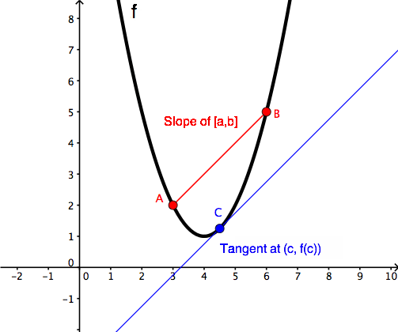
Concept
The road trip
Average speed
Point A and Point B
The actual speed at some point

Slide 5

In Math Term
In math terms, for a function f(x) that is smooth and continuous:
If you're traveling from x=a to x=b ,
The Mean Value Theorem guarantees there's a point c between a and b where:

Slide 6
Conditions
Continuity: The function f(x) must be continuous on the closed interval [a,b].
This means there are no breaks, jumps, or holes in the graph of the function between a and b.
Differentiability: The function f(x) must be differentiable on the open interval (a,b).
This means the graph of the function is smooth (no sharp corners or vertical tangents) between a and b.

Slide 7
Problem Statement
Verify the Mean Value Theorem for the function f(x) = x² on the interval [1, 3].

Slide 8
Step 1: Check the Conditions
Continuity: The function f(x) = x² is a polynomial, so it is continuous everywhere.
Differentiability: The derivative f'(x) = 2x exists everywhere, so the function is differentiable.
Thus, the function satisfies the conditions of MVT on [1, 3].

Slide 9
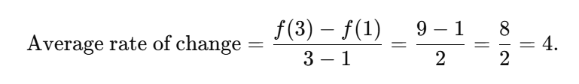
Step 2: Average Rate of Change
The average rate of change is given by:
For f(x) = x², a = 1, b = 3:
f(1) = 1² = 1, f(3) = 3² = 9

Slide 10

Step 3: Find the Point c
The derivative of f′(x)=2x. Set f′(c)=4
At c = 2, the instantaneous rate of change matches the average rate of change.

Slide 11
Step 4: Verify 𝑐 is in the interval
The point 𝑐=2 lies in the open interval (1,3), so it satisfies the theorem.

Slide 12
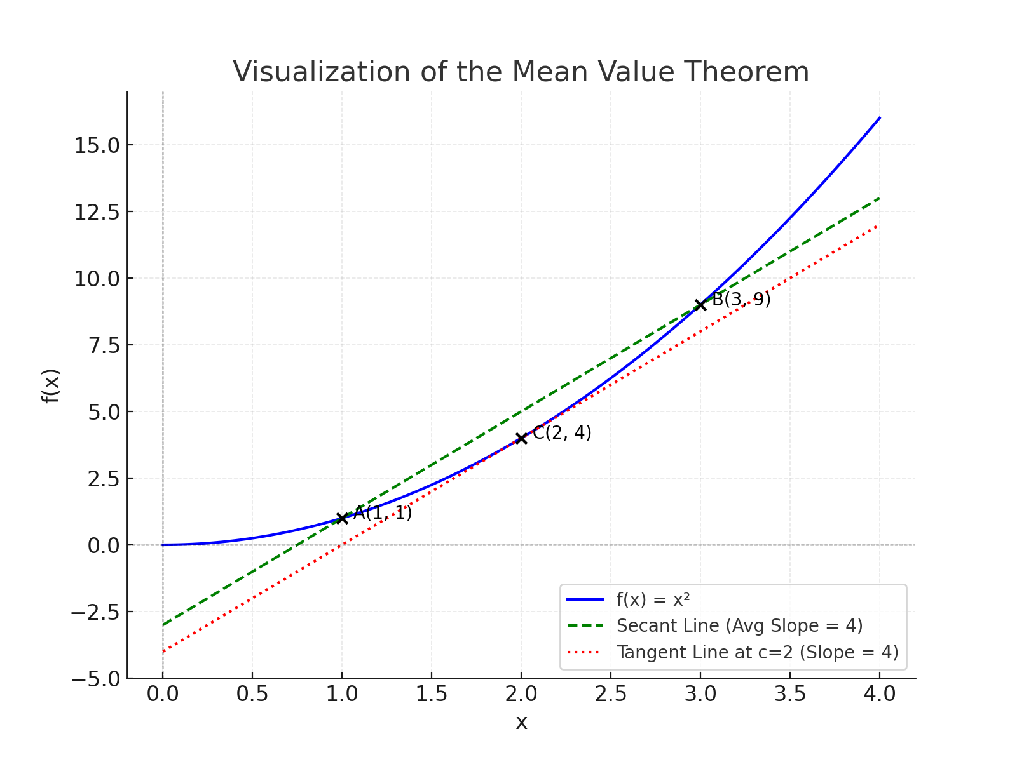
Visualization of Mean Value Theorem

