Slide 1
What is Rolle's Theorem?

Slide 2
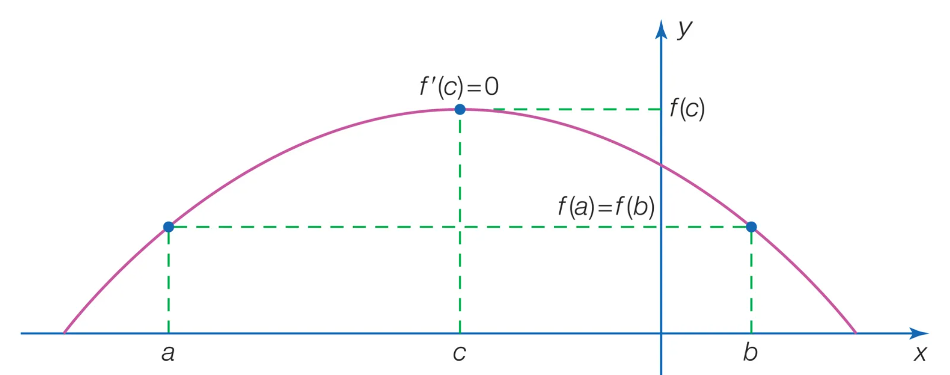
What is Rolle's Theorem?
This point is where the function's graph touches or crosses a horizontal line

Slide 3
Explanation
Rolle's Theorem is a concept in calculus that applies to continuous and smooth (differentiable) functions.
It tells us that under certain conditions, a function will have at least one point where its slope (rate of change) is zero
This point is where the function's curve has a "flat" tangent, or in simpler terms, the function's graph touches or crosses a horizontal line.
Notes:
Tangent: Line ko kehty hain

Slide 4
Conditions on Rolle's Theorem

Slide 5
Conditions
Rolle's Theorem states that if a function f(x) satisfies these conditions:
f(x) is continuous on [a, b].
f(x) is differentiable on (a, b).
f(a) = f(b).
Then, there exists at least one c in (a, b) such that f'(c) = 0.

Slide 6
In Simple Words
The function must be continuous: The function 𝑓(𝑥) must not have any breaks, jumps, or discontinuities within the interval [𝑎,𝑏]
“x=a to 𝑥=𝑏”
The function must be differentiable: It must have a defined derivative at every point in this interval. This ensures that the function has no sharp corners or cusps, where a derivative wouldn’t exist.
The function's values at the endpoints must be the same: The values of the function at the endpoints must be equal: 𝑓(𝑎)=𝑓(𝑏). This condition ensures that there is no net change in the function's value as it moves from 𝑥=𝑎 to 𝑥=𝑏, which is essential for finding a point where the slope is zero.
Notes:
Tangent: Line ko kehty hain

Slide 7
A step-by-step explanation and example

Slide 8
Example Problem
Verify if Rolle's Theorem applies to the function f(x) = x² - 4x + 3
on the interval [1, 3]. If applicable, find c where f'(c) = 0.

Slide 9
Verifying the Conditions
1. The function f(x) = x² - 4x + 3 is continuous and differentiable everywhere.
2. Evaluate f(1) and f(3):
f(1) = 1² - 4(1) + 3 = 0
f(3) = 3² - 4(3) + 3 = 0
Since f(1) = f(3), the conditions are satisfied.

Slide 10
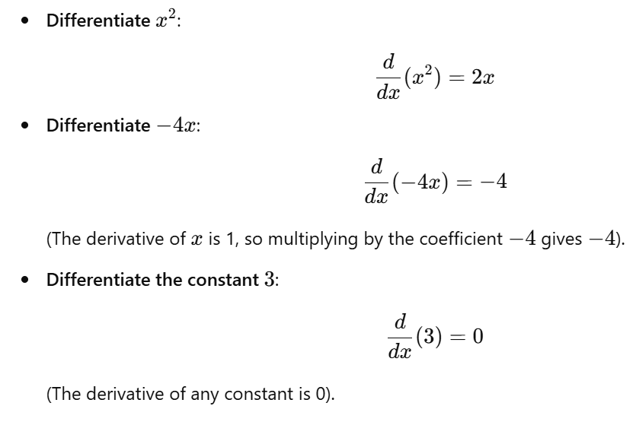
Finding the Derivative
The derivative of f(x) = x² - 4x + 3 is:

Slide 11
Finding the Derivative
The derivative of f(x) = x² - 4x + 3 is: f'(x) = 2x - 4 Set f'(x) = 0:
2x - 4 = 0
x = 2

Slide 12
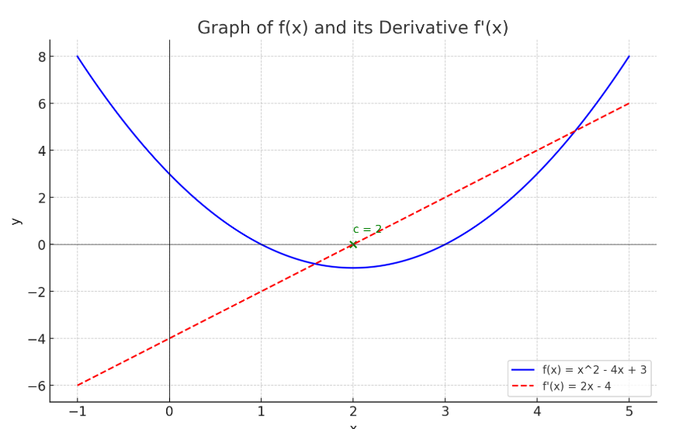
To Prove My Words
The function satisfies all conditions of Rolle's Theorem.
There exists a point c = 2 in (1, 3) such that f'(c) = 0.
This means the slope of the tangent to f(x) at x = 2 is zero.

