Slide 1
CHAPTER 9
ORGANIZATIONAL PLAN

Slide 2
Developing the Management Team
Investors demand that the management team not operate the business as a part-time venture.
It is assumed that the management team is prepared to operate the business full time and at a modest salary.
An attempt to draw a large salary out of the new venture may be perceived as a lack of commitment to the business.

Slide 3
Legal Forms of Business
Three basic legal forms of business:
  Proprietorship - Single owner, unlimited liability, controls all decisions, and receives all profits.
  Partnership - Two or more individuals having unlimited liability who have pooled resources to own a business.
  Corporation (C corporation) - Most common form of corporation; regulated by statute; treated as a separate legal entity for liability and tax purposes.

Slide 4
Legal Forms of Business (cont.)
New forms of business formations:
  Limited liability company (LLC).
  Limited liability partnership (LLP).

Slide 5
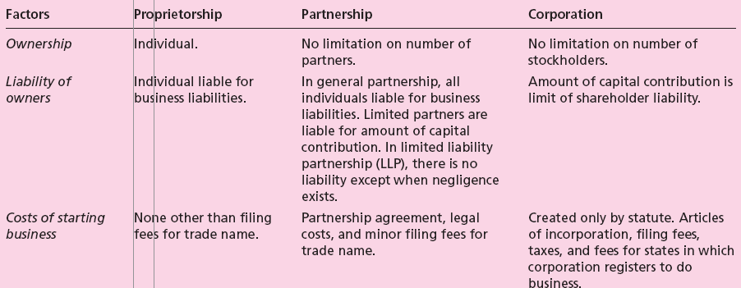
Table 9.1 - Three Forms of Business Formation

Slide 6
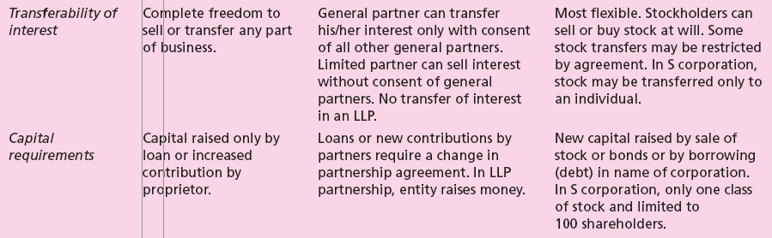
Table 9.1 - Three Forms of Business Formation (cont.)

Slide 7
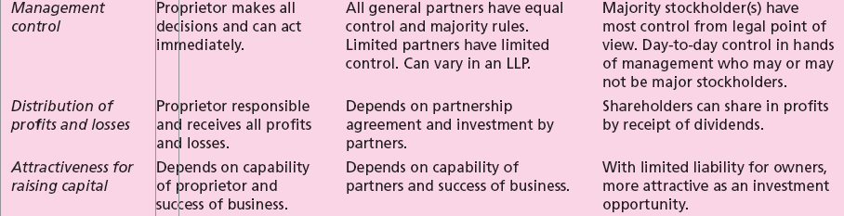
Table 9.1 - Three Forms of Business Formation (cont.)

Slide 8
Tax Attributes of Forms of Business
Tax Issues for Proprietorship
  IRS treats business as the individual owner; not regarded as a separate tax entity.
  All income appears on owner’s return as personal income.
  Tax advantages:
    No double tax when profits are distributed to owner.
    No capital stock tax or penalty for retained earnings.
Tax Issues for Partnership (general)
  Tax advantages and disadvantages similar sole proprietorship.

Slide 9
Tax Attributes of Forms of Business (cont.)
Tax Issues for Partnership (limited)
  Has the advantage of limited liability.
  Treated the same as the LLC for tax purposes.
Tax Issues for Corporation:
  Can take many deductions and expenses not available to proprietorship or partnership.
  Distribution of dividends is taxed twice.
  Double taxation can be avoided if income is distributed to entrepreneur(s) in the form of salary.

Slide 10
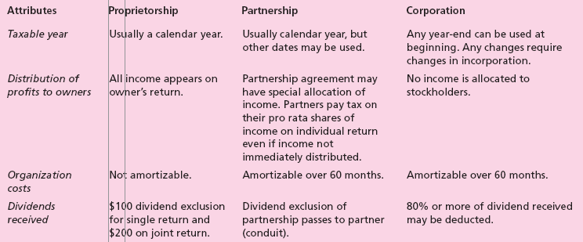
Table 9.2 - Tax Attributes of
Various Legal Forms of Business

Slide 11
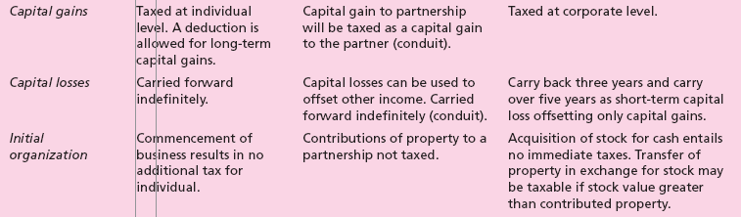
Table 9.2 - Tax Attributes of
Various Legal Forms of Business (cont.)

Slide 12
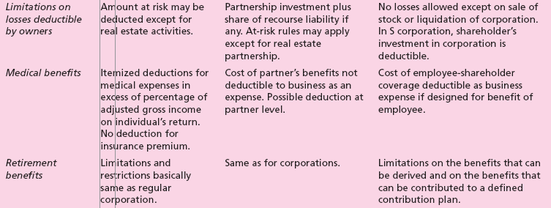
Table 9.2 - Tax Attributes of
Various Legal Forms of Business (cont.)

Slide 13
The Limited Liability Company
A partnership/corporation hybrid.
Laws governing its formation differ from state to state.
LLC has members.
No shares issued; each member owns an interest as designated by the articles of organization.
Liability does not extend beyond member’s capital contribution.

Slide 14
The Limited Liability Company (cont.)
Transfer of interest requires unanimous consent.
It is taxed as a partnership.
Standard acceptable term is 30 years; continuity restricted.

Slide 15
The Limited Liability Company (cont.)
Advantages of LLC
  Partners can add their proportionate shares of the LLC liabilities to their partnership interests.
  Most states do not tax LLCs.
  One or more (without limit) individuals, corporations, partnerships, trusts, or other entities form an LLC.
  Members share income, profit, expense, deduction, loss and credit, and equity of the LLC among themselves.

Slide 16
Designing the Organization
This is the entrepreneur’s formal and explicit indication to the members of the organization as to what is expected of them; expectations can be grouped into:
  Organization structure.
  Planning, measurement, and evaluation schemes.
  Rewards.
  Selection criteria.
  Training.

Slide 17
Building the Management Team and a Successful Organization Culture
A management team must be able to accomplish three functions:
  Execute the business plan.
  Identify fundamental changes in the business as they occur.
  Make adjustments to the plan based on changes in the environment and market that will maintain profitability.

Slide 18
Building the Management Team and a Successful Organization Culture (cont.)
Important factors in establishing an effective team:
  Desired culture must match business strategy outlined in the business plan.
  Employees must be motivated and rewarded for good work.
  Entrepreneur should be flexible to try different things.
  Spend extra time in the hiring process.
  Core values and appropriate tools must be provided for employees to effectively complete their jobs.

Slide 19
The Role of a Board of Directors
Functions of the board of directors:
  Reviewing operating and capital budgets.
  Developing longer-term strategic plans for growth and expansion.
  Supporting day-to-day activities.
  Resolving conflicts among owners or shareholders.
  Ensuring the proper use of assets.
  Developing a network of information sources for the entrepreneurs.

Slide 20
The Role of a Board of Directors (cont.)
They meet the requirements of the Sarbanes-Oxley Act and the following criteria:
  Ability to work with a diverse group and commit to the venture’s mission.
  Ability to understand the market environment.
  Ability to contribute important skills to the new venture’s achievement of planning goals.
  Ability to show good judgment in business decision making.

Slide 21
The Board of Advisors
They serve only in an advisory capacity.
No legal status; not subject to regulations stipulated in the Sarbanes-Oxley Act.
Likely to meet less frequently.
Useful in a family business.
Selection process is similar to the process for selecting a board of directors.
Advisors may be compensated on a per-meeting basis or with stock or stock options.

Slide 22
The Organization and Use of Advisors
Outside advisors are usually used on an as-needed basis.
They can become a part of the organization and need to be managed.
The relationship between the entrepreneur and outside advisors can be enhanced by involving them thoroughly and at an early stage.
Even after hiring advisors, the entrepreneur should question their advice.

