Slide 1
Chapter 10
The Financial Plan
McGraw-Hill/Irwin
Copyright © 2010 by The McGraw-Hill Companies, Inc. All rights reserved.

Slide 2
The Financial Plan
It provides the entrepreneur with a complete picture of:
  The amount funds and when they are coming into the organization.
  Where funds are going and how much cash is available.
  The projected financial position of the firm.
The plan explains how the entrepreneur intends to meet financial obligations and maintain the venture’s liquidity.

Slide 3
Operating and Capital Budgets
These are developed before developing the pro forma income statement.
Sales budget – An estimate of the expected volume of sales by month.
  Cost of sales can be determined from the sales forecasts.
  In manufacturing ventures, costs of internal production and subcontracting are compared.
  Includes estimated ending inventory required as a buffer.

Slide 4
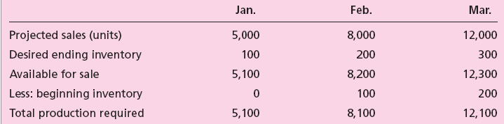
Table 10.1 - A Sample Manufacturing Budget for First Three Months

Slide 5
Operating and Capital Budgets
Operating costs:
  Includes fixed expenses incurred regardless of sales volume.
  Variable expenses must be linked to strategy in the business plan.
Capital budgets provide a basis for evaluating expenditures that will impact the business for more than one year.

Slide 6
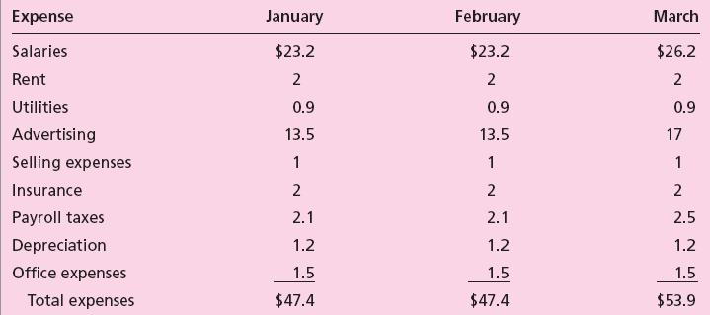
Table 10.2 - A Sample Operating Budget for First Three Months ($000s)

Slide 7
Pro Forma Income Statements
Pro forma income - Projected net profit calculated from projected revenue minus projected costs and expenses.
  Sales by month is calculated first.
    Basis of the figures - Marketing research, industry sales, trial experience, forecasting, and financial data on similar start-ups.
  Projections of all operating expenses for each of the months during the first year should be made.

Slide 8
Pro Forma Income Statements (cont.)
  Increasing selling expenses as sales increase should be taken into account.
  Changes in expenses during the first year can necessitate month-by-month illustration.
  Increase in individual expenses need to be reflected in the first year’s pro forma income statement.
  Projections should be made for years 2 and 3 as well; consider expenses that are likely to remain stable over time.

Slide 9
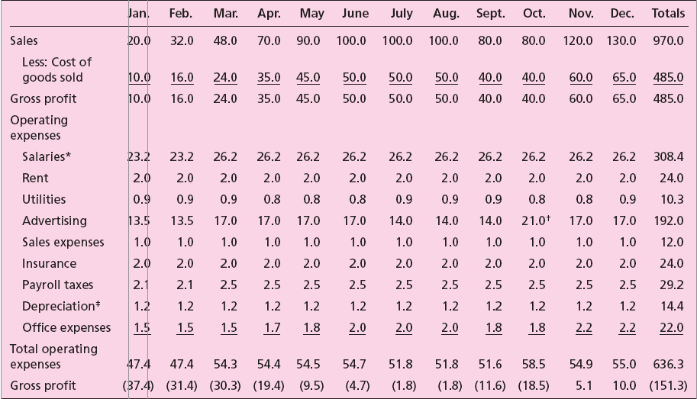
Table 10.3 - MPP Plastics Inc., Pro Forma Income Statement, First Year by Month ($000s)

Slide 10
Pro Forma Cash Flow
Projected cash available calculated from projected cash accumulations minus projected cash disbursements.
  It is not the same as profit.
  Sales may not be regarded as cash.
  Use of profit as a measure of success may be deceiving if there is significant negative cash flow.
  Cash flow can be projected using the indirect or direct method.

Slide 11
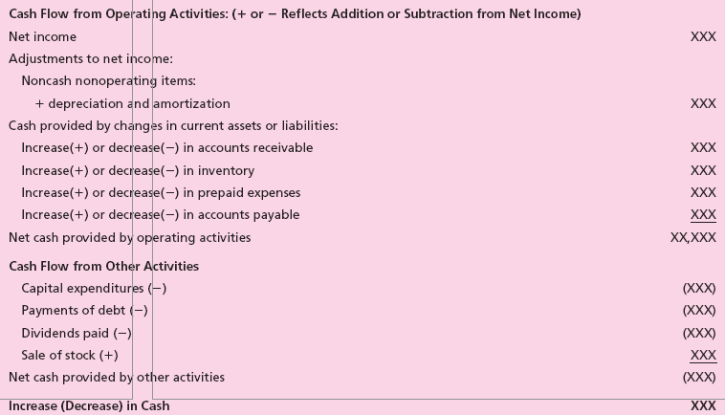
Table 10.5 - Statement of Cash Flows: The Indirect Method

Slide 12
Pro Forma Cash Flow (cont.)
Entrepreneurs must make monthly projections of cash.
  If disbursements are greater than receipts - entrepreneur must either borrow funds or have cash in a bank.
  Large positive cash flows need to be invested or deposited in a bank for periods when disbursements are greater than receipts.
  Determining the exact monthly receipts and disbursements is difficult.
Pro forma cash flow is based on best estimates.

Slide 13
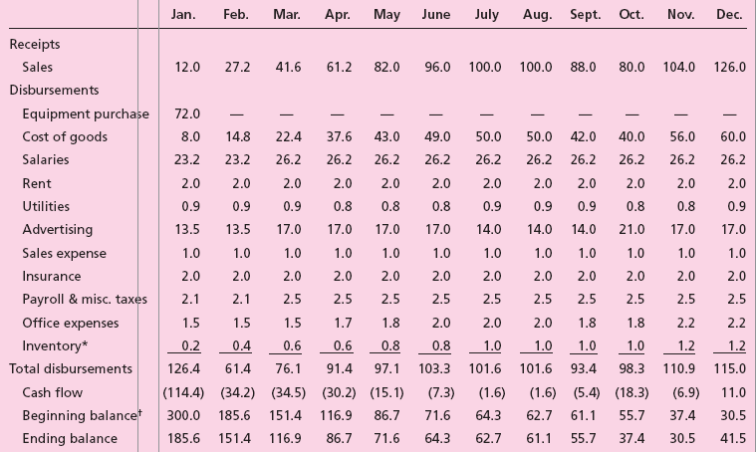
Table 10.6 - MPP Plastics Inc., Pro Forma Cash Flow, First Year by Month ($000s)

Slide 14
Pro Forma Balance Sheet
Summarizes the projected assets, liabilities, and net worth of the new venture.
  It is a picture of the business at a certain moment in time and does not cover a period of time.
  Consists of:
    Assets - Items that are owned or available to be used in the venture operations; can be current or fixed.
    Liabilities - Money that is owed to creditors; can be current or long-term debt.
    Owner’s equity - Amount owners have invested and/or retained from the venture operations.

Slide 15
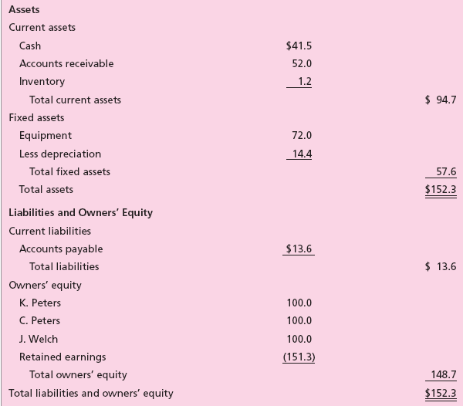
Table 10.7 - MPP Plastics Inc., Pro Forma Balance Sheet, End of First Year ($000s)

Slide 16
Break-Even Analysis
Breakeven - Volume of sales where the venture neither makes a profit nor incurs a loss.
The break-even formula:
B/E(Q) = __________TFC______________
SP-VC/unit (marginal contribution)
Major weakness in calculating the breakeven lies in determining if a cost is a fixed or variable.

Slide 17
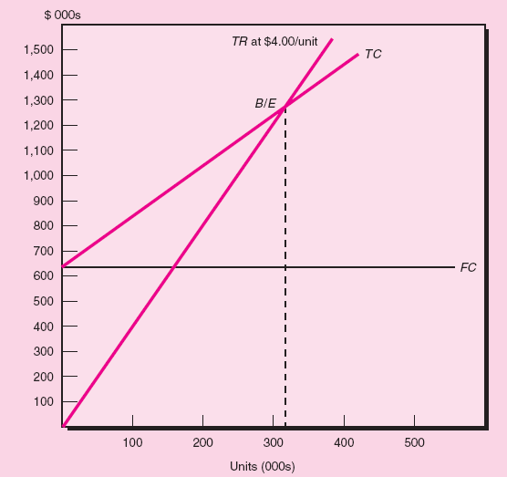
Figure 10.1 - Graphic Illustration of Breakeven

Slide 18
Pro Forma Sources and Applications of Funds
Sources:
  Operations.
  New investments.
  Long-term borrowing.
  Sale of assets.
Uses/ Applications:
  Increase assets.
  Retire long-term liabilities.
  Reduce owner or stockholders’ equity.
  Pay dividends.

Slide 19
Software Packages
A spreadsheet program (Microsoft Excel) is most suitable for completing pro forma statements.
  Helps present different scenarios and assess their impact on the pro forma statements.
A simple and easy to use software is useful in the start-up stage.
Software packages vary in price and complexity.

