Slide 1


Topic :
Gaming as a Professional Career
Presented by :
Muhammad Ijaz 2338
Hamza 2354

Slide 2

Content :
Budget in Gaming in future
carrier path in gaming
Pro gaming with skills
Game development
E sport caster
Financial aspects
Challenges and Realities of gaming carrier
Is a gaming carrier is a right for you?

Slide 3
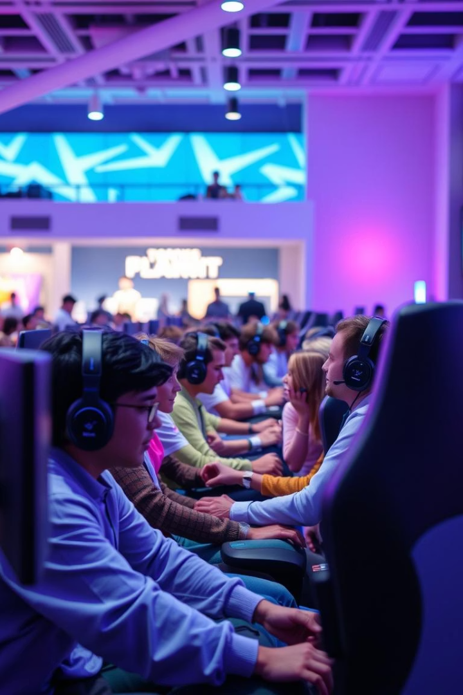
Gaming as a Professional Career:
The global gaming market is expected to hit $314 billion by 2027. With 2.5 billion players worldwide, gaming has evolved from a casual hobby to a thriving career.

Slide 4

Career Paths in Gaming:
Pro Gamer
Game Developer
Compete in tournaments and win prize money.
Design and build video games using coding languages.
E sports Caster/Analyst
Game Designer & Writer
Provide commentary and detailed game analysis.
Create game mechanics, storylines, and characters.

Slide 5

Pro Gaming: Skills and Requirements
Popular Titles
Teamwork
Game Types
League of Legends, Counter-Strike, Dota 2.
Practice
Communicate and strategize effectively with teammates.
Specialize in FPS, MOBAs, or fighting games.
10,000+ hours to sharpen reaction time (~200ms).

Slide 6
Game Development: Skills and Education
Technical Skills
Education & Art
Top Companies
C++, C#, Java, Python programming
Bachelors in computer science or related field
Rockstar Games, Ubisoft, Activision Blizzard
Game engines: Unity, Unreal Engine
3D modeling and texturing skills

Slide 7
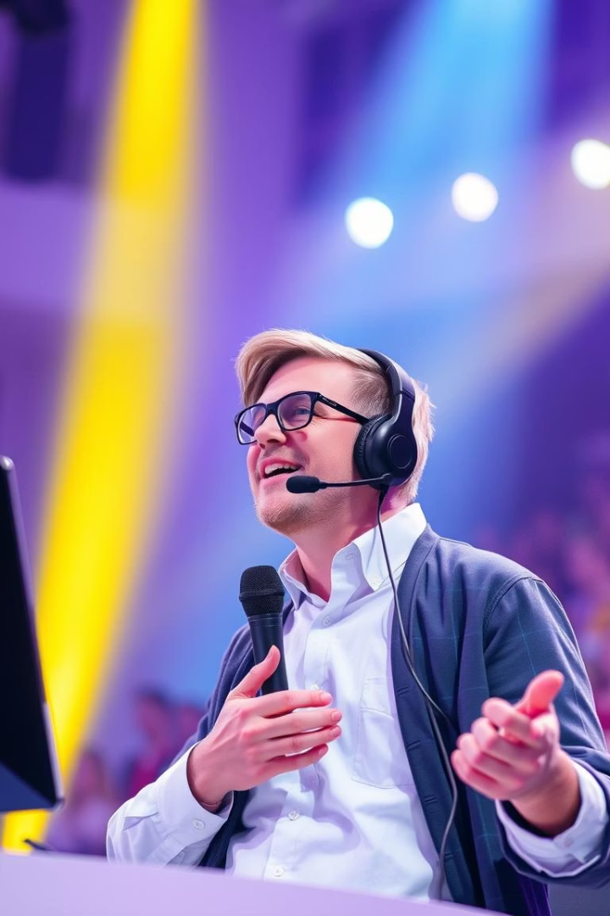




E sports Caster/Analyst: Skills and Knowledge
Game Expertise
Deep understanding of gameplay and trends.
Communication
Clear public speaking and engaging delivery.
Audience Engagement
Charisma to captivate and entertain viewers.
Platforms
Twitch, YouTube, ESPN broadcasts.

Slide 8
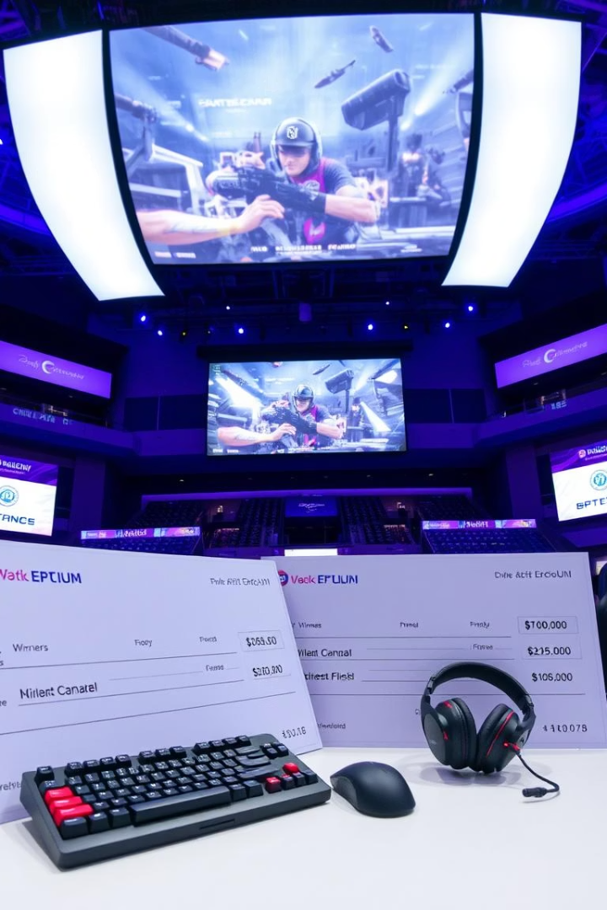
Financial Aspects: Salary and Revenue Streams
Pro Gamers
$50k - $1M+ annually
Game Developers
$60k - $150k+ annually
E sports Casters
$40k - $200k+ annually
Twitch Streamers
Variable: subs, donations, ads
E sports generated $1.08B in revenue in 2021, showing growth opportunities.

Slide 9





Challenges and Realities of a Gaming Career
High Pressure
Long Hours
Self-Discipline
Constant Adaptation
Competitive fields require stamina, discipline, and adaptability.

Slide 10
Is a Gaming Career Right for You?
Passion & Dedication
Realistic View
Learning & Growth
Networking
Understands the challenges and demands involved.
Keeps up with the evolving industry trends.
Builds relationships with peers and professionals.
Loves gaming and improving skills constantly.

Slide 11


