Slide 1
Emotion
Ms Fakiha Shoukat

Slide 2



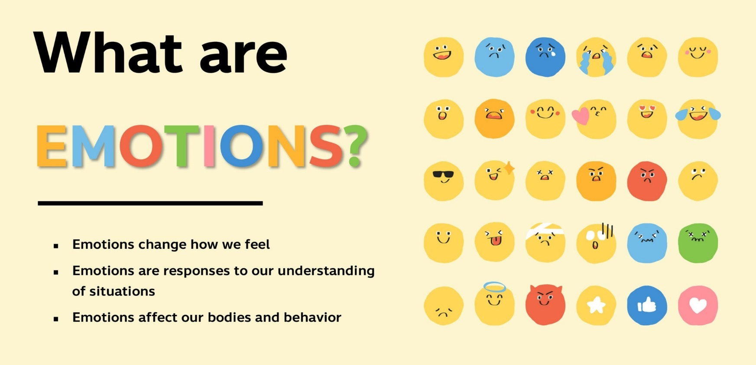
www.tuf.edu.pk
unioffaisalabad

Slide 3
Emotions
Emotions are mental states brought on by neurophysiological changes, variously associated with thoughts, feelings, behavioral responses, and a degree of pleasure or displeasure.
Emotions are very short-lived feelings that come from a known cause.
They are displayed through sudden physical body language and facial expressions, such as by smiling when happy or crying when sad.
Different types of emotions include: happiness, sadness, anger, fear, surprise, and disgust.

Slide 4
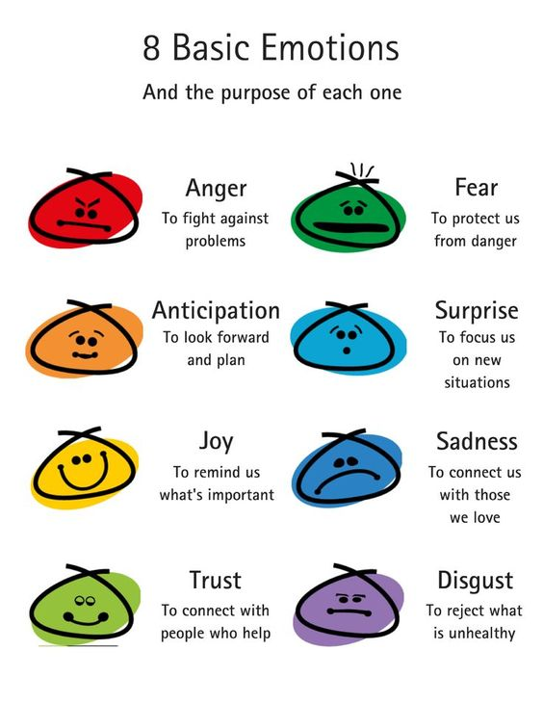
Types of Emotions

Slide 5
Cultural Expression of Emotions
Culture influences the expression of emotions by shaping the gestures that vary among different societies.
Cultural functions of emotion refer to the effects that emotions have on the functioning and maintenance of societies and cultures.
This refers to the process whereby individuals look for information from others to clarify a situation, and then use that information to act.
Cross Cultural Expression: Few expression has world wide universal meaning to a single world. (Happy, Sad, Fear, Surprised)

Slide 6
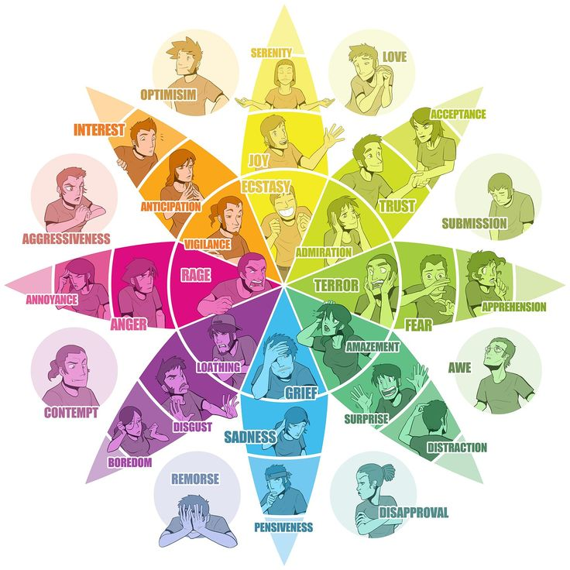

Slide 7
Expression and Emotions
Emotional expression is simply the acknowledgement of these emotions we are built to feel.
Healthy expression allows us to understand the emotions, truly feel them and move on.
Emotions can be expressed verbally (through words and tone of voice) or by using nonverbal communication, including the use of body language or facial expressions.

Slide 8
Facial expressions: are the most common form of expressing emotions
Body positions: are in many express how emotions are taken.
Criticism: The expression of disapproval of someone or something on the basis of perceived faults or mistakes.
Context: The circumstances that form the setting for an event, statement, or idea, and in terms of which it can be fully understood.

Slide 9
Social References: The process wherein infants use the affective displays of an adult to regulate their behaviors toward environmental objects, persons, and situations.
Smile: Facial expression in which the eyes brighten and the corners of the mouth curve slightly upward and which expresses especially amusement, pleasure, approval, or sometimes scorn.
Voluntary Control: The management of acts or behaviors by intentional action.

Slide 10
Arousal and Emotions
Emotional Arousal is a state of heightened physiological activity. This includes having strong emotions like anger and fear and we go to the emotional arousal state in response to our daily experiences.
For example the fight, flight or freeze response is a state of emotional arousal.

Slide 11
James-Lange Theory of Emotions
The James-Lange Theory states that emotions result from physiological reactions in the body.
There is a stimulus that causes a specific pattern of physiological arousal that causes an emotional response.
The James-Lange theory suggests that different patterns of arousal lead to different emotions.
The James-Lange theory, predicts the facial feedback hypothesis the muscles you use to create a facial expression triggers your experience of emotion.

Slide 12
