Slide 1
Motivation
Ms Fakiha Shoukat

Slide 2



Motivation
www.tuf.edu.pk
unioffaisalabad
The word Motivation comes from ‘Mover’ the Latin word meaning ‘To Move’.
Psychologists who study motivation focus on internal and external influence that might move a person.
Motivation means a need or desire that energizes and directs the behavior towards a goal.
Motivation is the general term for process of starting, directing and maintaining physical and psychological activities.

Slide 3
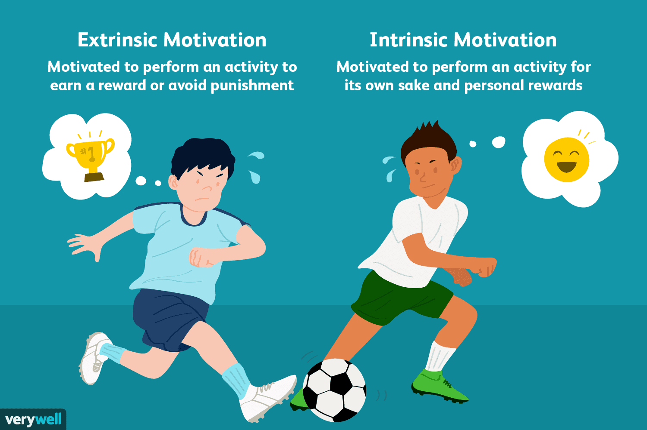
www.tuf.edu.pk
unioffaisalabad

Slide 4
www.tuf.edu.pk
unioffaisalabad
Motivation is a broad concept that collects all internal mechanisms involved in
Preference for one activity over another
Vigour/Stamina of responses
Persistence of organized patterns of action towards relevant goal.

Slide 5
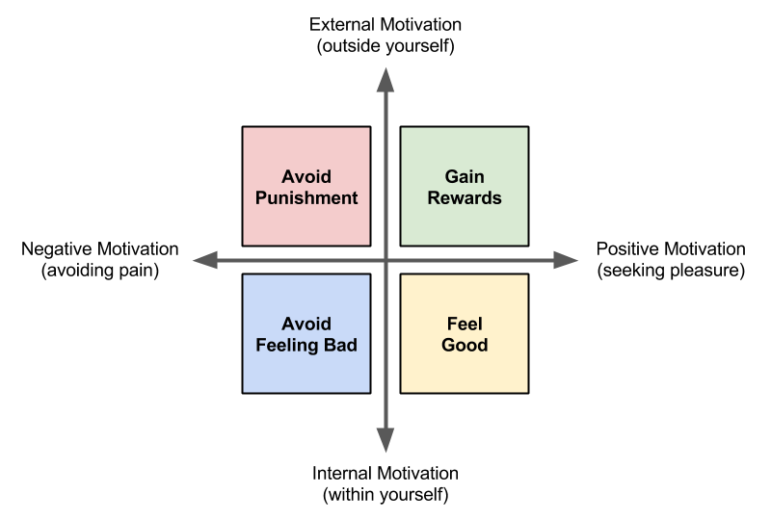
www.tuf.edu.pk
unioffaisalabad

Slide 6
Motives
www.tuf.edu.pk
unioffaisalabad
Primary
Secondary
Biological Motive
Hunger
Thirst
Temperature Regulation
Pain Reduction
Social Motives
Social Approval/Comparison
Psychological Motives
Affiliation
Self Esteem/Actualization
General Motives
Aggression
Achievement
Exploration/Manipulation

Slide 7
Principles of Motivation
www.tuf.edu.pk
unioffaisalabad
The basic principles of motivation are a sense of purpose, belonging, a positive work environment, autonomy, growth, and recognition.
These principles can guide leaders in implementing strategies that help people meet their needs, reach their full potential, and deliver superior performance.

Slide 8
www.tuf.edu.pk
unioffaisalabad
Purpose:
Humans have an innate need to seek out meaning in their lives even their work lives. Helping yourself and others to see a bigger purpose in their work, find meaning in their day-to-day duties, and see the impact of the work they do can have a positive effect on motivation.
Belonging:
A sense of belonging at work keeps morale high, improves cohesion, helps collaboration, and is linked to higher motivation. It also prevents work environments from becoming toxic. Creating a sense of belonging requires a psychologically safe work environment.

Slide 9
www.tuf.edu.pk
unioffaisalabad
Positive Work Environment:
A positive work environment facilitates teamwork and keeps morale high.
Autonomy:
Autonomy gives employees the flexibility they want, increases accountability, and builds trust.
Growth:
Growth helps employees achieve their professional goals, develop their skills, and perform better.

Slide 10
Theories
www.tuf.edu.pk
unioffaisalabad
McClelland theory
Achievement
Cognitive
Maslow’s Hierarchy

Slide 11
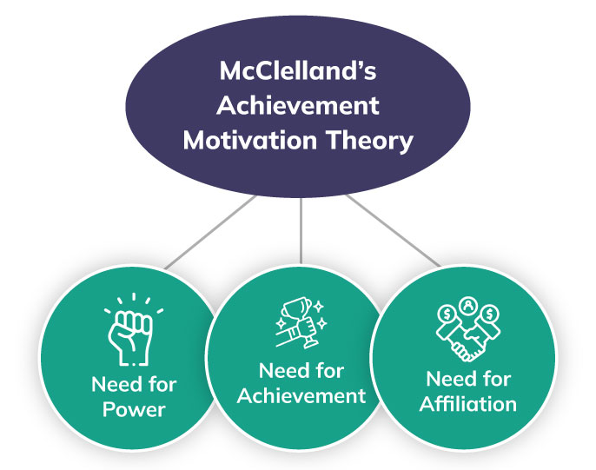
McClelland Theory
www.tuf.edu.pk
unioffaisalabad
McClelland's Human Motivation Theory states that every person has one of three main driving motivators: the needs for achievement, affiliation, or power.
Different people are motivated by different drivers, so understanding what specifically motivates a person to complete a task can vastly improve the likelihood that they'll complete the assignment and do it well.

Slide 12
www.tuf.edu.pk
unioffaisalabad
Achievement
Has a strong need to set and accomplish challenging goals.
Affiliation
Wants to belong to the group.
Power
Wants to control and influence others.
Takes calculated risks to accomplish their goals.
Likes to receive regular feedback on their progress and achievements.
Often likes to work alone.
Wants to be liked, and will often go along with whatever the rest of the group wants to do.
Favors collaboration over competition.
Doesn't like high risk or uncertainty.
Likes to win arguments.
Enjoys competition and winning.
Enjoys status and recognition.

Slide 13
Maslow’s Theory
www.tuf.edu.pk
unioffaisalabad
Maslow's hierarchy of needs is a theory of psychology explaining human motivation based on the pursuit of different levels of needs.
The theory states that humans are motivated to fulfill their needs in a hierarchical order.
This order begins with the most basic needs before moving on to more advanced needs.

Slide 14
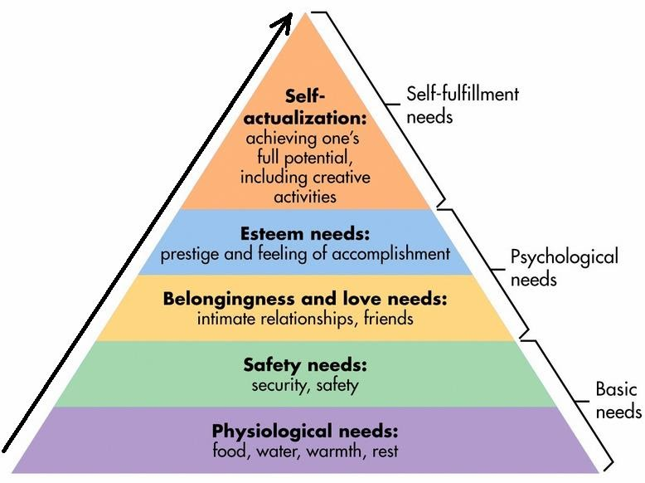
www.tuf.edu.pk
unioffaisalabad

