Slide 1
Intelligence
Ms Fakiha Shoukat

Slide 2




www.tuf.edu.pk
unioffaisalabad

Slide 3
www.tuf.edu.pk
unioffaisalabad
The ability to derive information, learn from experience, adapt to the environment, understand, and correctly utilize thought and reason.
Ability to solve complex problems or make decisions.
Capacity to adapt and learn from experiences.

Slide 4
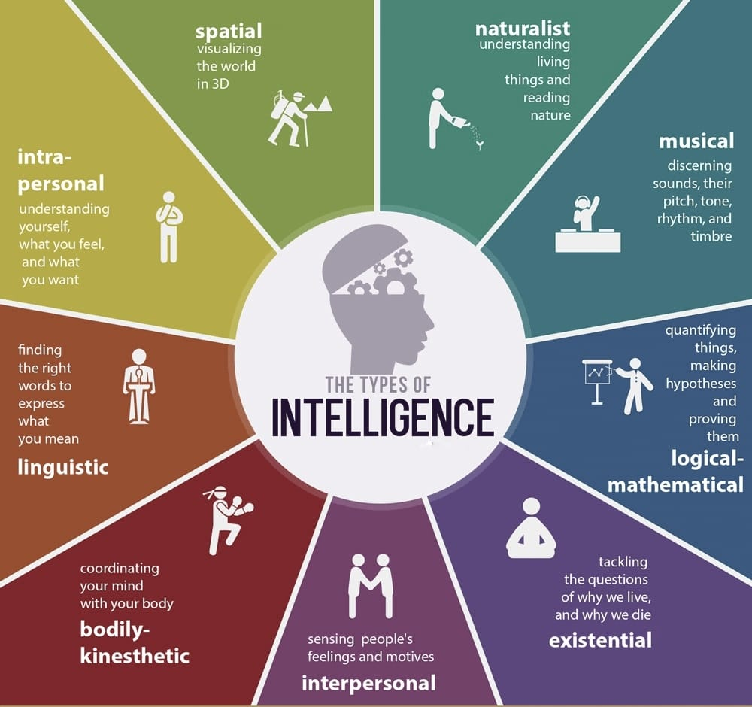
www.tuf.edu.pk
unioffaisalabad

Slide 5
Intelligence Quotient
www.tuf.edu.pk
unioffaisalabad
Intelligence quotient and, in short, it is a measure of a person's reasoning ability.
In other words, an IQ test is supposed to gauge how well someone can use information and logic to answer questions or make predictions.

Slide 6
How to Improve Intelligence Quotient
www.tuf.edu.pk
unioffaisalabad
Improve your relational skills
Learn a new language
Read more books
Write an “I did” list
Prioritize Quality Sleep
Practice memory activities
Practice your visual skills
Maintain a healthy lifestyle
Engage in Regular Mental Exercise

Slide 7
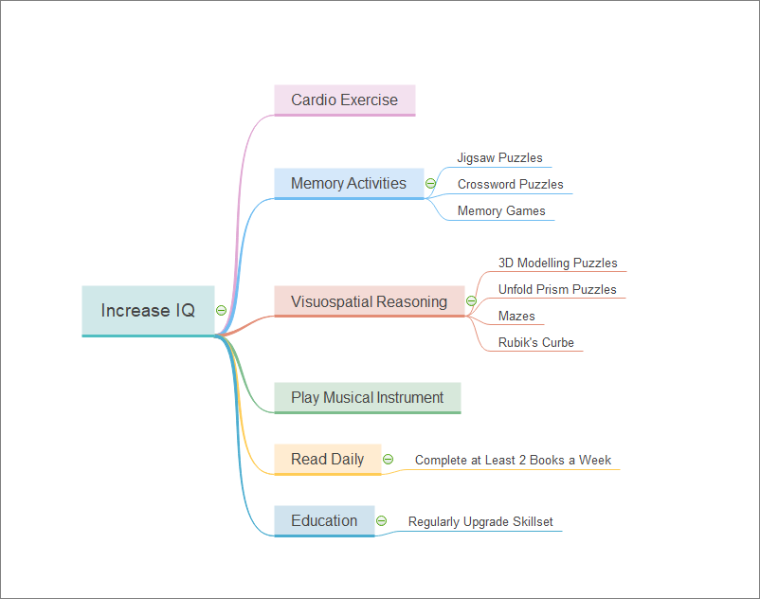
www.tuf.edu.pk
unioffaisalabad

Slide 8
Emotional Intelligence
www.tuf.edu.pk
unioffaisalabad
The ability to understand, use, and manage your own emotions in positive ways to relieve stress, communicate effectively, empathize with others, overcome challenges and defuse conflict
The ability to manage both your own emotions and understand the emotions of people around you.
There are five key elements to EI: self-awareness, self-regulation, decision making, empathy, and social skills.

Slide 9
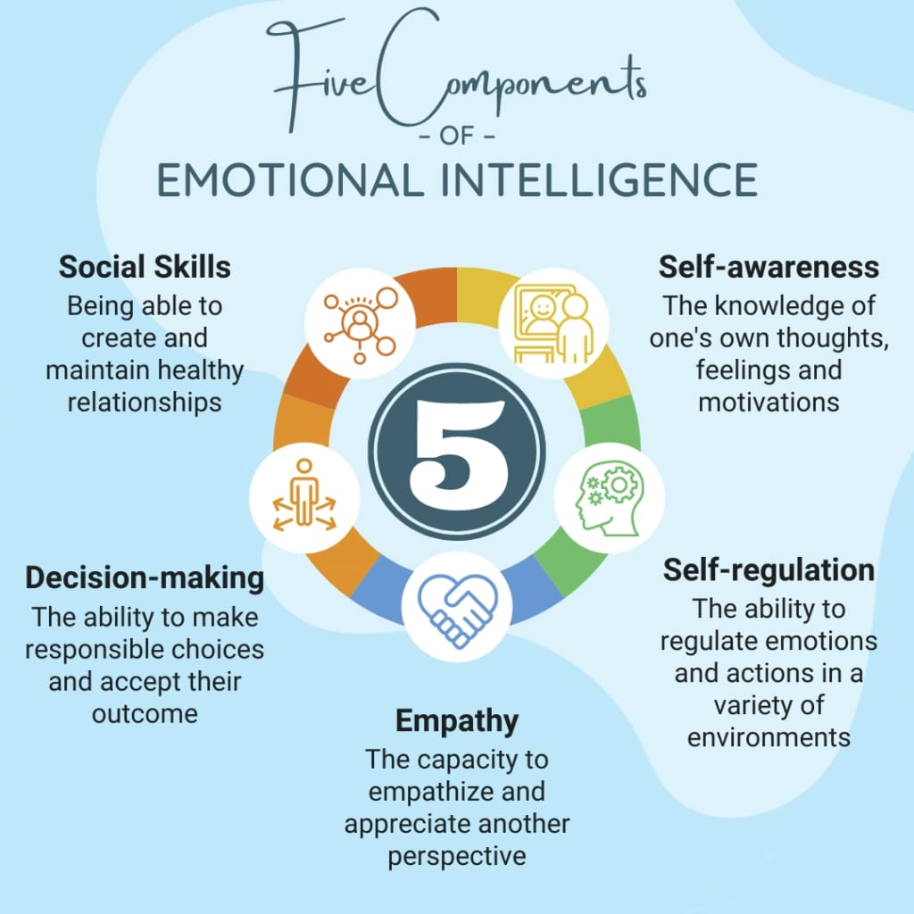
www.tuf.edu.pk
unioffaisalabad

Slide 10
How to Improve Emotional Intelligence
www.tuf.edu.pk
unioffaisalabad
Recognize your emotions and name them
Practice observing how you feel
Pay attention to how you behave
Question your own opinions
Take responsibility for your feelings
Listen
Learn to look at yourself objectively
Keep a diary
Understand what motivates you
Acknowledge your emotional triggers
Predict how you will feel
Trust your intuition
Personal goals
Take time to celebrate the positive But don’t ignore the negative
Be prepared to leave your comfort zone
Try to be approachable
Be realistic
Acknowledge what people are saying
Wear somebody else’s shoes
Ask for feedback

Slide 11
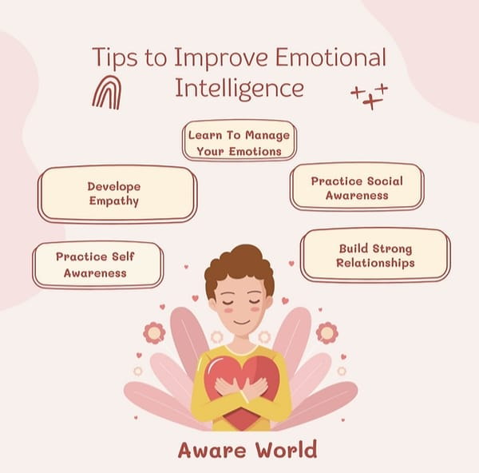
www.tuf.edu.pk
unioffaisalabad

Slide 12
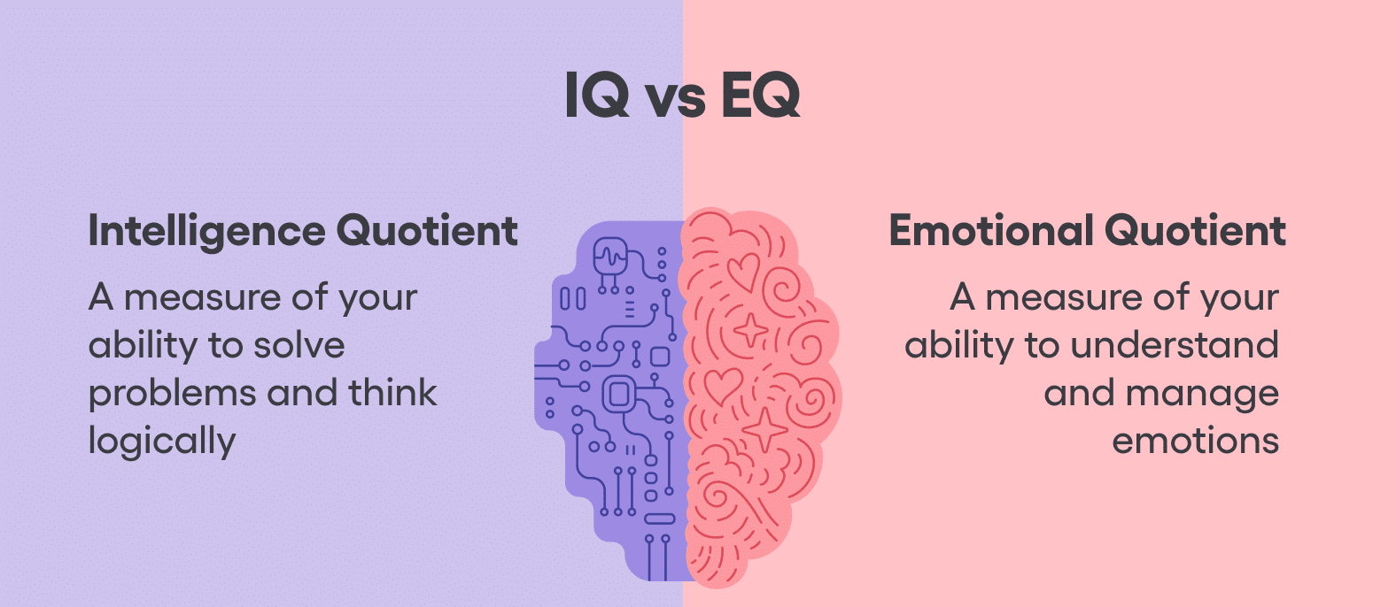
www.tuf.edu.pk
unioffaisalabad

