Slide 1
Counselling
Ms Fakiha Shoukat

Slide 2



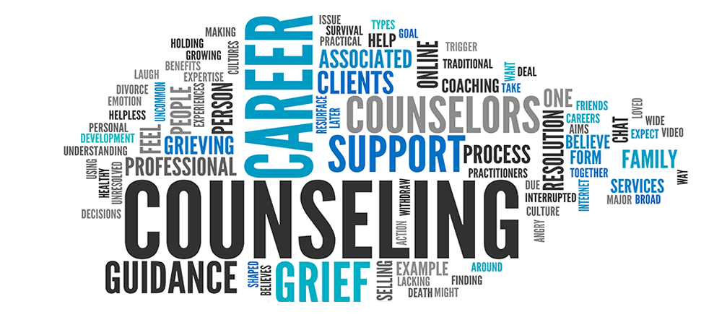
www.tuf.edu.pk
unioffaisalabad

Slide 3
Counselling
www.tuf.edu.pk
unioffaisalabad
Counselling is a talking therapy that involves a trained therapist listening to you and helping you find ways to deal with emotional issues.
Sometimes the term "counselling" is used to refer to talking therapies in general, but counselling is also a type of therapy in its own right.
Counselling is a form of 'talk therapy'.
It is a process where an individual, couple or family meet with a trained professional counsellor to talk about issues and problems that they are facing in their lives.

Slide 4
www.tuf.edu.pk
unioffaisalabad
Counseling psychologists focus on normative developmental and mental health issues and challenges faced by individuals across their lifespan, as well as systemic challenges (such as prejudice and discrimination) experienced in groups, workplaces, organizations, institutions, and communities.
Professional counselling is confidential and non-judgmental

Slide 5
Importance
www.tuf.edu.pk
unioffaisalabad
Counseling psychologists help people recognize their strengths and find resources to cope with everyday problems and adversity.
Counseling psychologists focus on interactions between people and their environment, and on educational and career development.

Slide 6
www.tuf.edu.pk
unioffaisalabad
Improved communication and interpersonal skills
Greater self-acceptance and self-esteem
Ability to change self-defeating behaviors/habits
Better expression and management of emotions, including anger
Relief from depression, anxiety or other mental health conditions
Increased confidence and decision-making skills
Ability to manage stress effectively
Improved problem-solving and conflict resolution abilities
Greater sense of self and purpose
Recognition of distorted thinking

Slide 7
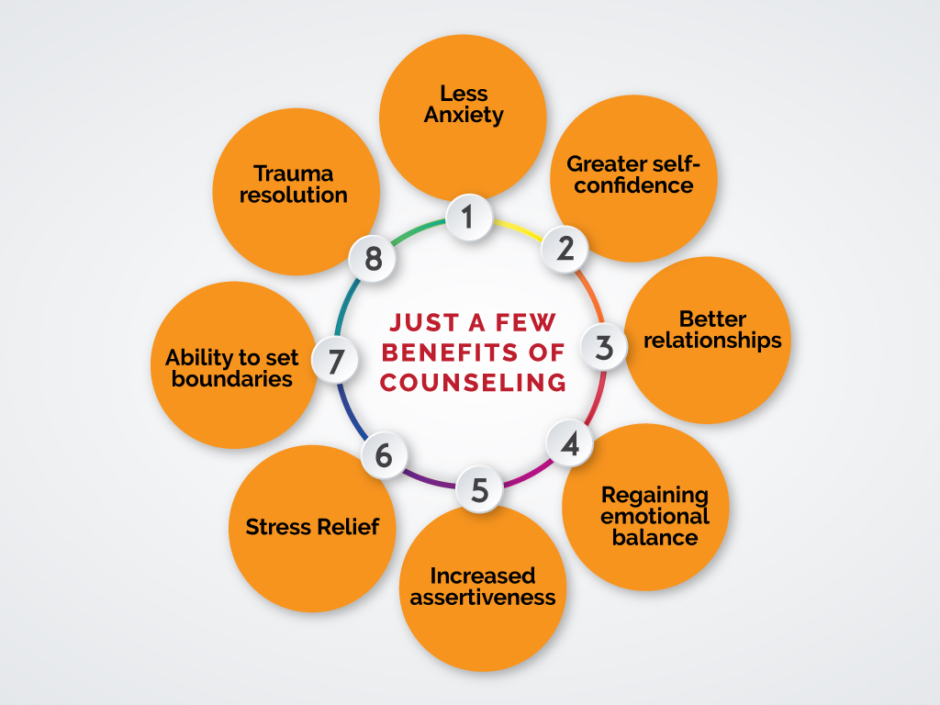
www.tuf.edu.pk
unioffaisalabad

Slide 8
Scope
www.tuf.edu.pk
unioffaisalabad
Counselling is an interactive process between the counselor and the client or counselee to help the clients’ needs. the relevance and the scope of counseling are inevitable. Each and every individual needs a positive and optimistic mind set. The major areas of counseling in
Life span Developmental
Cognitive modification
Behavior modification
Marital discord, child and family crisis
Career / Educational Counselling
Challenges Counselling

Slide 9
Stages of Counseling
www.tuf.edu.pk
unioffaisalabad
Directive counselling involves five stages. They are as follows:
Analysis
Synthesis
Diagnosis
Prognosis
Counselling

Slide 10
Stages of Counseling
www.tuf.edu.pk
unioffaisalabad
Analysis:
This involves collecting from various sources the data needed for an adequate understanding of the client.
This includes administration of psychological tests.
Synthesis:
This refers to summarizing and organizing the data so obtained, as to reveal the assets, liabilities, adjustments and maladjustments of the counselee.

Slide 11
www.tuf.edu.pk
unioffaisalabad
Diagnosis:
This stage is concerned with formulating conclusions regarding the nature and the course of the problems exhibited by the student.
Drawing conclusions from the results of psychological testing, administration of questionnaires are done here.
Prognosis:
This refers to predicting the future course of development of the counselee’s problem in the light of conclusions as made earlier.

Slide 12
www.tuf.edu.pk
unioffaisalabad
Counselling:
This is the most important and time consuming step in the whole process.
This is where the expertise of the counsellor is needed most.
It is a highly personalized teaching and learning process.
It may be direct teaching through explicit explanations, assistance in searching for relevant aptitudes and interest that illuminate the counselee’s problems and so on.
It may also involve practice sessions where with the warm support of the counsellor the counselee acts out the way he/she should.

Slide 13
Role of a Counselor
www.tuf.edu.pk
unioffaisalabad
Counsellors provide a valuable service to many different kinds of people. The responsibilities of a counsellor are largely person-facing, with a typical day involving working directly with people for most of the time. Some of the key responsibilities that a counsellor has can include:
Providing counselling services
Leading group counselling sessions
Working with families, groups and individuals
Maintaining confidential records
Listener
Empathy
Observer
Patience
Emotional control
Good communication

