Slide 1
Stress
Ms Fakiha Shoukat

Slide 2



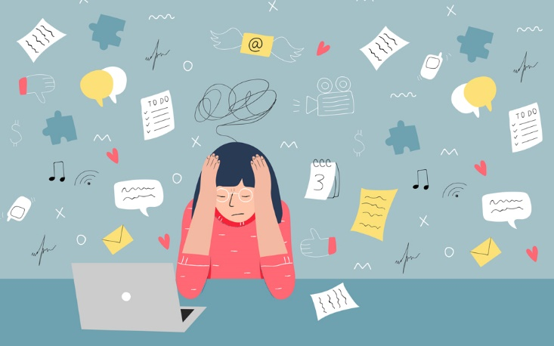
www.tuf.edu.pk
unioffaisalabad

Slide 3
www.tuf.edu.pk
unioffaisalabad
Stress can be defined as a state of worry or mental tension caused by a difficult situation.
Stress is a natural human response that prompts us to address challenges and threats in our lives.
Stress is how we react when we feel under pressure or threatened.
It usually happens when we are in a situation that we don't feel we can manage or control.
When we experience stress, it can be as: An individual, for example when you have lots of responsibilities that you are struggling to manage.

Slide 4
Symptoms
www.tuf.edu.pk
unioffaisalabad
Difficulty breathing.
Panic attacks.
Blurred eyesight or sore eyes.
Sleep problems.
Fatigue.
Muscle aches and headaches.
Chest pains and high blood pressure.
Indigestion or heartburn.

Slide 5
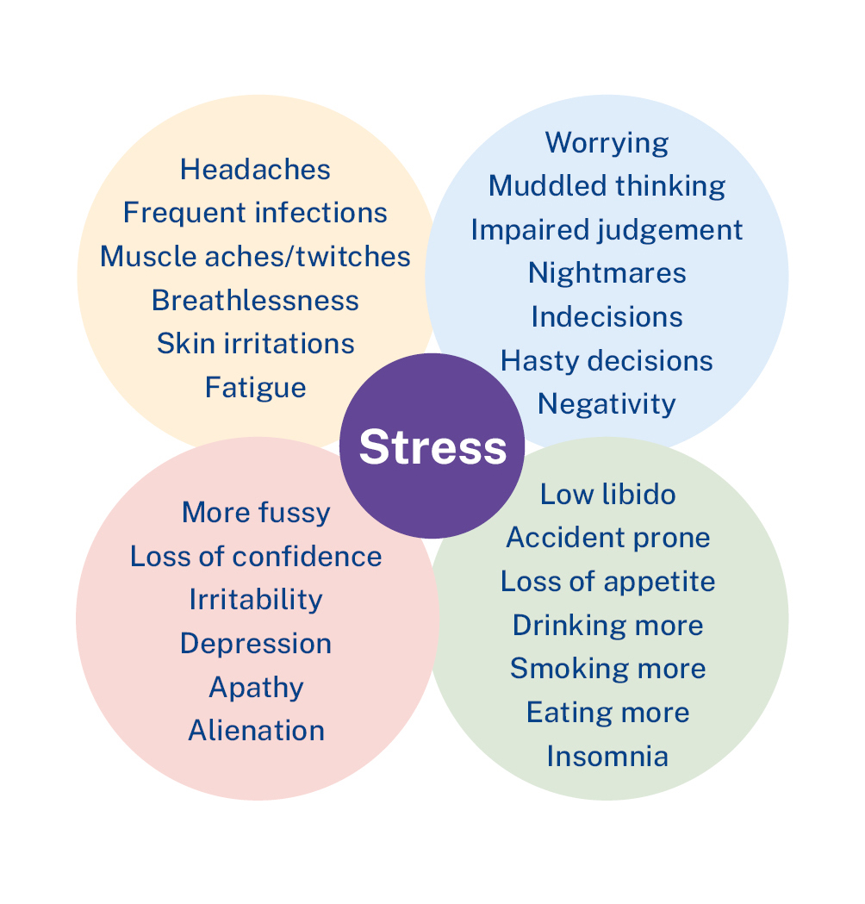
www.tuf.edu.pk
unioffaisalabad

Slide 6
Types
www.tuf.edu.pk
unioffaisalabad
Acute stress: Acute stress results from your body’s reaction to a new or challenging situation. Acute stress is classified as short-term. Usually, emotions and the body return to their normal state relatively soon.
Episodic acute stress: Episodic acute stress is when acute stresses happen on a frequent basis. This can be because of repeatedly tight work deadlines
Chronic stress: Chronic stress is the result of stressors that continue for a long period of time. This type of stress feels never-ending. We often have difficulty seeing any way to improve or change the situation that is the cause of our chronic stress.

Slide 7
Causes
www.tuf.edu.pk
unioffaisalabad
Feel under lots of pressure.
Face big changes in your life.
Are worried about something.
Don't have much or any control over the outcome of a situation.
Have responsibilities that you find overwhelming.
Don't have enough work, activities or change in your life.
Experience discrimination, hate or abuse.

Slide 8
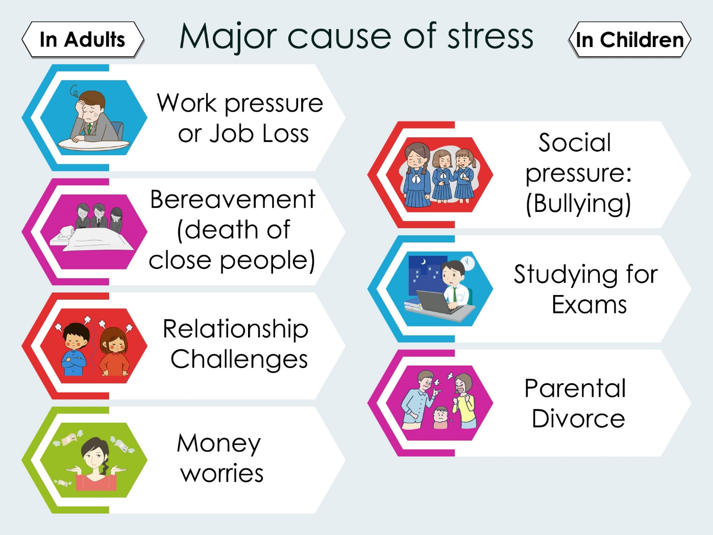
www.tuf.edu.pk
unioffaisalabad

Slide 9
Stress Management
www.tuf.edu.pk
unioffaisalabad
Exercise
Utilize mindfulness
Try therapy and coaching
Time management
Spend time in nature
Eat healthily
Spend time with friends and family

Slide 10
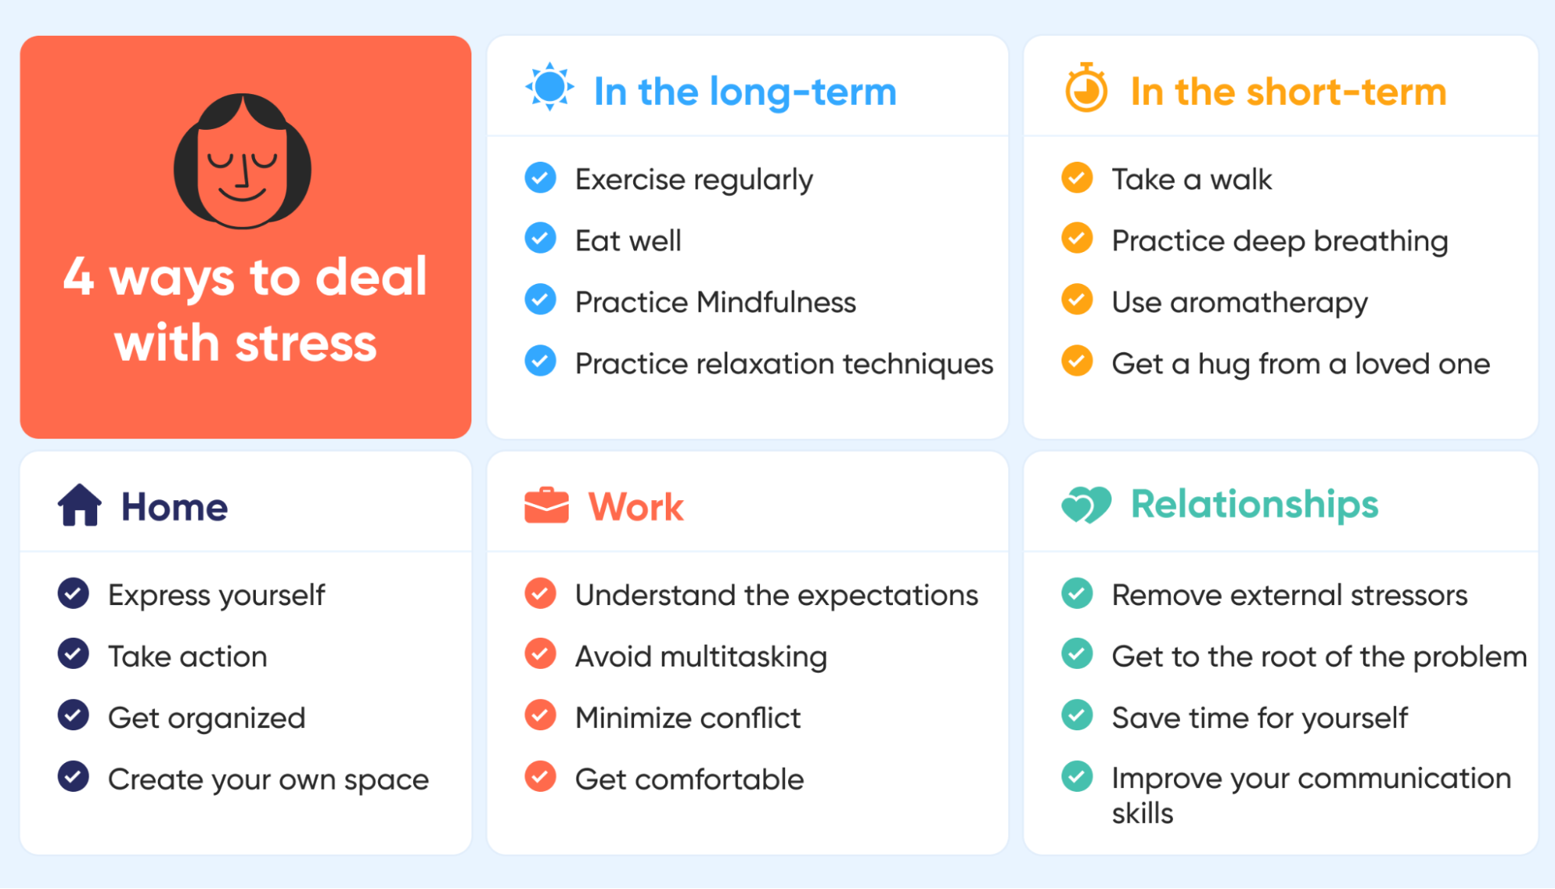
www.tuf.edu.pk
unioffaisalabad

Slide 11
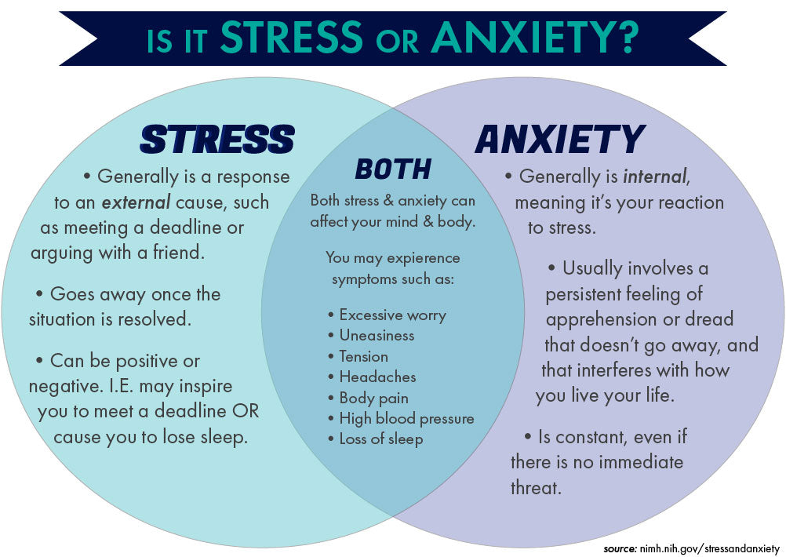
www.tuf.edu.pk
unioffaisalabad

Slide 12
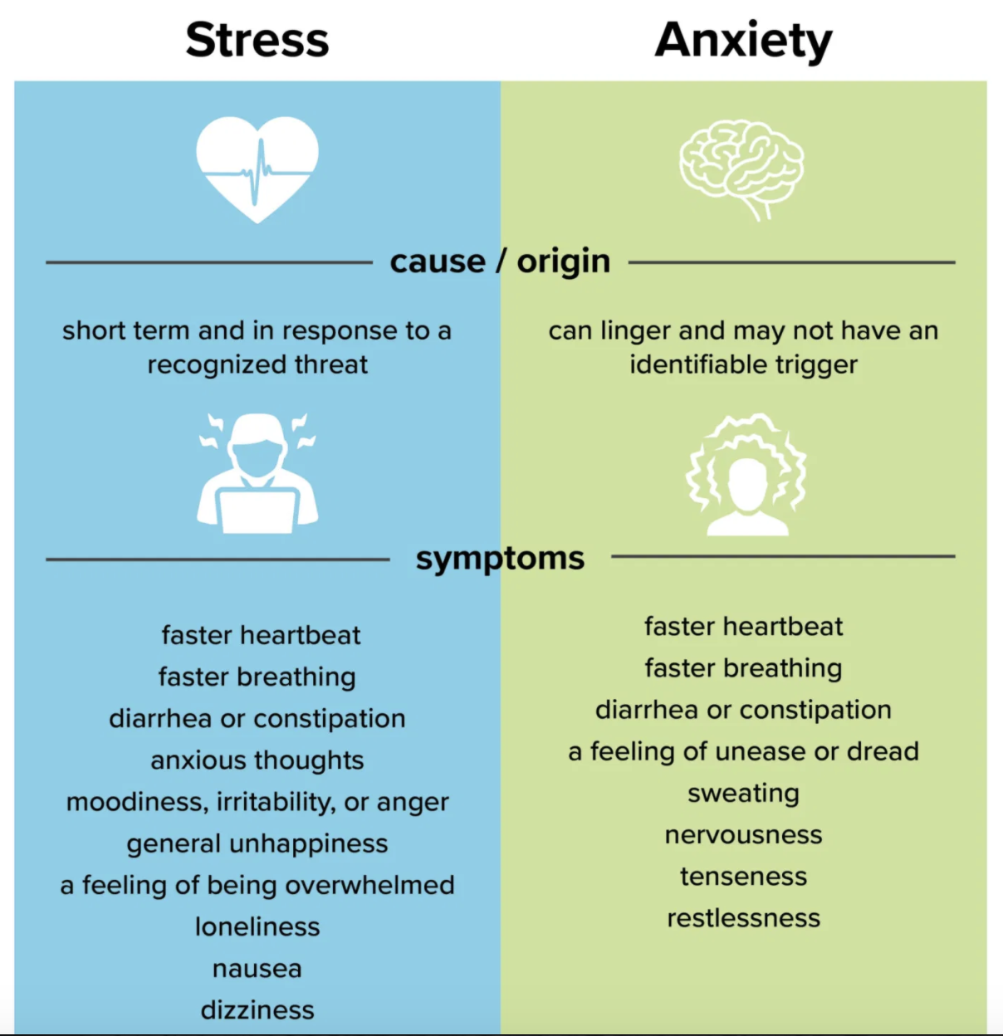
www.tuf.edu.pk
unioffaisalabad

