Slide 1
Defence Mechanism
Ms Fakiha Shoukat

Slide 2



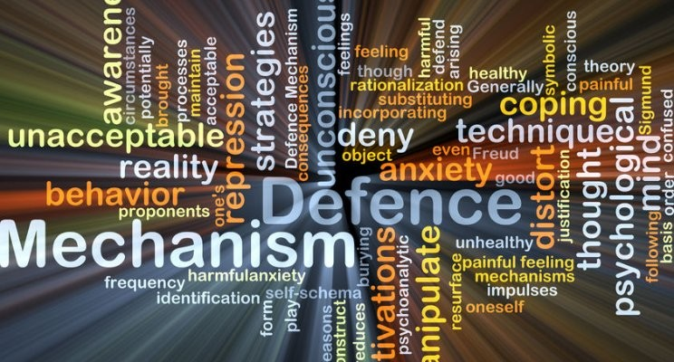
www.tuf.edu.pk
unioffaisalabad

Slide 3
www.tuf.edu.pk
unioffaisalabad
Defense mechanisms are psychological strategies that are unconsciously used to protect a person from anxiety arising from unacceptable thoughts or feelings.
Defense mechanisms operate at an unconscious level and help ward off unpleasant feelings or make good things feel better for the individual.

Slide 4
www.tuf.edu.pk
unioffaisalabad
The idea of defense mechanisms comes from psychoanalytic theory, a psychological perspective of personality that sees personality as the interaction between three components: id, ego, and super-ego.
These psychological strategies may help people put distance between themselves and threats or unwanted feelings, such as guilt or shame.

Slide 5
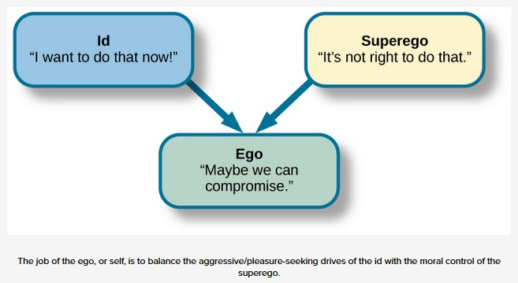
Psychoanalytic Theory
www.tuf.edu.pk
unioffaisalabad
The id is the inherited part of the personality, basic need
Ego is responsible for self and how we react to event / condition
Superego is governed by morals and societal compasses.

Slide 6
Defense Mechanisms
www.tuf.edu.pk
unioffaisalabad
Denial
Repression
Projection
Displacement
Regression
Rationalization
Sublimation
Reaction formation
Compartmentalization
Intellectualization

Slide 7
www.tuf.edu.pk
unioffaisalabad
Denial
Denial of the existence of specific feelings, thoughts, or even perceptions.
Acknowledge certain facts about a particular situation.
After the unexpected death of a loved one, a person might refuse to accept the reality of the death and deny that anything has happened.
Repression
When individual experience or think things that may be threatening, they may choose to repress them instead.
Subconsciously blocking ideas or impulses that are undesirable.
A child, who faced abuse by a parent, later has no memory of the events but has trouble forming relationships.

Slide 8
www.tuf.edu.pk
unioffaisalabad
Projection
Unwanted feelings are displaced onto another person, where they then appear as a threat from the external world.
Some thoughts or feelings you have about another person may make you uncomfortable.
A parent may project unfulfilled ambitions onto their child.
Displacement
Transferring one's emotional burden or emotional reaction from one entity to another.
You direct strong emotions and frustrations toward a person or object that doesn’t feel threatening.
A person angry at their boss may “take out” their anger on a family member.

Slide 9
www.tuf.edu.pk
unioffaisalabad
Regression
Individuals cope with stressors by acting in a childish, immature, or age-inappropriate manner.
Regression may be seen at any stage of development in both adults and children when someone is not behaves in a appropriate way.
When individual doesn’t take responsibilities and behave immaturely.
Rationalization
Reaction someone might have after they make a decision, have a thought, or engage in a specific behavior.
When a person finds a situation difficult to accept, they will make up a logical reason why it has happened.
Someone who didn’t get a promotion at work might say they didn’t want the promotion anyways.

Slide 10
www.tuf.edu.pk
unioffaisalabad
Sublimation
Redirects energy from an unacceptable impulse or emotion into a more socially acceptable one.
It's seen as a mature form of behavior and is used to cope with difficult situations.
Someone with anger issues may channel their aggressive urges into sports instead of lashing out at others physically or verbally.
Reaction formation
Person unconsciously replaces an unwanted or anxiety-provoking impulse with its opposite, often expressed in an exaggerated or showy way.
Recognize how they feel, but they choose to behave in the opposite manner of their instincts.
Acting like you hate someone but actually you don’t.

Slide 11
www.tuf.edu.pk
unioffaisalabad
Compartmentalization
Avoid the anxiety that arises from the clash of contradictory values or emotions.
Thoughts and feelings that seem to conflict are kept separated or isolated from each other in the mind.
While you recognize that you are dealing with heavy emotions, you still manage to show up every day and perform well at work
Intellectualization
A person using reason and logic to avoid uncomfortable or anxiety-provoking emotions.
Intellectualization can be a useful way of explaining and understanding negative events.
If individual is rude to you, you may think about possible reasons for such behavior.

