Slide 1
Abnormal Psychology
Ms Fakiha Shoukat

Slide 2



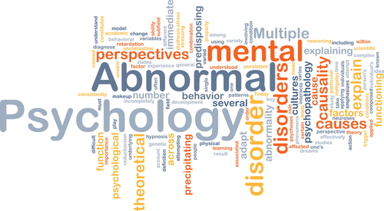
www.tuf.edu.pk
unioffaisalabad

Slide 3
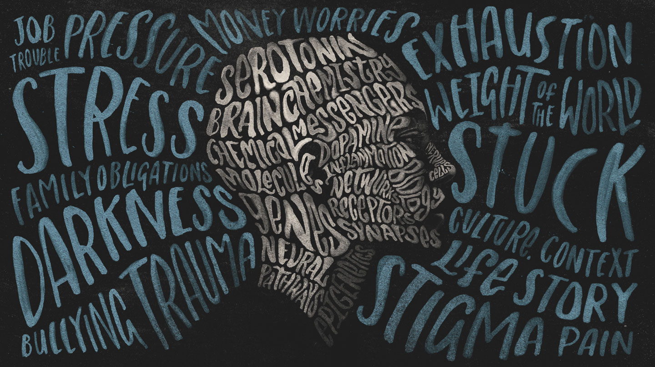
www.tuf.edu.pk
unioffaisalabad

Slide 4
Depression
www.tuf.edu.pk
unioffaisalabad
Depression is a common and serious medical illness that negatively affects how you feel, the way you think and how you act.
It involves a depressed mood or loss of pleasure or interest in activities for long periods of time.
Depression is different from regular mood changes and feelings about everyday life.
Depression causes feelings of sadness or a loss of interest in activities you once enjoyed.
Depression affects how you feel, think, and behave and can interfere with your ability to function and carry on with daily life.

Slide 5
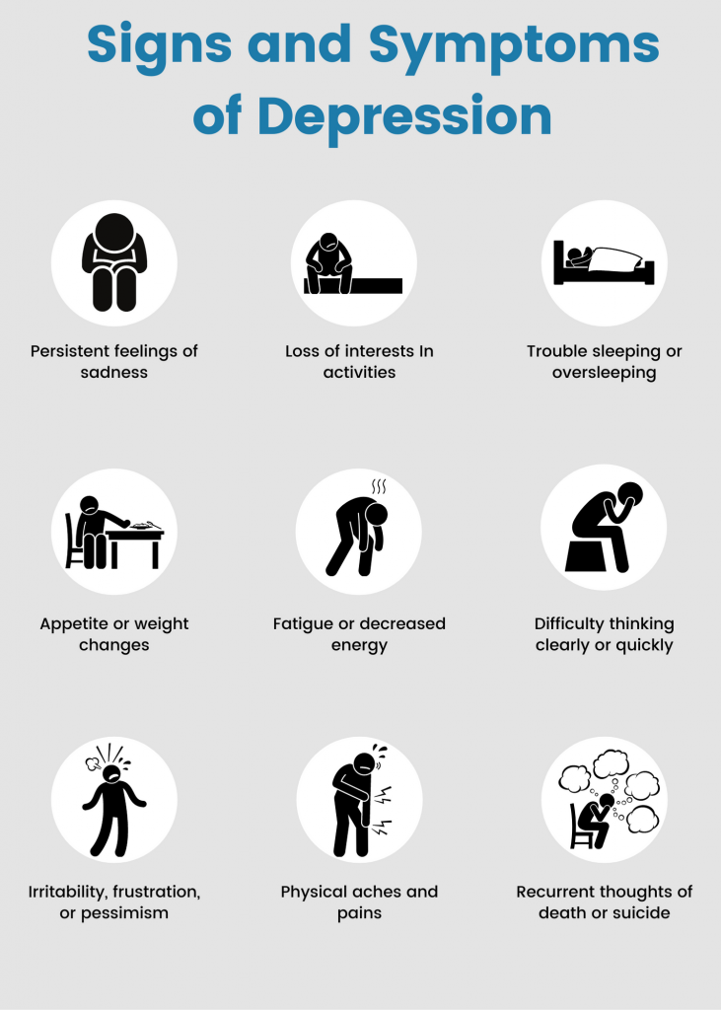
www.tuf.edu.pk
unioffaisalabad

Slide 6
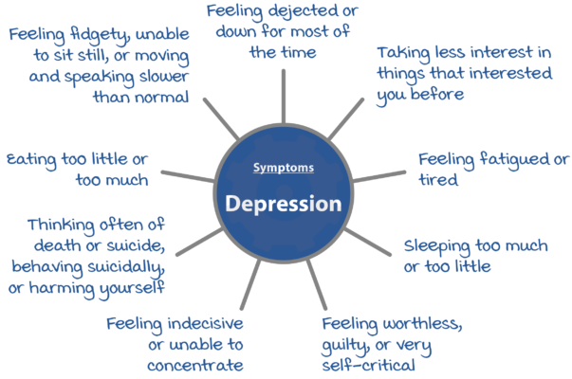
www.tuf.edu.pk
unioffaisalabad

Slide 7
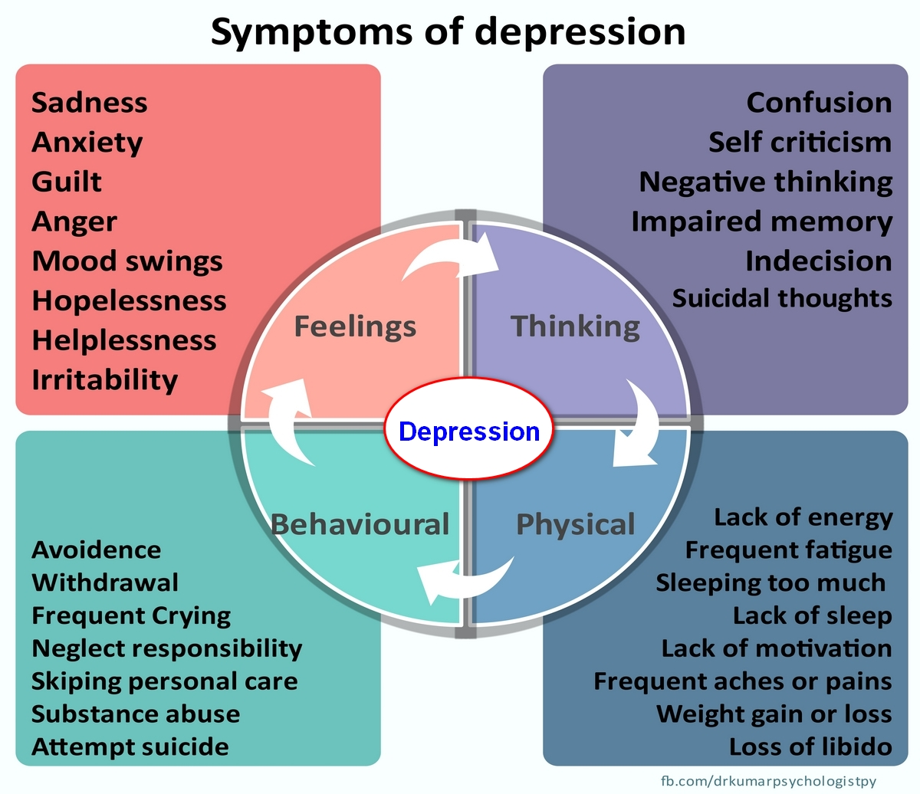
www.tuf.edu.pk
unioffaisalabad

Slide 8
Causes
www.tuf.edu.pk
unioffaisalabad
Family history.
Depression can run in families and some people will be at an increased genetic risk.
Personality.
Some people may be more at risk of depression because of their personality.
Serious medical illness.
Drug and alcohol use.
Life events.
Changes in the brain.

Slide 9
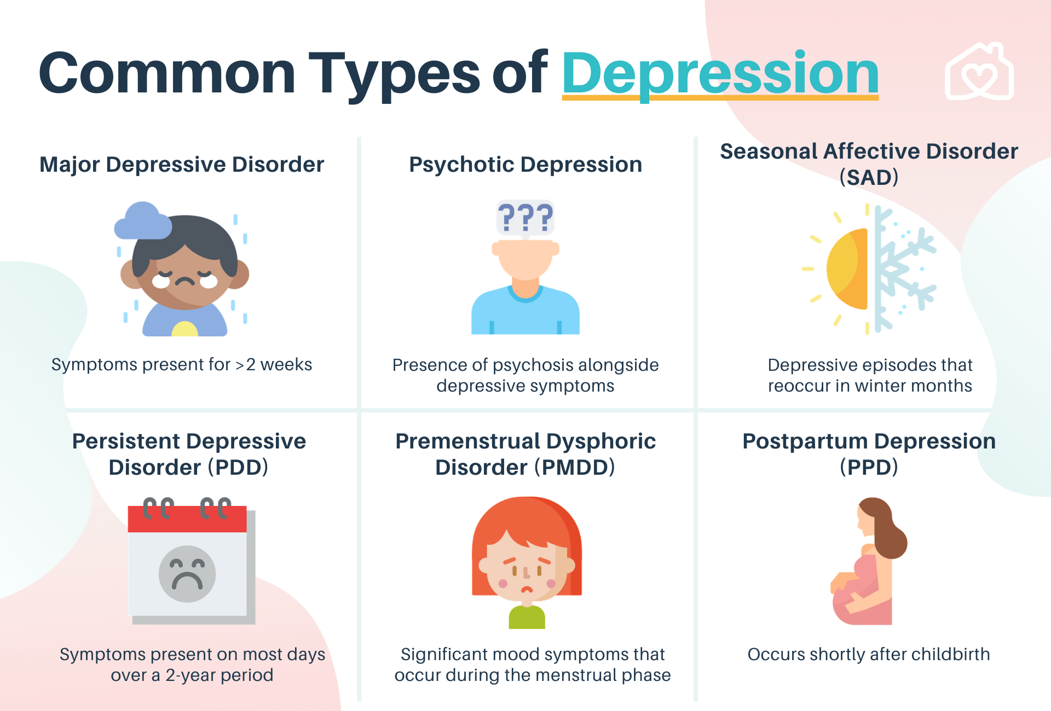
www.tuf.edu.pk
unioffaisalabad

Slide 10
Management Skills
www.tuf.edu.pk
unioffaisalabad
Express Yourself in Writing
Boost Your Self-Image
Stick to a Schedule
Sleep Well
Challenge your thinking
Set realistic goals
Make face-time a priority

Slide 11
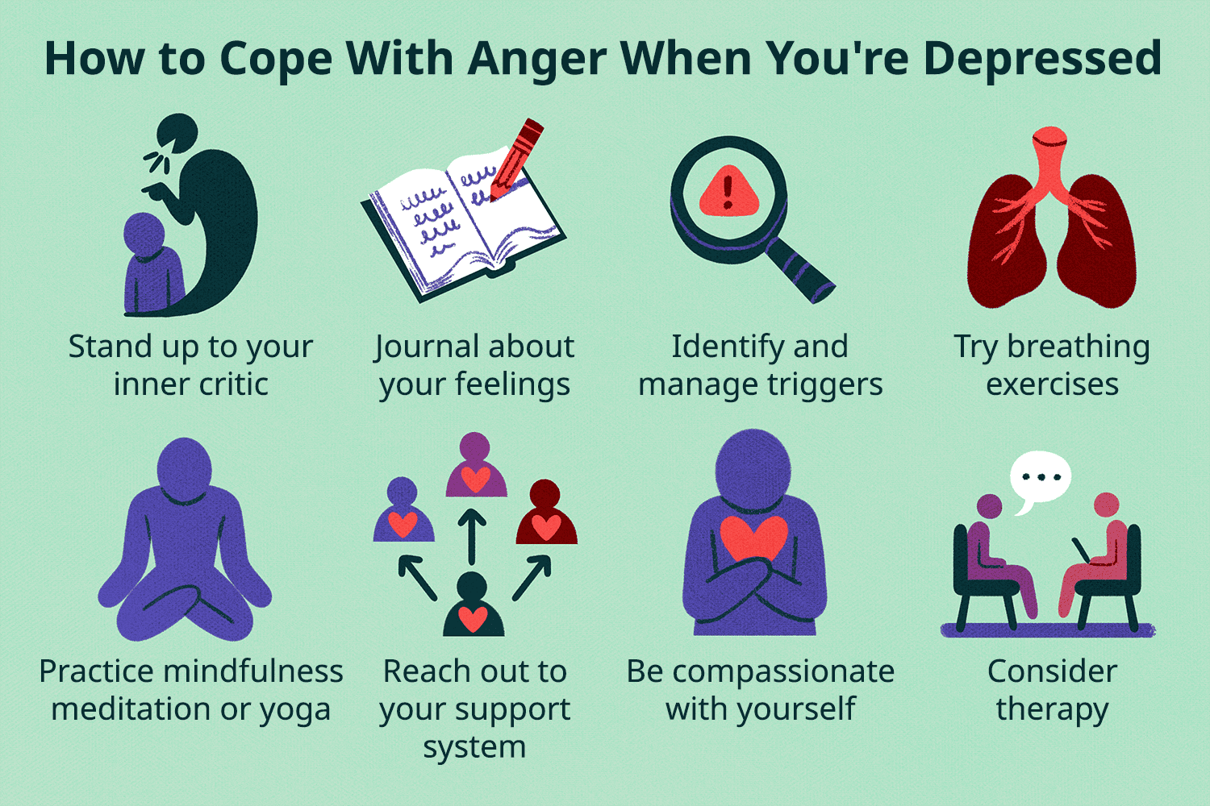
www.tuf.edu.pk
unioffaisalabad

Slide 12
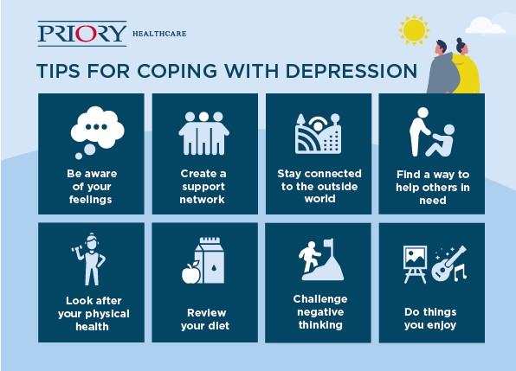
www.tuf.edu.pk
unioffaisalabad

Slide 13
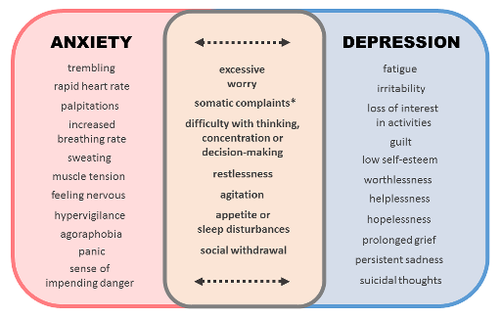
www.tuf.edu.pk
unioffaisalabad

Slide 14
Schizophrenia
www.tuf.edu.pk
unioffaisalabad
Schizophrenia is a serious mental illness that affects how a person thinks, feels, and behaves.
People with schizophrenia may seem like they have lost touch with reality, which can be distressing for them and for their family and friends.
Symptoms can include delusions, hallucinations, disorganized speech, trouble with thinking and lack of motivation.

Slide 15
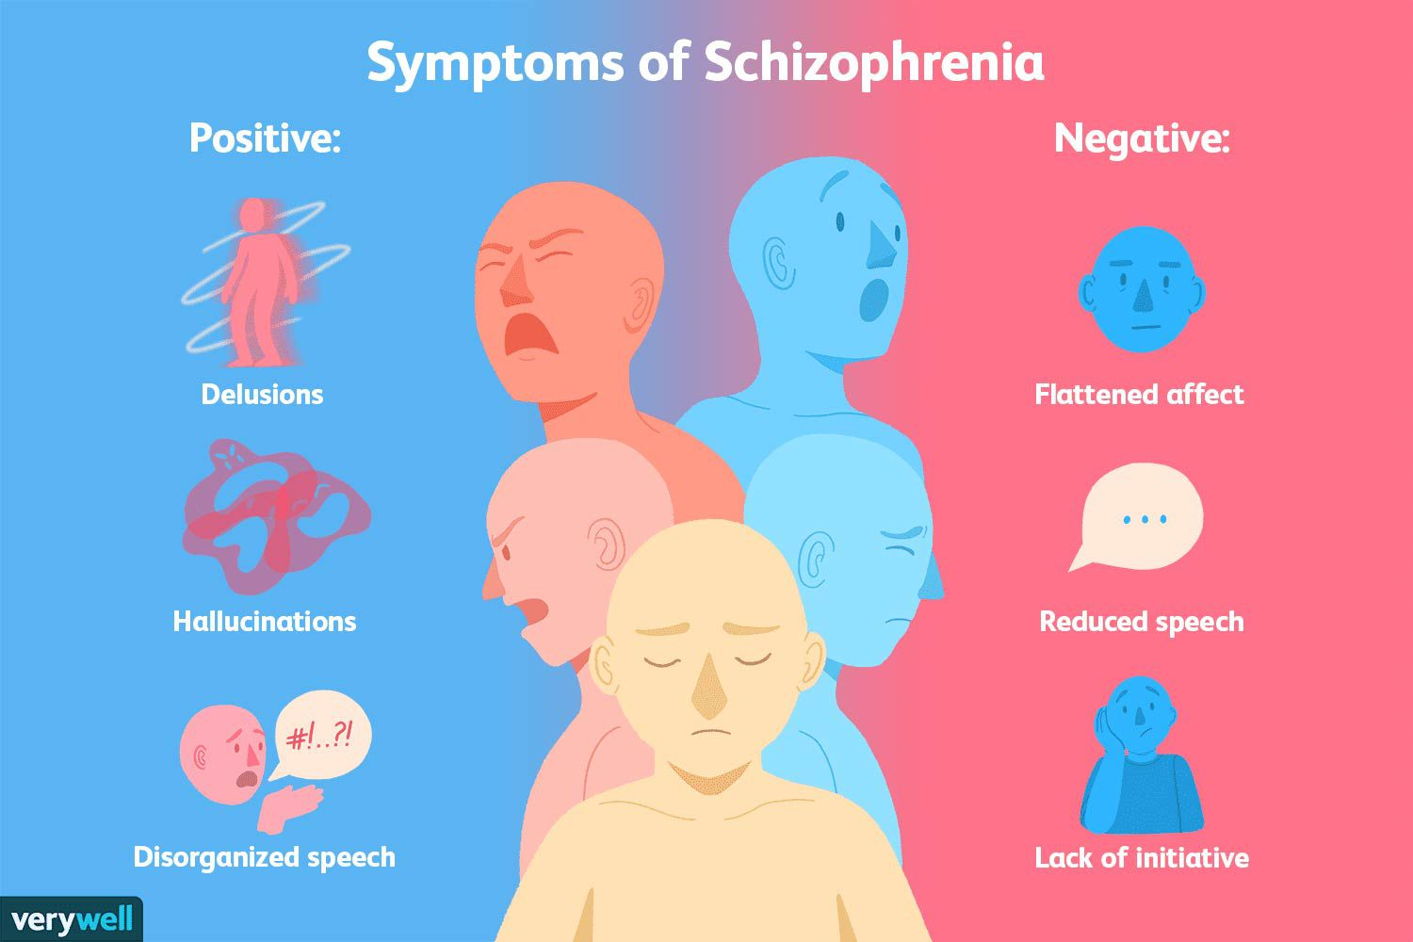
www.tuf.edu.pk
unioffaisalabad

Slide 16
Childhood Disorders
www.tuf.edu.pk
unioffaisalabad
Autism Spectrum Disorder
Intellectual Disability
ADHD
Specific Learning Disability

Slide 17
Autism Spectrum Disorder
www.tuf.edu.pk
unioffaisalabad
Autism spectrum disorder (ASD) is a developmental disability caused by differences in the brain.
People with ASD often have problems with social communication and interaction, and restricted or repetitive behaviors or interests.
People with ASD may also have different ways of learning, moving, or paying attention.

Slide 18
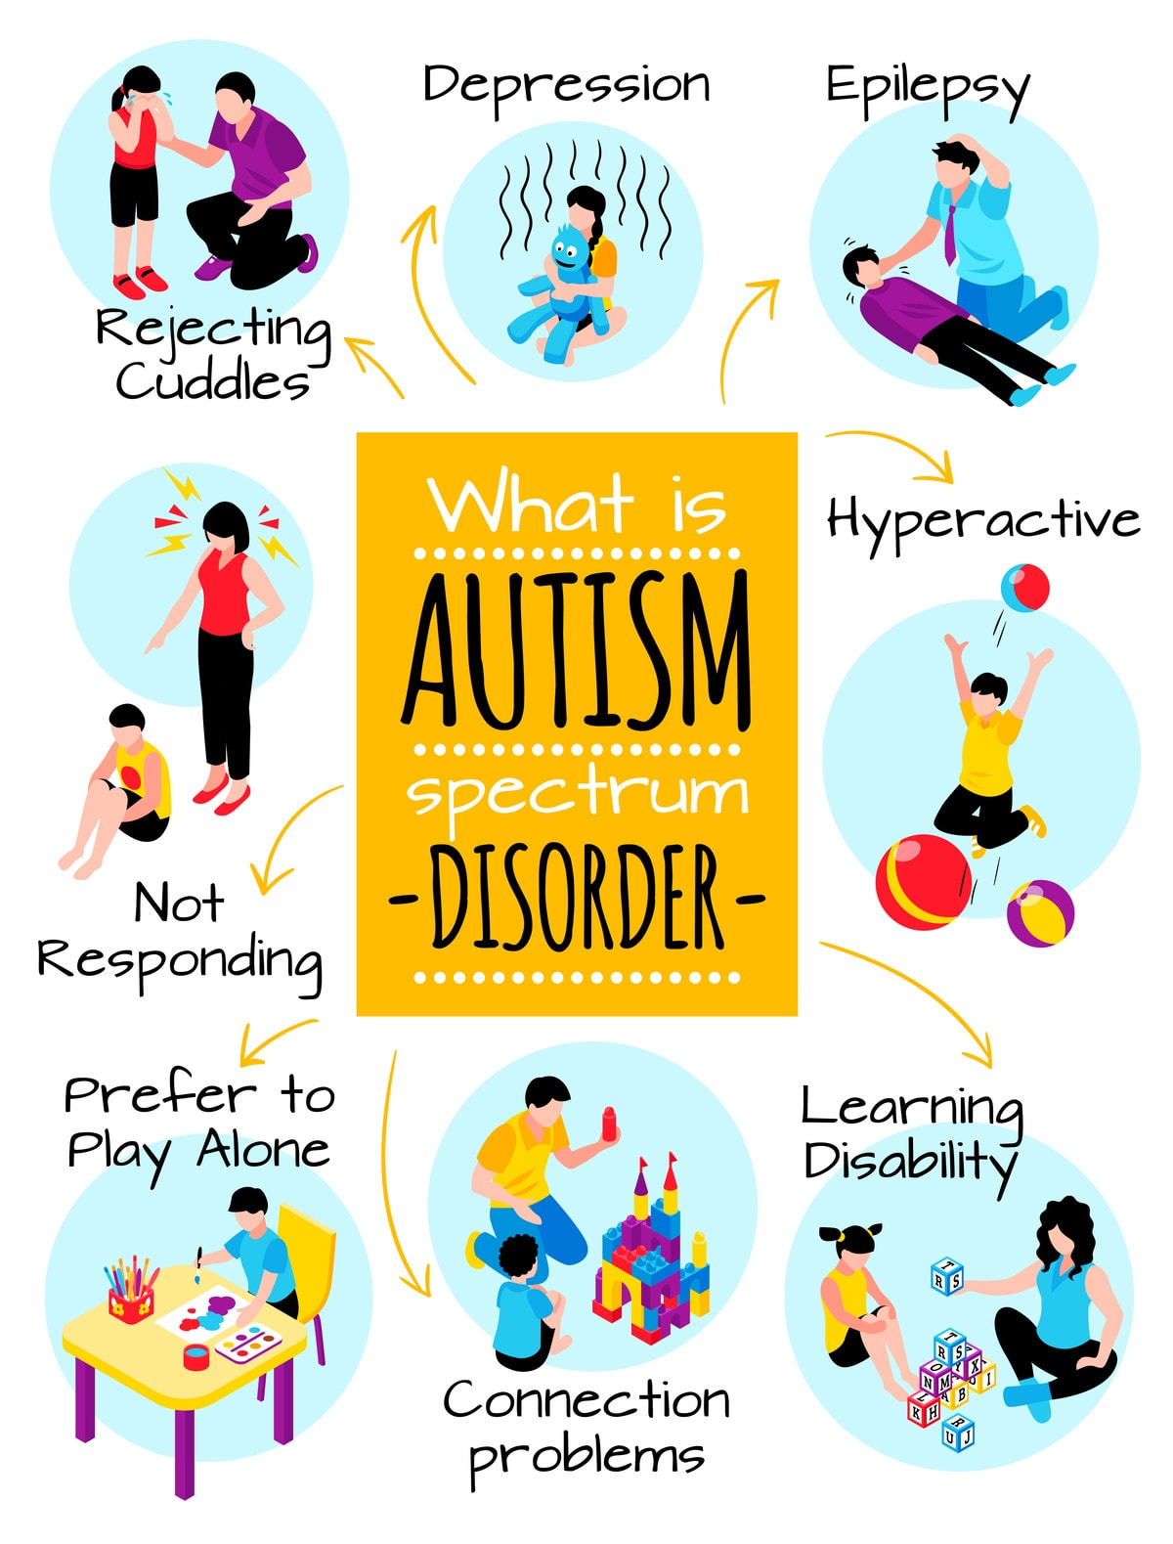
www.tuf.edu.pk
unioffaisalabad

Slide 19
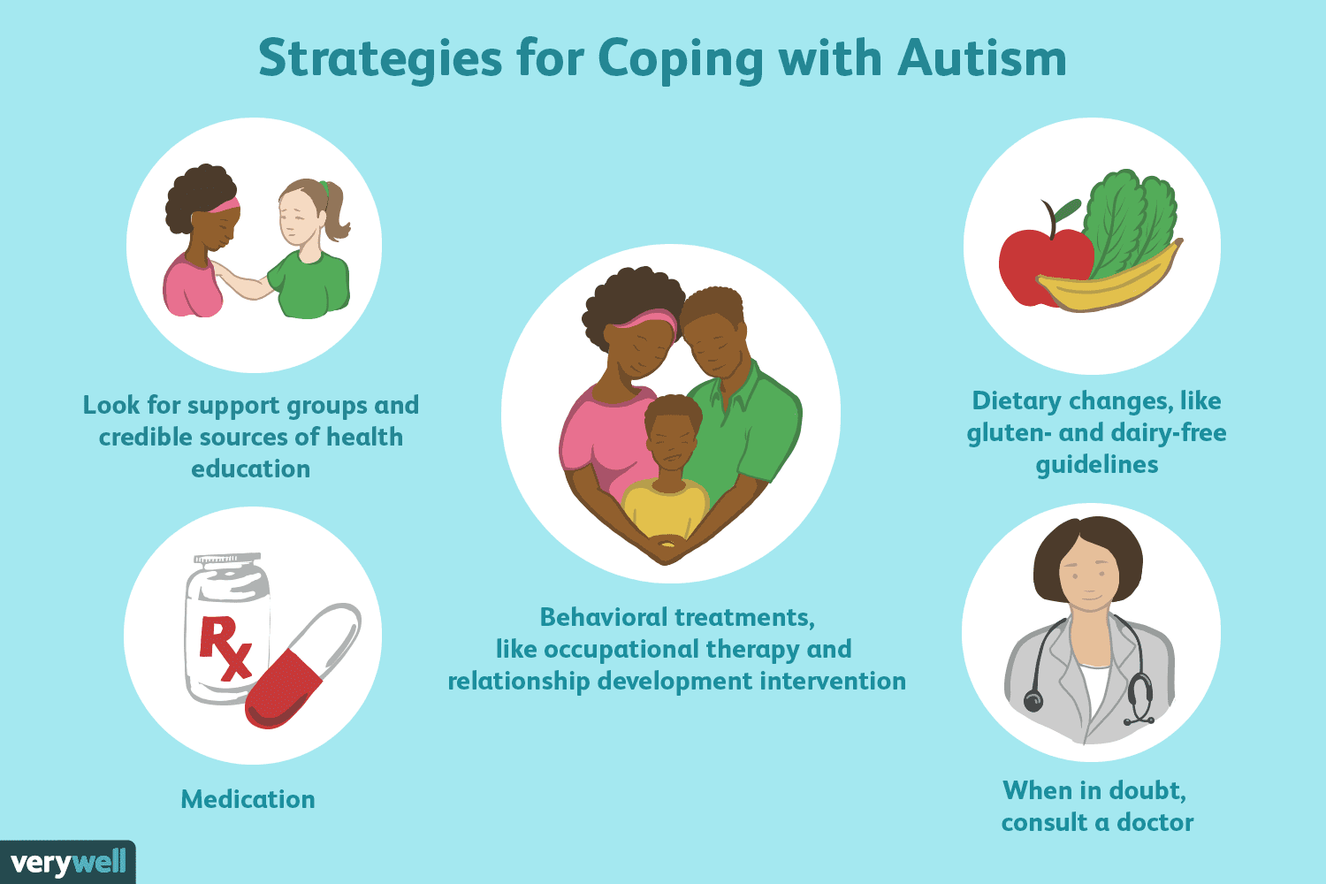
www.tuf.edu.pk
unioffaisalabad

Slide 20
Intellectual Disability
www.tuf.edu.pk
unioffaisalabad
Intellectual disability is a term used when there are limits to a person's ability to learn at an expected level and function in daily life.
Levels of intellectual disability vary greatly in children.
Intellectual disability can be caused by a problem that starts any time before a child turns 18 years old even before birth.
It can be caused by injury, disease, or a problem in the brain.
For many children, the cause of their intellectual disability is not known.

Slide 21
www.tuf.edu.pk
unioffaisalabad
There are many signs of intellectual disability. For example, children with intellectual disability may:
Sit up, crawl, or walk later than other children
Learn to talk later, or have trouble speaking
Find it hard to remember things
Have trouble understanding social rules
Have trouble seeing the results of their actions
Have trouble solving problems

Slide 22
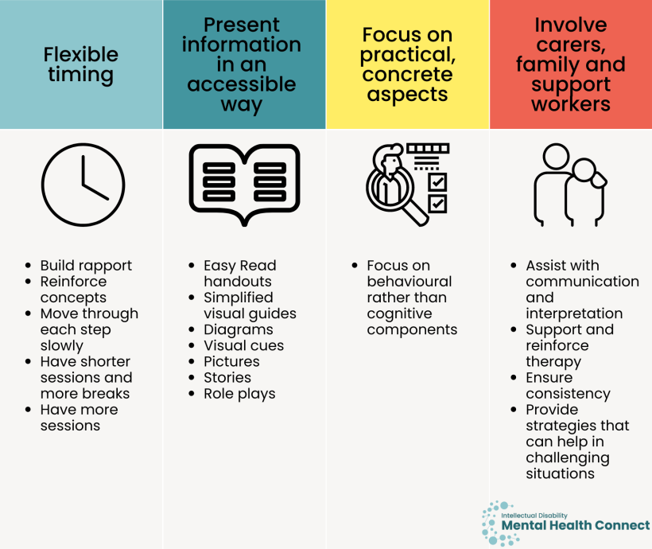
www.tuf.edu.pk
unioffaisalabad

Slide 23
ADHD
www.tuf.edu.pk
unioffaisalabad
Attention deficit hyperactivity disorder (ADHD) is one of the most common neurodevelopmental disorders of childhood.
It is usually first diagnosed in childhood and often lasts into adulthood.
Children with ADHD may have trouble paying attention, controlling impulsive behaviors (may act without thinking about what the result will be), or be overly active.

Slide 24
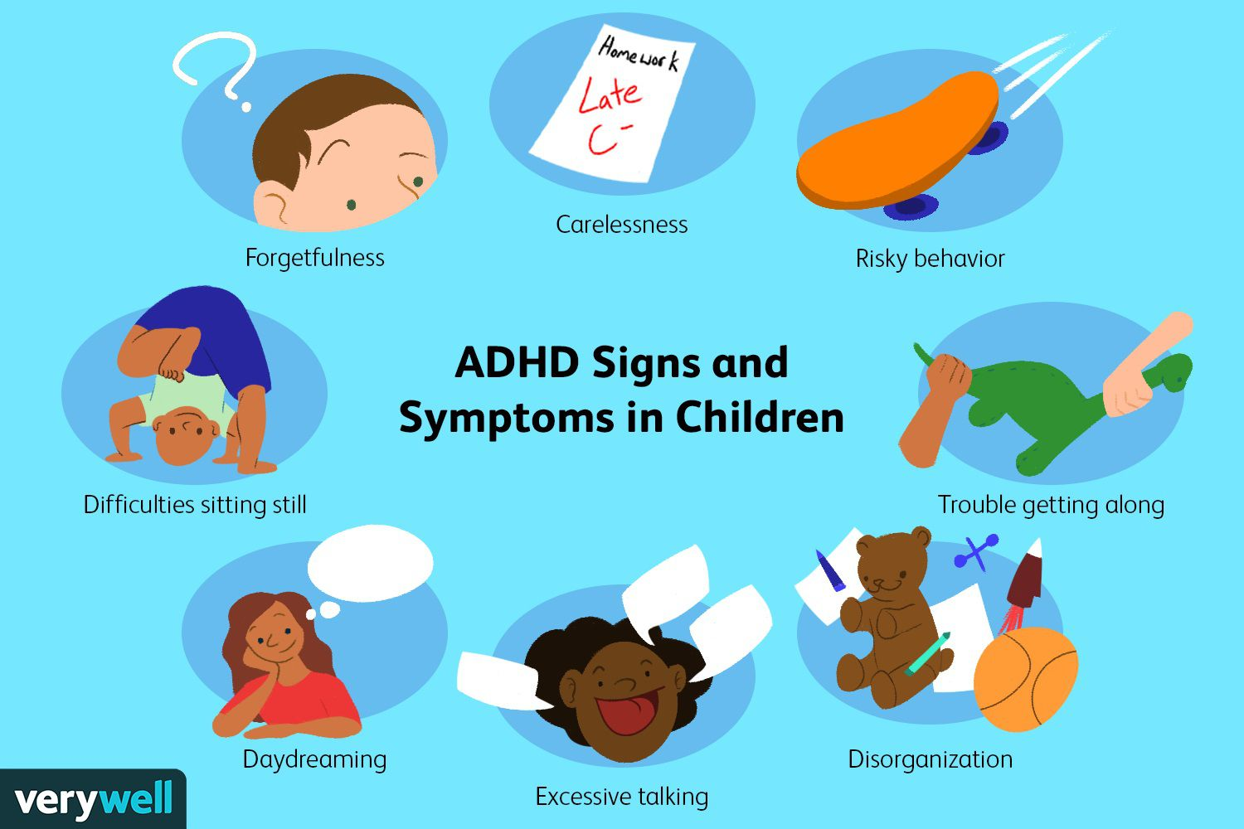
www.tuf.edu.pk
unioffaisalabad

Slide 25
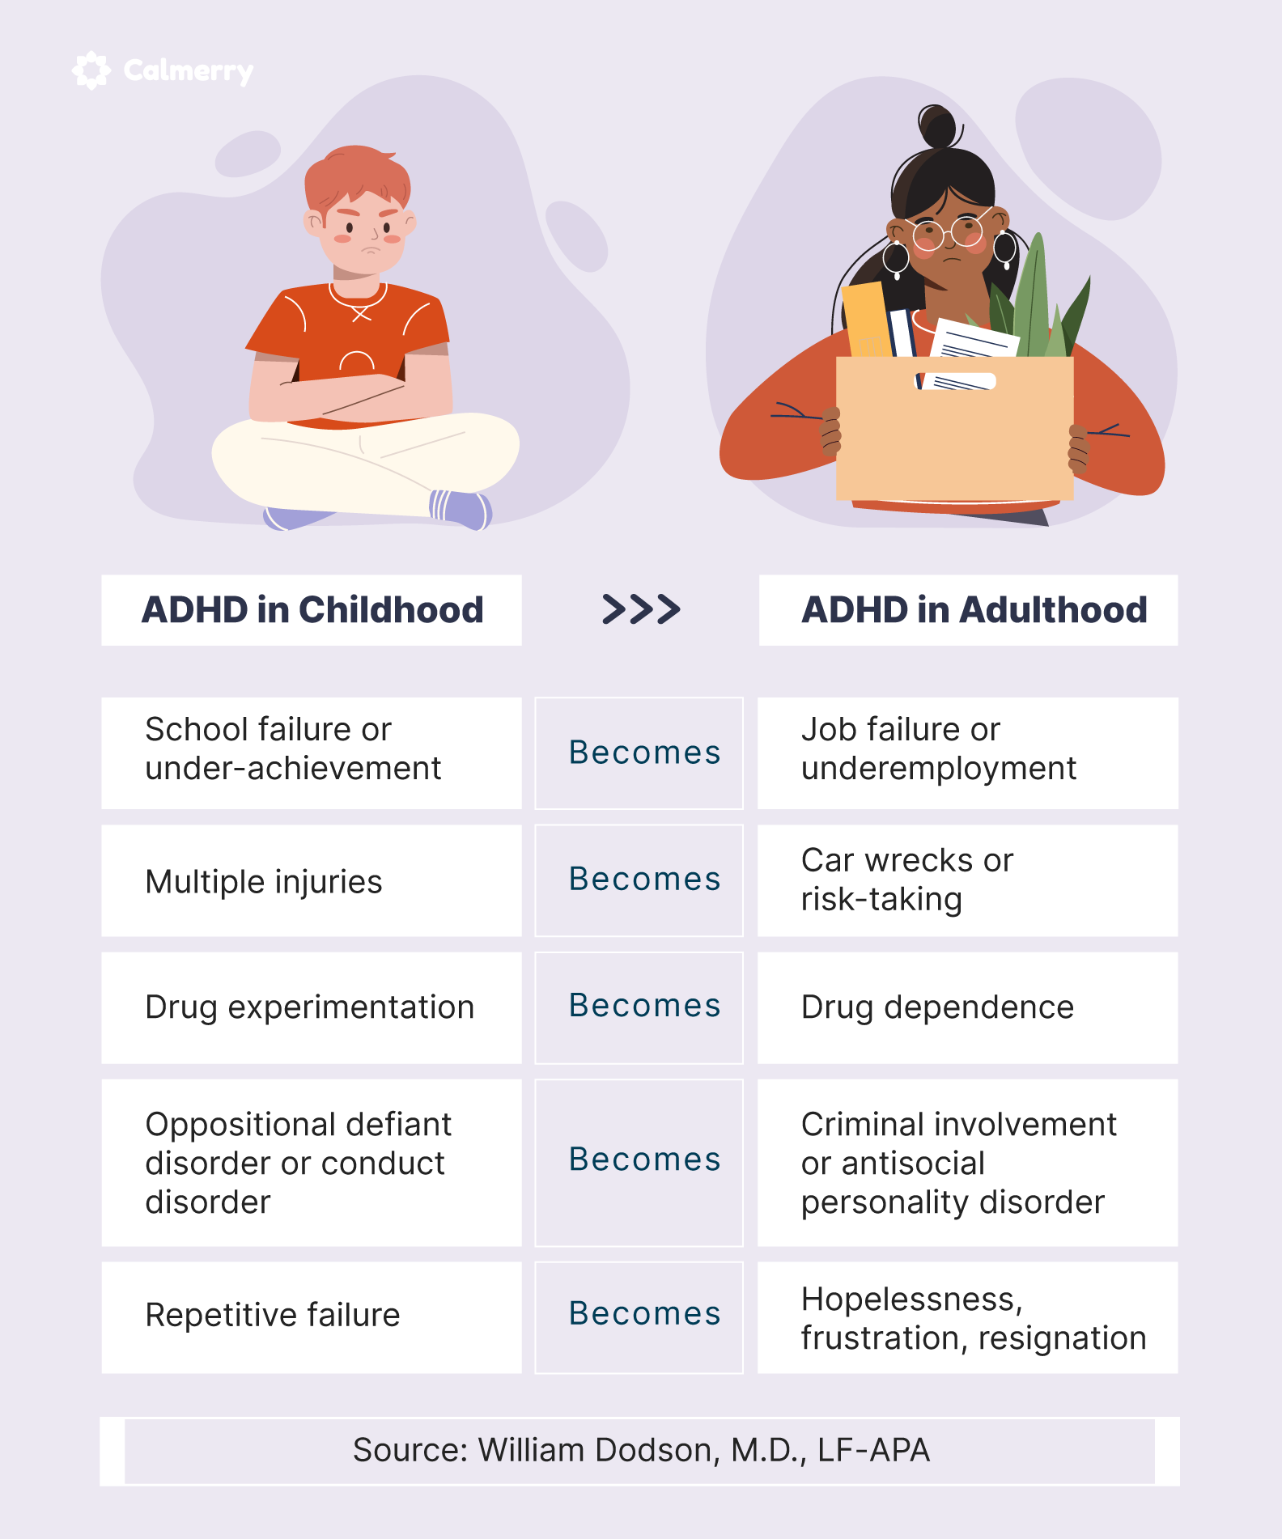
www.tuf.edu.pk
unioffaisalabad

Slide 26
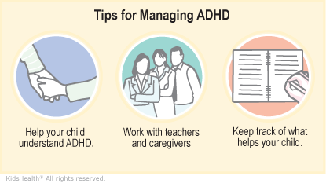
www.tuf.edu.pk
unioffaisalabad

Slide 27
Specific Learning Disabilities
www.tuf.edu.pk
unioffaisalabad
Specific Learning Disabilities refer to a group of specific lifelong cognitive impairments identified through the unexpected underachievement in a range of learning processes involving the skills of listening, speaking, spelling, written expression, mathematics, understanding, or reading including decoding and comprehension.

Slide 28
www.tuf.edu.pk
unioffaisalabad
Common signs that a person may have learning disabilities include the following:
Problems reading and/or writing.
Problems with math.
Poor memory.
Problems paying attention.
Trouble following directions.
Trouble telling time.
Problems staying organized.

