Slide 1
Therapy
Ms Fakiha Shoukat

Slide 2



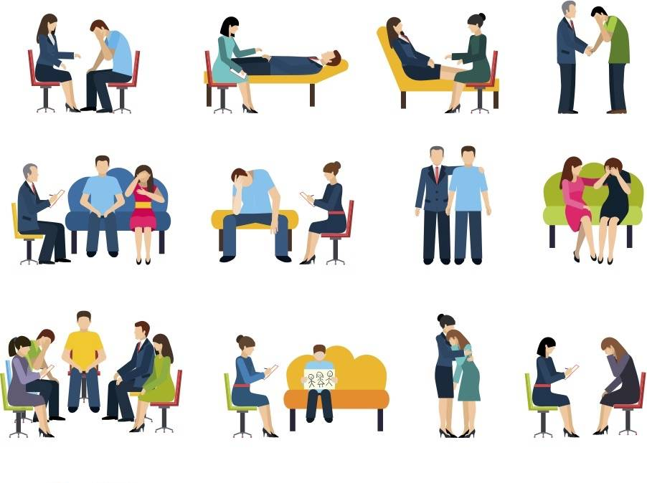
www.tuf.edu.pk
unioffaisalabad

Slide 3
Cognitive Behavioral Therapy (CBT)
www.tuf.edu.pk
unioffaisalabad
Cognitive behavior therapy (CBT) is a type of psychotherapy.
It may help you to change unhelpful or unhealthy ways of thinking, feeling and behaving.
CBT uses practical self-help strategies.
These are designed to immediately improve your quality of life. CBT can be an effective way to treat depression and anxiety.

Slide 4
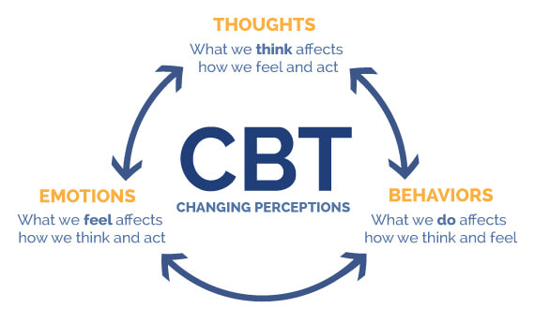
www.tuf.edu.pk
unioffaisalabad

Slide 5
www.tuf.edu.pk
unioffaisalabad
5 Easy Steps to Changing Your Thinking Using Cognitive Behavioral Therapy (CBT)
Step One – Make A List.
Step Two – Record Unproductive Thoughts.
Step Three – Create Replacement Thoughts.
Step Four – Read Your List Often.
Step Five – Notice And Replace.

Slide 6
Behavioral Therapy
www.tuf.edu.pk
unioffaisalabad
Behavioral therapy is an umbrella term for types of therapy that treat mental health disorders.
It's based on the idea that all behaviors are learned and that behaviors can be changed.
This form of therapy looks to identify and help change potentially self-destructive or unhealthy behaviors.
“3 C's” which is a formalized process for doing both the above techniques (Catch it, Check it, Change it).

Slide 7
www.tuf.edu.pk
unioffaisalabad
Identify the problem.
This involves investigating what the problem is and its history.
Behavioral Techniques.
This involves identifying and developing strategies that will assist in the change process.
Implement the Plan.
Assess Progress.
Continue the Process.

Slide 8
Psychodrama
www.tuf.edu.pk
unioffaisalabad
Psychodrama is a structured form of therapy in which a person dramatizes a personal problem or conflict, usually in front of a group of other therapy participants.
The other participants usually take part in the drama, though each performance focuses on a single person's concerns.
There are three basic components of a psychodrama session:
The Warm-Up Phase.
The Action Phase.
The Sharing Phase.

Slide 9
Family Therapy
www.tuf.edu.pk
unioffaisalabad
Family therapy is a form of talk therapy that focuses on the improvement of relationships among family members.
It can also help treat specific mental health or behavioral conditions, such as substance use disorder or oppositional defiant disorder.
Family therapy can involve any combination of family members.
Usual goals of family therapy are improving the communication, solving family problems, understanding and handling special family situations, and creating a better functioning home environment.

