Slide 1
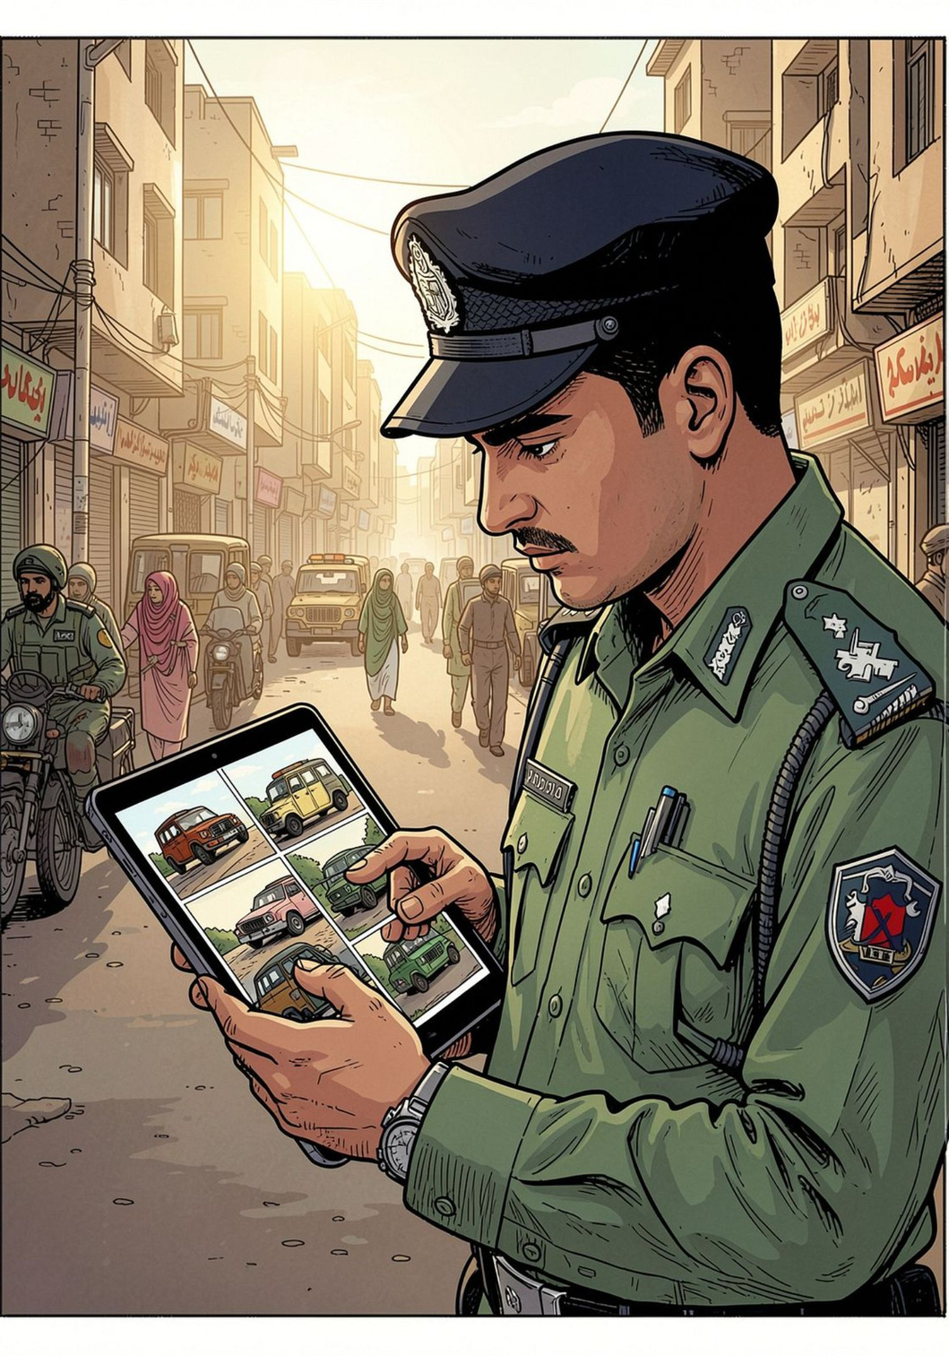
AI-Based Smart Car Diagnostic System
)
Zunaira(2023-BS-AI-121)
Faizamehak (2023-BS-AI-72)
SAQLAIN RAJPOOT (2023-BS-AI-98)

Slide 2




Context & Problem
www.tuf.edu.pk
unioffaisalabad
Vehicle damage is not properly monitored on Pakistani roads.
Damaged vehicles may continue operating without inspection.
Manual checking is time-consuming and limited.
Serious damage may go unnoticed or undocumented.
An AI-based system is needed to detect damage and identify vehicles automatically.

Slide 3
Proposed System Overview
www.tuf.edu.pk
unioffaisalabad
An AI-based system to detect visible car damage using images or videos.
Uses YOLOv8 to identify damaged vehicle parts.
Reads Pakistani license plates to identify vehicles.
Provides a web dashboard and mobile application.
Sends notifications to vehicle owners about detected damage.
vehicle damage records for traffic authorities

Slide 4
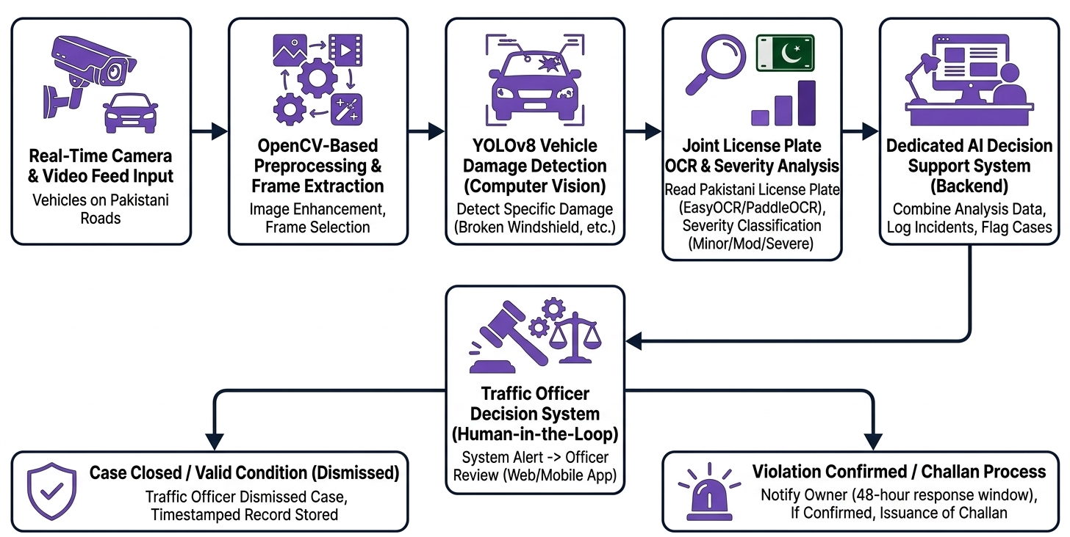
www.tuf.edu.pk
unioffaisalabad

Slide 5
Key Features
www.tuf.edu.pk
unioffaisalabad
AI-based damage detection using Computer Vision.
Pakistani license plate recognition for vehicle identification.
Damage severity detection to identify the level of damage.
48-hour owner notification before further action.
Web dashboard and mobile app for easy monitoring.
Automatic records of vehicle damage and incidents

Slide 6
Literature Study
www.tuf.edu.pk
unioffaisalabad
Related Work | Limitation / Gap
Car Damage Assessment | Mainly detects vehicle damage
Computer Vision Damage Detection | Not designed for Pakistani roads
Insoore AI | Mainly focused on insurance
CarDD Dataset | Uses international vehicle data
YOLO-based Detection | Needs local adaptation

Slide 7
Related Work & Research Gap
www.tuf.edu.pk
unioffaisalabad
Related Work
Existing systems use AI and Computer Vision for vehicle damage detection.
License Plate Recognition is used to identify vehicles.
Some systems support traffic monitoring and violation detection.
Research Gap
Limited systems are designed specifically for Pakistani vehicles and license plates.
Existing solutions do not combine damage detection, plate recognition, alerts, and incident records in one system.
Our system aims to address this gap for Pakistani road conditions.

Slide 8
Problem Identified
www.tuf.edu.pk
unioffaisalabad
Vehicle damage is not properly monitored on Pakistani roads.
Manual vehicle inspection is slow and difficult to manage.
Damaged vehicles may continue to operate without proper checking.
Serious vehicle damage can be missed or remain undocumented.
There is a need for an AI-based system to automatically detect vehicle damage and identify vehicles.

Slide 9
Project Scope
www.tuf.edu.pk
unioffaisalabad
Detect visible vehicle damage using AI and Computer Vision
Recognize Pakistani vehicle license plates.
Identify the type and severity of damage.
Store vehicle damage and incident information with date, time, and location.
Provide alerts through a web dashboard and mobile app.
Support traffic officers in vehicle safety monitoring and inspection.
Cover common vehicle types such as cars, SUVs, and sedans

Slide 10
Motivation: Aim & Objectives
www.tuf.edu.pk
unioffaisalabad
Aim:
To develop an AI-based smart car diagnostic system that automatically detects visible vehicle damage and identifies vehicles using Pakistani license plates.
Objectives:
Detect common vehicle damage using AI and Computer Vision.
Recognize and read Pakistani license plates.
Identify the type and severity of vehicle damage.
Record vehicle damage with date, time, and location.
Send notifications to vehicle owners about detected damage.
Provide a web dashboard and mobile app for monitoring and reporting.

Slide 11
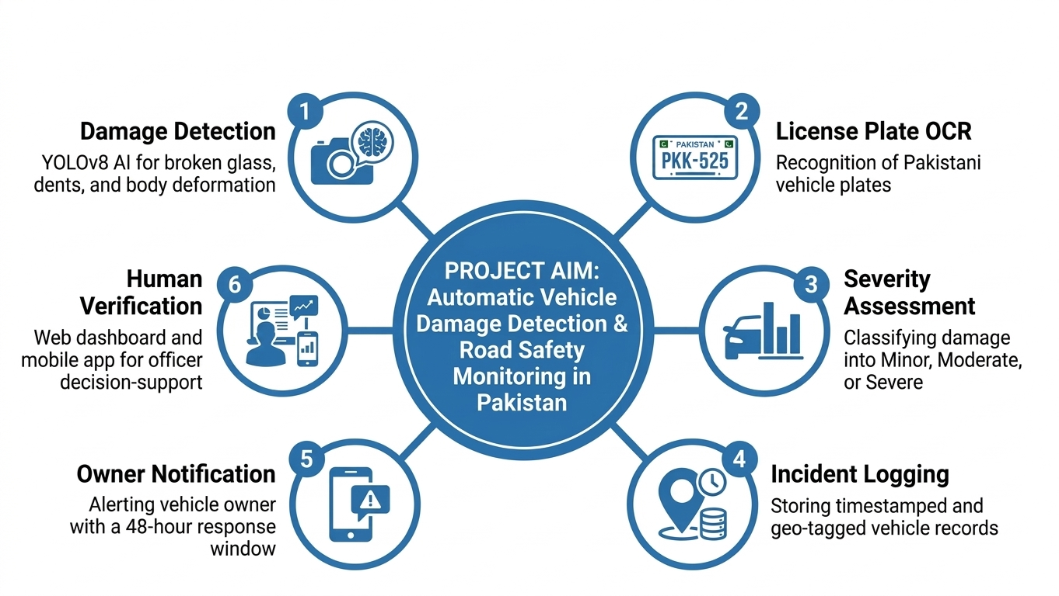
www.tuf.edu.pk
unioffaisalabad

Slide 12
Implementation: Details
www.tuf.edu.pk
unioffaisalabad
Data Collection: Collect vehicle images and videos for system training and testing.
Image Processing: Preprocess images to improve detection accuracy.
Damage Detection: Use YOLOv8 to detect visible vehicle damage.
License Plate Recognition: Use OCR to read Pakistani license plates.
Damage Analysis: Identify the type and severity of detected damage.
Database: Store vehicle, damage, date, time, and location information.
Web & Mobile App: Display results, alerts, and vehicle records.
Human Verification: Traffic officers review detected cases before further action.

Slide 13
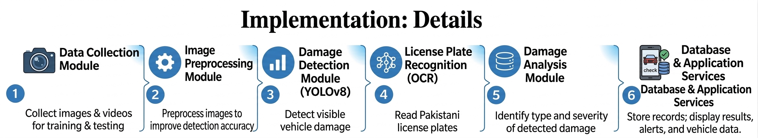

Slide 14
Tools and Technologies
www.tuf.edu.pk
unioffaisalabad
Python – Main programming language.
YOLOv8 – Vehicle damage detection.
OpenCV – Image and video processing.
OCR – Pakistani license plate recognition.
PyTorch – Training and running AI models.
VS Code – Coding and development.
Google Colab – Model training and testing.
GitHub – Code management and version control.
Web Dashboard & Mobile App – Display results, alerts, and records.

Slide 15
Deliverables: Project Timeline / GANTT Chart
www.tuf.edu.pk
unioffaisalabad
Semester 1: Research, requirements, data collection, preprocessing, and AI model development.
Semester 2: License plate recognition, system integration, web/mobile development, testing, and final documentation.
Final Deliverables: Working AI damage detection model, license plate recognition module, web dashboard, mobile app, database, testing results, and final project report.

Slide 16
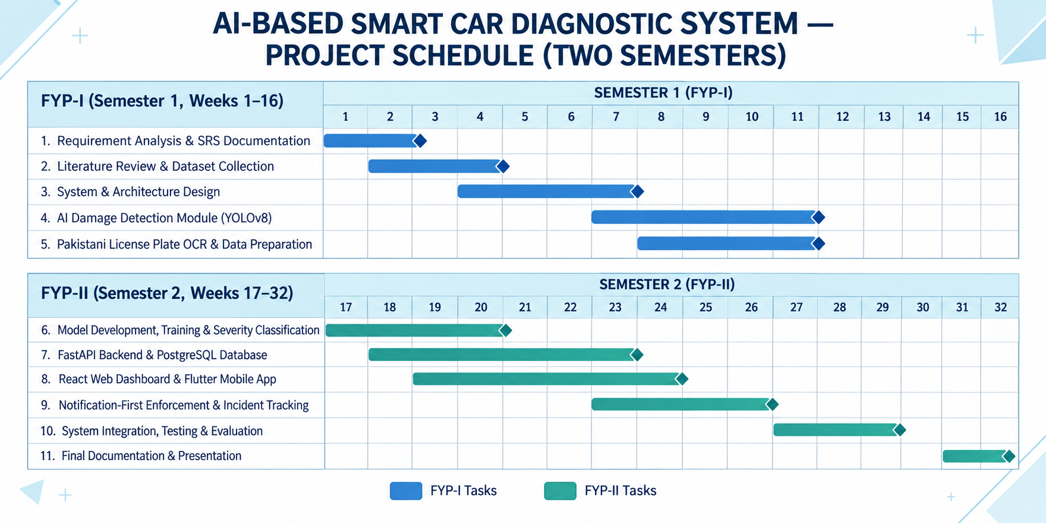
www.tuf.edu.pk
unioffaisalabad

Slide 17
Any Questions ?
Thank YOU

