Slide 1
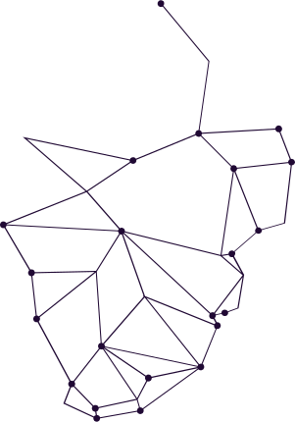
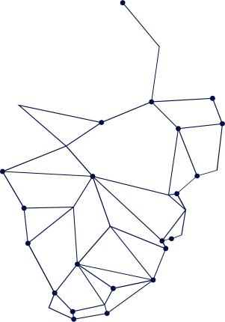
DATA ENCRYPTION STANDARD
Presented By:
Samreen Shoukat
Haleema Abid
Hamna Saleem
Jalisha Eman

Slide 2
Generating SubKeys
6
5
4
3
2
16 SubKeys
Generated
1
PC-2
Table
Left Shift
Each Round
Split into
Halves
C₀ & D₀
PC-1
Table
Initial
64-Bit
Key
Title
Title
Click here to add text
Click here to add text
2
Title
Title
4
3
Click here to add text
Click here to add text
5
6
Title
Title
Click here to add text
Click here to add text

Slide 3
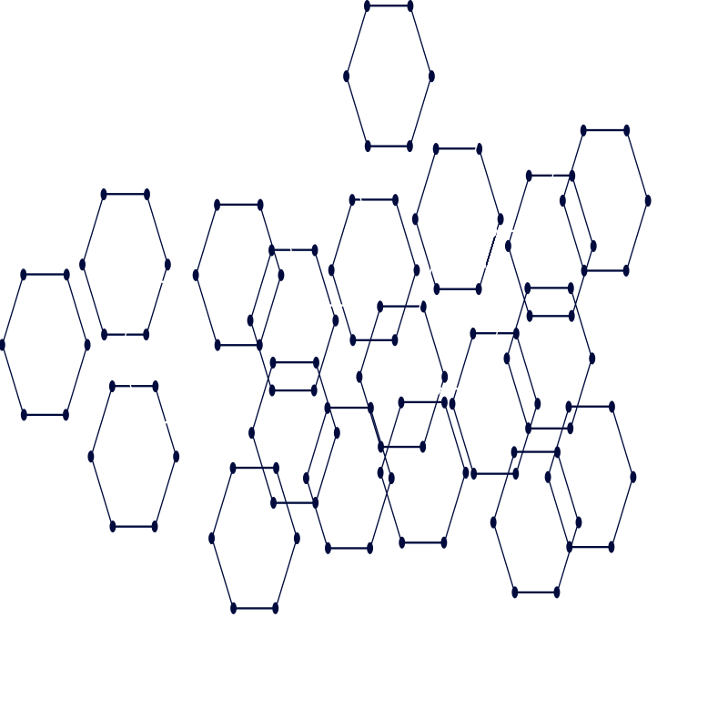
DES Encryption
01
02
03
04
05
06
06
Plaintext
64-Bit
Initial Permutation
Split into Halves
L₀ & R₀
16
Rounds
Final
Swap
Final
Permutation
Ciphertext
64-Bit

Slide 4
16 Rounds of DES
XOR R with SubKey
Expansion (R)
1
2
3
Input
(right half &
subkey)
P-Table
S-boxes
5
4
6
7
XOR with left Half
Swap Halves
Repeat

Slide 5
Extending to 24 Rounds
01
02
03
04
05
06
06
Plaintext
64-Bit
Initial Permutation
Split into Halves
L₀ & R₀
24
Rounds
Final
Swap
Final
Permutation
Ciphertext
64-Bit

Slide 6

Time Complexity
Metric | Before 16 rounds | After 24 rounds
Encryption | O(1) | O(1)
Decryption | O(1) | O(1)
Key Schedule | 16 subkeys | 24 subkeys
Overall | O(1) | O(1)

Slide 7
Space Complexity
Metric | Before 16 rounds | After 24 rounds
SubKey Storage | 96 bytes | 144 bytes
Block Size | 64 bits | 64 bits
Key Storage | 56 bits | 56 bits
Overall | O(1) | O(1)

Slide 8
Performance
Metric | Before 16 rounds | After 24 rounds
Number of operations | Lower | Higher
Encryption speed | Faster | ~50% slower
Decryption speed | Faster | ~50% slower
CPU usage | Lower | Higher
Power consumption | Lower | Higher

Slide 9
Security
Metric | Before 16 rounds | After 24 rounds
Differential cryptanalysis resistance | Strong | Stronger
Linear cryptanalysis resistance | Strong | Stronger
Brute-force resistance | Weak | Weak
Key size | 56-bit | 56-bit

Slide 10
THANK YOU

