Slide 1
MyShell
>_
A Custom Unix Shell
Operating Systems Project
Presented By:
Haleema Abid
Samreen Shoukat
Hamna Saleem
Department Of Computer Science Air University A&ACK

Slide 2
TABLE OF CONTENTS
01
Project Overview
02
System Architecture
03
Core Features
04
Technical Deep Dive
05
Output
MyShell
2

Slide 3
PROJECT OVERVIEW
What is MyShell?
8
The shell is the outer layer of an OS that acts as a bridge, taking your commands and translating them for the computer's core. It serves as the user's interface to control the system's inner workings.
Goal:
Build a fully functional Unix shell from scratch in C
Features
Implemented
Scope:
8 built-in features + process management + I/O control
cd · history · !! · help · exit · & · I/O redirect · pipe
Tech:
C, Linux (GCC)
MyShell
3

Slide 4
SYSTEM ARCHITECTURE
User
Input
Command Parser
Command
Router
Execution
Engine
Output
▶
▶
▶
▶
stdin / keyboard
tokenize & split
built-in vs exec
fork/exec/wait
stdout
Core Modules
Input & History Handler
Process Manager
Logical Parser
Pipe/Redirect Handler
Built-in Commands
MyShell
4

Slide 5
CORE FEATURES
cd
≡
!!
?
cd
history
!!
help
Change working directory
View last 10 commands
Repeat last command
List all built-in commands
⏻
&
> >>
|
exit / quit
Background (&)
I/O Redirection
Pipe ( | )
Terminate the shell
Run process in background
Redirect stdin/stdout
Chain commands together
MyShell
5

Slide 6
Process Management
Parent Process
(MyShell)
pid_t child_pid = fork();
if (child_pid == 0) {
setup_redirection(exec_args);
if (execvp(exec_args[0], exec_args) == -1) {
printf(RED " Command not found: '%s'\n" RESET, exec_args[0]);
exit(EXIT_FAILURE);
}
}
else if (child_pid > 0) {
if (run_in_background == 0)
waitpid(child_pid, NULL, 0);
else
printf(CYAN " [Background PID: %d]\n" RESET, child_pid);
}
else {
perror(RED " fork() failed" RESET);
}
fork()
Child Process
execvp(cmd)
MyShell
6

Slide 7
I/O Redirection & Pipes
I/O Redirection — dup2()
Pipe Chain — cmd1 | cmd2
int fd = open(args[i + 1], O_WRONLY | O_CREAT | O_TRUNC, 0644);
if (fd == -1) {
perror(RED " open()" RESET);
exit(EXIT_FAILURE);
}
dup2(fd, STDOUT_FILENO);
close(fd);
pipe(fd)
→
cmd1
→
dup2(write)
→
readEnd
→
Pipe Buffer
→
writeEnd
→
Dup2(read)
→
cmd2
int fd = open(args[i + 1], O_RDONLY);
if (fd == -1) {
perror(RED " open()" RESET);
exit(EXIT_FAILURE);
}
dup2(fd, STDIN_FILENO);
close(fd);
MyShell
7

Slide 8
Command History Module
MAX_HISTORY = 10
cmd1
cmd2
cmd3
cmd4
cmd5
cmd6
cmd7
0
1
2
3
4
5
6
7
8
9
save_to_history(cmd)
Appends command to buffer
show_history()
Prints numbered list of last N commands to stdout
!!
Fetches last entry and re-executes it immediately
MyShell
8

Slide 9
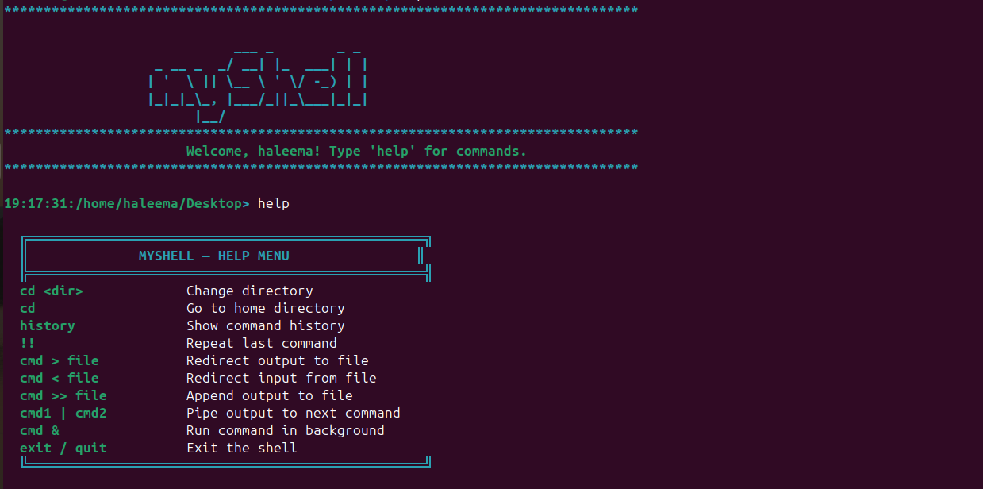
Output
MyShell
9

Slide 10
>_
MyShell successfully demonstrates
core OS concepts in practice.
8 working features — from built-ins to background execution
Full I/O redirection & pipe chaining
Thank You

