Slide 1
Computer security
Ahmed Al-waili, Mahmudul Fakrul, Taha Zahoni

Slide 2
Introduction
Alice -
Bob -
Charlie -
We have implemented the RSA algorithm with the Needham-Schroeder algorithm. We will show how Alice and bob communicate and how Charlie intercepts the message.

Slide 3
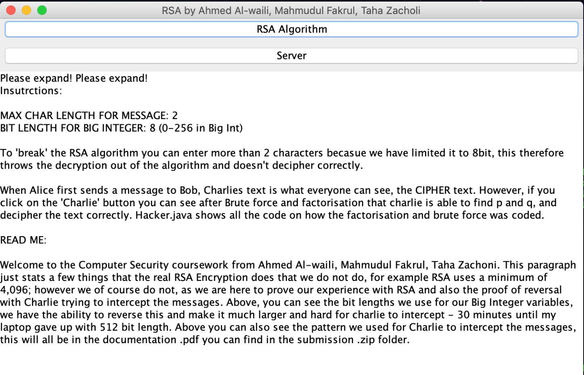
RSA
When starting our program you have two options. The RSA Algorithm and the Server side implementation.
We have limited the encryption to 8/16 bit because it would take a longer time decrypting as Charlie for a 4,096 bits.
For the example we wanted to show how Charlie encrypts the message by Prime factorisation.

Slide 4
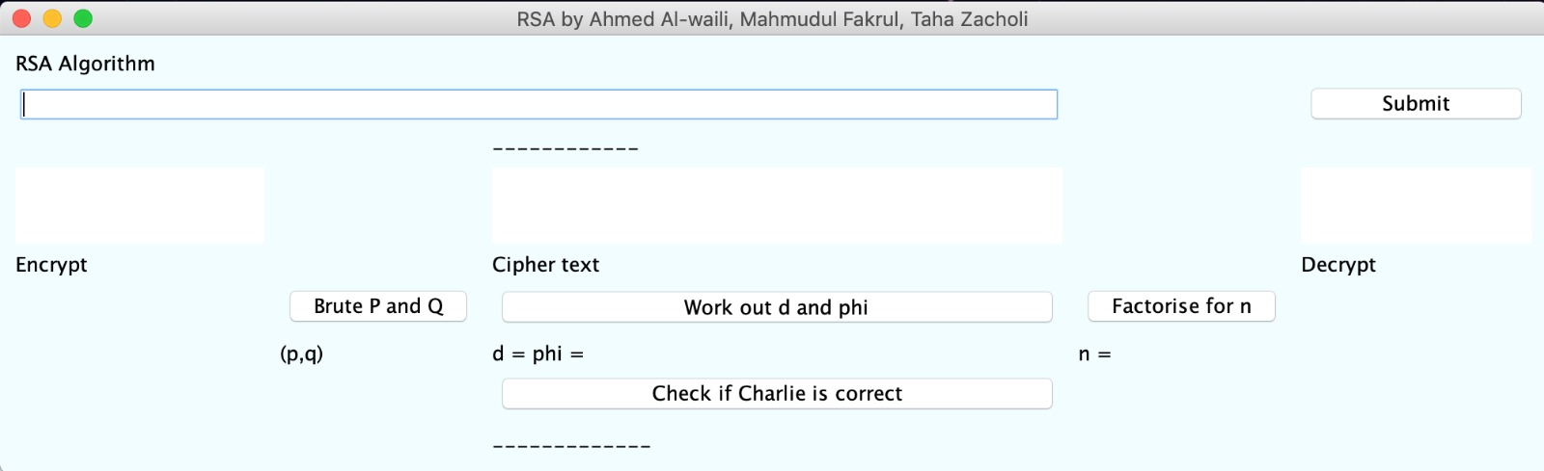
RSA - Algorithm
We used GUI to display the input of the message and outputs of the Encryption, Cipher text and Decryption.
We also used buttons to show how Charlie intercepts and decrypts to find the public key which is D.

Slide 5
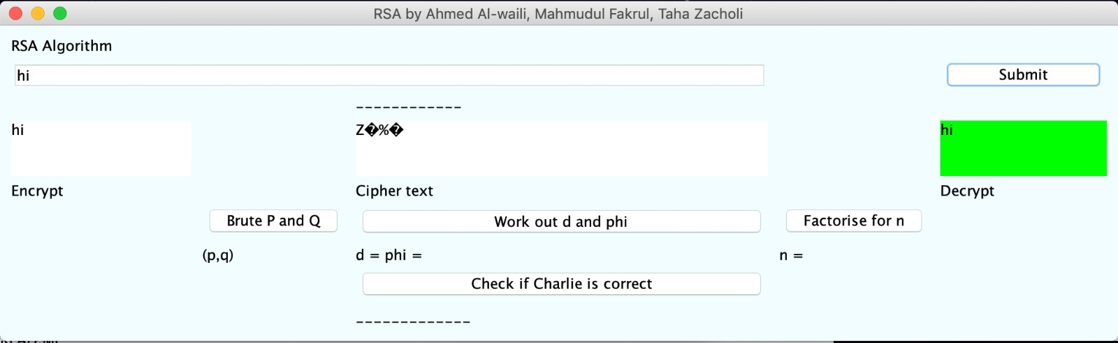
RSA - Algorithm
Every conversation starters is done by a greeting. We can see here that Alice has sent Bob a message “hi”. We can see the encryption, Cipher text and Decryption on the message.
This is the time Charlie intercepts and uses brute force to find the Private key!

Slide 6
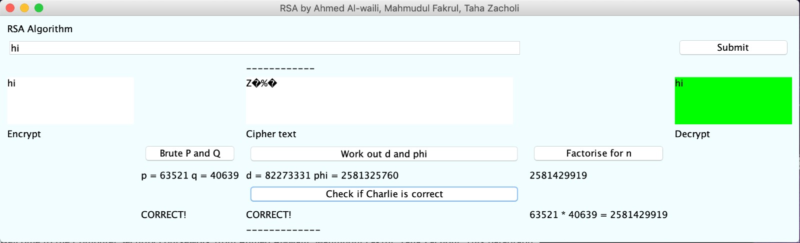
RSA - Charlie’s Interception
By clicking through each button Charlie can:
Brute force P and Q.
Work out the D and Phi.
Check if Charlie is correct.

Slide 7
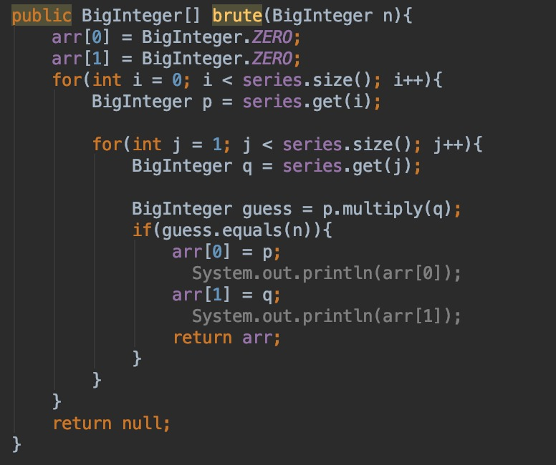
RSA - Are we cheating?

Slide 8
Server Implementation

Slide 9
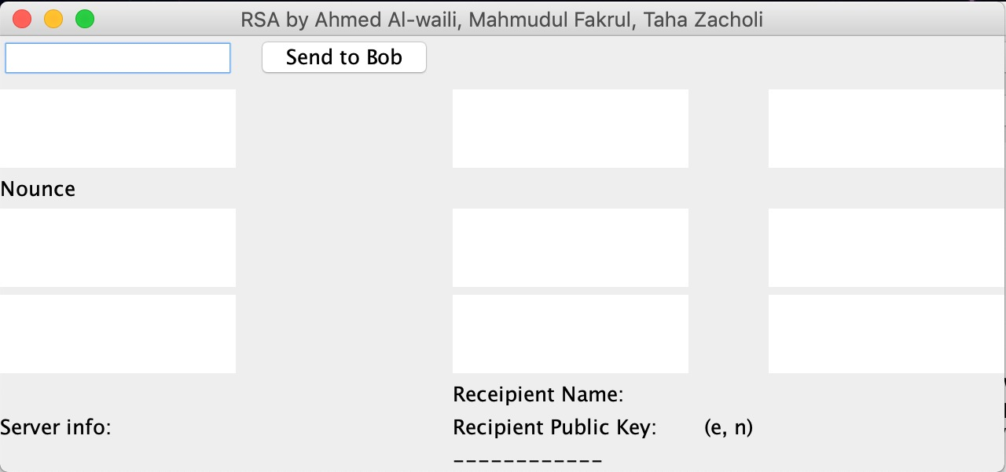
Server Implementation
The server implementation has a similar GUI to the RSA Algorithm.
It has a basic message that is being sent.
It has the Recipient name and Public key.
Encryption and decryption through RSA.

Slide 10
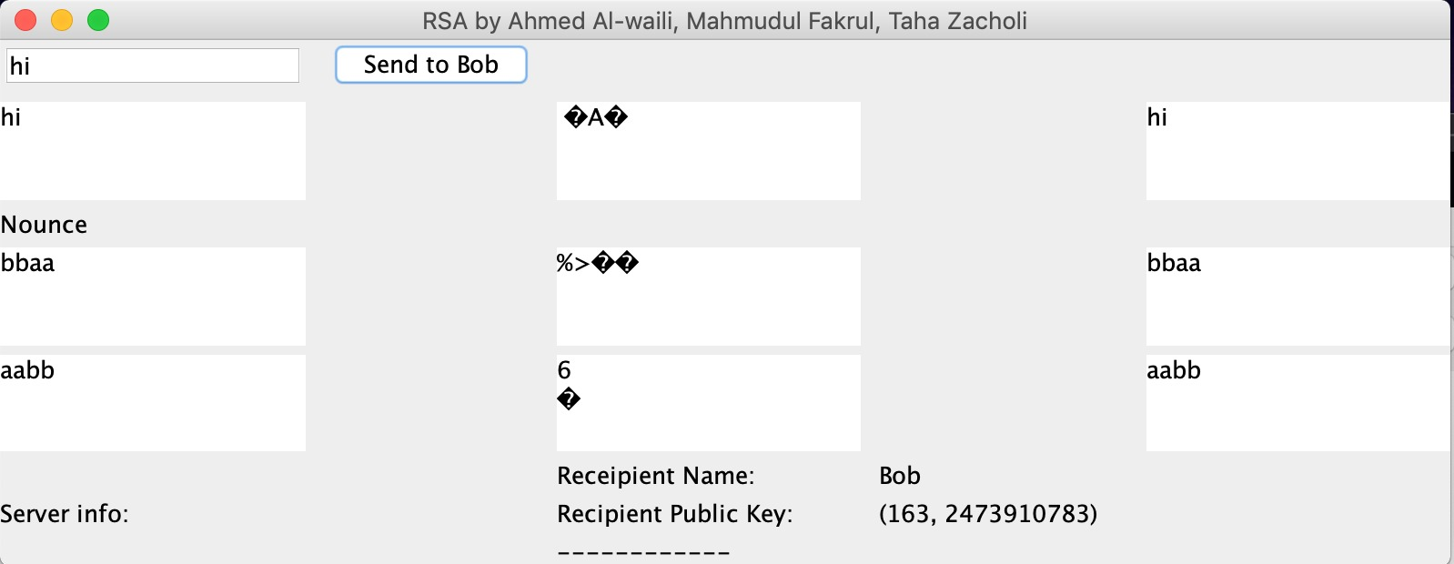
Server Implementation
Here we can see the recipients name that is receiving the message.

