Slide 1



MSDS 422 - Practical Machine Learning
Data Analysis and Forecasting of Natural Disasters
Fall 2024
Genki Hirayama
Hamdi Kucukengin
Maddy Lok

Slide 2
Introduction
Agenda
Exploratory Data Analysis
Feature Engineering
Model Implementation
Results
Recommendations
01
02
03
04
05
06
MSDS 422

Slide 3
Our Data
Fall 2024
01
MSDS 422

Slide 4


Fall 2024
Data Source: Forecasting Disaster Management in 2024
This dataset consists of synthetically generated data describing natural disasters across 6 different countries.
MSDS 422

Slide 5
Data Description
Fall 2024
Disaster_ID: A special number assigned to every calamity.
Disaster_Type: Category (e.g., Flood, Fire, Earthquake).
Location: The nation where the catastrphe happened.
Magnitude: The disaster's intensity (scale of 1.0 to 10.0).
Date: The event's timestamp.
Fatalities: The total number of people killed by the calamity.
Economic_Loss($): Damage to finances expressed in US dollars.
MSDS 422

Slide 6
Exploratory Data Analysis
Fall 2024
02
MSDS 422

Slide 7
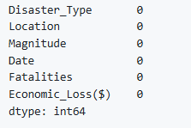

Data Preparation
Checking for missing values
Checking unique values for categorical features
Fall 2024
MSDS 422

Slide 8
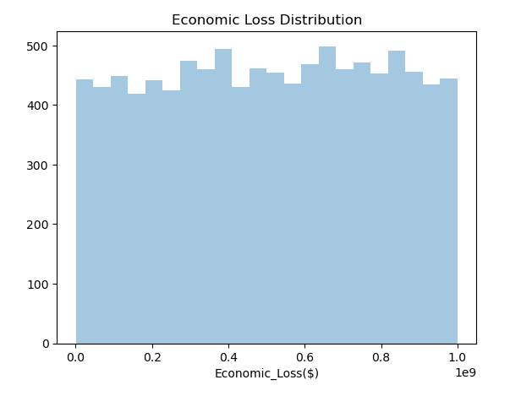
Density Distribution of Target Variable
Fall 2024
The distribution of the target variable does not follow a normal distribution, or any trend for that matter. It seems to be randomly distributed.
50
40
Users (in millions)
30
20
10
YEAR 1
YEAR 2
YEAR 3
YEAR 4
YEAR 5
Years
MSDS 422

Slide 9
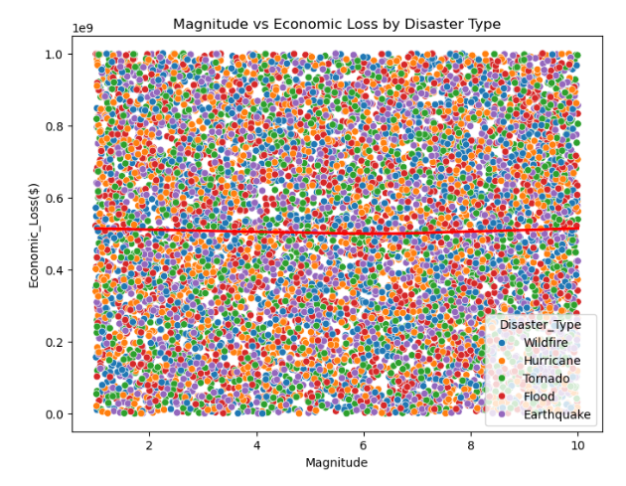
Investigating Potential Connections
Fall 2024
Our Category
We wanted to identify any connections between the magnitude of the disaster and the target variable and compare the results based on disaster type.
Economic loss does not seem to be affected by the magnitude or type of the disaster.
MSDS 422

Slide 10
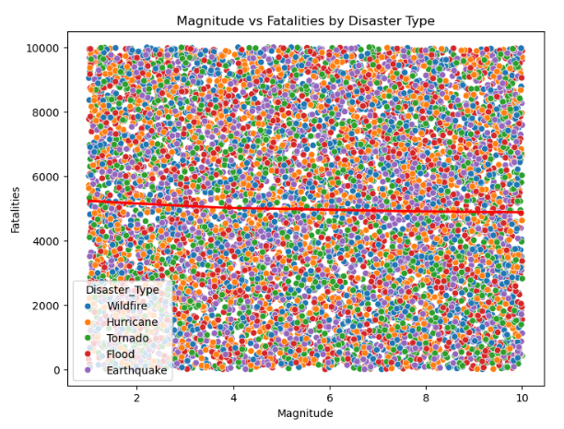
Investigating Potential Connections
Fall 2024
Our Category
This scatterplot displays the relationships between disaster magnitude and number of fatalities based on the type of disaster.
MSDS 422

Slide 11
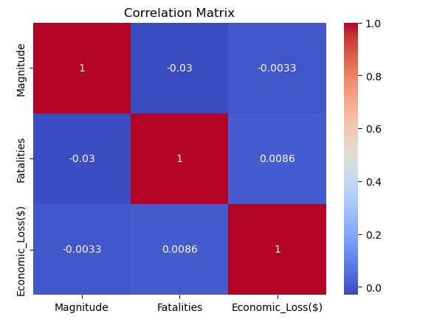
Investigating Potential Connections
Fall 2024
Our Category
We generated a correlation matrix to find more general correlations between features and the target variable.
MSDS 422

Slide 12
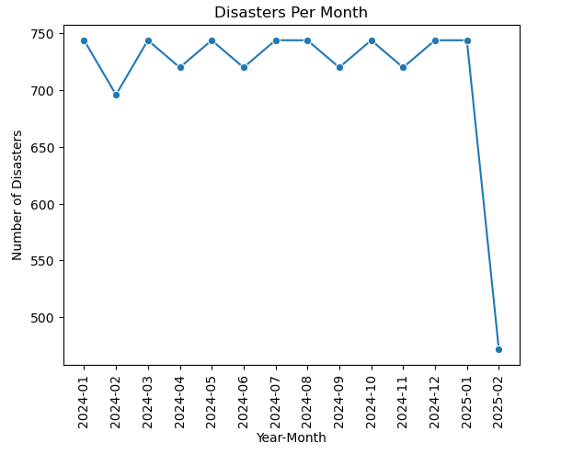
Time Series Analysis
Fall 2024
Our Category
We wanted to investigate the number of disasters per month to identify any seasonal trends.
The dropoff during Feb-2025 is likely due to the synthetic data generation process that resulted in the hourly disaster generation not lasting until the month of February 2025.
We recommend the removal of these data points to avoid any unintentional skewing of the dataset.
MSDS 422

Slide 13
Feature Engineering
Fall 2024
03
MSDS 422

Slide 14
Our new features:
Loss Per Fatality
Log of Economic Loss
Encoding Data
Created by dividing economic loss by the number of fatalities
Better representation of any potential correlation between economic loss and the fatality rate.
Could be utilized to better show any variations in economic loss while handling outliers that could potentially skew the data.
The categorical data was encoded and assigns numbers to disaster type and location features to allow for better investigation of these features and any correlations to the target variable.
MSDS 422
Fall 2024

Slide 15
Market
Size
Fall 2024
18%
35%
50%
5%
⬤ Customer Group A
⬤ Customer Group B
⬤ Customer Group C
⬤ Customer Group D
MSDS 422

Slide 16
Model Implementation
Fall 2024
04
MSDS 422

Slide 17
Fall 2024
Types of Models Utilized in this Study:
Linear Regression Model
Gradient Boosting Regressor Model
Bayesian Ridge Regressor Model
Recurrent Neural Network
MSDS 422

Slide 18
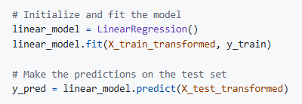
Linear Regression Model
Fall 2024
Used to set up a baseline. Model was trained and fitted on preprocessed dataset that was then split into train and test sets.
MSDS 422

Slide 19
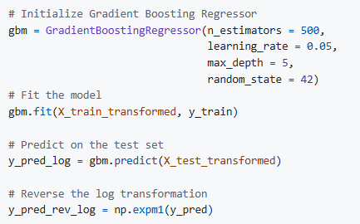
Fall 2024
These types of models are known for their predictive accuracy and ability to capture complex relationships in datasets.
Gradient Boosting Regressor Model
MSDS 422

Slide 20
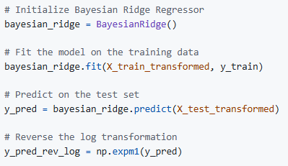
Fall 2024
Bayesian Ridge Regressor Models have built in regularization which mitigates risks of overfitting.
Bayesian Ridge Regressor Model
MSDS 422

Slide 21
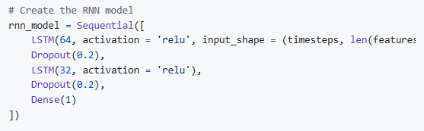
Fall 2024
Recurrent Neural Network
RNNs are useful for handling temporal patterns. We utilized this model to analyze the “Date” column of our dataset for predictive analysis.
Preprocess dataset: convert date column to “timestamp” type data for standardization.
Feature grouping: features grouped by year-month.
Calculations: average Magnitude, Economic Loss, and Loss per fatality were calculated.
Feature Scaling
Data Splitting
Our model has an LSTM layer with 64 hidden units and a ReLu activation. A dropout layer was included to reduce the risk of overfitting. We implemented a second LSTM layer with 32 hidden units and a subsequent dropout layer. The final layer is a dense layer used for prediction output.
MSDS 422

Slide 22
Results
Fall 2024
04
MSDS 422

Slide 23
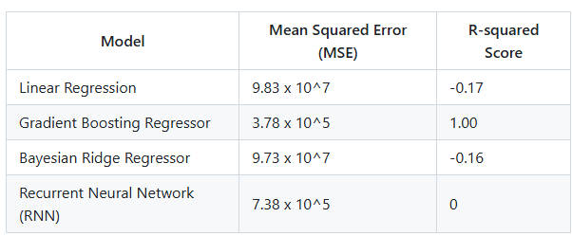
Our Model Results
Fall 2024
MSDS 422

Slide 24
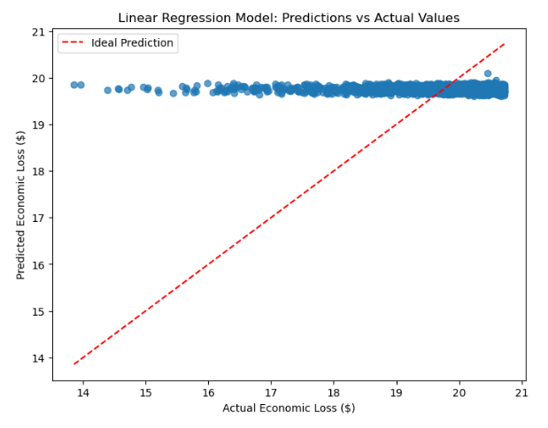
Fall 2024
Linear Regression Model
MSE: 9.83 x 10^7 | R-squared: -0.17
The Linear Regression Model was unable to make accurate predictions. The high MSE score suggests that the target variable has a wide range of values, which is also supported by the density distribution plot. Both the high MSE and negative R-squared scores show that the model was fitting poorly to the dataset.
MSDS 422

Slide 25
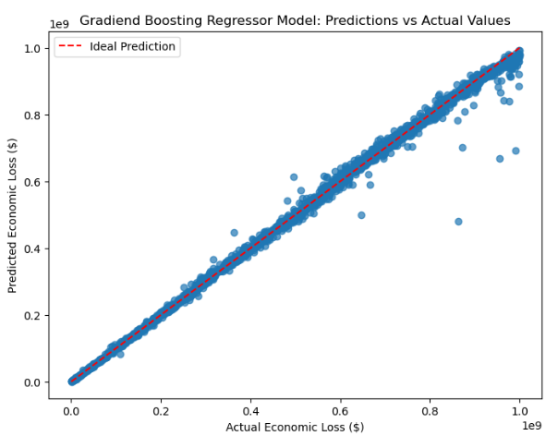
Fall 2024
Gradient Boosting Regressor
MSE: 3.78x10^5 | R-squared: 1.00
This model showed very accurate results. Because the scale of the target variable is at 10^8, the MSE score is reasonable.
Due to the R-squared score being 1.00, it is important to note that there may be some potential issues in model implementation that is causing a perfect match. This could be caused by overfitting or target leakage.
MSDS 422

Slide 26
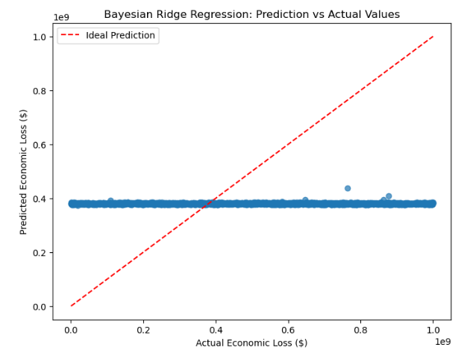
Fall 2024
Bayesian Ridge Regressor
MSE: 9.73x10^7 | R-squared: -0.16
The Bayesian Ridge Regressor model indicated slightly better performance than the linear regression model, but the negative R-squared value and high MSE score show that the model still performs poorly.
MSDS 422

Slide 27
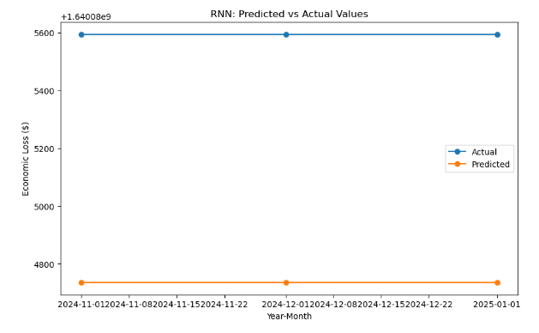
Fall 2024
Recurrent Neural Network
MSE: 7.38x10^5 | R-squared: 0
This model is the best performing model of the four we created. This is likely due to the model’s ability to analyze temporal relationships.
The R-squared score of the RNN suggests that the model is not capable of explaining the change in the target variable using the features that were selected.
MSDS 422

Slide 28
Fall 2024
Conclusions
There was no consensus between our four models predictions when applied to cross-validations. The negative R-squared scores show that the models are not fitted well for the dataset.
Possible causes:
Low number of features in dataset
Randomness and uniformity in dataset
Synthetic nature of the data
MSDS 422

Slide 29
Recommendations
Fall 2024
01
MSDS 422

Slide 30
Summary
Fall 2024
The four models returned inconsistent results, which suggests potential issues with the data quality of mishandling of the data.
Potential causes:
Insufficient features that are not correlated with the target variable
Random nature of the dataset
Mishandling of preprocessing of dataset
Mishandling of scaling of target variables
MSDS 422

Slide 31
Fall 2024
Recommendations
If synthetic data is still preferred, it is necessary to generate data that captures the complex relationships between features and the target variable prior to training any type of predictive model.
We recommend spending more resources on higher quality data collection from real events over generating synthetic datasets.
MSDS 422

Slide 32
Fall 2024
References
Forecasting Disaster Management in 2024 (Adnaan Faiz): https://www.kaggle.com/datasets/umeradnaan/prediction-of-disaster-management-in-2024/data
MSDS 422

