Slide 1
Reinforcement Learning for Emergency Space-Air-Ground Connectivity: Qusin, Nablus
From a GitHub repository to a reproducible, honest evaluation
Mohammed Yadak | ID 12217817 | October 2026

Slide 2
The problem: what if the ground network is down?
Six villages around Qusin (west of Nablus) lose service in an emergency
Fall-back: HAPS at 20 km as flying base stations, backed by LEO satellites
Question: how to assign users to HAPS and set power so nobody is left out?
Goal: a problem from our own surroundings, solved with an open-source tool
6
villages, about 16,500 people (2017 census)
4 + 3
HAPS + LEO satellites in the fall-back network

Slide 3
The tool: a Q-learning SAGIN toolkit (GitHub topic: sagin)
Question | Answer
Why | Correct, reproducible rewrite of an old MATLAB project; teaching and baseline reference (no novelty claim)
What | Python + NumPy; independent tabular Q-learners for user association and transmit power; 3 baselines
Where | Rural and emergency coverage studies, teaching; not a production network planner
When | Quick, transparent experiments (seconds to minutes); baseline for new methods
How | git clone, pip install, python tests.py, python experiment.py
Why this repo: 7 stars, runs on a laptop, ships tests and baselines (the only other repo in the topic needs an LLM API).

Slide 4
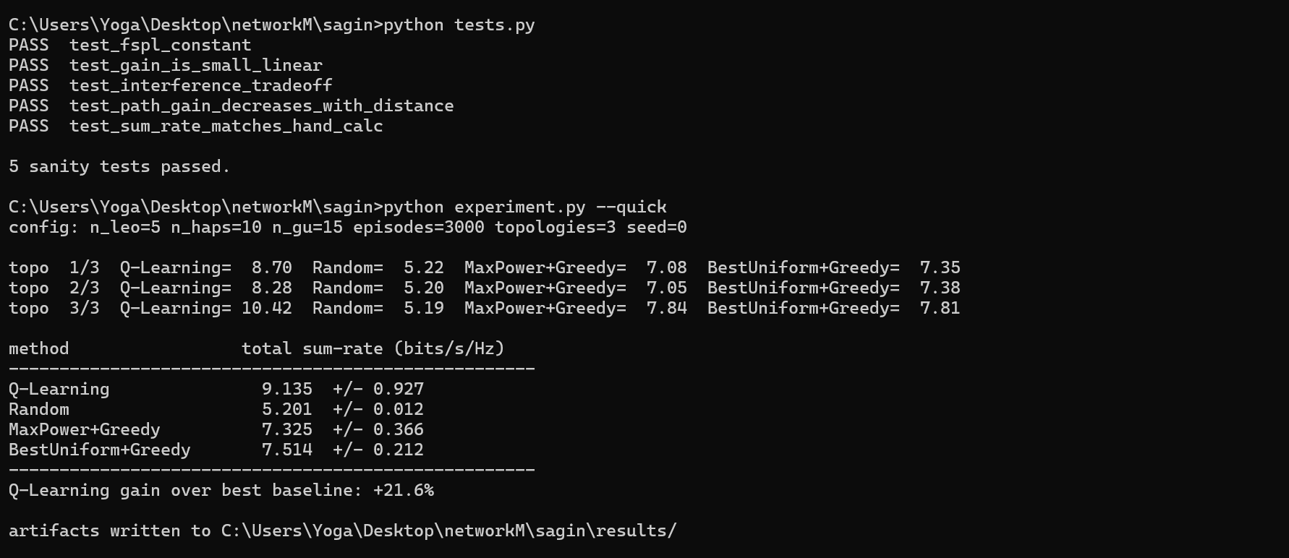
Running the toolkit on my own laptop
python tests.py: 5 sanity tests pass. python experiment.py --quick: Q-learning is +21.6% over the best baseline.

Slide 5
Scenario: real villages, population-weighted users
Village | Population (2017)
Qusin | 2,251
Deir Sharaf | 2,949
Beit Iba | 4,079
Sarra | 3,384
Zawata | 2,537
Beit Wazan | 1,312
Users placed around villages in proportion to population
30 (moderate) and 45 (busy) representative users
Metrics: outage (< 1 Mbit/s), worst-5% rate, transmit power, blocked users
End-to-end rate = min(access rate, backhaul share)
Coordinates and populations: public village pages citing PCBS 2017.

Slide 6
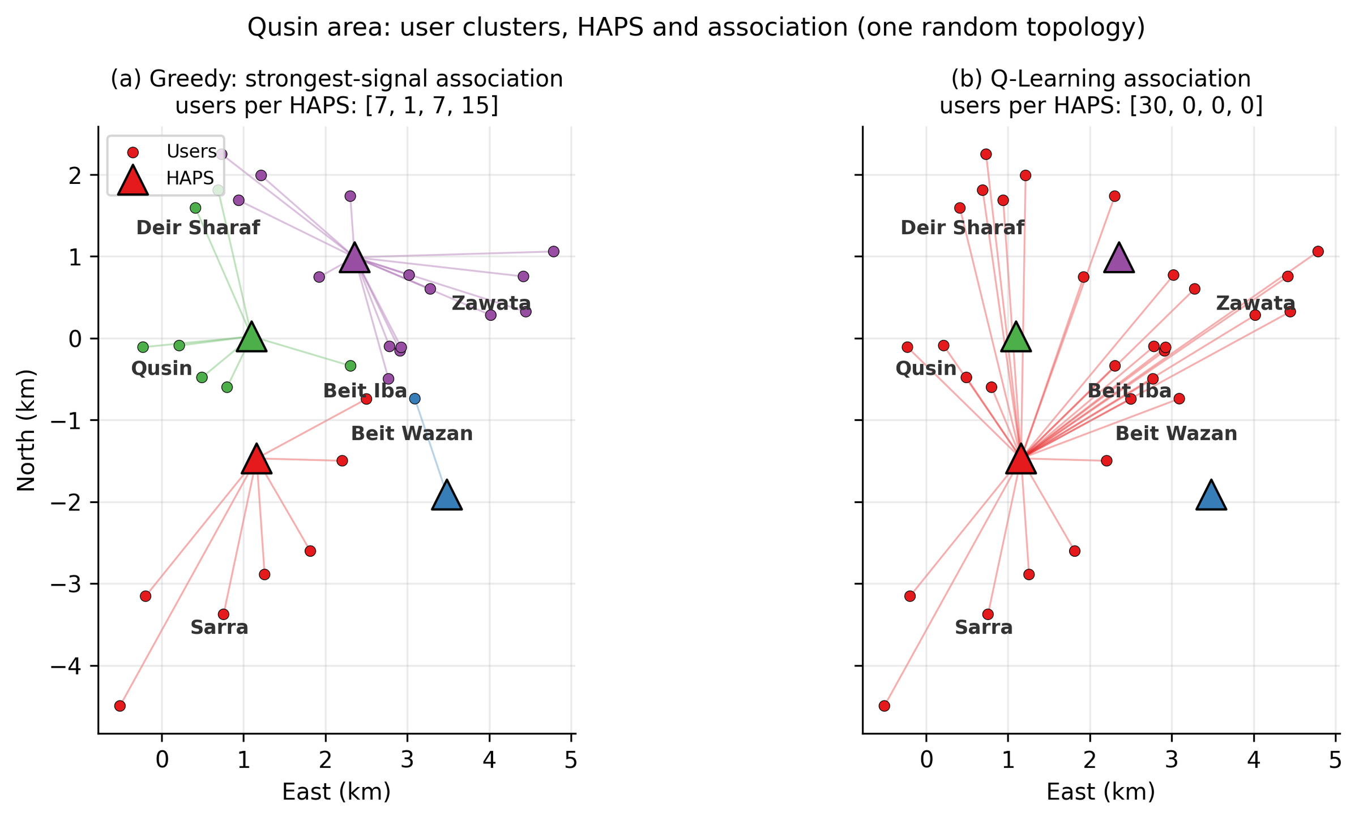
A red flag: the first result looked great
Q-learning outage: 14% vs 51% for naive baselines
But the control 'all users on one HAPS' scored 10%
Q-learning had switched off most HAPS (1.5 of 4 active)
Cause: unrealistic radio model; interference swamps the signal
Lesson 1
Always run the simplest possible control before believing a gain.

Slide 7
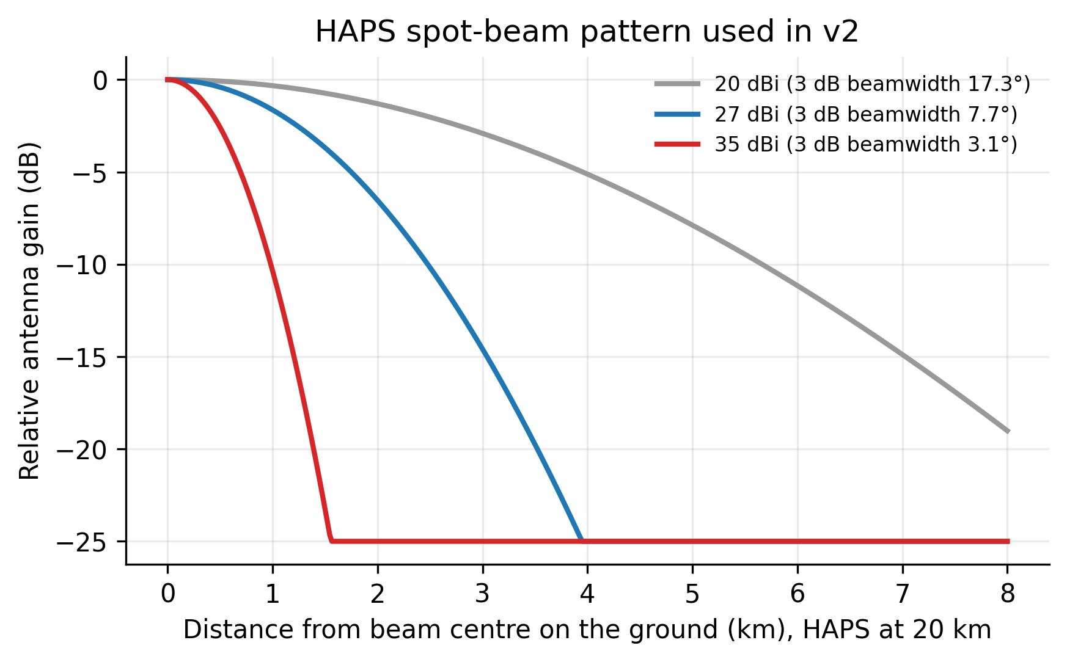
The fix: a more realistic radio model
Spot beams
Interference depends on beam angle (35 dBi, 25 dB side-lobe cap)
Frequency reuse
Band split into sub-bands; neighbouring HAPS use different ones
Capacity limit
12 users per HAPS; extra users are blocked
A 20 dBi beam covers the whole area; a 35 dBi beam separates users 1-2 km apart.
Directional backhaul
Each HAPS points a dish at its LEO; other LEOs are attenuated

Slide 8
Fair baselines changed the conclusion
GreedyLB
Capacity-aware association: strongest users first, best HAPS with room
21 of 21 outage users were limited by the satellite backhaul
30 topologies per load
Paired differences with 95% bootstrap CIs
GreedyLB+LEO
Also balances HAPS across satellites (all HAPS tended to pick the same one)
minP
Smallest common power that keeps outage at 1% or less
SingleHAPS
Control: all users on the best HAPS

Slide 9
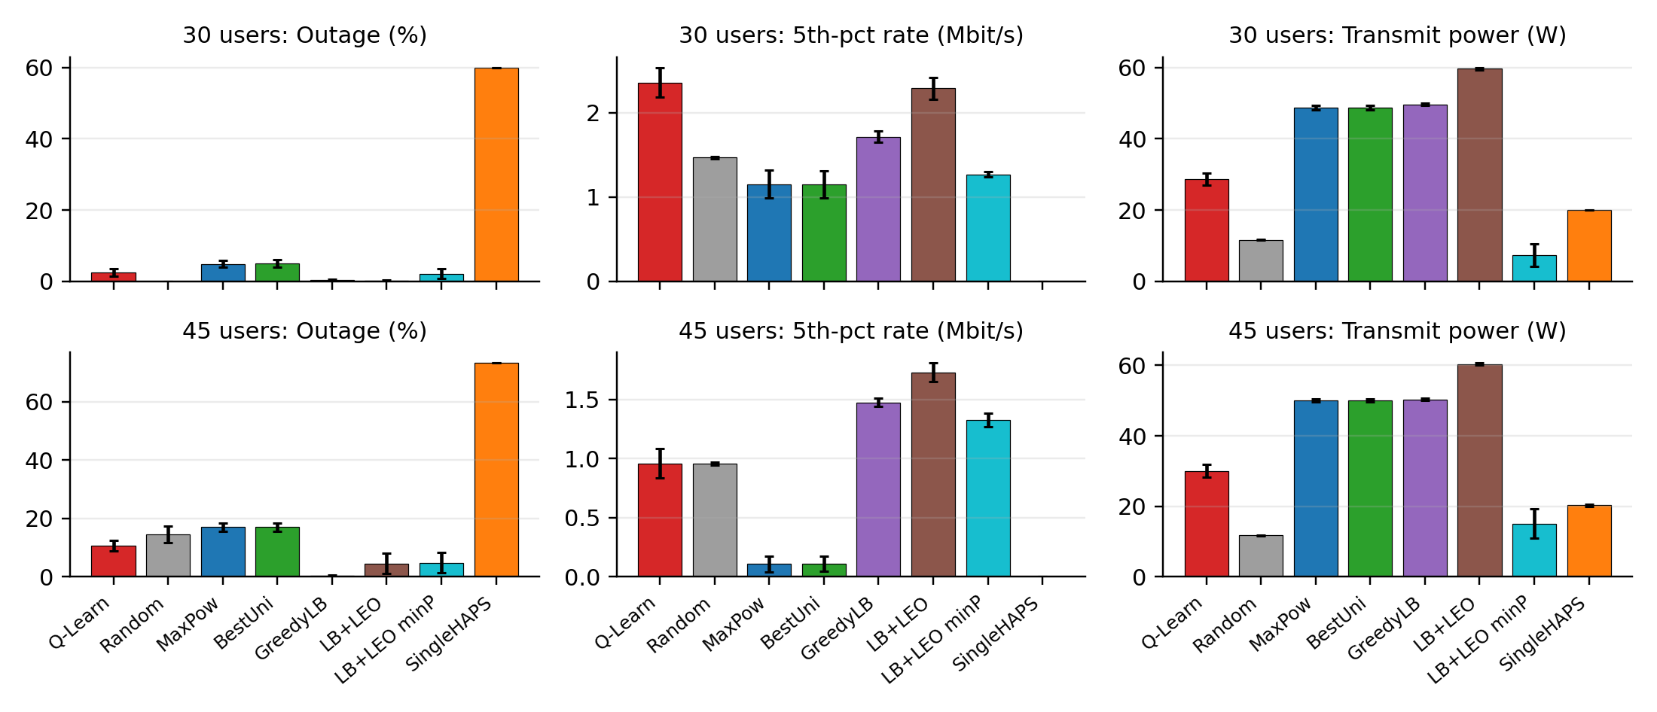
Results: 30 and 45 users, 30 random topologies each
Error bars: standard error over 30 topologies. 3 LEO, 4 HAPS, 35 dBi beams, 2 sub-bands.

Slide 10
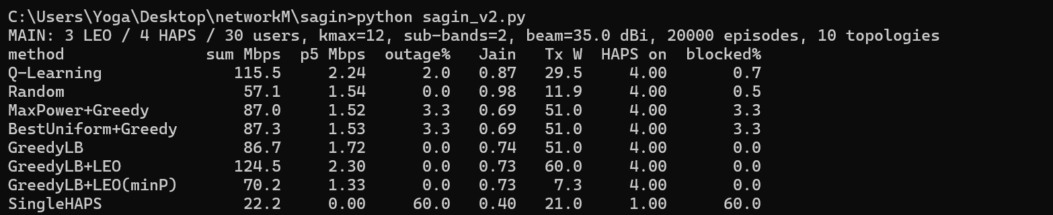
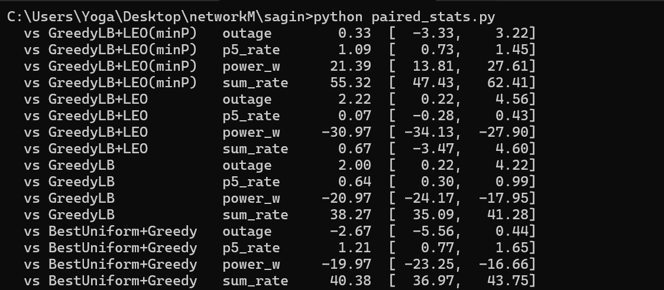
My own run reproduces the article's numbers
python sagin_v2.py: 10 topologies, 20,000 episodes
python paired_stats.py: 30 topologies, 95% bootstrap CIs
Paired results match Table 8 and sweeps match Table 9 of the article

Slide 11
What the numbers say
-6.4 pp
+10.3 pp
30 vs 7-15 W
outage vs best uniform baseline at 45 users (CI -10.5 to -2.2); about 20 W less power
outage vs GreedyLB at 45 users: 10.7% vs 0.4%
Q-learning vs minP total transmit power
Q-learning clearly beats naive strategies, but not capacity-aware heuristics on outage
Beam gain dominates: at 20 dBi every method has 20-31% outage; at 35 dBi sensible methods are at a few percent
Q-learning is best only when beams are weak (20 dBi)

Slide 12
Lessons and takeaways
Hardware first
Antenna directivity changes outage far more than the algorithm
Respect capacity, balance the backhaul
The largest avoidable losses come from overloaded HAPS and a single shared satellite
Controls and strong baselines
They turned a flattering plot into evidence
Limits
Simulation with assumed parameters; no claim about real infrastructure
Full tutorial article and code: every step reproducible on a laptop, no GPU.

