Slide 1

Web fundamentals
How does the web works?
What do you need to be a web developer?
What’s the role of a web developer
Made by:
Mohamed Amine Hmamdia
22th, December, 2020

Slide 2
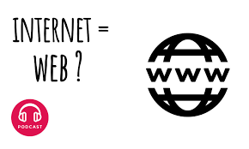
Not to be confused !!!!!!!!
Contrarily to what most of people think, World Wide Web or Simply WEB is an information system identified by Uniform Resource Locators (“URL”) containing documents and Web resources and accessible on the inernet using Web browsers.
However, Internet is a sum of connections between computers and other hardware devices = Large network of networks.

Slide 3
Web development
Web development is the the work done in order to build or to fix a website in the internet.
Web development is made on two phases:
Frontend: the work made on what the screen displays for the user.
Backend: the work made behind the scenes and not seen by the user and eventually the link between the back and the front and what makes the website works.

Slide 4

Web developer
Every Web developer must have a basic understanding of HTML, CSS and Java Script or one of the multitude of coding languages existing in the world.

Slide 5
Thank you for your time

