Slide 1

Model–Based Dynamic Resource Management for Service Oriented Clouds
Hamoun Ghanbari
Supervisor: Marin Litoiu

Slide 2
Outline
Motivation
General background, model-based approach architecture
Contributions

Slide 3
Concepts
Cloud
Application
Class of users
Service
Host
Instance

Slide 4
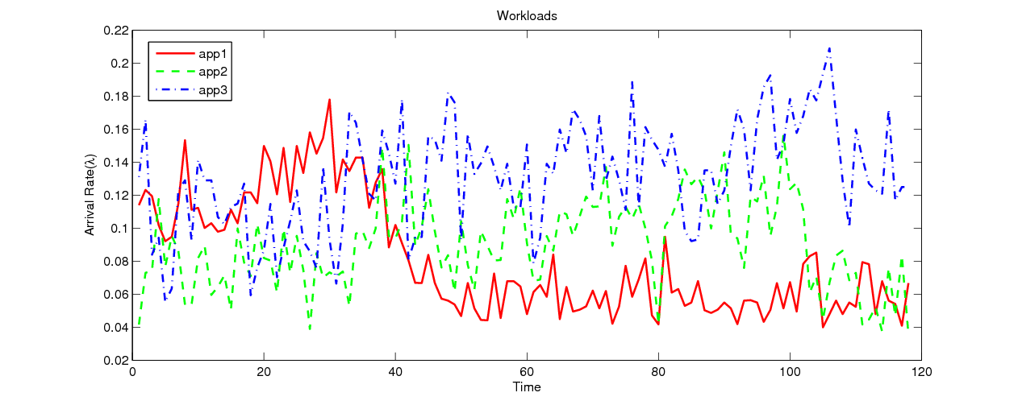




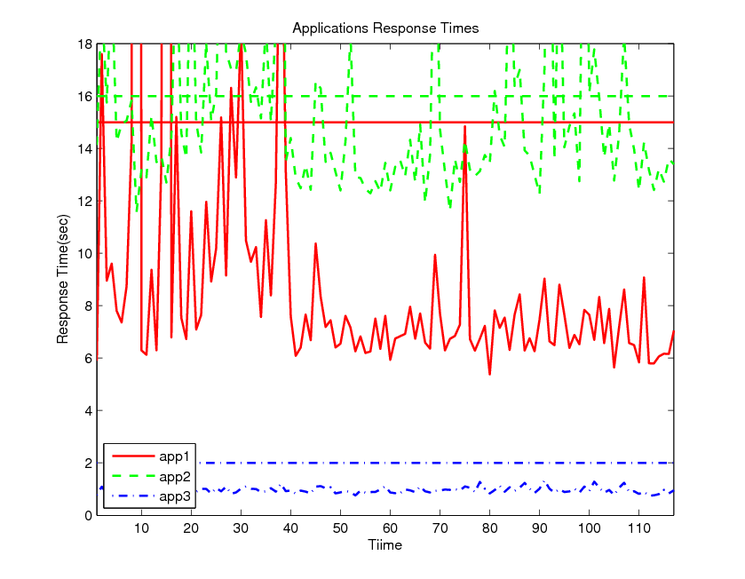

Concepts
Workloads
Applications
APP1
APP2
APP3
Resource
Allocation
Cost
Performance
Metrics
<>?SLAs
Revenue
Notes:
Cost to the provider is minimized
Meet all client application requirements (as specified in the SLAs).

Slide 5
Architecture: Model Based Approach

Slide 6
Contributions
Contribution 1: Improving The Convergence Of Performance Model Estimators Using Dynamic Clustering Of User Classes
Contribution 2: Optimal Resource Share Adjustment in Cloud Using Dynamically Tuned Empirical Models
Contribution 3: Optimal Service Replica Placement via Model Predictive Control

Slide 7
Contribution 1: Problem
The necessary and sufficient condition for convergence in Kalman filter puts a hard constraint on the number of classes that can be modeled.
For each additional class, there needs to be some additional measurements from the system.
For a large-scale system with many classes, measuring and storing an excessive amount of monitoring information at all times for the filter is impractical.
When user services have different performance behavior, then a single class model, which averages all services, is not an accurate description of the system.

Slide 8
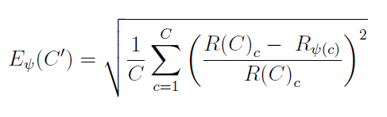
Contribution 1: Solution
Introduced the concept of modeling error:
Improving the convergence of the KF by reducing the size of the model through clustering of user classes
Dynamic clustering algorithm presented in page 69 of the thesis

Slide 9
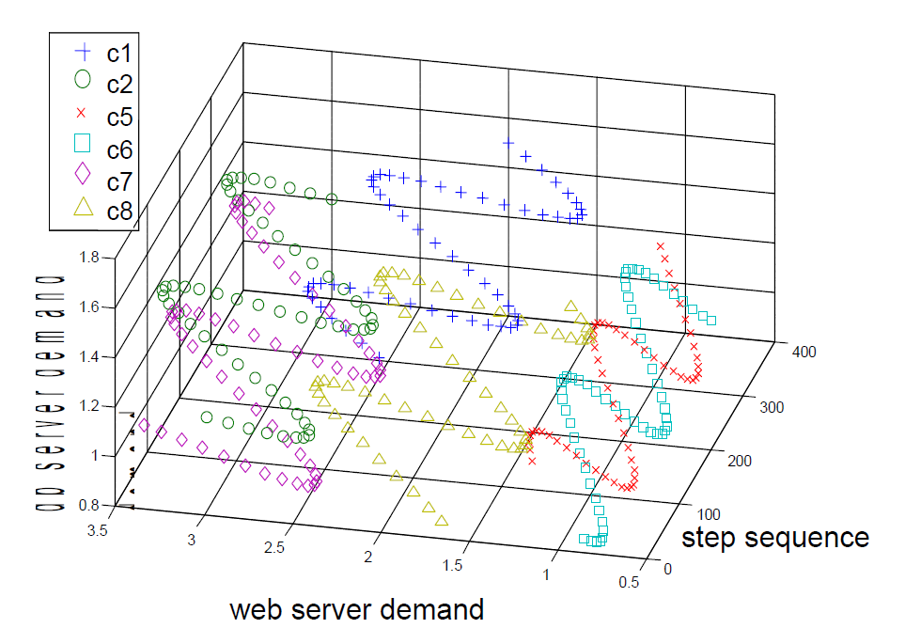
Contribution 1: Results
Variation of service demands
Service demands for 8 different classes [c1,c2,c5,c6,c7,c8] on two services.

Slide 10
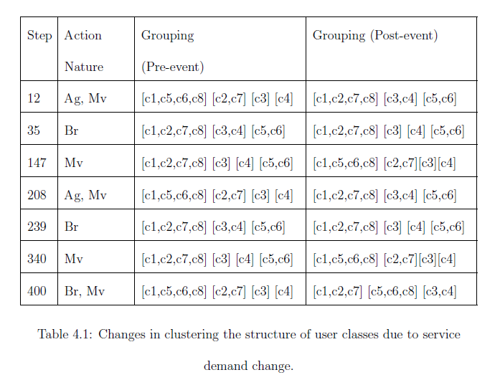
Contribution 1: Results
10
Modeling error with dynamic clustering applied.

Slide 11
Contribution 1: Conclusions
We investigated a tracking approach, that identifies the performance parameters of groups of classes (we call them clusters) instead of individual classes.
We proposed an algorithm that finds the appropriate number of clusters with a pre-defined clustering accuracy.

Slide 12
Contribution 2: Problem
Empirical regression based performance models do not typically use feedback of runtime performance data. When applications are deployed in a production environment, the models gradually become inaccurate.

Slide 13
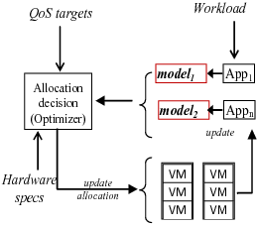
Contribution 2: Proposed Solution
Using dynamic application-specific performance models
Periodically, each application submits its performance model to the middleware.

Slide 14
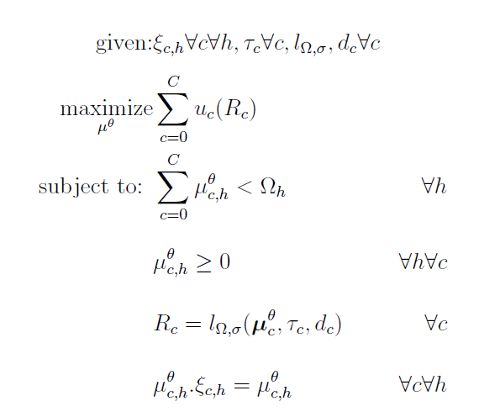
Contribution 2:Problem Formulation
Sum of utilities
Capacity Constraints
Application model
Deployment model

Slide 15
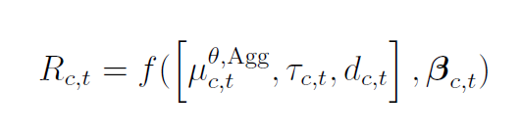
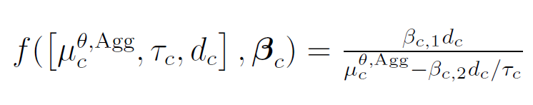
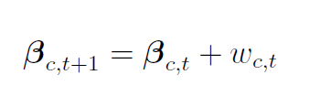
Contribution 2: Solution (Model)
Building an offline model through nonlinear regression and dynamically tune it through an Extended Kalman Filter
Model Simplification→
Selected Model→
Random walk → changes

Slide 16
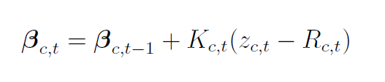
Contribution 2: Solution (Feedback Based Estimation)
Linear feedback equation based on new measurements

Slide 17
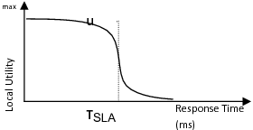
Contribution 2: Solution (An Individual Utility Function)
The function was selected in a way that makes it suitable for subgradient optimization method
Vertical line indicates the SLA target of an application

Slide 18
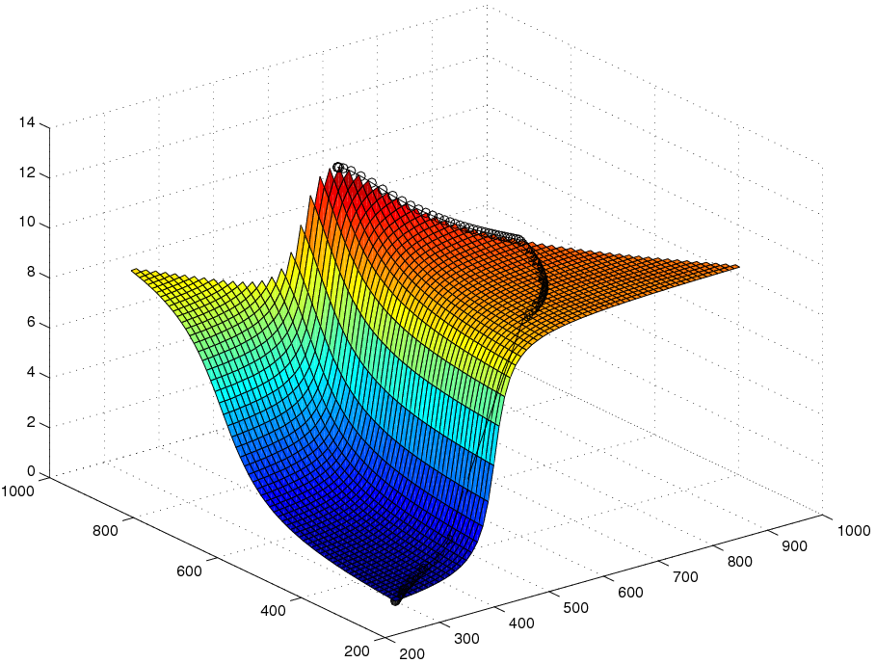

Contribution 2: Solution (Global Utility Maximization)
We find the maximum utility with variations in capacity using subgradient optimization algorithm.
Detailed algorithm is presented in page 100 of the thesis.

Slide 19
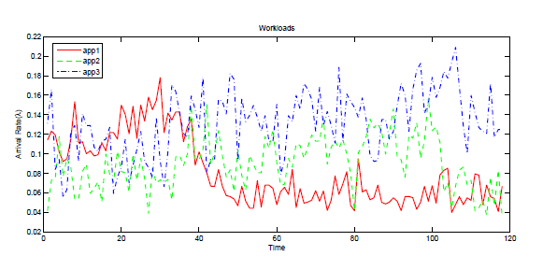
Contribution 2: Results (Workload)
Workload of 3 applications

Slide 20
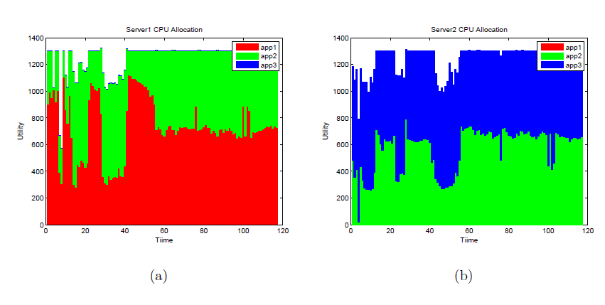
Contribution 2: Results (Allocations)
Optimal allocation of two physical machines to 3 applications over time.

Slide 21
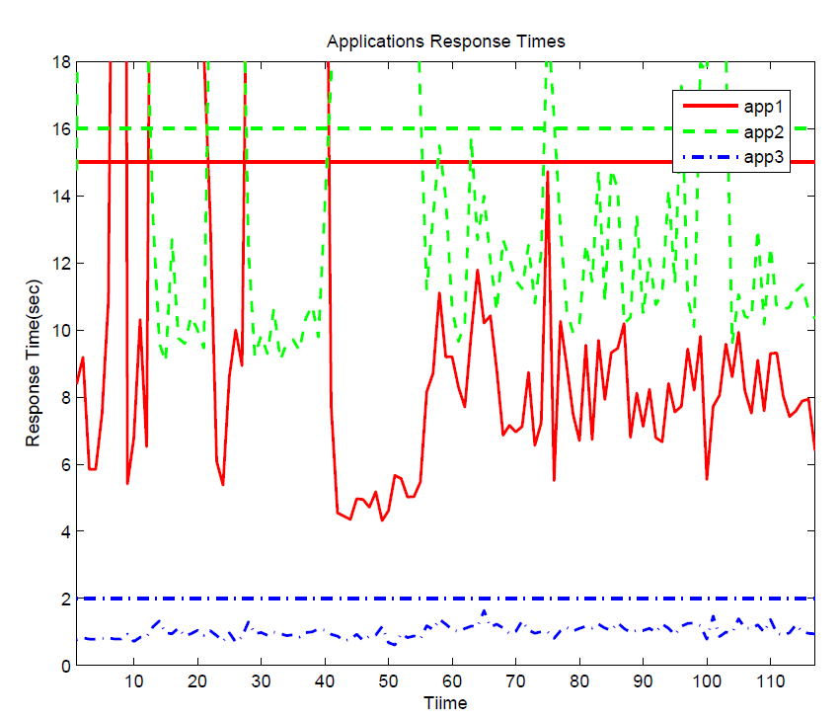
Contribution 2: Results (SLA Achievement)
Response Time of Applications and Response Time SLAs

Slide 22
Contribution 2: Conclusion
We investigated an approach which dynamically updates an empirical model for each application at runtime.
We showed, in terms of performance, dynamic adjustment of model parameters using an EKF, can outperform a model built off-line using a non-linear regression.

Slide 23
Contribution 3: Problem
When there is a restriction, guideline, or associated cost on the number of reconfigurations, the static optimization does not work well.

Slide 24
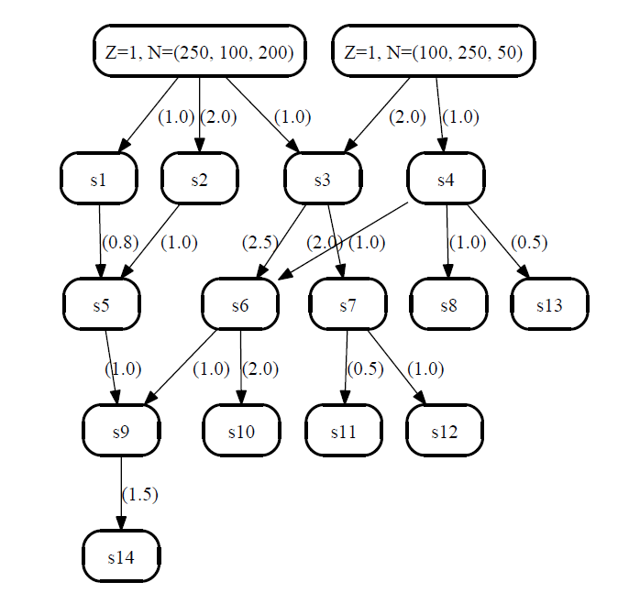
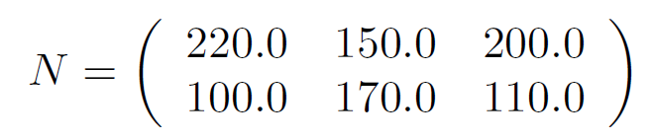


Contribution 3: Problem (Example: A Small Scale Service Center with Dynamic Stochastic Traffic)

Slide 25
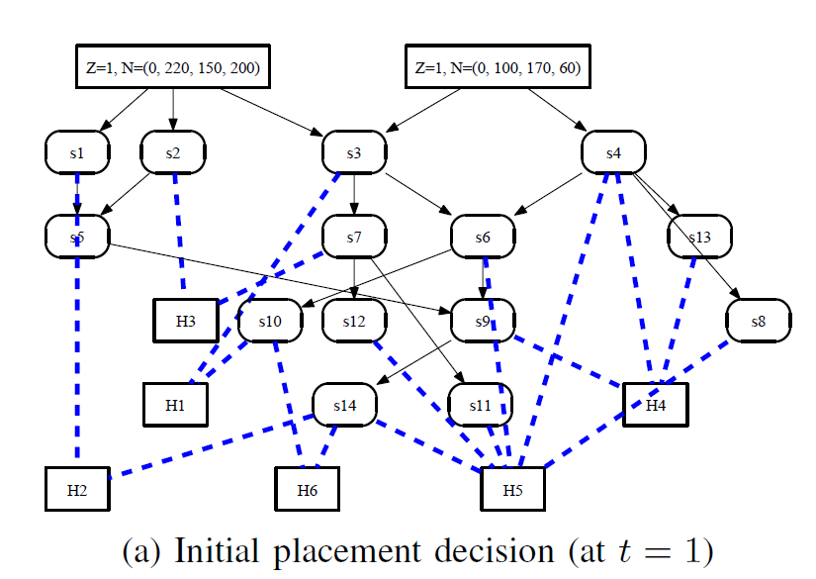
Contribution 3: Problem (Example: A Small Scale Service Center with Dynamic Stochastic Traffic)

Slide 26
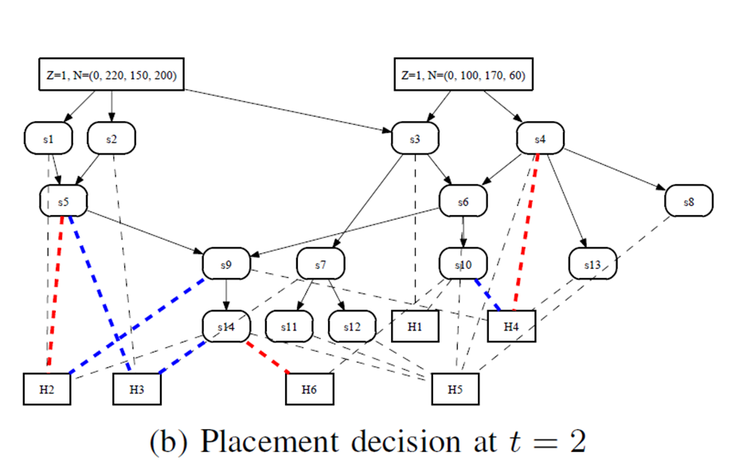
Contribution 3: Problem (Example: A Small Scale Service Center with Dynamic Stochastic Traffic)

Slide 27
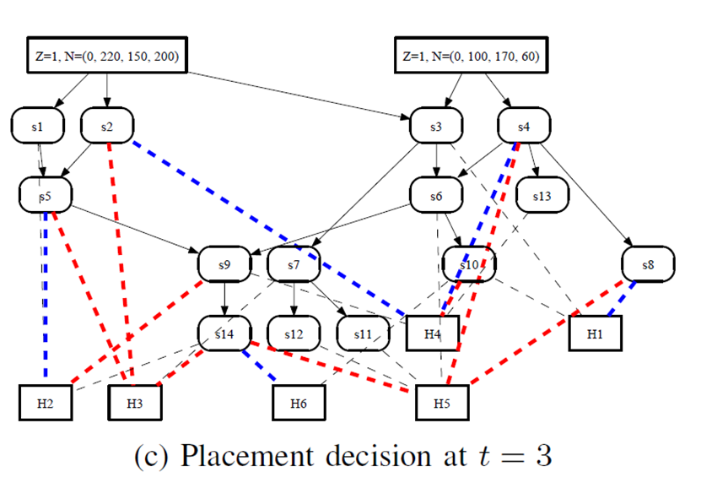
Contribution 3: Problem (Example: A Small Scale Service Center with Dynamic Stochastic Traffic)

Slide 28
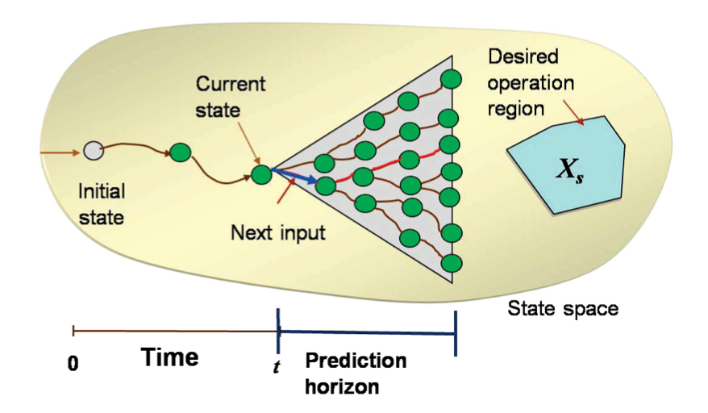
Contribution 3: Approach
We propose a dynamic service placement algorithm that considers the trashing cost in calculating the optimal configuration using Model Predictive Control (MPC).
From [Bai and Abdelwahed]

Slide 29
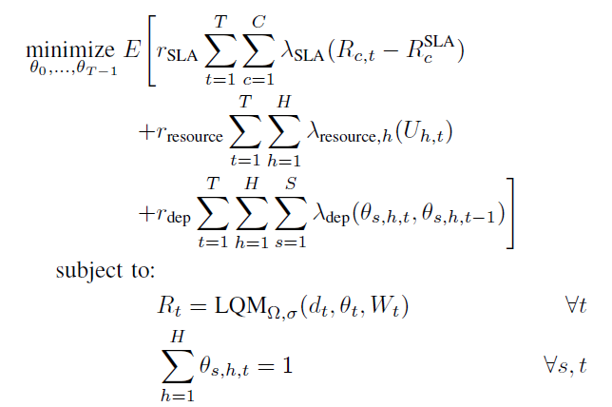
Contribution 3: Problem Formulation
← Cost of SLA violations
← Cost of resources
← Cost of reconfiguration
Notes:
What is each cost component? add that

Slide 30
Contribution 3: Solution
The Solution is presented in page 131 of the thesis
It addresses 4 challenges:
Dealing with the non-linearity of the LQM
Approximating the Effects of Resource Contention
Non-linearity in the Resource Cost
Non-linearity in the Reconfiguration Cost
Considers the Stochastic Workload
A ‘Solver Friendly Format’ is presented in page 136 of the thesis
A solution considering the effect of the contention is presented in page 138

Slide 31
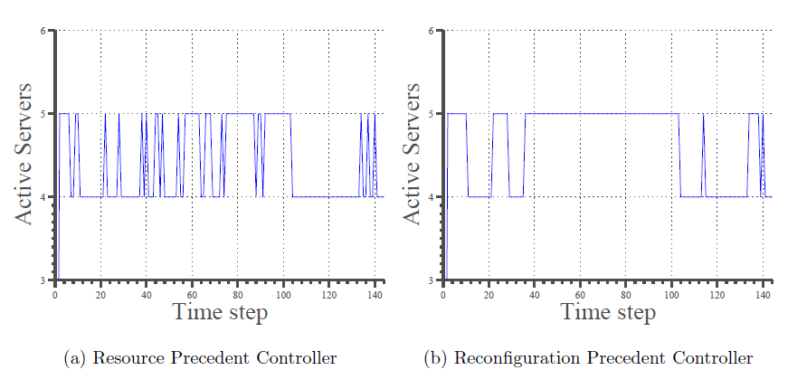
Contribution 3: Results

Slide 32
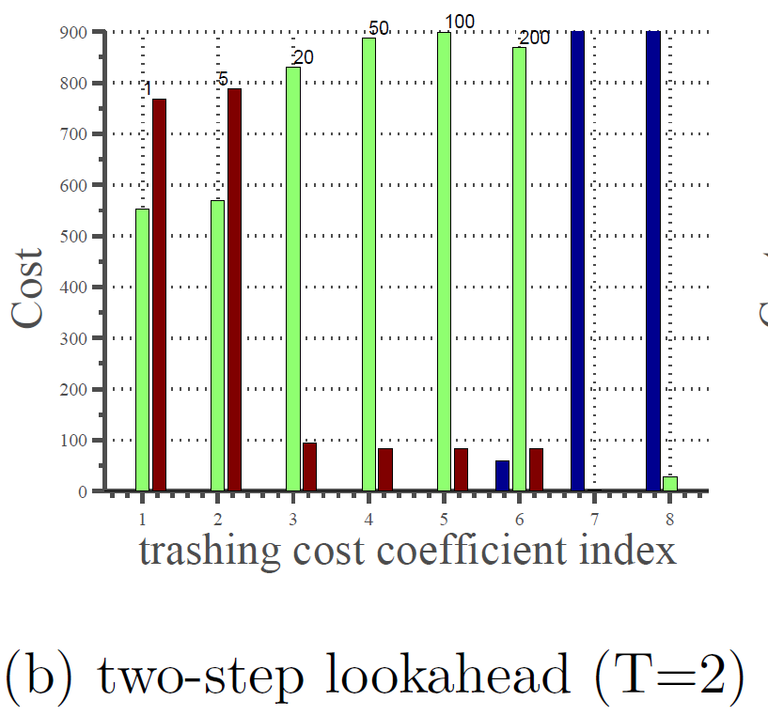
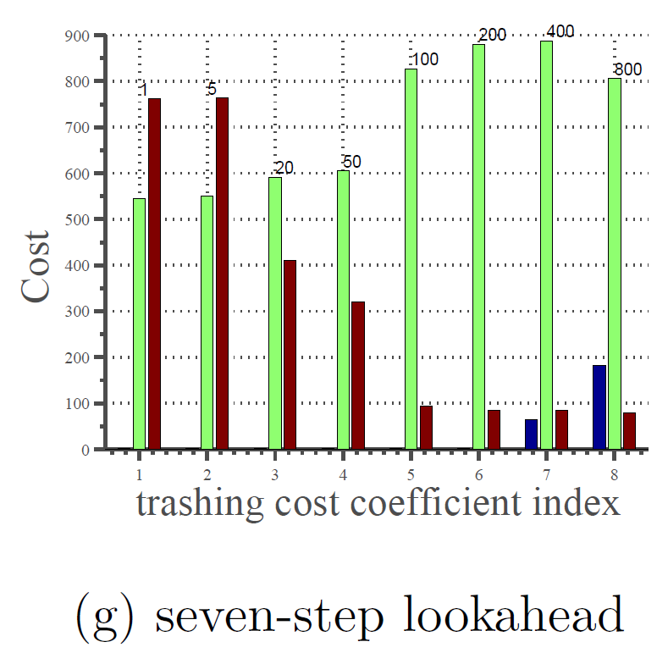

Contribution 3: Results

Slide 33
Contribution 3: Conclusion
We introduced a new optimization model and a simple fast algorithm for the optimal service placement (OSP) of a set of N-tier software systems, subject to changes in the workloads, SLAs, and the administrators preferences.
The described experiments validated our hypothesis that model predictive approaches perform better than simple stepwise optimization when the objective functions are long term and when reconfiguration is taken into account.

Slide 34
Summary of Contributions
We investigated a tracking approach, that identifies the performance parameters of groups of classes (we call them clusters) instead of individual classes.
We proposed an algorithm that finds the appropriate number of clusters with a pre-defined clustering accuracy.
We investigated an approach which dynamically updates an empirical model for each application at runtime.
We showed, in terms of performance, dynamic adjustment of model parameters using an EKF, can outperform a model built off-line using a non-linear regression.
We introduced a new optimization model and a simple fast algorithm for the optimal service placement (OSP) of a set of N-tier software systems.
The described experiments validated our hypothesis that model predictive approaches perform better than simple stepwise optimization.

Slide 35
Future Work
In contribution 1, we used the maximum acceptable error value of 8% in the experiments, to control the balance between the introduced error and complexity of the model. One can model the relationship between the computation complexity and the modelling error explicitly.
For contribution 2 one can investigate solving the dual optimization problem, which is more suitable for mapping to an agent-oriented optimization approach.
One can consider different models of non-stationary autonomous processes for the workload, and see if these models result into different performances in the overall control.

Slide 36
Publications
Hamoun Ghanbari, Marin Litoiu, Cornel Barna, Przemyslaw Pawluk, Replica placement in cloud through simple stochastic model predictive control.
H. Ghanbari, B. Simmons, M. Litoiu, C. Barna, and G. Iszlai, Optimal autoscaling in a IaaS cloud.
H. Ghanbari, B. Simmons, M. Litoiu, and G. Iszlai, Feedback-based optimization of a private cloud.
Hamoun Ghanbari, Bradley Simmons, Marin Litoiu, and Gabriel Iszlai, Exploring alternative approaches to implement an elasticity policy.
H. Ghanbari et al., Tracking adaptive performance models using dynamic clustering of user classes.
Hamoun Ghanbari and Marin Litoiu, Identifying implicitly declared selftuning behavior through dynamic analysis.
Hamoun Ghanbari, Autonomic mechanisms in cloud computing ecosystems, Qualifying exam report, 2011, http://www.cse.yorku.ca/~hamoun/qual/.
Notes:
Include the papers
Sub contributions
First slides after title should be list of papers

Slide 37


