Slide 1
Optimal Italian restaurant placement
Predicting best London borough for Gordon Ramsay’s new upscale restaurant

Slide 2
Introduction
Gordon Ramsay is starting a new fancy Italian restaurant in London, but where?
Restaurant competition in London is high and we need to ensure plenty of potential customers – with thick wallets
Data science can be used to compare Londons 32 boroughs based on:
Competitiveness (number of Italian restaurants per square km)
Customer spending proclivity (aggregated income per square km)

Slide 3
Datasets & APIs
Wikipedia page: List of London Neighborhoods with postal codes
https://en.wikipedia.org/wiki/List_of_areas_of_London
Greater London Authority: Average Income of Taxpayers, Borough and Population Density, Borough, datasets
https://data.london.gov.uk/dataset/average-income-tax-payers-borough
https://data.london.gov.uk/dataset/land-area-and-population-density-ward-and-borough
Geocoder API: Called to get coordinates for adresses
https://geocoder.readthedocs.io/index.html
Foursquare API: Called to get list of venues within specified range of a coordinate
https://developer.foursquare.com/

Slide 4
Methodology – Data Aquisition
Income of Taxpayers and Population Density were downloaded straight into Pandas dataframes
List of areas of London was scraped from Wikipedia using BeautifulSoup package
Coordinates added by calling Geocoder for each neighborhood and borough

Slide 5
Methodology – Data Cleaning I
Income of Taxpayers and Population Density datasets were filtered to only keep the following data for the London boroughs:
Median Household Income 2018, Population per km^2, Square kilometers
Some neighborhoods were assigned to multiple boroughs
A function was written to assign venues to the closest of the boroughs which its neighborhood was assigned to, based on venue and borough coordinates
Foursquare was called for each neighborhood coordinates, up to 500 results within 2 km
Duplicates were removed
Resulting dataframe had 28989 venues with 322 different categories

Slide 6
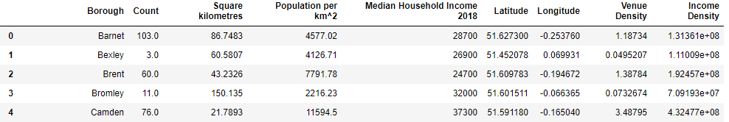
Methodology – Data Cleaning II
Venues dataframe filtered for ’Italian’ and ’Pizza’ categories
Results 545 pizza places and 477 Italian restaurants
Venues were grouped by borough
No results returned for four boroughs – these were removed
Number of restaurants per square km and aggregated taxpayer income per square km calculated (Venue Density & Income Density) for each borough
Cleaned and ready dataframe header below:

Slide 7

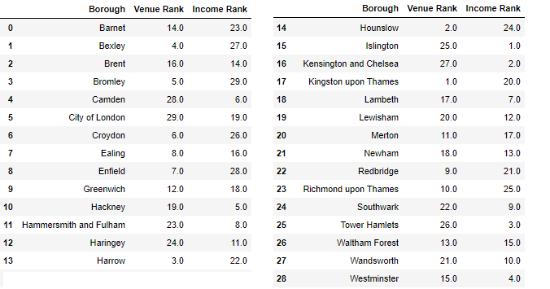
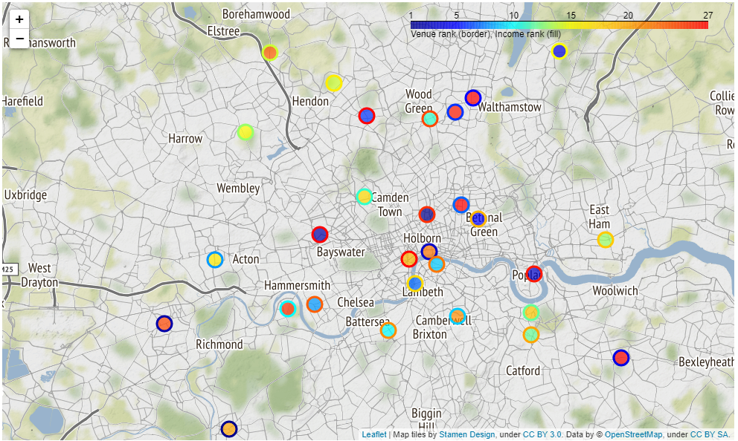
Results I
Exploratory analysis by ranking boroughs on Venue Density (lower density is better) and Income Density (higher is better)
Plotted on Folium heat map by venue rank (border color) and income rank (fill color) of markers
Boroughs with border and fill on blue spectrum are promising (high on both rankings)
Ealing
Hackney
Lambeth
Waltham Forest
Westminster

Slide 8
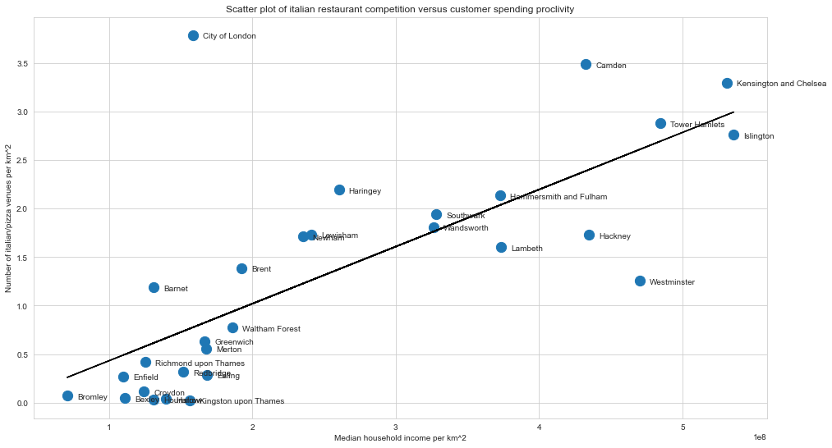
Results II
Rankings were complemented by plooing the relationship between venue density and income density
Linear regression trendline added
Best boroughs will be below line and far to the right: Few restaurants and high income compared to other boroughs
Westminster, followed by Hackney and Lambeth are clear best candidates
Islington possible candidate – high income
Waltham Forest in bottom left has low income – not a candidate for high end restaurant

Slide 9
Conclusion
Open data from the Greater London Authority, Wikipedia, Foursquare and Geocoder was used to find the optimal placement of a high-end italian restaurant in London
Parameters used were number of competing Italian restaurants per square km and aggregated income per square km
Analysis indicated Westminster being the best candidate, with Lambeth, Hackney and Islington as viable options
Further analysis should be conducted on the neighborhood level (as opposed to borough) and using a greater range of parameters (e.g property cost, competing non-Italian restaurants)

