Slide 1
vigilance in mobile camps using MQTT protocol
P HAMSA DATTA 15BEC0173
K VAMSI KRISHNA 15BEC0049

Slide 2

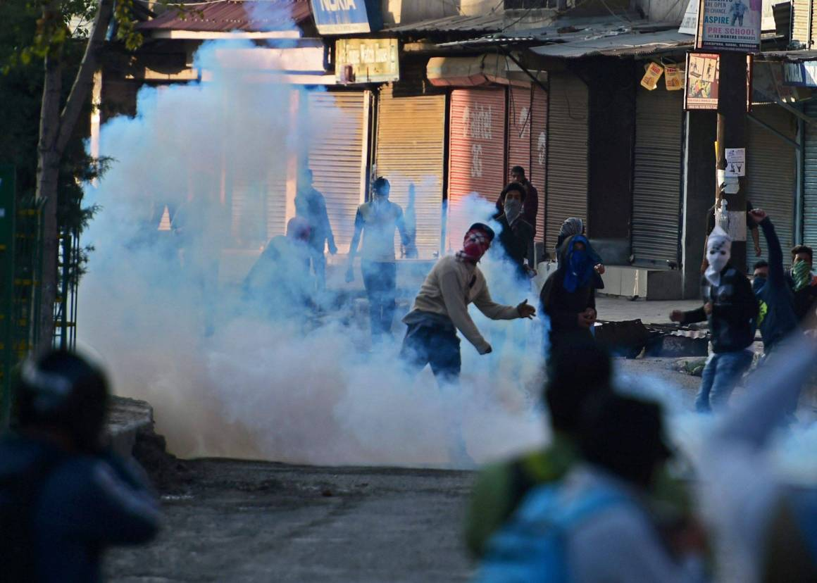
Motivation

Slide 3

Motivation

Slide 4

MQTT
MQTT stands for MQ Telemetry Transport.
Works in Publish/subscribe method.
Extremely simple and lightweight messaging protocol, designed for constrained devices and low-bandwidth, high-latency or unreliable networks.
For mobile applications where bandwidth and battery power are at a premium.

Slide 5
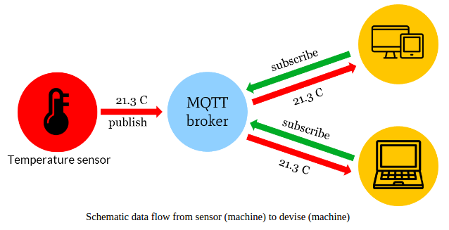
MQTT in short

Slide 6
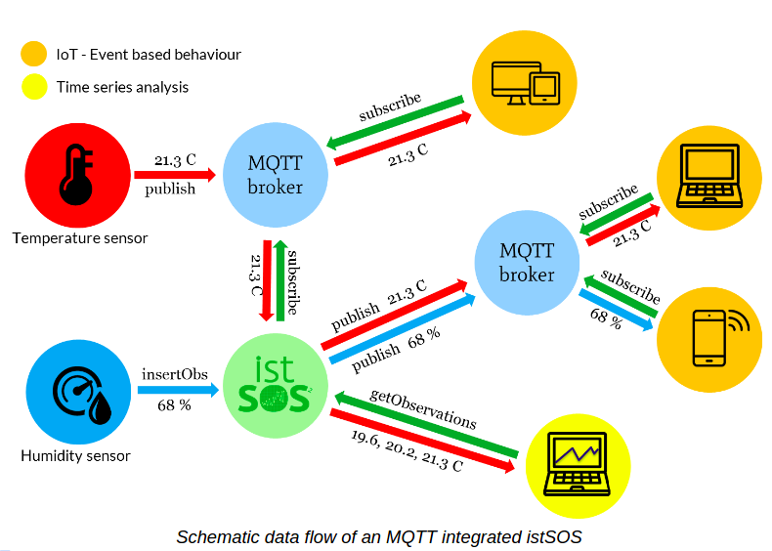
MQTT With Multiple Brokers

Slide 7
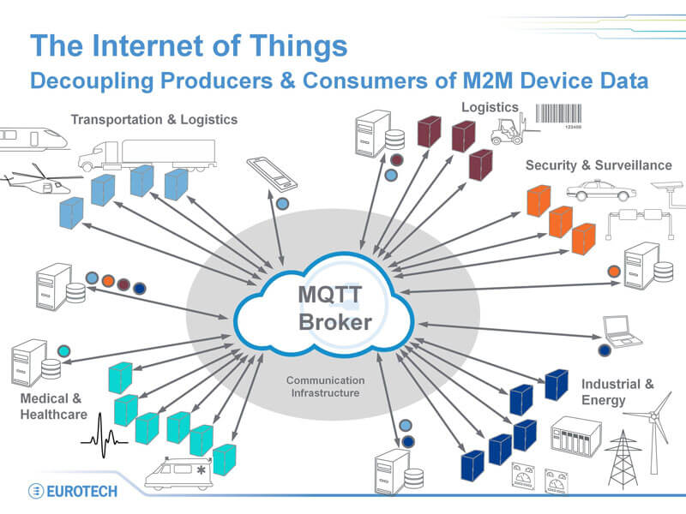
MQTT Possibilities

Slide 8
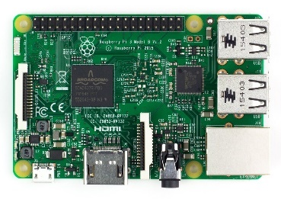
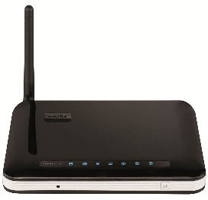
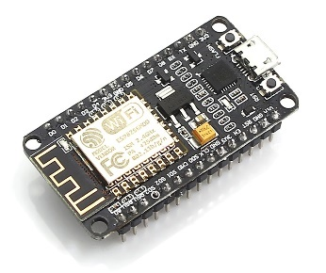
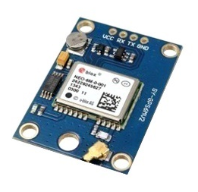
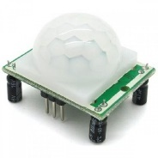
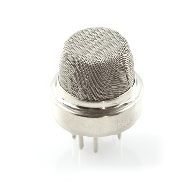
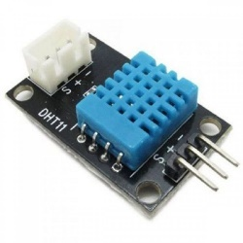
Block Diagram
Raspi Server
DWR-113 Router
Wireless Link
NodeMCU
Node(mobile)
Node
GPS
PIR
Gas
PIR
Temperature

Slide 9
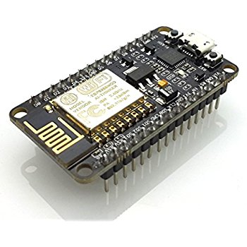
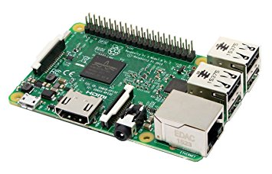
Overview
Protocol: MQTT
No of MQTT brokers(Master node) :1
No of Nodes: 3
No of sensors: 5-6
Hardware:
MQTT Broker Nodes

Slide 10
THANK YOU

