Slide 1
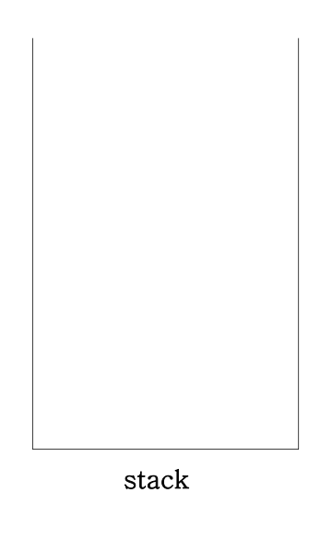
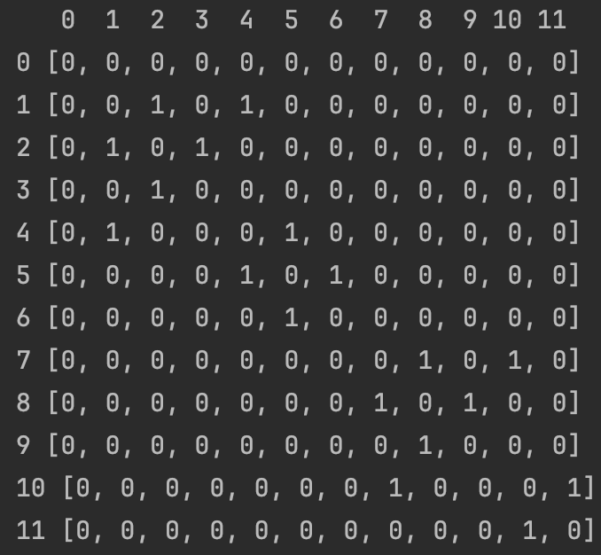
cnt = 0

Slide 2
DFS(1)
cnt = 1

Slide 3
DFS(1)
cnt = 1

Slide 4
DFS(2)
DFS(1)
cnt = 2

Slide 5
DFS(2)
DFS(1)
cnt = 2

Slide 6
DFS(2)
DFS(1)
cnt = 2

Slide 7
DFS(3)
DFS(2)
DFS(1)
cnt = 3

Slide 8
DFS(3)
DFS(2)
DFS(1)
cnt = 3

Slide 9
DFS(3)
DFS(2)
DFS(1)
cnt = 3

Slide 10
DFS(2)
DFS(1)
cnt = 3

Slide 11
DFS(1)
cnt = 3

Slide 12
DFS(1)
cnt = 3

Slide 13
DFS(4)
DFS(1)
cnt = 4

Slide 14
DFS(4)
DFS(1)
cnt = 4

Slide 15
DFS(5)
DFS(4)
DFS(1)
cnt = 5

Slide 16
DFS(5)
DFS(4)
DFS(1)
cnt = 5

Slide 17
DFS(5)
DFS(4)
DFS(1)
cnt = 5

Slide 18
DFS(6)
DFS(5)
DFS(4)
DFS(1)
cnt = 6

Slide 19
DFS(6)
DFS(5)
DFS(4)
DFS(1)
cnt = 6

Slide 20
DFS(6)
DFS(5)
DFS(4)
DFS(1)
cnt = 6

Slide 21
DFS(5)
DFS(4)
DFS(1)
cnt = 6

Slide 22
DFS(4)
DFS(1)
cnt = 6

Slide 23
DFS(1)
cnt = 6

Slide 24
cnt = 6

