Slide 1

Bike Rental Demand Forecasting System
A machine learning–powered platform that predicts bike-sharing demand using weather conditions, seasonal trends, and temporal patterns — enabling smarter resource allocation and operational planning for smart cities.
ML · PREDICTIVE ANALYTICS · SMART CITIES

Slide 2
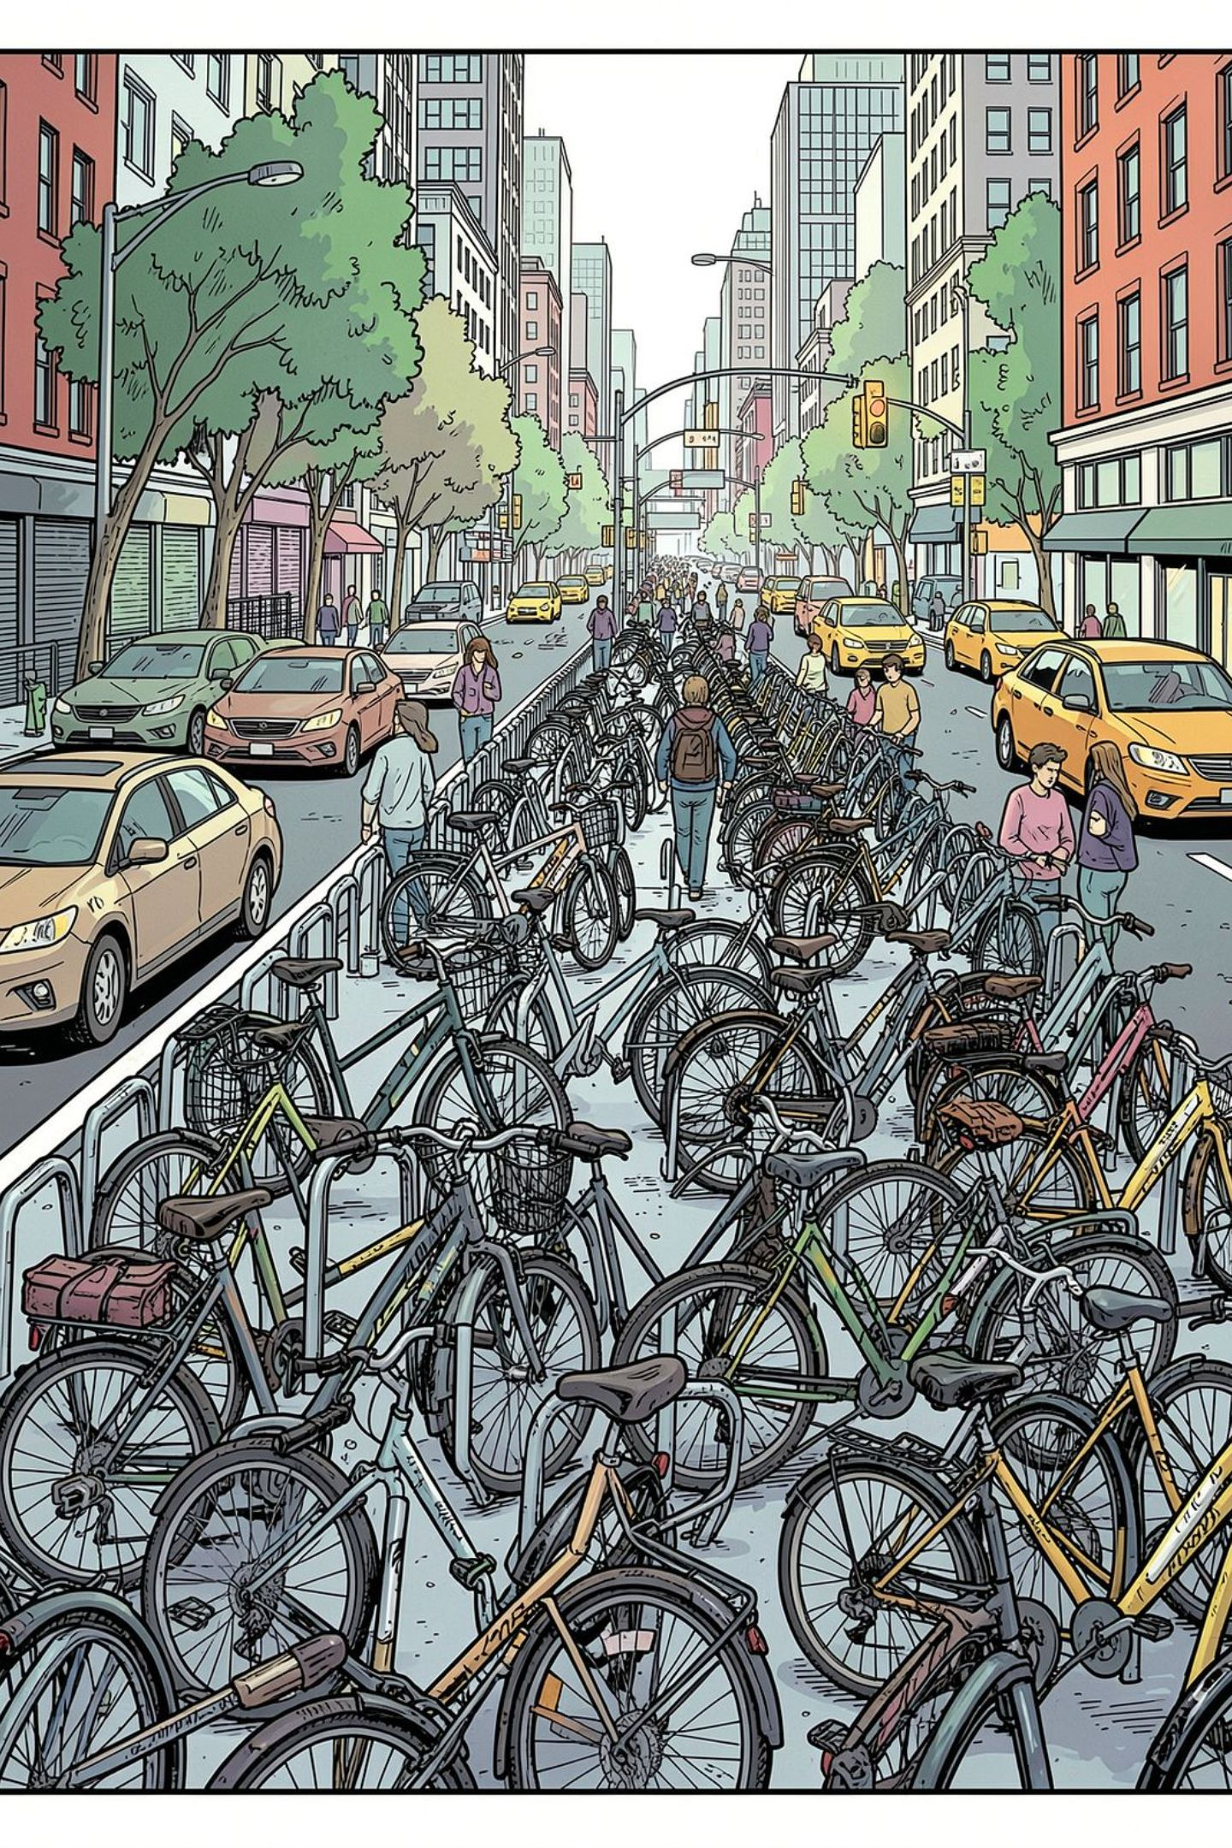
The Problem: Unpredictable Demand Hurts Operations
Imbalanced Fleet Distribution
Reactive Resource Planning
Stations run empty or overflow because operators cannot anticipate demand spikes tied to weather, holidays, or rush hours.
Manual redistribution is costly and slow. Without forecasts, companies respond to shortages after they occur.
Missed Revenue & Poor UX
Unavailable bikes frustrate users and reduce ridership, directly impacting revenue and customer retention.

Slide 3
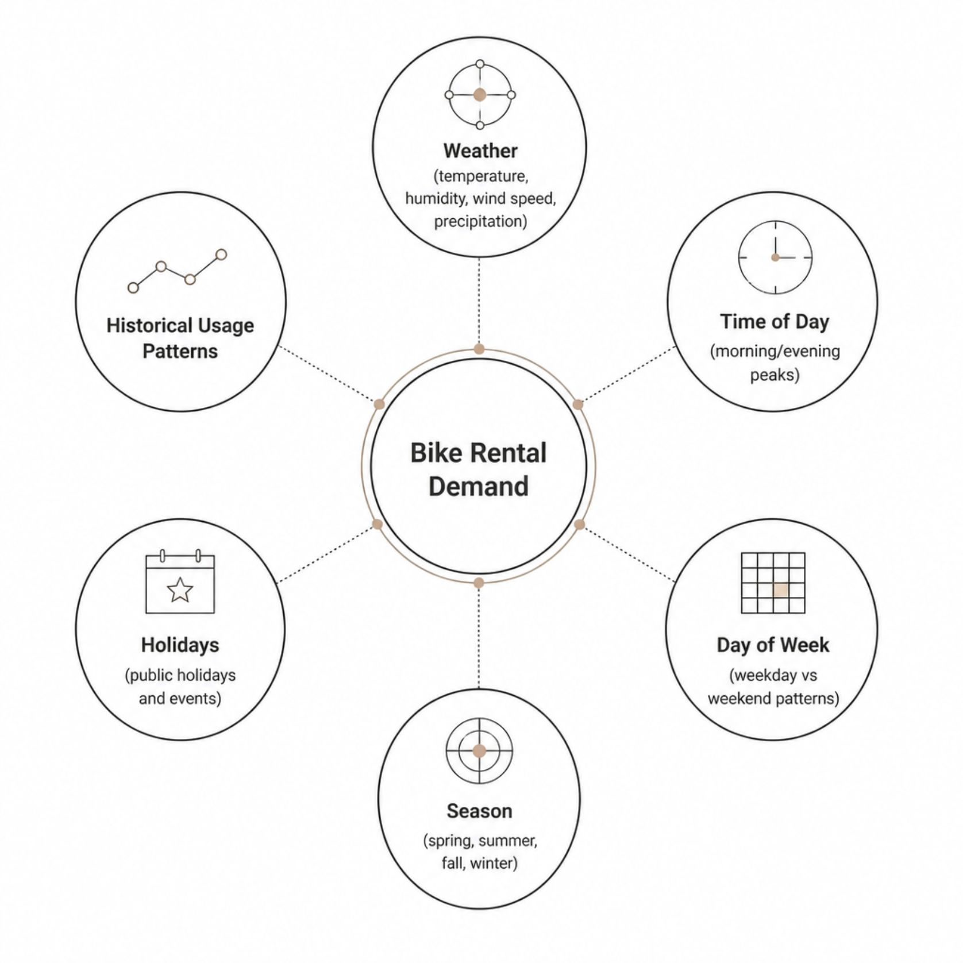
What Drives Bike Rental Demand?
Demand is shaped by a complex interplay of environmental, temporal, and social factors. Our system captures all of them.
Multi-Factor Influence
Each factor contributes uniquely to demand variability. Weather and seasonality dominate long-term trends, while time-of-day and holidays drive short-term fluctuations.
Temperature & humidity shift rider behavior
Holidays create irregular demand surges
Seasonal cycles reveal annual patterns
Peak hours concentrate commuter traffic

Slide 4

Project Objectives
1
2
Collect & Integrate Data
Engineer Predictive Features
Aggregate historical rental records with real-time weather, calendar, and environmental data sources.
Transform raw inputs into meaningful features — lag variables, rolling averages, and seasonal encodings.
3
4
Train & Evaluate Models
Deploy Real-Time Forecasts
Apply regression algorithms (Random Forest, XGBoost, Linear Regression) and benchmark using RMSE & R².
Deliver live demand predictions through an interactive dashboard for operational decision-making.

Slide 5
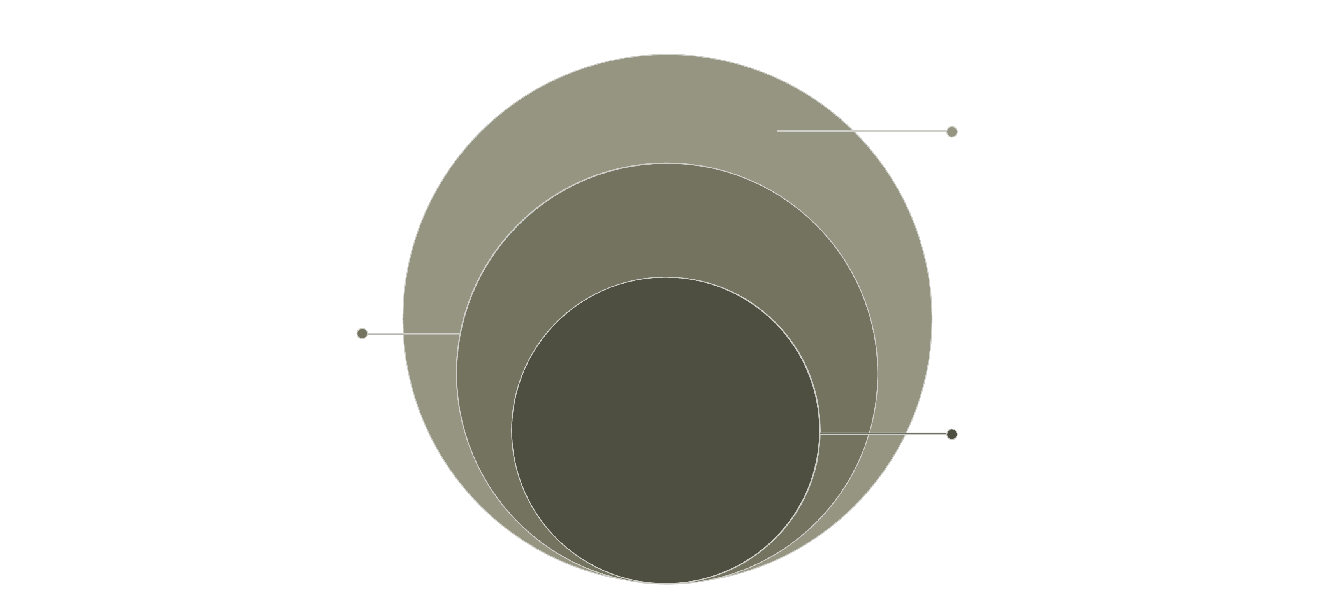
System Architecture
Data & App
Historical data, APIs, forecasts
Processing
Preprocessing and feature engineering
Core ML
Model training and evaluation
The pipeline flows from raw data ingestion through intelligent processing and model inference to actionable outputs — ensuring low-latency, accurate demand forecasts at every operational level.

Slide 6
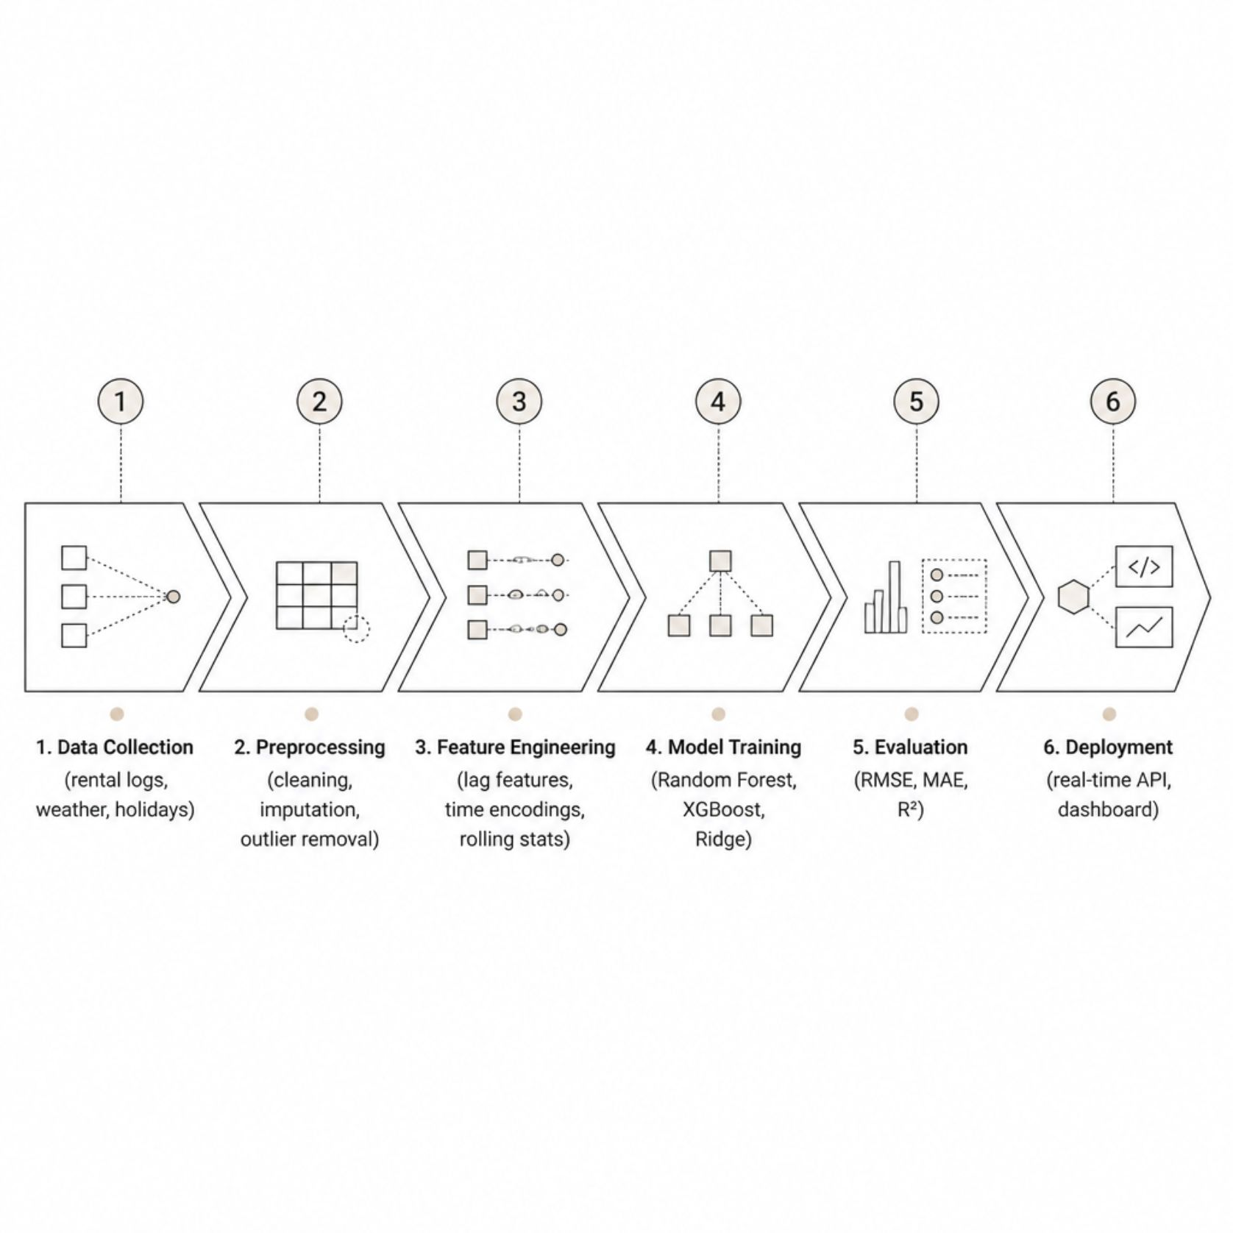

Machine Learning Workflow
End-to-End Predictive Pipeline
Each stage is designed for reproducibility and scalability. Cross-validation and hyperparameter tuning ensure models generalize well to unseen conditions.
Models are retrained periodically to adapt to evolving usage patterns and seasonal shifts.

Slide 7





Data Preprocessing & Feature Engineering
Data Cleaning
Handle missing values, remove outliers, and standardize formats across weather and rental datasets.
Temporal Features
Encode hour, day-of-week, month, and holiday flags. Create lag features capturing recent demand history.
Weather Encoding
Normalize temperature, humidity, and wind speed. One-hot encode categorical weather conditions.
Rolling Statistics
Compute 7-day and 30-day rolling averages to capture trend momentum and seasonality signals.

Slide 8
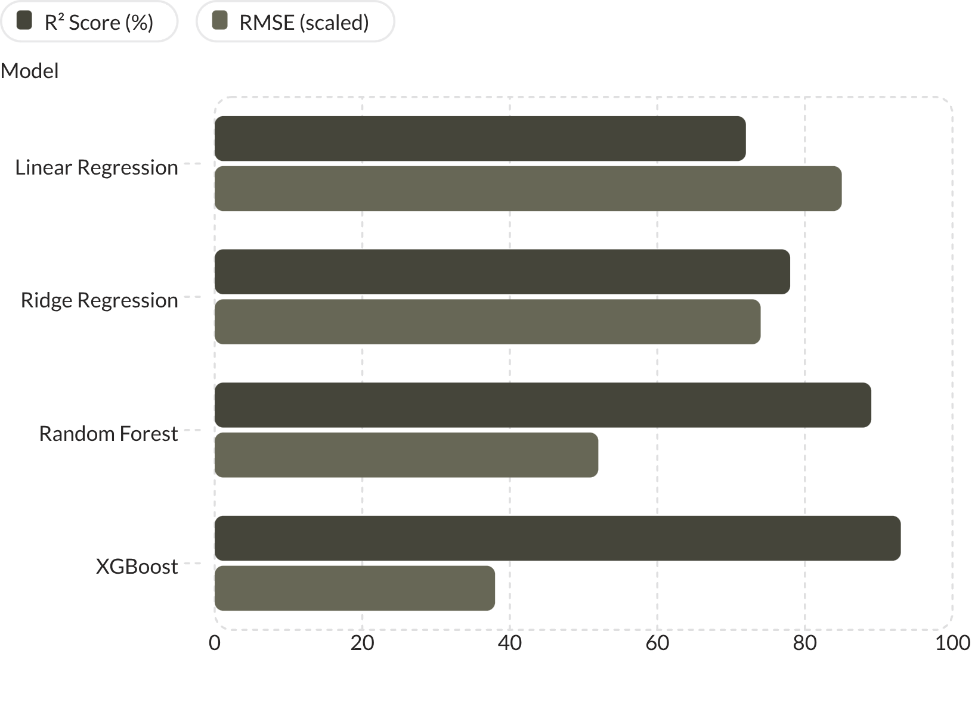
Model Training & Evaluation
Comparative Model Performance
Gradient boosting models (XGBoost, Random Forest) consistently outperform linear baselines, capturing non-linear weather-demand relationships and interaction effects.
XGBoost achieves highest R² (93%) with lowest RMSE
Feature importance reveals temperature & hour as top predictors
Cross-validation confirms robustness across seasons

Slide 9
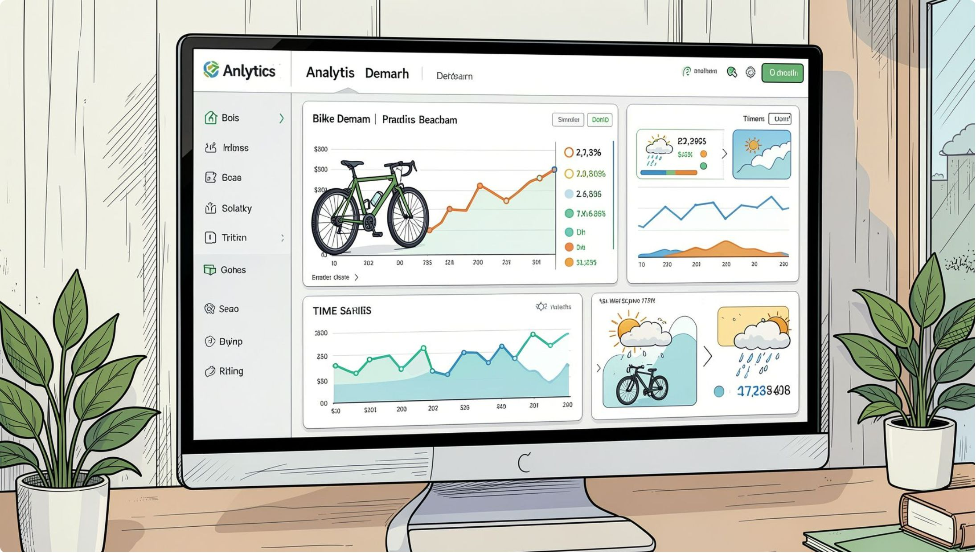

Interactive Analytics Dashboard
Real-Time Operational Intelligence
The dashboard translates model outputs into actionable insights for fleet managers and city planners.
Demand Forecast Charts
Weather Impact Analysis
Station Utilization Heatmap
Hourly and daily predicted demand with confidence intervals overlaid on historical trends.
Correlation views showing how temperature, rain, and wind shift rental patterns.
Geospatial view of predicted demand hotspots for proactive redistribution.

Slide 10
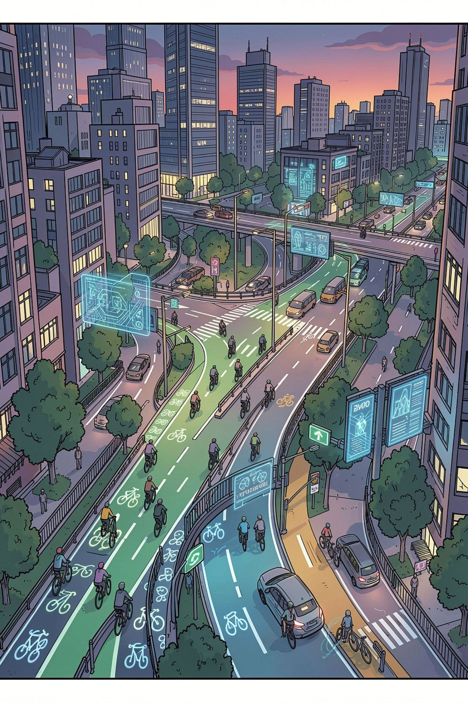

Impact, Applications & Roadmap
🚲 Bike-Sharing Operators
🏙️ Smart City Initiatives
Optimize fleet redistribution, reduce empty-station incidents, and lower operational costs through predictive planning.
Integrate demand forecasts into urban mobility platforms for sustainable, data-driven transportation management.
🔭 Future Enhancements
Deep learning (LSTM/Transformer), real-time streaming, user behavior modeling, and multi-city scalability.
Key Outcome: Accurate demand forecasting reduces operational costs, improves bike availability, and enables intelligent, sustainable urban transportation.

