Slide 1

CST1510 Programming for data communication and data structure
Week 19

Slide 2
Revision:
Tkinter GUI

Slide 3
Objectives:
Socket Programming in Python
Socket API Overview
Socket Client and Server

Slide 4
Introduction:
Socket programming refers to an abstract principle by which two programs can share any data stream by using an Application Programming Interface (API) for different protocols available in the internet TCP/IP stack, typically supported by the operating systems.
Sockets are the main components that allow us to exploit the capabilities of the operating system to interact with the network.
You may regard sockets as a point-to-point channel of communication between a client and a server.
Communication between different entities in a network is based on the classic socket concept developed by Python. A socket is specified by the machine's IP address, the port it is listening to, and the protocol it uses.
Notes:
In computer science, inter-process communication or interprocess communication (IPC) refers specifically to the mechanisms an operating system provides to allow the processes to manage shared data. Typically, applications can use IPC, categorized as clients and servers, where the client requests data and the server responds to client requests.

Slide 5
Sockets in Python
Creating a socket in Python is done through the socket.socket() method.
Based on the communication type, sockets are classified as follows:
Sockets can also be categorized by family. The following options are available:
There are two basic types of raw socket
s = socket.socket (socket_family, socket_type, protocol=0)
TCP sockets (socket. SOCK STREAM)
UDP sockets (socket. SOCK DGRAM)
TCP is connection-oriented, while UDP is non-connection-oriented
UNIX sockets (socket. AF UNIX), based on data
The socket. AF INET socket for working with the IPv4 protocol
The socket.AF INET6 socket for working with the IPv6 protocol
AF_PACKET family: The raw sockets of the AF_PACKET family are the lowest level and allow
reading and write protocol headers of any layer.
AF_INET family: The AF_INET raw sockets delegate the construction of the link headers to the operating system and allow
shared manipulation of the network headers.

Slide 6
The socket module
The socket module provides all of the required functionalities to quickly write TCP and UDP clients and servers.
The socket module provides every function you need in order to create a socket server or client.
When we are working with sockets, most applications use the concept of client/server where there are two applications, one acting as a server and the other as a client, and where both communicate through message-passing using protocols such as TCP or UDP:
Server: This represents an application that is waiting for connection by a client.
Client: This represents an application that connects to the server.

Slide 7
Socket API Overview
The primary socket API functions and methods in this module are:
socket()
bind()
listen()
accept()
connect()
connect_ex()
send()
recv()
close()
Notes:
Berkeley sockets is an application programming interface (API) for Internet sockets and Unix domain sockets, used for inter-process communication (IPC). It is commonly implemented as a library of linkable modules. It originated with the 4.2BSD Unix operating system, released in 1983.
A socket is an abstract representation (handle) for the local endpoint of a network communication path. The Berkeley sockets API represents it as a file descriptor (file handle) in the Unix philosophy that provides a common interface for input and output to streams of data.
Berkeley sockets evolved with little modification from a de facto standard into a component of the POSIX specification. The term POSIX sockets is essentially synonymous with Berkeley sockets, but they are also known as BSD sockets, acknowledging the first implementation in the Berkeley Software Distribution.

Slide 8
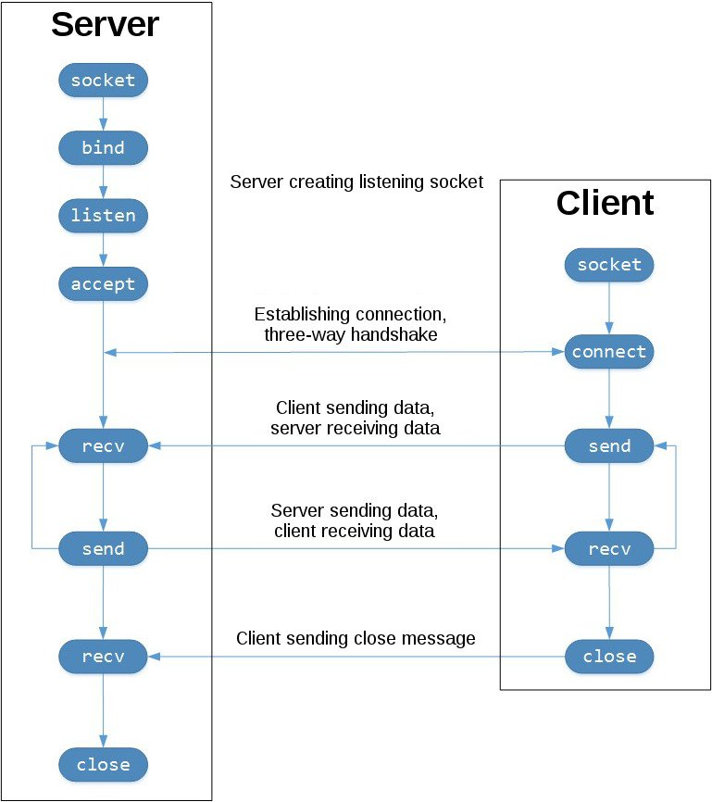
TCP Socket Flow (image source)

Slide 9
Server socket methods
socket.bind(address): This method allows us to connect the address with the socket, with the requirement that the socket must be open before establishing the connection with the address.
socket.listen(count): This method accepts as a parameter the maximum number of connections from clients and starts the TCP listener for incoming connections.
socket.accept(): This method enables us to accept client connections and returns a tuple with two values that represent client_socket and client_address. You need to call the socket.bind() and socket.listen() methods before using this method.

Slide 10
General socket methods used in both clients and servers:
socket.recv(buflen): This method receives data from the socket. The method argument indicates the maximum amount of data it can receive.
socket.recvfrom(buflen): This method receives data and the sender's address.
socket.recv_into(buffer): This method receives data into a buffer.
socket.recvfrom_into(buffer): This method receives data into a buffer.
socket.send(bytes): This method sends bytes of data to the specified target.
socket.sendto(data, address): This method sends data to a given address.
socket.sendall(data): This method sends all the data in the buffer to the socket.
socket.close(): This method releases the memory and finishes the connection.

Slide 11
Client socket methods
socket.connect(ip_address): This method connects the client to the server IP address.
socket.connect_ext(ip_address): This method has the same functionality as the connect() method and also offers the possibility of returning an error in the event of not being able to connect with that address.

Slide 12
Basic- Server and client socket implementation
import socket # step 1 Create a server socket server_socket = socket.socket(socket.AF_INET, socket.SOCK_STREAM) # step 2 Bind host and a port with a specific socket server_socket.bind(("localhost", 9999)) # step 3 Listen for a connection from the client server_socket.listen(1) # step 4 Accept requests from a client socket, keeps waiting for incoming connections socket_client, (host, port) = server_socket.accept() # step 5 Receive and/or send data received_data = socket_client.recv(1024) print("Received data: ", received_data.decode('utf-8')) # step 6 Close the connection socket_client.close()
SERVER
CLIENT
import socket
# step 1 Create a client socket client_socket = socket.socket(socket.AF_INET, socket.SOCK_STREAM) # step 2 Connects the client to the server IP address. client_socket.connect(("localhost", 9999))
# step 3 Receive and/or send data message = 'hello from client' client_socket.send(bytes(message.encode("utf-8"))) # step 4 Close the connection client_socket.close()

Slide 13
SERVER
CLIENT
import socket HOST = '127.0.0.1' PORT = 65432 # step 1 Create a server socket server_socket = socket.socket(socket.AF_INET, socket.SOCK_STREAM) # step 2 Bind server_socket.bind((HOST, PORT)) # step 3 Listen server_socket.listen(1) print('Waiting for connection') # step 4 Accept socket_client, (host, port) = server_socket.accept() print(f'Received connection from {host} ({port})\n') print(f'Connection Established., Connected from: {host}')
# step 5 Received data from server received_data = socket_client.recv(1024) received_data= received_data.decode() print(f': The client said: {received_data} ')
# Sending data to the client server_message = 'Hello from Server' socket_client.send(server_message.encode()) # step 6 Close the connection socket_client.close()
import socket HOST = '127.0.0.1' PORT = 65432
# step 1 Create a server socket client_socket = socket.socket(socket.AF_INET, socket.SOCK_STREAM) # step 2 Connect client_socket.connect((HOST, PORT))
# step 3 Sending data to the server message = 'Hello from Client' client_socket.send(message.encode()) # step 4 Receiving data back from the server received_message = client_socket.recv(1024) server_message = received_message.decode() print(f': The server said: {server_message} ') # step 5 Close the connection client_socket.close()
Notes:
TOW ways sending and receiving data basic example

Slide 14
Activity
Implement server and client chat room system using Socket python module.
(you can modify/extend the client.py and serever.py from the unihub)

Slide 15
Object Oriented Python - Object Serialization
In serialization, an object is transformed into a format that can be stored, so as to be able to deserialize it later and recreate the original object from the serialized format.
Pickle
Pickling is the process whereby a Python object hierarchy is converted into a byte stream (usually not human readable) to be written to a file, this is also known as Serialization.
Unpickling is the reverse operation, whereby a byte stream is converted back into a working Python object hierarchy.
Pickle is operationally simplest way to store the object. The Python Pickle module is an object-oriented way to store objects directly in a special storage format.

Slide 16
Pickle methods
The pickle interface provides four different methods.
dump() − The dump() method serializes to an open file (file-like object).
dumps() − Serializes to a string
load() − Deserializes from an open-like object.
loads() − Deserializes from a string.
Please check (pickle_client and pickle_server py file for example of sending and receiving serialised data)

Slide 17
Note
Please check the Uni_Hub for sample code

