Slide 1


2025 - 2026
EAM Platform for Intelligent
Predictive Maintenance
Operational management, seven ML models and a RAG assistant
Host company: SagemCom Ezzahra
Realised by: Hamza Mbarki
1

Slide 2
Summary
01
General Context
04
Design & Implementation
02
Project Study
05
Demo
03
Requirements & Analysis
06
Conclusion & Perspectives
2

Slide 3
01
General
Context
3

Slide 4
01. General Context
Host Company
Industrial group designing and manufacturing high-value communication equipment
Products: set-top boxes, internet boxes, smart meters
Host department: Software Engineering & Innovation, in-house digital tools for equipment maintenance
Production lines served by the platform
SMT assembly
surface-mount lines
Functional testing
board & unit tests
Automated quality control
inspection stations
✓
7 months
✓
7 ML models (P1-P7)
✓
4 user roles
4

Slide 5
01. General Context
Background & Motivation
1
2
3
Reactive:
Preventive:
Predictive:
Repair after the failure
Repair on a calendar
Repair before the failure
Line stoppage, emergency parts ordering, maximum total cost.
Fixed intervals regardless of real condition: parts replaced too early, or failures between two visits.
Continuous reading of the machine's own signals (temperature, torque, wear) to anticipate it.
In most cases a machine's degradation is visible in its sensor data well before the stoppage. That is the premise the whole ML pipeline is built on.
5

Slide 6
02
Project
Study
6

Slide 7
02. Project Study
Problem Statement
X
Operations and prediction live in separate tools
X
Predictions technicians cannot understand
X
Failures are found after the stoppage
X
Documentation is disconnected from live machine status
How can one platform cover classic operational management and predictive maintenance, with predictions people trust and automation they control?
7

Slide 8
02. Project Study
Study of the Existant
ERP / EAM suites
Industrial IoT / APM
CMMS & spreadsheets
✓
Proven EAM coverage of assets and work orders
✓
Sensor analytics and reliability at scale
✓
Cheap and lightweight
✗
Predictive ML is a costly add-on, heavy licensing
✗
No assistant tied to live machine status, integration cost
✗
No prediction, no explanation, no traceability
SAP PM · IBM Maximo
GE Digital Predix · Maximo APM
Generic CMMS · Excel
8

Slide 9
02. Project Study
Study of the Existant
Criteria | EAM suites | IoT / APM | CMMS / Excel | Our solution
Full EAM coverage | ✓ | ⚠ | ⚠ | ✓
Predictive ML built in | ⚠ | ✓ | ✗ | ✓
Predictions explained in plain language | ✗ | ⚠ | ✗ | ✓
Assistant tied to live machine status | ✗ | ✗ | ✗ | ✓
No heavy licensing | ✗ | ✗ | ✓ | ✓
Automation guarded by human approval | ⚠ | ⚠ | ✗ | ✓
Qualitative assessment from public product positioning; ✓ yes · ⚠ partial or add-on · ✗ no
9

Slide 10
02. Project Study
Our Proposed Solution
Full EAM foundation
Users, machines, work orders, intervention orders, scheduling, archiving
Systematic explainability
Every prediction ships with a plain-language explanation
✓
✓
7 predictive models (P1-P7)
Failure, failure type, remaining life, anomaly, priority, schedule, parts
Conversational RAG assistant
Documentation + real-time machine status merged into every answer
✓
✓
Evidence fusion (DST)
4 advanced signals combined into one honest, unified health score
Guarded automation
Parts proposals generated, never ordered without human approval
✓
✓
10

Slide 11
02. Project Study
Working Methodology
Product Owner
SagemCom supervisor: prioritises business needs and validates each deliverable
1 Specify
2 Plan
Scrum Master
Intern: drives the specify → plan → build → verify cycle
3 Build
4 Verify
Development team
Intern, paired with an AI assistant for implementation and testing
7 monthly sprints, aligned with the roadmap.
Every feature has a written specification and an implementation plan before any code is written: full traceability of technical decisions.
11

Slide 12
03
Requirements
& Analysis
12

Slide 13
03. Requirements & Analysis
The Four Platform Roles
Administrator
Head Technician
AD
HE
Infrastructure & data
Planning & approval
Manages users, machines and the document base; overall view of the system.
Plans interventions, arbitrates priorities, approves procurement proposals.
Operations Manager
Technician
OP
TE
Oversight
Field execution
Consults machine labels and statuses at a glance.
Executes intervention orders, checks health status, queries the AI assistant.
13

Slide 14
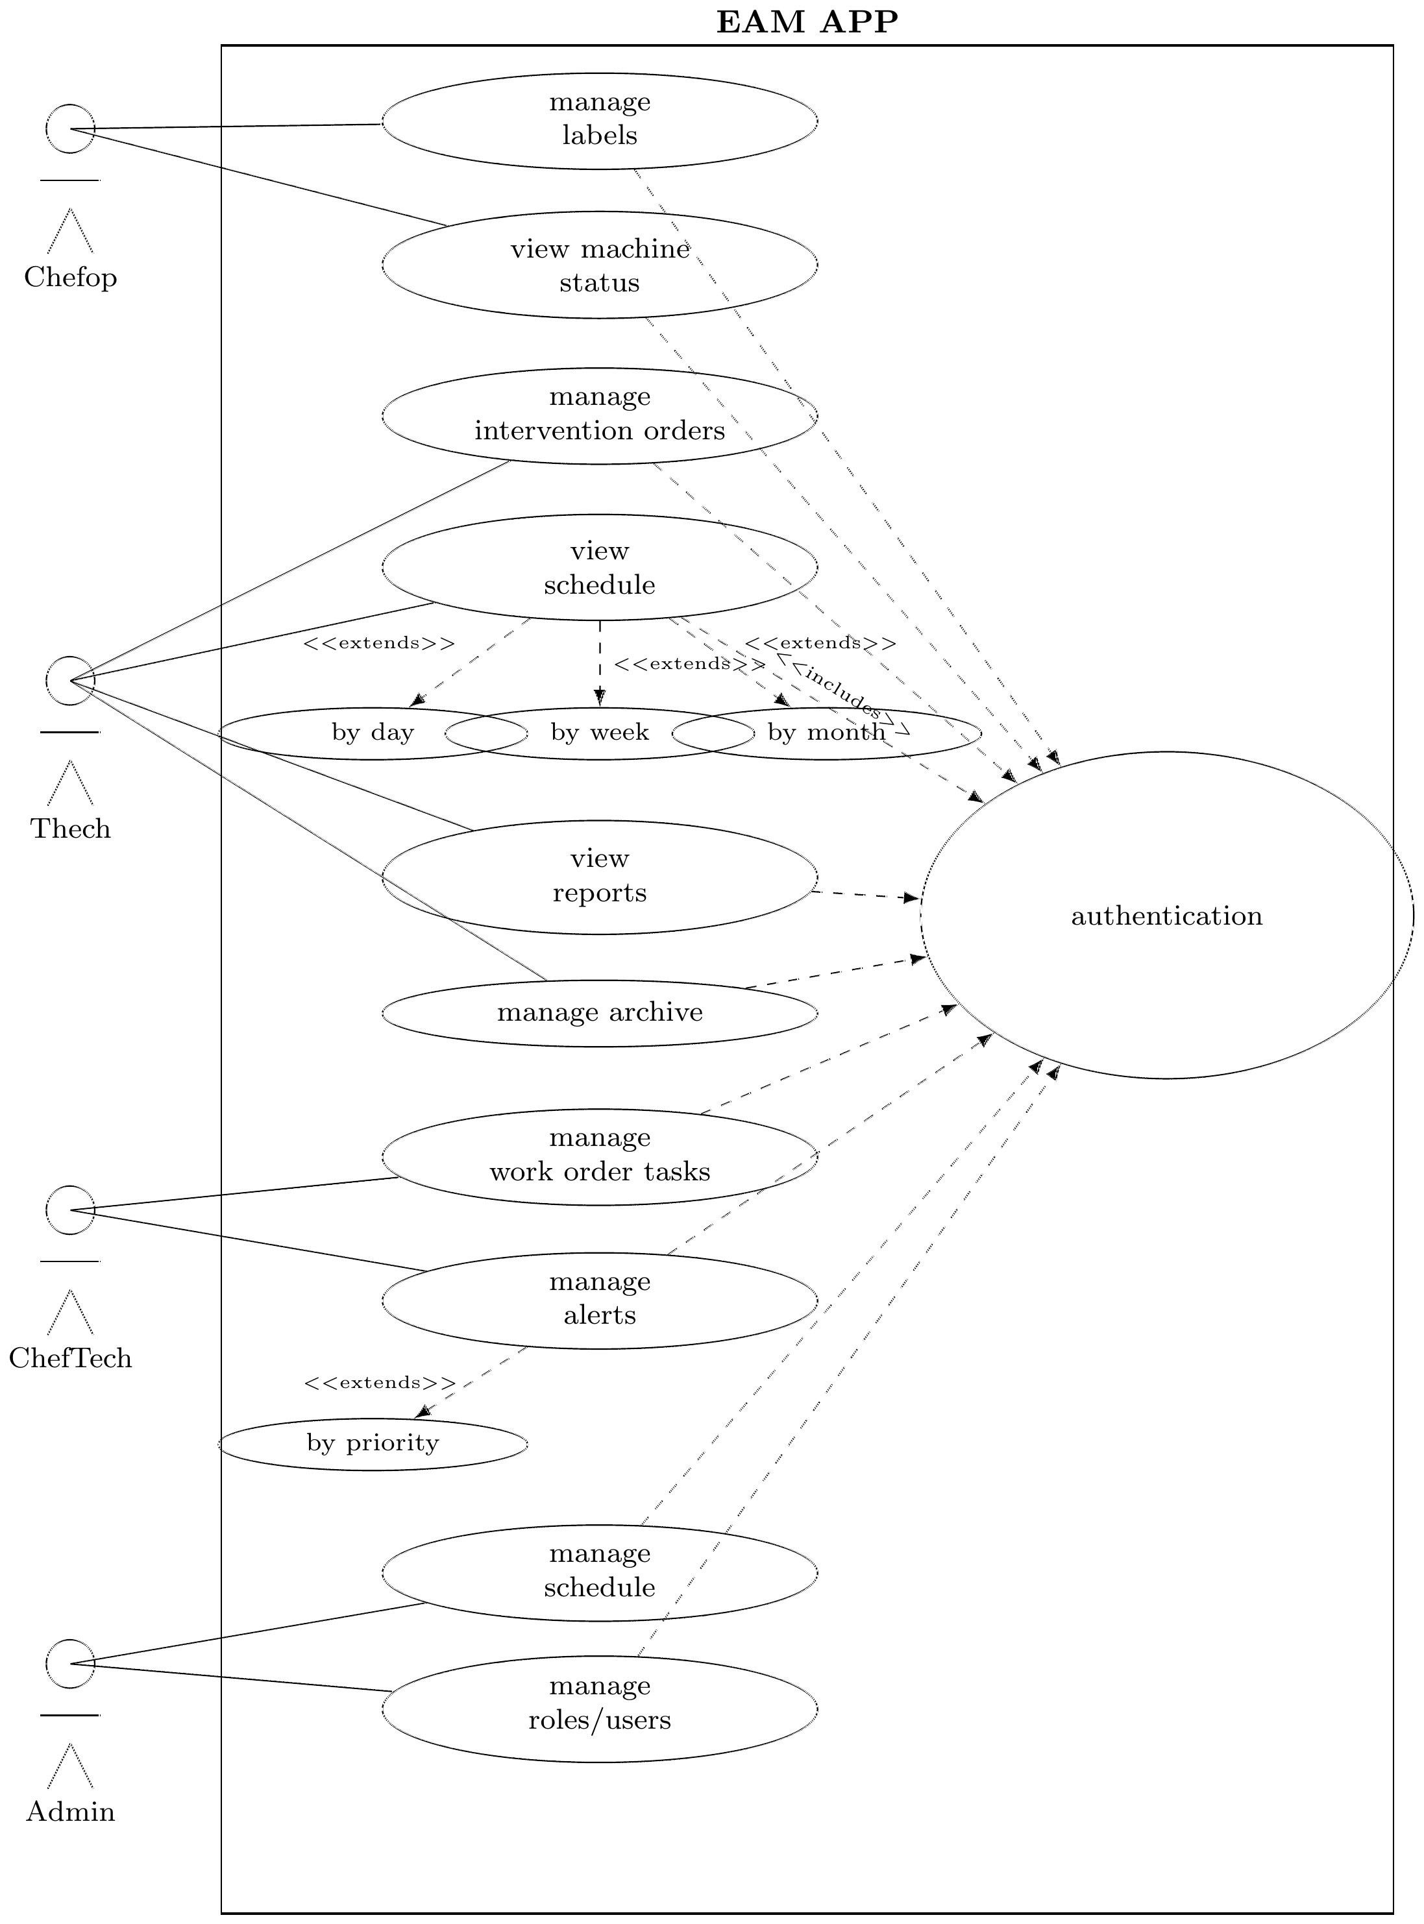
03. Requirements & Analysis
Use Case Diagram
14

Slide 15
03. Requirements & Analysis
Functional Requirements: 9 Areas
1
Authentication & authorization
4
Scheduling
7
Conversational assistant
2
Machine management
5
ML predictions (P1-P7)
8
Dashboards
3
Order management
6
Alerts & notifications
9
Archiving & traceability
Two rules cut across all nine: every prediction explains itself in plain language, and the system degrades honestly, reporting missing telemetry instead of inventing a value.
15

Slide 16
03. Requirements & Analysis
Non-Functional Requirements
Performance
Availability
< 2 s common operations; < 5 s full ML inference
EAM features keep working if the ML service is down
Maintainability
Portability
Layered separation; versioned Alembic migrations
Docker Compose / Helm; configuration in one .env
Usability
Integrity & confidentiality
Interface adapted to role and device (desktop or tablet)
Role-scoped data; intervention history immutable
Security
OWASP Top 10 hardened; scanned on every push
16

Slide 17
03. Requirements & Analysis
Used Tools & Technologies
Frontend
Backend
ML microservice
React 19 · TypeScript
Vite · Tailwind · shadcn/ui
nginx (static + /api proxy)
FastAPI · SQLAlchemy
Alembic · Celery
JWT role-based access
FastAPI · XGBoost
scikit-learn · Cox PH
Dempster-Shafer fusion
RAG & AI
Data & messaging
Infrastructure
pgvector · BAAI/bge-m3
bge-reranker-v2-m3
Groq LLM
PostgreSQL 15 + pgvector
MinIO (S3) · RabbitMQ
Docker Compose · Caddy
Terraform · AKS · Helm
Key Vault · ACR
DevSecOps: GitLab CI · Gitleaks · Semgrep · SonarQube · Trivy · OWASP ZAP · Prometheus · Grafana
17

Slide 18
04
Design &
Implementation
18

Slide 19
04. Design: Logical Architecture
Logical Architecture: Layers & Dependencies
Users: Administrator · Operations Manager · Head Technician · Technician
HTTPS · browser
PRESENTATION
React 19 + TypeScript single-page app · role-based spaces (Admin, Head Technician, Technician) · ML Intelligence panel · AI assistant
REST / JSON + JWT
EXTERNAL SERVICES
APPLICATION: BACKEND API (FastAPI)
Auth & RBAC
Machines & assets
Work & intervention orders
Planning & scheduling
HTTPS
Groq LLM API
chat completions
Inventory & procurement
Alerts & notifications
ML gateway (unified health)
AI chat orchestrator
HTTP /predict
HTTP /retrieve
SQL ·
S3 API ·
AMQP
SPECIALIST SERVICES
ML microservice (FastAPI)
P1-P7 · Wave 2 signals · DST fusion
RAG service (FastAPI)
ingest · hybrid retrieval · rerank · bge-m3
Celery worker + beat
consumes tasks · uses PostgreSQL
SMTP
SMTP server
e-mail notifications
SQL (vectors)
DATA
Backend is the only caller of the ML and RAG services. RAG reads PostgreSQL only; ML reads model files only.
Model artifacts
.pkl, read-only
PostgreSQL + pgvector
business data · ML logs · chunks
Object storage
MinIO / S3
Message broker
RabbitMQ
19
Notes:
LOGICAL view: responsibilities and dependencies only. No hosts, ports or containers here (that is the physical view). The browser runs a React SPA. All traffic goes to the FastAPI backend, which holds the business logic (auth/RBAC, machines, orders, planning, inventory, alerts, ML gateway, AI chat orchestrator). The backend is the only caller of the two specialist services: the ML microservice (FastAPI, seven models + Wave 2 signals + Dempster-Shafer fusion, reading model files) and the RAG service (FastAPI, hybrid retrieval, reranker, bge-m3 embeddings, reading PostgreSQL/pgvector only). Celery workers consume tasks from RabbitMQ for e-mails and scheduled jobs. Data: PostgreSQL+pgvector, MinIO/S3 for attachments and RAG documents. External: Groq LLM (called by the backend chat) and SMTP (called by Celery).

Slide 20
04. Design: Logical Architecture
Request Flow: Unified Machine Health
1
2
3
Frontend asks
Backend reads telemetry
ML microservice
GET /machines/{id}/unified-health
Latest real sensor data; none found → telemetry_available: false, stop
P1-P7 in parallel on the sensor snapshot
4
5
6
Wave 2 signals
DST fusion
Log & render
Run concurrently on the telemetry history
One unified score and verdict
Stored in ml_prediction_logs; panel updates
Graceful degradation: no telemetry on record never means a fabricated prediction; the platform falls back to a maintenance-history-only score.
20

Slide 21
04. Design: Physical Architecture
Physical Architecture: Docker Compose Host
DOCKER HOST: developer workstation (dev) or Azure VM (demo) · docker compose
asset_management_network (bridge): containers resolve each other by name
frontend
nginx, React SPA
:80 (dev → :3000)
backend
FastAPI / uvicorn
:8000
ml-service
FastAPI
:8000 (dev → :8001)
rag-service
FastAPI + bge-m3
:8003
Groq LLM API
HTTPS 443
from backend
Caddy 2.8
:80 / :443
TLS (Let's Encrypt)
prod overlay only
Users
browser
HTTPS
celery_worker
backend image
Celery worker
celery_beat
backend image
Celery scheduler
rabbitmq
AMQP :5672
(mgmt :15672)
minio
S3 API :9000
console :9001
SMTP (Gmail)
:587
from Celery
/ → frontend:80
/api/* → backend:8000
/grafana/* → grafana:3000
postgres
pgvector/pg15 :5432 · volume postgres_data
pgadmin
dev only, host :5050
models/*.pkl
bind mount, read-only
Container registry
images for
prod overlay
monitoring_network (compose -f monitoring)
on-demand stacks (own compose files)
Prometheus :9095 · Pushgateway :9091
Grafana :3001 · Trivy scanner
SonarQube CE :9090 + Postgres 15
Jupyter notebooks :8888 (offline ML research)
Prod overlay: every service un-published except Caddy; images pulled from the container registry (pull_policy: always).
21
Notes:
PHYSICAL view 1/2: one Docker host running docker compose, either a developer workstation or the Azure demo VM. Application containers share asset_management_network and reach each other by service name (backend calls ml-service:8000 and rag-service:8003). Host ports in dev: frontend 3000, backend 8000, ml-service 8001 (container port 8000), rag 8003, postgres 5432, rabbitmq 5672/16200, minio 9000/9001, pgadmin 5050. In the demo VM the prod overlay publishes nothing except Caddy on 80/443, which routes / to the frontend, /api to the backend and /grafana to Grafana. Monitoring (Prometheus, Pushgateway, Grafana, Trivy) sits on its own network; SonarQube and Jupyter are separate on-demand stacks. The frontend is a static React/Vite build served by nginx, which also proxies /api to the backend.

Slide 22
04. Design: Physical Architecture
Physical Architecture: Production on Azure AKS
MICROSOFT AZURE: resource group eam-prod-rg · Poland Central
VNet 10.10.0.0/16 · AKS subnet 10.10.1.0/24
PostgreSQL Flexible Server 15
pgvector + pg_trgm · burstable B2s
DBs: asset_management / _prod
AKS cluster · Azure CNI + network policy · OIDC / workload identity
5432
namespaces eam-prod and eam-staging (same layout)
ngrok edge
public HTTPS
static domain
tunnel (pod dials out)
ngrok
tunnel agent
frontend
nginx :80
backend
FastAPI :8000
Users
browser
Azure Key Vault
JWT · Groq · SMTP · DB password
Secrets Store CSI driver
ml-service
:8000
rag-service
:8003
celery-worker
backend image
secrets
celery-beat
backend image
rabbitmq
:5672
minio
:9000 · PVC 5Gi
Azure Container Registry
images pulled by kubelet identity (AcrPull)
Groq LLM API · SMTP
HTTPS / SMTP egress via the AKS outbound IP
pull
System node pool
critical add-ons only
User node pool
autoscale 2-4 · Standard_B2s_v2
Azure's inbound public Load Balancer is blocked at subscription level, so the ngrok pod dials out to its edge and relays public traffic to frontend:80 (nginx proxies /api to the backend).
GitLab CI
secret scan · SCA · SAST · SonarQube · build · Trivy · gate
deploy-aks
docker build → push to ACR → rollout restart
Terraform + Helm
Azure resources (state on HCP Terraform) · chart eam, values per env
22
Notes:
PHYSICAL view 2/2: production target on Azure, provisioned with Terraform. Public users reach the app through an ngrok tunnel because the Azure inbound Load Balancer is blocked at subscription level; the ngrok pod dials out and relays to the frontend (nginx), which proxies /api to the backend. AKS (Poland Central, Azure CNI, network policy, workload identity) hosts the eam-staging and eam-prod namespaces: frontend, backend, ml-service, rag-service, celery worker/beat, plus in-cluster RabbitMQ and MinIO. PostgreSQL is a managed Azure Flexible Server with pgvector; secrets come from Key Vault through the Secrets Store CSI driver; images come from ACR. Delivery: GitLab CI gates the code, deploy-aks builds and pushes images then restarts deployments, Terraform and Helm define the infrastructure and the chart.

Slide 23
04. Implementation: DevSecOps
Security & Quality Pipeline
1 · Gitleaks
Secret scanning
of git history
2 · SCA
pip-audit and
pnpm audit
3 · SAST
Semgrep rule sets
(auto, explicit, custom)
4 · SonarQube
Static analysis
and hotspots
5 · Build + Trivy
Docker images
and IaC scan
6 · Quality gate
Final blocking
check
Blocking: stages 1-6. Non-blocking: lint. OWASP ZAP DAST logs in as all 4 roles and probes the running stack; results feed Grafana.
0
100%
2.6%
74.8%
new violations
hotspots reviewed
duplication (was 10.3%)
coverage (target 70%)
Quality gate: fully green on the EAMSagemCom project (branch Phase_2)
23

Slide 24
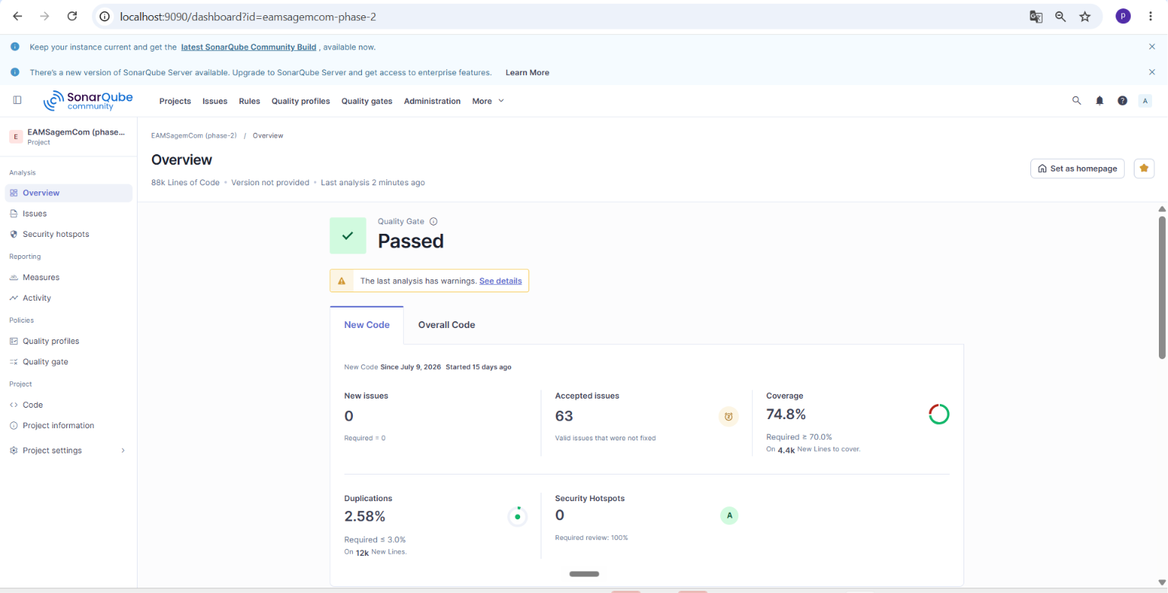
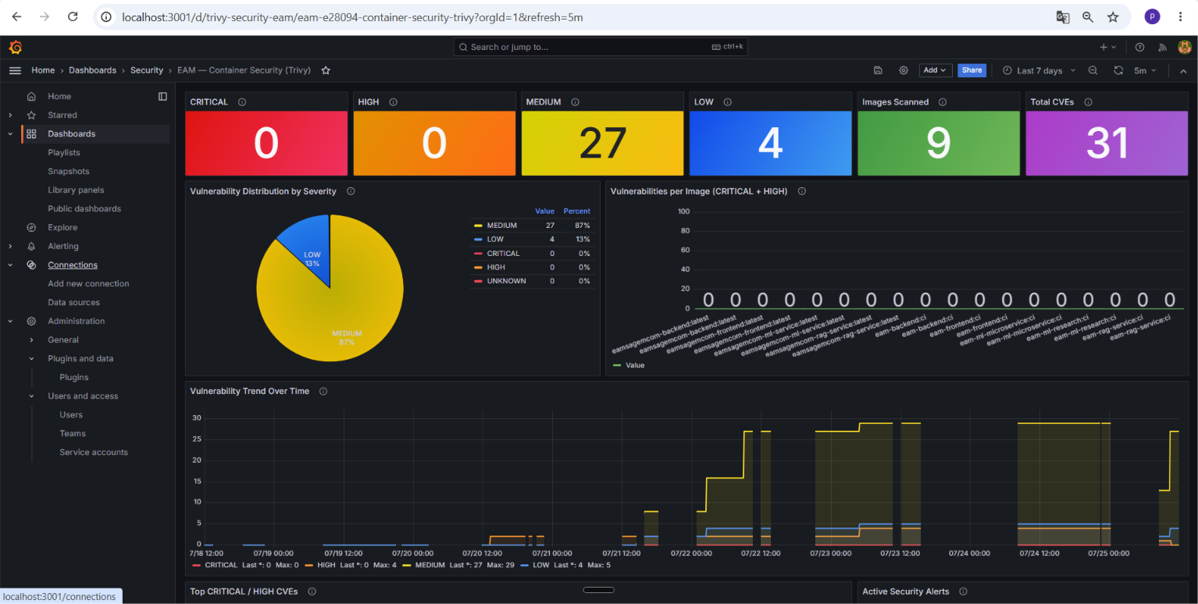
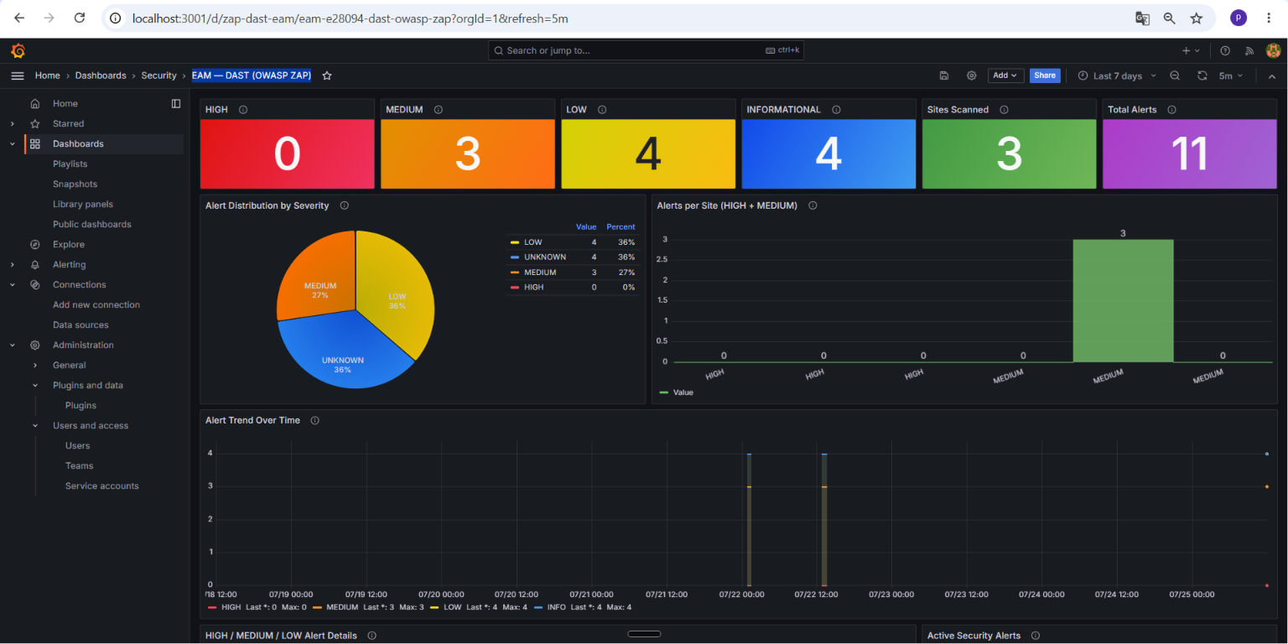
04. Implementation: DevSecOps
Security Pipeline: Live Evidence
SonarQube quality gate
Trivy image scan
OWASP ZAP DAST
Live dashboards from the running SonarQube and Grafana instances of this project, not mockups.
24

Slide 25
04. Implementation: Machine Learning
Machine Learning Pipeline
Sensor telemetry
air temperature
process temperature
rotational speed
torque
tool wear
7 models in parallel (P1-P7)
P1 Failure chance
P2 Failure type
P3 Life left
P4 Odd behavior
P5 Urgency
Health score
0-100 +
plain-language
verdict
Feature pipeline
heat build-up and
workload
P6 Best timing
DST fusion
Dempster-Shafer;
says 'not sure'
on conflict
P7 Parts needed
4 Wave 2 signals (history)
PINN: keeps estimates realistic
Cox PH: how long it can run
Mahalanobis: off its own normal
CUSUM + Kalman: slow decline
A score is shown only when the evidence is confident; every result is logged for audit and retraining.
25

Slide 26
04. Implementation: Machine Learning
Models & Why They Were Chosen
Problem | Model used | Alternatives considered | Why this one
P1 Failure probability | XGBoost + SMOTE | Random Forest, logistic regression | Non-linear, imbalanced sensor data
P2 Failure type | Multi-output XGBoost | Multi-output Random Forest | Higher F1 on rare failure modes
P3 Remaining life | XGBoost + quantile heads | Hand-coded linear regression | Calibrated uncertainty range (MAE 14.95)
P4 Anomaly | 4-method ensemble | Isolation Forest or autoencoder alone | Catches shapes a single method misses
P5 Priority | XGBoost multi-class | Rule-based heuristic | Learns patterns, not fixed thresholds
P6 Schedule | XGBoost classifier | Prophet, ARIMA, LSTM | Robust on sparse per-machine data
P7 Parts demand | Survival + Croston | Reorder point, moving average | Built for bursty, intermittent demand
Wave 2 fusion | Dempster-Shafer | Weighted average, majority vote | Reports uncertainty, no forced consensus
26

Slide 27
04. Implementation: RAG Assistant
Conversational RAG Assistant
Ingestion (admin, once per document)
Upload
PDF / docs via
backend (ADMIN)
MinIO
bucket rag-docs
stored first
Chunk + embed
BAAI/bge-m3
via RAG service
pgvector
chunks stored in
PostgreSQL
Document retrieval
hybrid (vector + keyword)
+ cross-encoder rerank
Query (every chat message)
Question
+ machine_id
from the machine page
Prompt + Groq LLM
ML block injected just
before the question
Grounded answer
docs + what the machine is
doing right now · ml_context_used
fetched in parallel
Live ML snapshot
unified health of the
machine, in parallel
If the ML service is down the assistant still answers: a rule-based fallback score keeps the context block valid.
27

Slide 28
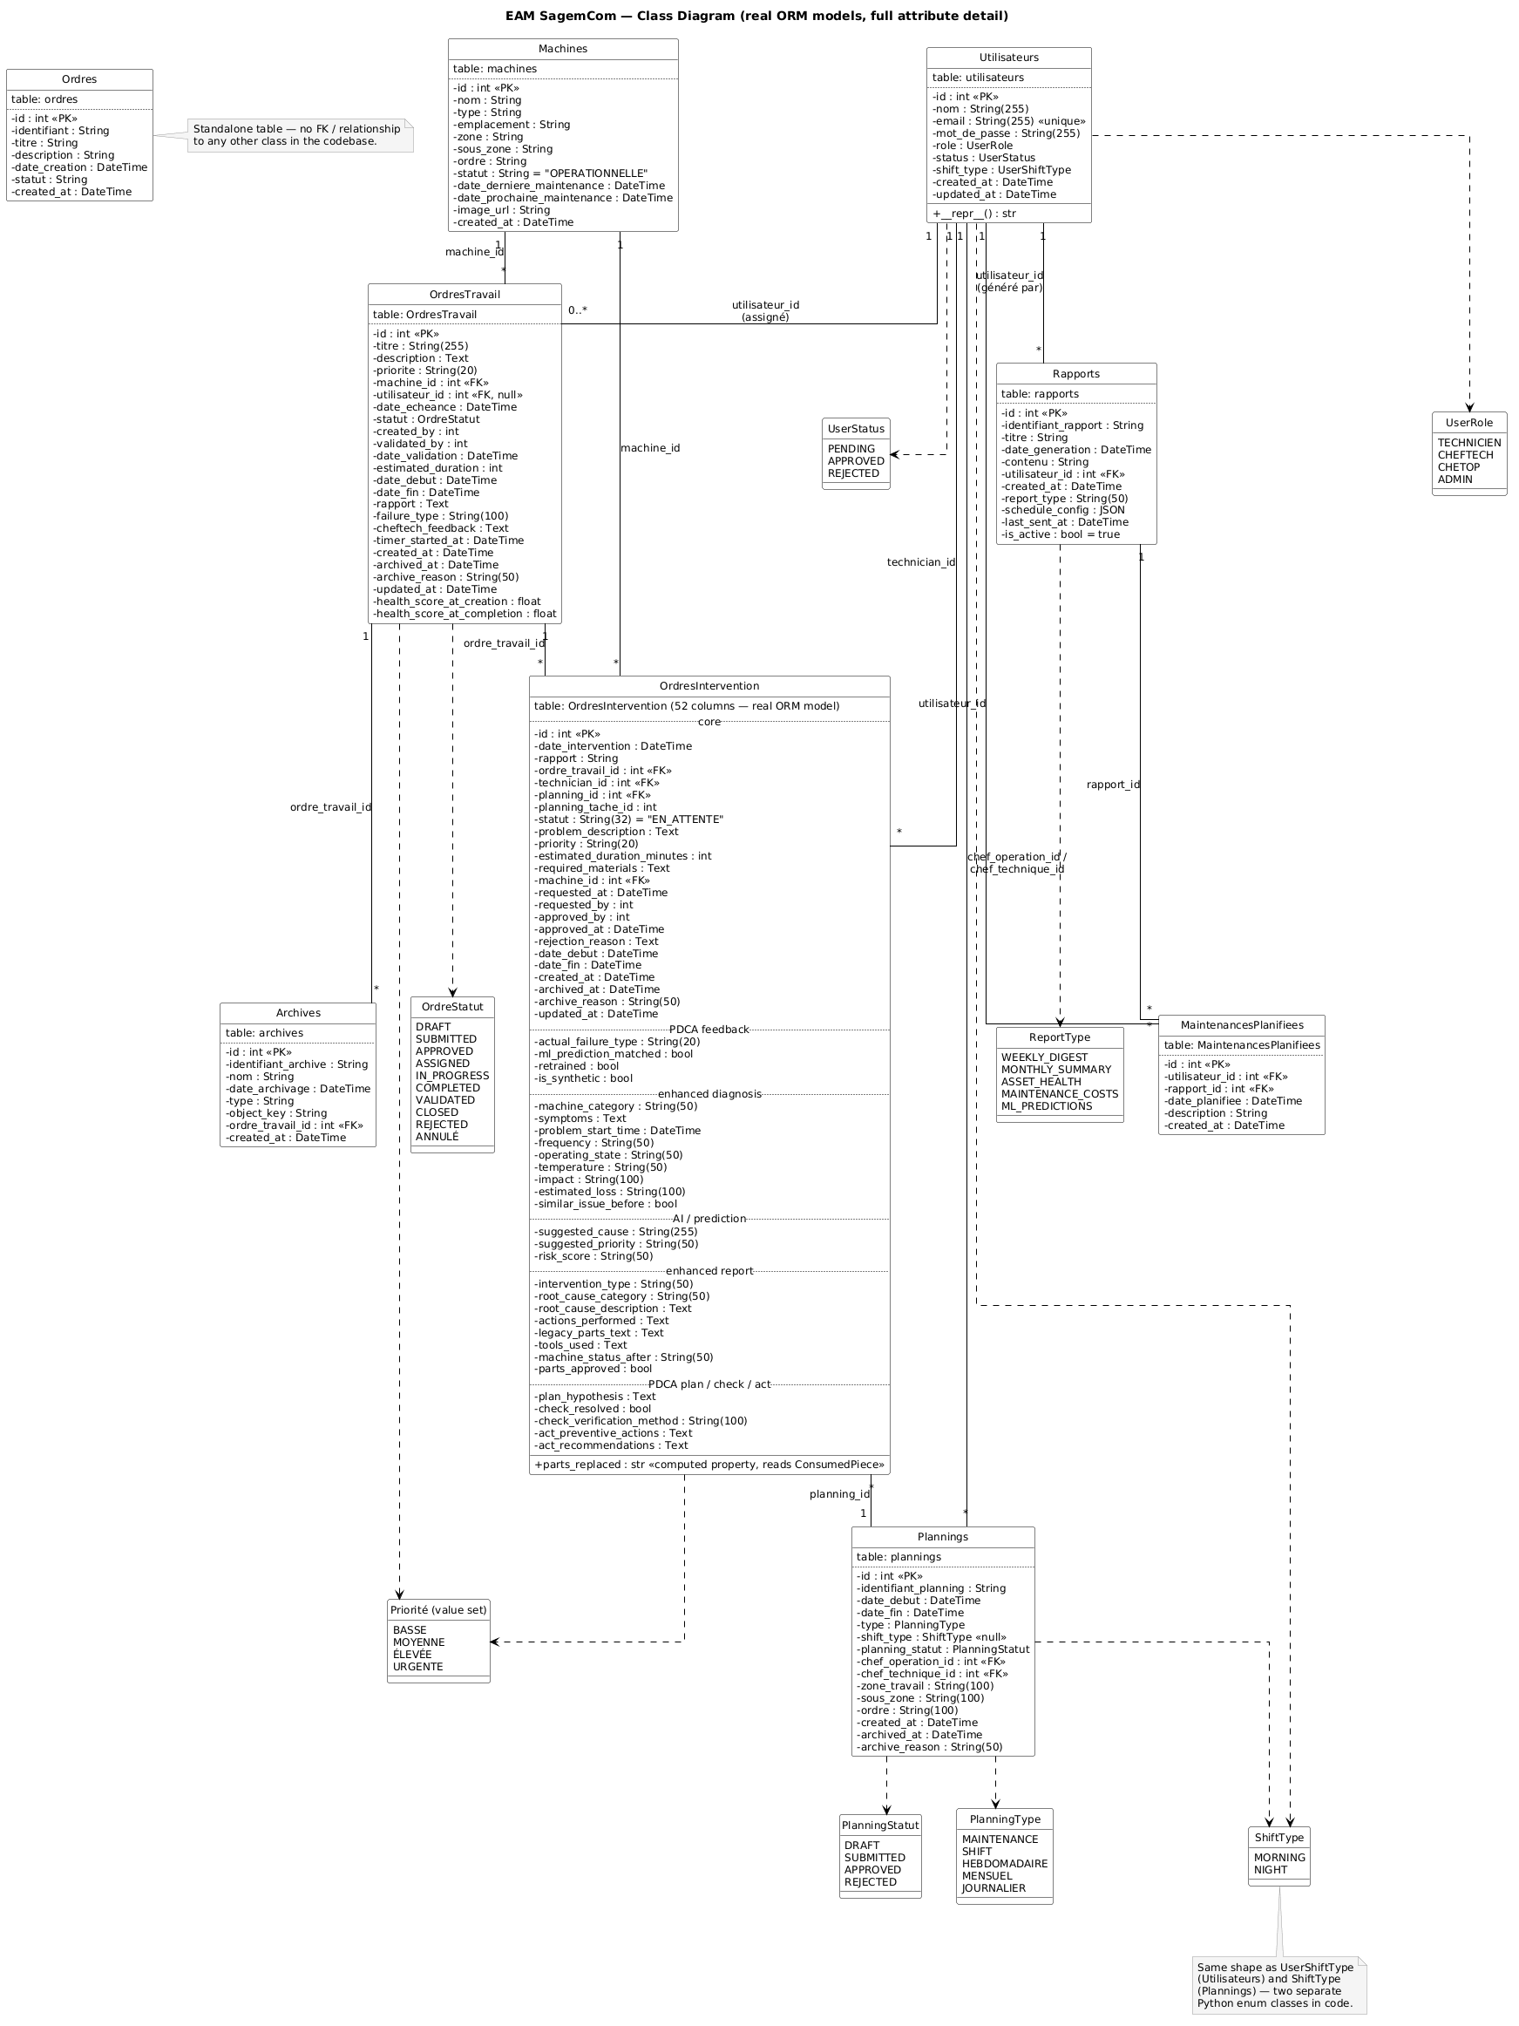
04. Design: Data Model
Class Diagram
28

Slide 29
05
Demo
29

Slide 30




05. Demo
Features Delivered
Head Technician dashboard
Conversational RAG assistant
Per-machine ML intelligence
Secure authentication
30

Slide 31
05. Demo
Live Walkthrough of the Nine Areas
1
Authentication & authorization
4
Scheduling
7
Conversational assistant
2
Machine management
5
ML predictions (P1-P7)
8
Dashboards
3
Order management
6
Alerts & notifications
9
Archiving & traceability
▶ Narrated demo video
end-to-end · all four roles · 6:47
31

Slide 32
06
Conclusion
& Perspectives
32

Slide 33
06. Conclusion
A solid EAM foundation and an honest predictive AI, secured and deployable on Azure
→ Operational management + 7 ML models + RAG assistant, in one platform
→ Every feature specified, planned, built, then verified, with full traceability
→ Honest rigor: label leakage was detected and reported, not hidden
→ Secured by a 6-stage pipeline; staging and prod namespaces running on AKS
33

Slide 34
06. Perspectives
Real ground-truth data to resolve the leaked labels (P1 / P2 / P5)
Public inbound path on AKS (resolve the Load Balancer quota)
What's
Next?
Production hardening: HA database, autoscaling, centralized logs
Managed object storage and secret rotation
34

Slide 35
Thank You for your
Attention
Any Questions?
35

