Slide 1


2025 - 2026
EAM Platform for Intelligent
Predictive Maintenance
Operational management, seven ML models and a RAG assistant
Host company: SagemCom Ezzahra
Realised by: Hamza Mbarki
1

Slide 2
Summary
01
General Context
04
Design & Implementation
02
Project Study
05
Demo
03
Requirements & Analysis
06
Conclusion & Perspectives
2

Slide 3
01
General
Context
3

Slide 4
01. General Context
Host Company
Industrial group designing and manufacturing high-value communication equipment
Products: set-top boxes, internet boxes, smart meters
Host department: Software Engineering & Innovation, in-house digital tools for equipment maintenance
Production lines served by the platform
SMT assembly
surface-mount lines
Functional testing
board & unit tests
Automated quality control
inspection stations
✓
6-7 months
✓
7 ML models (P1-P7)
✓
4 user roles
4

Slide 5
01. General Context
Background & Motivation
1
2
3
Reactive:
Preventive:
Predictive:
Repair after the failure
Repair on a calendar
Repair before the failure
Line stoppage, emergency parts ordering, maximum total cost.
Fixed intervals regardless of real condition: parts replaced too early, or failures between two visits.
Continuous reading of the machine's own signals (temperature, torque, wear) to anticipate it.
In most cases a machine's degradation is visible in its sensor data well before the stoppage. That is the premise the whole ML pipeline is built on.
5

Slide 6
02
Project
Study
6

Slide 7
02. Project Study
Problem Statement
X
Operations and prediction live in separate tools
X
Predictions technicians cannot understand
X
Failures are found after the stoppage
X
Documentation is disconnected from live machine status
How can one platform cover classic operational management and predictive maintenance, with predictions people trust and automation they control?
7

Slide 8
02. Project Study
Study of the Existant
ERP / EAM suites
Industrial IoT / APM
CMMS & spreadsheets
✓
Proven EAM coverage of assets and work orders
✓
Sensor analytics and reliability at scale
✓
Cheap and lightweight
✗
Predictive ML is a costly add-on, heavy licensing
✗
No assistant tied to live machine status, integration cost
✗
No prediction, no explanation, no traceability
SAP PM · IBM Maximo
GE Digital Predix · Maximo APM
Generic CMMS · Excel
8

Slide 9
02. Project Study
Study of the Existant
Criteria | EAM suites | IoT / APM | CMMS / Excel | Our solution
Full EAM coverage | ✓ | ⚠ | ⚠ | ✓
Predictive ML built in | ⚠ | ✓ | ✗ | ✓
Predictions explained in plain language | ✗ | ⚠ | ✗ | ✓
Assistant tied to live machine status | ✗ | ✗ | ✗ | ✓
No heavy licensing | ✗ | ✗ | ✓ | ✓
Automation guarded by human approval | ⚠ | ⚠ | ✗ | ✓
Qualitative assessment from public product positioning; ✓ yes · ⚠ partial or add-on · ✗ no
9

Slide 10
02. Project Study
Our Proposed Solution
Systematic explainability
Every prediction ships with a plain-language explanation
✓
Full EAM foundation
Users, machines, work orders, intervention orders, scheduling, archiving …etc
✓
7 predictive models (P1-P7)
Failure, failure type, remaining life, anomaly, priority, schedule, parts
Conversational RAG assistant
Documentation + real-time machine status merged into every answer
✓
✓
Evidence fusion (DST)
4 advanced signals combined into one honest, unified health score
Guarded automation
Parts proposals generated, never ordered without human approval
✓
✓
10

Slide 11
02. Project Study
Working Methodology
Product Owner
SagemCom supervisor: prioritises business needs and validates each deliverable
1 Specify
2 Plan
Scrum Master
Intern: drives the specify → plan → build → verify cycle
4 Verify
3 Build
Development team
Intern, paired with an AI assistant for implementation and testing
6-7 monthly sprints, aligned with the roadmap.
Every feature has a written specification and an implementation plan before any code is written: full traceability of technical decisions.
11

Slide 12
03
Requirements
& Analysis
12

Slide 13
03. Requirements & Analysis
The Four Platform Roles
Administrator
Head Technician
AD
HE
Infrastructure & data
Planning & approval
Manages users, machines and the document base; overall view of the system.
Plans interventions, arbitrates priorities, approves procurement proposals.
Operations Manager
Technician
OP
TE
Oversight
Field execution
Consults machine labels and statuses at a glance.
Executes intervention orders, checks health status, queries the AI assistant.
13

Slide 14
03. Requirements & Analysis
Functional Requirements: 9 Areas
1
Authentication & authorization
4
Scheduling
7
Conversational assistant
2
Machine management
5
ML predictions (P1-P7)
8
Dashboards
3
Order management
6
Alerts & notifications
9
Archiving & traceability
Two rules cut across all nine: every prediction explains itself in plain language, and the system degrades honestly, reporting missing telemetry instead of inventing a value.
14

Slide 15
03. Requirements & Analysis
Non-Functional Requirements
Performance
Availability
< 2 s common operations; < 5 s full ML inference
EAM features keep working if the ML service is down
Maintainability
Portability
Layered separation; versioned Alembic migrations
Docker Compose / Helm; configuration in one .env
Usability
Integrity & confidentiality
Interface adapted to role and device (desktop or tablet)
Role-scoped data; intervention history immutable
Security
OWASP Top 10 hardened; scanned on every push
15

Slide 16
03. Requirements & Analysis
Used Tools & Technologies
Frontend
Backend
ML microservice
React 19 · TypeScript
Vite · Tailwind · shadcn/ui
nginx (static + /api proxy)
FastAPI · SQLAlchemy
Alembic · Celery
JWT role-based access
FastAPI · XGBoost
scikit-learn · Cox PH
Dempster-Shafer fusion
RAG & AI
Data & messaging
Infrastructure
pgvector · BAAI/bge-m3
bge-reranker-v2-m3
Groq LLM
PostgreSQL 15 + pgvector
MinIO (S3) · RabbitMQ
Docker Compose · Caddy
Terraform · AKS · Helm
Key Vault · ACR
DevSecOps: GitLab CI · Gitleaks · Semgrep · SonarQube · Trivy · OWASP ZAP · Prometheus · Grafana
16

Slide 17
04
Design &
Implementation
17

Slide 18
04. Design: Logical Architecture
Logical Architecture: Layers & Dependencies
Users: Administrator · Operations Manager · Head Technician · Technician
HTTPS · browser
PRESENTATION
React 19 + TypeScript single-page app · role-based spaces (Admin, Head Technician, Technician) · ML Intelligence panel · AI assistant
REST / JSON + JWT
EXTERNAL SERVICES
APPLICATION: BACKEND API (FastAPI)
Auth & RBAC
Machines & assets
Work & intervention orders
Planning & scheduling
HTTPS
Groq LLM API
chat completions
Inventory & procurement
Alerts & notifications
ML gateway (unified health)
AI chat orchestrator
HTTP /predict
HTTP /retrieve
SQL ·
S3 API ·
AMQP
SPECIALIST SERVICES
ML microservice (FastAPI)
P1-P7 · Wave 2 signals · DST fusion
RAG service (FastAPI)
ingest · hybrid retrieval · rerank · bge-m3
Celery worker + beat
consumes tasks · uses PostgreSQL
SMTP
SMTP server
e-mail notifications
SQL (vectors)
DATA
Backend is the only caller of the ML and RAG services. RAG reads PostgreSQL only; ML reads model files only.
Model artifacts
.pkl, read-only
PostgreSQL + pgvector
business data · ML logs · chunks
Object storage
MinIO / S3
Message broker
RabbitMQ
18
Notes:
LOGICAL view: responsibilities and dependencies only. No hosts, ports or containers here (that is the physical view). The browser runs a React SPA. All traffic goes to the FastAPI backend, which holds the business logic (auth/RBAC, machines, orders, planning, inventory, alerts, ML gateway, AI chat orchestrator). The backend is the only caller of the two specialist services: the ML microservice (FastAPI, seven models + Wave 2 signals + Dempster-Shafer fusion, reading model files) and the RAG service (FastAPI, hybrid retrieval, reranker, bge-m3 embeddings, reading PostgreSQL/pgvector only). Celery workers consume tasks from RabbitMQ for e-mails and scheduled jobs. Data: PostgreSQL+pgvector, MinIO/S3 for attachments and RAG documents. External: Groq LLM (called by the backend chat) and SMTP (called by Celery).

Slide 19
04. Design: Logical Architecture
Logical Architecture: Layer by Layer
USERS & PRESENTATION
Four roles reach the platform over HTTPS. The frontend is a React + TypeScript single-page app (SPA): loaded once, it then only exchanges data with the server, with no full page reloads. Each role gets its own space, plus the ML panel and AI assistant.
APPLICATION: BACKEND API
FastAPI holds all the business logic. The frontend calls it with REST/JSON, and every request carries a JWT, a signed login token proving who the user is. RBAC (role-based access control) decides what each role is allowed to do.
SPECIALIST SERVICES
ML microservice: P1-P7 models and Wave 2 signals, merged into one verdict by Dempster-Shafer fusion. RAG service: turns manuals into vectors (bge-m3), finds relevant passages with keyword + semantic search, then reranks them for the LLM. Celery: background jobs (worker) and scheduled jobs (beat).
DATA
PostgreSQL + pgvector: business data, ML logs and document vectors in one database. MinIO: S3-compatible file storage. RabbitMQ: message queue; the backend posts a task and Celery runs it asynchronously. .pkl files: trained models, read-only.
EXTERNAL SERVICES
Groq LLM API writes the AI assistant's answers from the retrieved passages. SMTP server sends e-mail notifications, called by Celery.
Design rule: only the backend calls ML and RAG: one entry point, least privilege, independent services.
19
Notes:
Walk the diagram top to bottom. Users reach a React single-page app over HTTPS; it is loaded once and then only exchanges data. The app calls the FastAPI backend with REST and JSON, each request carrying a JWT that identifies the user and role, and RBAC decides what that role may do. The backend holds the business logic and is the only caller of the specialist services: the ML microservice (P1-P7, Wave 2 signals, Dempster-Shafer fusion) and the RAG service, which embeds documents with bge-m3, retrieves passages with hybrid search and reranks them before the LLM answers. Celery runs background and scheduled jobs that the backend queues in RabbitMQ. PostgreSQL with pgvector stores business data, ML logs and document vectors; MinIO stores files; models are read-only .pkl files. Groq generates chat answers and SMTP sends e-mails. Key message: one entry point, least privilege, independent services.

Slide 20
04. Design: Logical Architecture
Request Flow: Unified Machine Health
1
2
3
Frontend asks
Backend reads telemetry
ML microservice
GET /machines/{id}/unified-health
Latest real sensor data; none found → telemetry_available: false, stop
P1-P7 in parallel on the sensor snapshot
4
5
6
Wave 2 signals
DST fusion
Log & render
Run concurrently on the telemetry history
One unified score and verdict
Stored in ml_prediction_logs; panel updates
Graceful degradation: no telemetry on record never means a fabricated prediction; the platform falls back to a maintenance-history-only score.
20

Slide 21
04. Design: Physical Architecture
Physical Architecture: Docker Compose Host
DOCKER HOST: developer workstation (dev) or Azure VM (demo) · docker compose
asset_management_network (bridge): containers resolve each other by name
frontend
nginx, React SPA
:80 (dev → :3000)
backend
FastAPI / uvicorn
:8000
ml-service
FastAPI
:8000 (dev → :8001)
rag-service
FastAPI + bge-m3
:8003
Groq LLM API
HTTPS 443
from backend
Caddy 2.8
:80 / :443
TLS (Let's Encrypt)
prod overlay only
Users
browser
HTTPS
celery_worker
backend image
Celery worker
celery_beat
backend image
Celery scheduler
rabbitmq
AMQP :5672
(mgmt :15672)
minio
S3 API :9000
console :9001
SMTP (Gmail)
:587
from Celery
/ → frontend:80
/api/* → backend:8000
/grafana/* → grafana:3000
postgres
pgvector/pg15 :5432 · volume postgres_data
pgadmin
dev only, host :5050
models/*.pkl
bind mount, read-only
Container registry
images for
prod overlay
monitoring_network (compose -f monitoring)
on-demand stacks (own compose files)
Prometheus :9095 · Pushgateway :9091
Grafana :3001 · Trivy scanner
SonarQube CE :9090 + Postgres 15
Jupyter notebooks :8888 (offline ML research)
Prod overlay: every service un-published except Caddy; images pulled from the container registry (pull_policy: always).
21
Notes:
PHYSICAL view 1/2: one Docker host running docker compose, either a developer workstation or the Azure demo VM. Application containers share asset_management_network and reach each other by service name (backend calls ml-service:8000 and rag-service:8003). Host ports in dev: frontend 3000, backend 8000, ml-service 8001 (container port 8000), rag 8003, postgres 5432, rabbitmq 5672/16200, minio 9000/9001, pgadmin 5050. In the demo VM the prod overlay publishes nothing except Caddy on 80/443, which routes / to the frontend, /api to the backend and /grafana to Grafana. Monitoring (Prometheus, Pushgateway, Grafana, Trivy) sits on its own network; SonarQube and Jupyter are separate on-demand stacks. The frontend is a static React/Vite build served by nginx, which also proxies /api to the backend.

Slide 22
04. Design: Physical Architecture
Docker Compose Host: Key Concepts
Container & Compose
Caddy: reverse proxy
Bridge network
A container packages an app with all its dependencies and runs it in isolation; each box on the diagram is one. Docker Compose describes every container in one file and starts them together.
The single entry point from the internet. It handles HTTPS automatically (Let's Encrypt) and routes by path: / to the frontend, /api to the backend, /grafana to the dashboards.
asset_management_network is a private network shared by the app containers. They reach each other by service name, never by a hard-coded IP address.
Ports & storage
Monitoring stack
On-demand stacks
Each service listens on a port; in dev some are opened on the host (e.g. :3000) for debugging. A volume keeps PostgreSQL data across restarts; models are a read-only bind mount.
On its own network. Prometheus collects metrics, Pushgateway receives them from short jobs, Grafana shows dashboards, Trivy scans images for known vulnerabilities.
Started only when needed, each from its own Compose file: SonarQube for code-quality analysis and Jupyter for the offline ML research notebooks.
Dev vs demo: dev exposes every port; the prod overlay leaves only Caddy (80/443) open and pulls prebuilt images.
22
Notes:
Everything runs on one machine: a developer workstation or the Azure demo VM. Each component is a Docker container, and Docker Compose starts them all from one file. Caddy is the reverse proxy and single entry point: it terminates HTTPS with Let's Encrypt certificates and routes / to the frontend, /api to the backend and /grafana to Grafana. Application containers share a private bridge network and call each other by service name. Ports are exposed on the host only in development; PostgreSQL keeps its data on a volume and the model files are mounted read-only. Monitoring (Prometheus, Pushgateway, Grafana, Trivy) runs on its own network, while SonarQube and Jupyter are started only when needed. In the demo, the prod overlay un-publishes everything except Caddy on 80/443 and pulls ready-built images from the registry, so the attack surface is one encrypted entry point.

Slide 23
04. Design: Physical Architecture
Physical Architecture: Production on Azure AKS
MICROSOFT AZURE: resource group eam-prod-rg · Poland Central
VNet 10.10.0.0/16 · AKS subnet 10.10.1.0/24
PostgreSQL Flexible Server 15
pgvector + pg_trgm · burstable B2s
DBs: asset_management / _prod
AKS cluster · Azure CNI + network policy · OIDC / workload identity
5432
namespaces eam-prod and eam-staging (same layout)
ngrok edge
public HTTPS
static domain
tunnel (pod dials out)
ngrok
tunnel agent
frontend
nginx :80
backend
FastAPI :8000
Users
browser
Azure Key Vault
JWT · Groq · SMTP · DB password
Secrets Store CSI driver
ml-service
:8000
rag-service
:8003
celery-worker
backend image
secrets
celery-beat
backend image
rabbitmq
:5672
minio
:9000 · PVC 5Gi
Azure Container Registry
images pulled by kubelet identity (AcrPull)
Groq LLM API · SMTP
HTTPS / SMTP egress via the AKS outbound IP
pull
System node pool
critical add-ons only
User node pool
autoscale 2-4 · Standard_B2s_v2
Azure's inbound public Load Balancer is blocked at subscription level, so the ngrok pod dials out to its edge and relays public traffic to frontend:80 (nginx proxies /api to the backend).
GitLab CI
secret scan · SCA · SAST · SonarQube · build · Trivy · gate
deploy-aks
docker build → push to ACR → rollout restart
Terraform + Helm
Azure resources (state on HCP Terraform) · chart eam, values per env
23
Notes:
PHYSICAL view 2/2: production target on Azure, provisioned with Terraform. Public users reach the app through an ngrok tunnel because the Azure inbound Load Balancer is blocked at subscription level; the ngrok pod dials out and relays to the frontend (nginx), which proxies /api to the backend. AKS (Poland Central, Azure CNI, network policy, workload identity) hosts the eam-staging and eam-prod namespaces: frontend, backend, ml-service, rag-service, celery worker/beat, plus in-cluster RabbitMQ and MinIO. PostgreSQL is a managed Azure Flexible Server with pgvector; secrets come from Key Vault through the Secrets Store CSI driver; images come from ACR. Delivery: GitLab CI gates the code, deploy-aks builds and pushes images then restarts deployments, Terraform and Helm define the infrastructure and the chart.

Slide 24
04. Design: Physical Architecture
Azure AKS: Key Concepts
Kubernetes (AKS)
Node pools
Namespaces
Network security
Runs containers (in pods) across a cluster of VMs, restarts any that fail and scales with load. AKS is Azure's managed Kubernetes.
System pool: Kubernetes' own components only. User pool: our application, autoscaling 2 to 4 VMs with demand.
Logical partitions of the cluster: eam-staging to test new versions, eam-prod for real users, with the same layout.
Private VNet. Network policies act as firewall rules between pods; workload identity lets pods reach Azure without stored credentials.
Managed services
Key Vault
ngrok tunnel
CI/CD & IaC
PostgreSQL Flexible Server: Azure runs backups and patching. ACR stores the images. MinIO keeps files on a persistent volume.
Holds every secret: JWT, Groq, SMTP, DB password. The CSI driver injects them into pods at runtime, never in code or images.
Azure's inbound load balancer is blocked at subscription level, so the ngrok pod dials out and relays public HTTPS to the frontend.
GitLab CI checks every push; deploy-aks builds, pushes to ACR and restarts. Terraform defines Azure, Helm the deployment.
Versus Docker Compose: self-healing, autoscaling, managed database, centralized secrets, reproducible infrastructure.
24
Notes:
Same application, now on Azure Kubernetes Service. Kubernetes runs the containers in pods across several VMs, restarts failed pods and scales with load. The system node pool runs Kubernetes' own components; the user pool runs our app and autoscales between two and four VMs. Two namespaces, eam-staging and eam-prod, have the same layout so new versions are tested before real users see them. The cluster sits in a private VNet, network policies restrict pod-to-pod traffic, and workload identity lets pods authenticate to Azure without stored credentials. PostgreSQL is a managed Flexible Server, images come from Azure Container Registry, and all secrets live in Key Vault, injected at runtime by the Secrets Store CSI driver. Because the inbound public load balancer is blocked at subscription level, an ngrok pod dials out and relays public traffic to the frontend. Delivery: GitLab CI gates every push, deploy-aks builds, pushes and restarts, and Terraform plus Helm define the infrastructure as code.

Slide 25
04. Implementation: DevSecOps
Security & Quality Pipeline
1 · Gitleaks
Secret scanning
of git history
2 · SCA
pip-audit and
pnpm audit
3 · SAST
Semgrep rule sets
(auto, explicit, custom)
4 · SonarQube
Static analysis
and hotspots
5 · Build + Trivy
Docker images
and IaC scan
6 · Quality gate
Final blocking
check
Blocking: stages 1-6. Non-blocking: lint. OWASP ZAP DAST logs in as all 4 roles and probes the running stack; results feed Grafana.
0
100%
2.6%
74.8%
new violations
hotspots reviewed
duplication (was 10.3%)
coverage (target 70%)
Quality gate: fully green on the EAMSagemCom project (branch Phase_2)
25

Slide 26
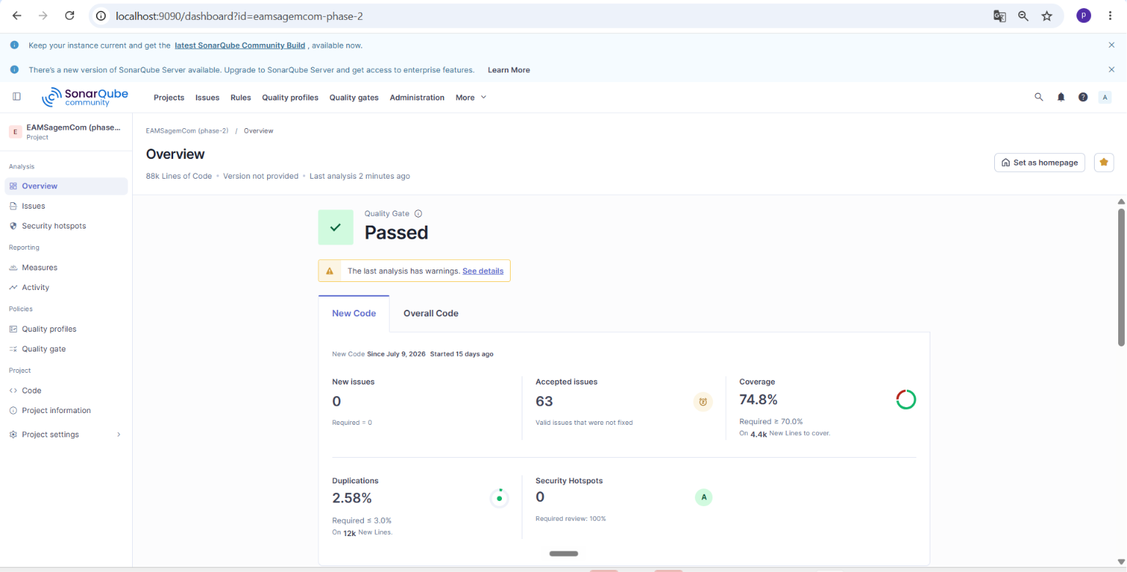
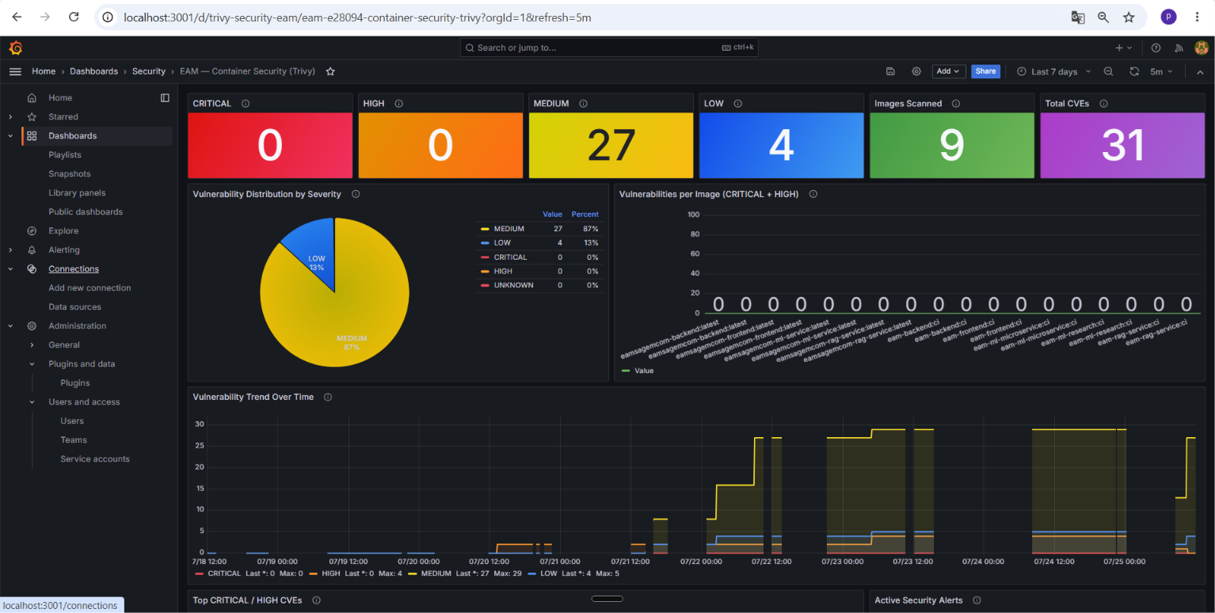
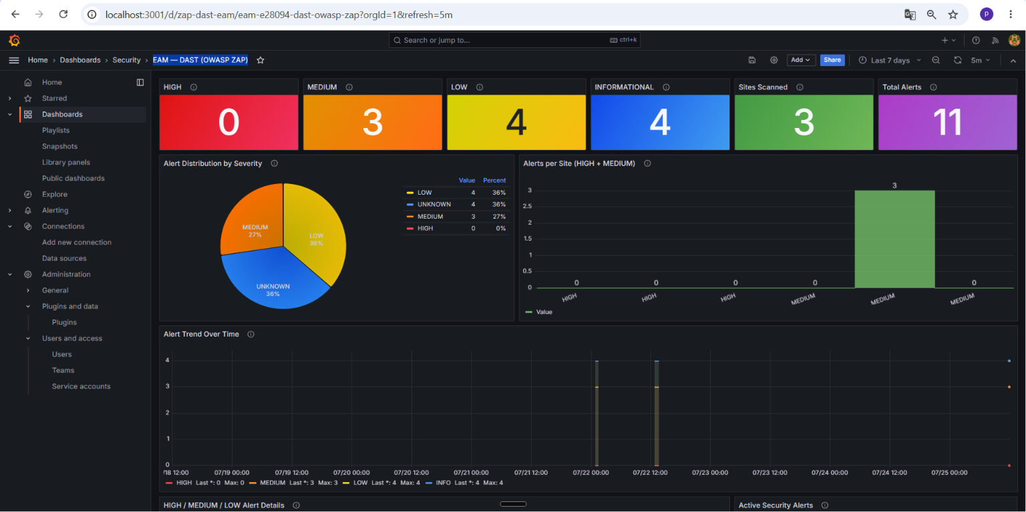
04. Implementation: DevSecOps
Security Pipeline: Live Evidence
SonarQube quality gate
Trivy image scan
OWASP ZAP DAST
Live dashboards from the running SonarQube and Grafana instances of this project, not mockups.
26

Slide 27
04. Implementation: Machine Learning
Machine Learning Pipeline
Sensor telemetry
air temperature
process temperature
rotational speed
torque
tool wear
7 models in parallel (P1-P7)
P1 Failure chance
P2 Failure type
P3 Life left
P4 Odd behavior
P5 Urgency
Health score
0-100 +
plain-language
verdict
Feature pipeline
heat build-up and
workload
P6 Best timing
DST fusion
Dempster-Shafer;
says 'not sure'
on conflict
P7 Parts needed
4 Wave 2 signals (history)
PINN: keeps estimates realistic
Cox PH: how long it can run
Mahalanobis: off its own normal
CUSUM + Kalman: slow decline
A score is shown only when the evidence is confident; every result is logged for audit and retraining.
27

Slide 28
04. Implementation: Machine Learning
Models & Why They Were Chosen
Problem | Model used | Alternatives considered | Why this one
P1 Failure probability | XGBoost + SMOTE | Random Forest, logistic regression | Non-linear, imbalanced sensor data
P2 Failure type | Multi-output XGBoost | Multi-output Random Forest | Higher F1 on rare failure modes
P3 Remaining life | XGBoost + quantile heads | Hand-coded linear regression | Calibrated uncertainty range (MAE 14.95)
P4 Anomaly | 4-method ensemble | Isolation Forest or autoencoder alone | Catches shapes a single method misses
P5 Priority | XGBoost multi-class | Rule-based heuristic | Learns patterns, not fixed thresholds
P6 Schedule | XGBoost classifier | Prophet, ARIMA, LSTM | Robust on sparse per-machine data
P7 Parts demand | Survival + Croston | Reorder point, moving average | Built for bursty, intermittent demand
Wave 2 fusion | Dempster-Shafer | Weighted average, majority vote | Reports uncertainty, no forced consensus
28

Slide 29
04. Implementation: RAG Assistant
Conversational RAG Assistant
Ingestion (admin, once per document)
Upload
PDF / docs via
backend (ADMIN)
MinIO
bucket rag-docs
stored first
Chunk + embed
BAAI/bge-m3
via RAG service
pgvector
chunks stored in
PostgreSQL
Document retrieval
hybrid (vector + keyword)
+ cross-encoder rerank
Query (every chat message)
Question
+ machine_id
from the machine page
Prompt + Groq LLM
ML block injected just
before the question
Grounded answer
docs + what the machine is
doing right now · ml_context_used
fetched in parallel
Live ML snapshot
unified health of the
machine, in parallel
If the ML service is down the assistant still answers: a rule-based fallback score keeps the context block valid.
29

Slide 30
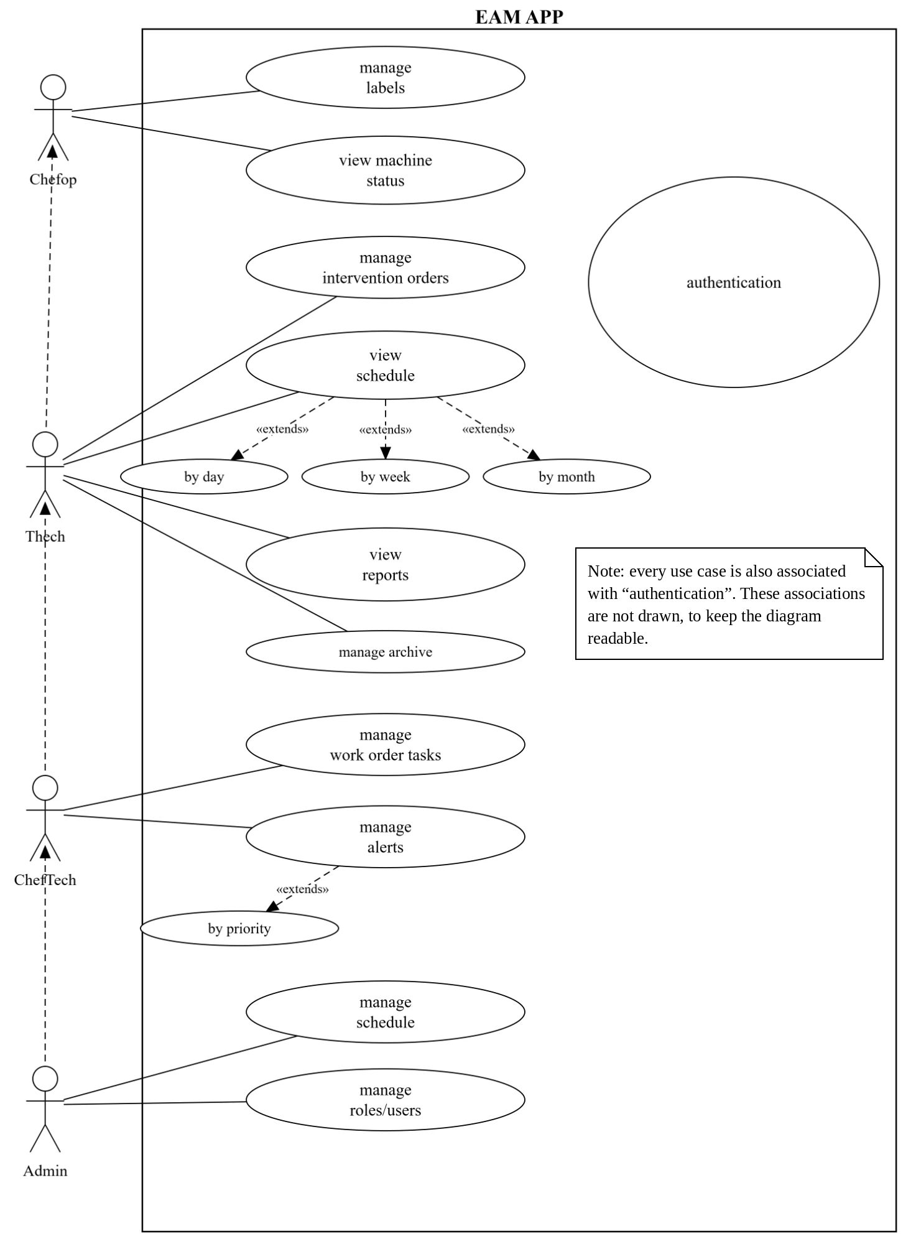
03. Requirements & Analysis
Use Case Diagram
30

Slide 31
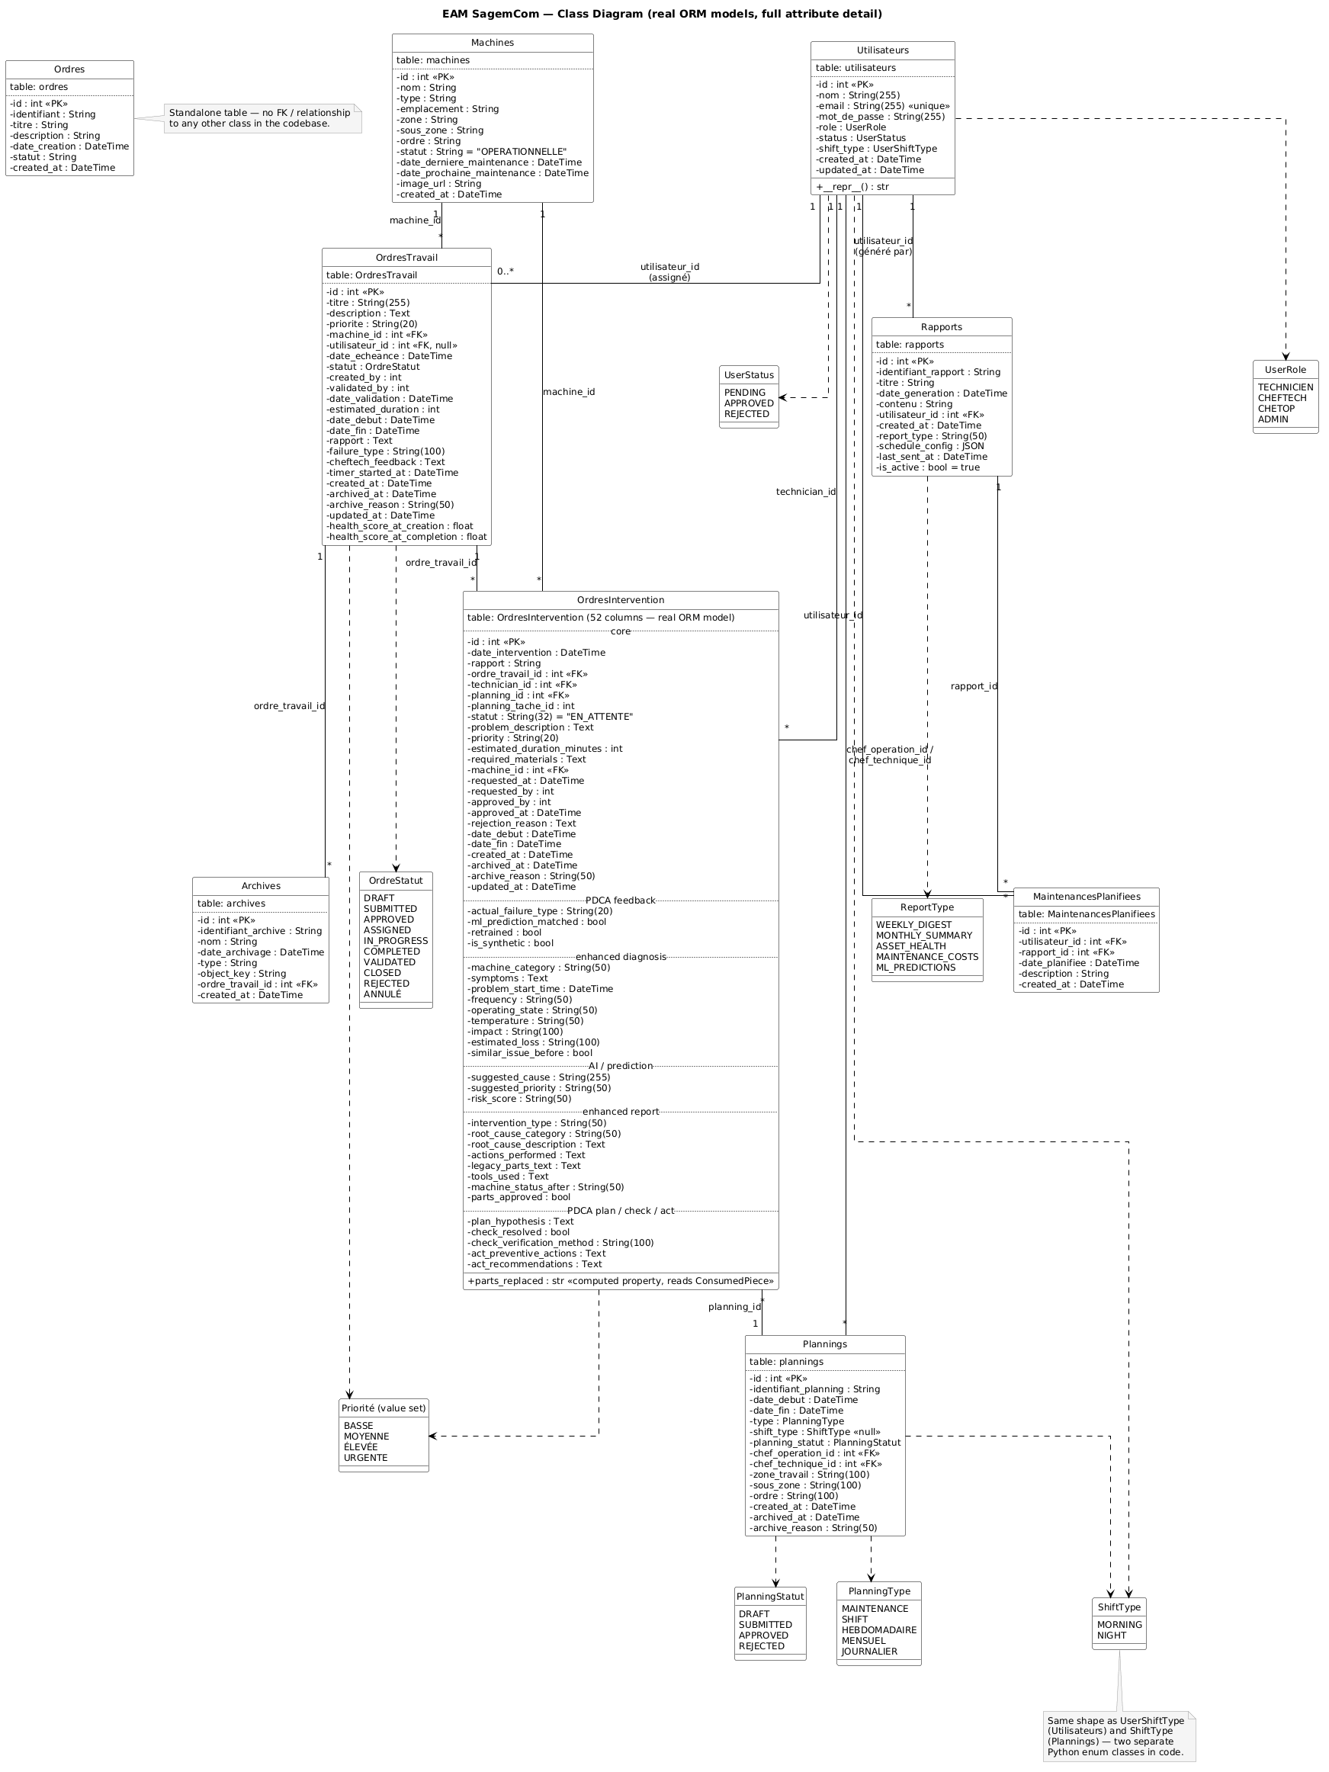
Class Diagram
04. Design: Data Model
31

Slide 32
05
Demo
32

Slide 33
05. Demo
Live Walkthrough of the Nine Areas
1
Authentication & authorization
4
Scheduling
7
Conversational assistant
2
Machine management
5
ML predictions (P1-P7)
8
Dashboards
3
Order management
6
Alerts & notifications
9
Archiving & traceability
▶ Narrated demo video
end-to-end · all four roles · 6:47
33

Slide 34
06
Conclusion
& Perspectives
34

Slide 35
06. Conclusion
A solid EAM foundation and an honest predictive AI, secured and deployable on Azure
→ Operational management + 7 ML models + RAG assistant, in one platform
→ Every feature specified, planned, built, then verified, with full traceability
→ Honest rigor: label leakage was detected and reported, not hidden
→ Secured by a 6-stage pipeline; staging and prod namespaces running on AKS
35

Slide 36
06. Perspectives
Real ground-truth data to resolve the leaked labels (P1 / P2 / P5)
Public inbound path on AKS (resolve the Load Balancer quota)
What's
Next?
Production hardening: HA database, autoscaling, centralized logs
Managed object storage and secret rotation
36

Slide 37
Thank You for your
Attention
Any Questions?
37

