Slide 1

START WITH THE NAME OF ALMIGHTY ALLAH THE MOST BENEFICIENT AND THE MOST MERCIFUL

Slide 2
COMPUTER FUNDAMENTAL PRESENTATION
TOPIC : “ HOSPITAL MANAGEMENT SYSTEM “
PRESENTED BY:-
HAMZA ARSHAD
ABDUL HANAN
MUHAMMAD HARIS SARWAR

Slide 3
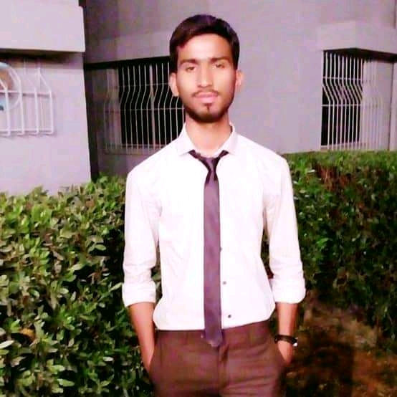

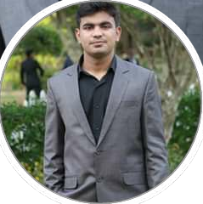

01
02
03
team
HAMZA
ABDUL HANAN
HARIS SARWAR
STUDENT
STUDENT
STUDENT
BSE -1B
BSE -1B
BSE 1-B

Slide 4



Slide 5
WELCOME TO SHAHEEN CITY HOSPITAL
GENERAL INTRODUCTION TO SHAHEEN CITY HOSPITAL
OUR MISSION AND VISION
To be committed to excellence in all of our services to our patients so that we may help them achieve the highest level of dental health appropriate for their needs in an atmosphere of trust and compassion. We at Rogers Dental Center will continually update ourselves regarding the best and most current materials and technology available in dentistry and infection control. We will treat the patient's dental needs with the highest level of care, skill, judgment and comfort. We will adapt, grow and evolve with our profession and society. We will appreciate, communicate and empathize with our patients and our fellow team members so that we may enhance the lives of every person involved in achieving our mission.

Slide 6
GENERAL INTRODUCTION OF SHAHEEN CITY HOSPITAL
OUR STAFF
The doctors of Rogers Dental Center are extremely proud of our staff and feel that they're a great asset to our business. This group of highly-trained professionals is excited about what they do, have the highest standards of quality and integrity and are motivated to achieve the best for our patients.
Appointments
Your scheduled appointment time has been reserved specifically for you. We request a 48-hour notice if you need to cancel your appointment. We are aware that unforeseen events sometimes require missing an appointment. After missing your second appointment without notifying us 48 hours in advance, you are subject to being charged an additional fee.

Slide 7

GENERAL INTRODUCTION OF SHAHEEN CITY HOSPITAL
ISURANCE POLICY
Our office is committed to helping you maximize your insurance benefits. Because insurance policies vary, we can only estimate your coverage in good faith but cannot guarantee coverage due to the complexities of insurance contracts. Your estimated patient portion must be paid at the time of service. As a service to our patients, we will bill insurance companies for services and allow them 45 days to render payment. After 60 days, you are responsible for the entire balance, paid-in-full. If you have any questions, our courteous staff is always available to answer them

Slide 8
DEPARTMENTS IN SHAHEEN CITY HOSPITAL
ADMINISTRATION
ENT SPECIALIST DEPARTMENT
SKIN SPECIALIST DEPARTMENT
OPD DEPARTMENT
CARDIOLOGIST DEPARTMENT
SERVICES IN SHAHEEN CITY HOSPITAL
PROFESSIONAL DOCTORS
HUMBLE STAFF
UPTO DATE MACHINERY
CLINICAL NUTRITION AND CAFETERIA
CANCER CENTER
CARDIOLOGY SERVICE
EMERGENCY

Slide 9
SERVICES OFFERED
OUR PROFESSIONAL DOCTORS
Undertaking patient consultations and physical examinations.
organizing workloads.
performing surgical procedures.
providing general pre- and post-operative care.
monitoring and administering medication.
assessing and planning treatment requirements.

Slide 10
SERVICES OFFERED
OUR HUMBLE STAFF
clinical assistants – take care of ward housekeeping.
patient services assistants – bring meals and drinks.
porters – take care of patient lifting and transport.
volunteers – help with fundraising and ward visits.
ward clerks – staff the ward reception desks.

Slide 11
SERVICES OFFFERED
FINANCIAL SUPPORT TO NEEDY PEOPLES
Your treatment plan will include a breakdown of all applicable fees, and we will inform you of all costs before treatment is administered. For the convenience of our patients, we accept Visa, MasterCard, Discover and American Express. We also offer third-party financing through CareCredit to help make your treatment more affordable. Discounts are also available for patients who pay in full prior to the onset of treatment. Charges are payable at the time of treatment. Please ask a member of our staff, and we will review our payment options to accommodate your financial needs. If special arrangements are needed, please discuss your situation with our financial coordinator prior to receiving service.

Slide 12


