Slide 1
Axi Lite Bus
Hassan Muavia: 2022-EE-162
Hamza Ahmad: 2022-EE-165
Hamza Bin Abid: 2022-EE-181
Abdullah Rasheed: 2022-EE-122

Slide 2
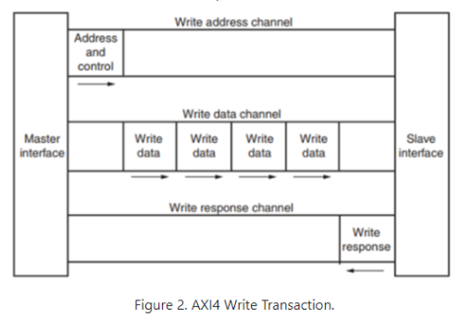
Write Operation

Slide 3
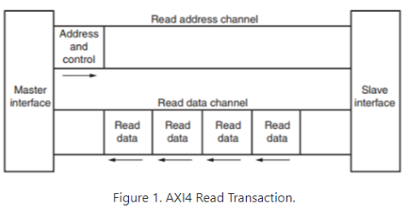
Read Operation

Slide 4
Expected Goals
Support 32-bit read and write operations.
Implementation of valid/ready handshaking.

Slide 5
Achieved Goals
Successfully added support for 32-bit read and write operations.
Implemented valid/ready handshaking.

Slide 6
Algorithm

