Slide 1
Commuter Aided Design CAD
Lecture 2

Slide 2
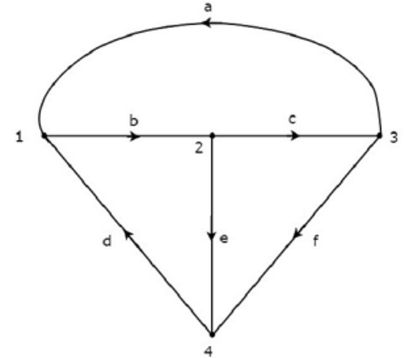
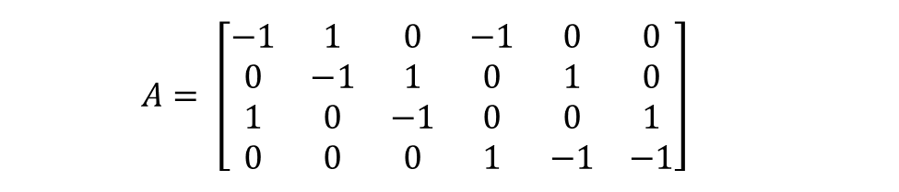

Reduced incidence matrix
Any node of a connected graph can be selected as a reference node.
Then the voltages of the other nodes (referred to as buses) can be measured with respect to the assigned reference.
$$A= \left[\begin{matrix}−1 & 1 & 0 & −1 & 0 & 0 \\ 0 & −1 & 1 & 0 & 1 & 0 \\ 1 & 0 & −1 & 0 & 0 & 1 \\ 0 & 0 & 0 & 1 & −1 & −1\end{matrix}\right]$$
$$A= \left[\begin{matrix}−1 & 1 & 0 & −1 & 0 & 0 \\ 0 & −1 & 1 & 0 & 1 & 0 \\ 1 & 0 & −1 & 0 & 0 & 1 \\ 0 & 0 & 0 & 1 & −1 & −1\end{matrix}\right]$$

Slide 3
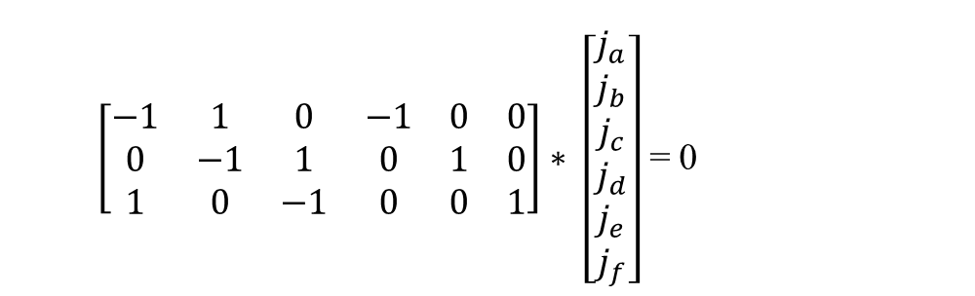
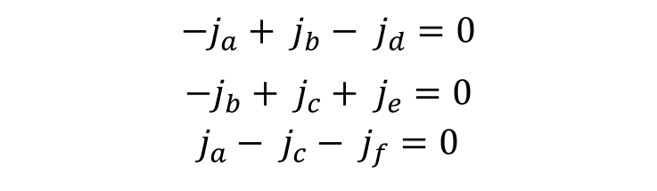

Apply Electrical Lows
From incidence matrix (A) we can apply KCL.
A * J_{B} = 0
$\left[\begin{matrix}−1 & 1 & 0 & −1 & 0 & 0 \\ 0 & −1 & 1 & 0 & 1 & 0 \\ 1 & 0 & −1 & 0 & 0 & 1\end{matrix}\right]∗ \left[\begin{matrix}j_{a} \\ j_{b} \\ j_{c} \\ j_{d} \\ j_{e} \\ j_{f}\end{matrix}\right]$ = 0
$$\begin{matrix}a & b & c & d & e & f\end{matrix}$$
$${−j}_{a}+ j_{b}− j_{d}=0$$
$${−j}_{b}+ j_{c}+ j_{e}=0$$
$$j_{a}− j_{c}− j_{f}=0$$

Slide 4
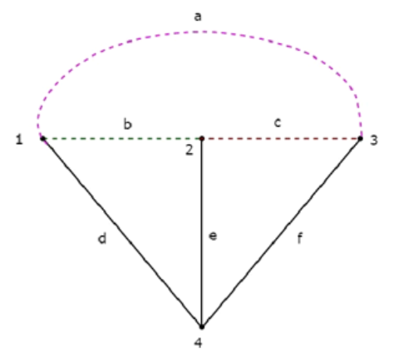

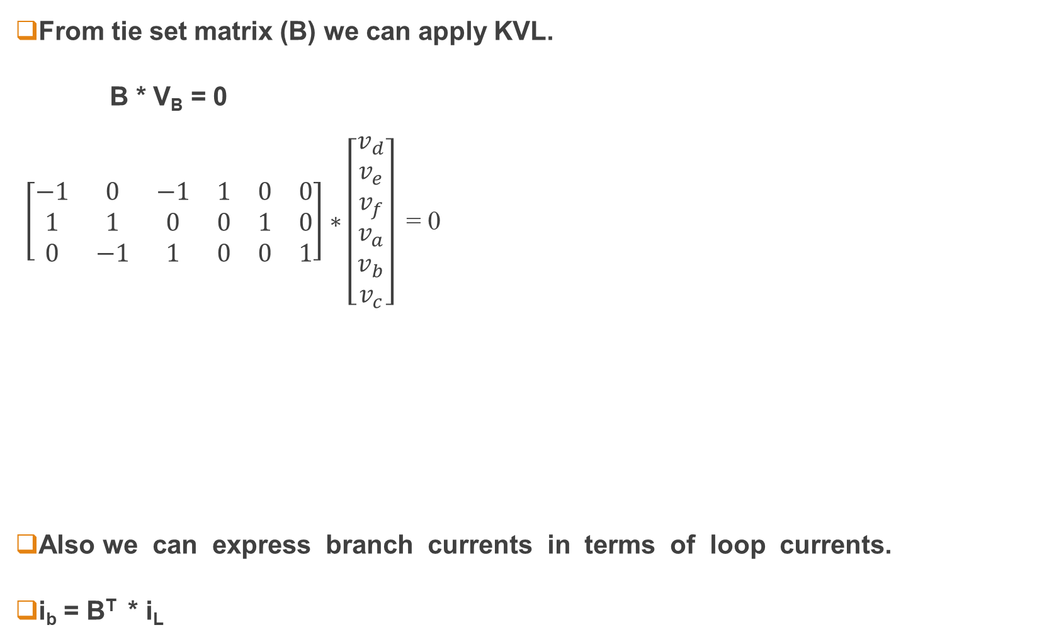

Apply Electrical Lows
From tie set matrix (B) we can apply KVL.
B * V_{B} = 0
$\left[\begin{matrix}−1 & 0 & −1 & 1 & 0 & 0 \\ 1 & 1 & 0 & 0 & 1 & 0 \\ 0 & −1 & 1 & 0 & 0 & 1\end{matrix}\right]∗\left[\begin{matrix}v_{d} \\ v_{e} \\ v_{f} \\ v_{a} \\ v_{b} \\ v_{c}\end{matrix}\right]$ = 0
Also we can express branch currents in terms of loop currents.
i_{b} = B^{T} * i_{L}
$$\begin{matrix}d & e & f & a & b & c\end{matrix}$$
$${−v}_{d}− v_{f}+ v_{a}=0$$
$$v_{d}+ v_{e}+ v_{b}=0$$
$${−v}_{e}+ v_{f}+ v_{c}=0$$

Slide 5

Apply Electrical Lows
Also we can express branch currents in terms of loop currents.
$J_{B}=B^{T}∗ I_{L}$
$Where J_{B} are brances current$
$Where I_{L} are loop current$

Slide 6

Relation between Network Topology Matrices
$C_{L}= {−B}_{T}^{t}$
$C_{L}= A_{T}^{−1}∗ A_{L}$
$C= A_{T}^{−1}∗ A$

Slide 7

Example
From A matrix calculate the B and C matrices and verify your answer by mean of obtained graph
$$A= \left[\begin{matrix}−1 & 1 & 1 & 1 & 0 \\ 0 & 0 & 0 & −1 & 0 \\ 1 & −1 & 0 & 0 & −1\end{matrix}\right]$$

