Slide 1

Consumer Goods Ad_Hoc Insights

Slide 2
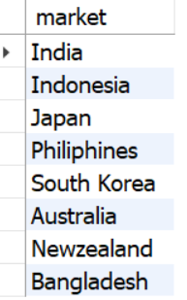
Question 1 Output:
Market list for ‘Atliq Exclusive’ customer
Provide the list of markets in which customer "Atliq Exclusive" operates its business in the APAC region.
SELECT
DISTINCT market
FROM dim_customer
WHERE customer = 'Atliq Exclusive' AND region = 'APAC'

Slide 3
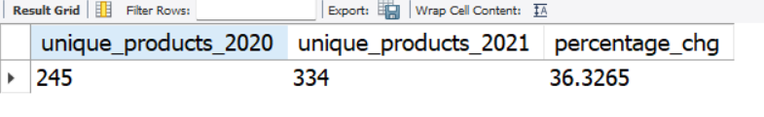
Question 2 Output:
Unique product ‘2021 vs. 2020’ percentage
What is the percentage of unique product increase in 2021 vs. 2020? The final output contains these fields,
unique_products_2020
unique_products_2021
percentage_chg

Slide 4
Insights
Conversion of Output to visual
Significant growth in the variety of products sold between 2020 and 2021.
Indicates positive trends such as product expansion, diversification, or the introduction of new items.

Slide 5
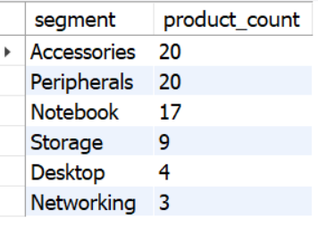
Question 3 Output:
Unique product count ‘each segment ’
Provide a report with all the unique product counts for each segment and sort them in descending order of product counts. The final output contains 2 fields,
segment
product_count

Slide 6

Insights
Conversion of Output to visual
Accessories and Peripherals segments have the highest product counts, each with 20 products.
Desktop and Networking segments have fewer product options, with 4 and 3 items, respectively. This could imply either a lower demand or a more specialized market for these products.

Slide 7
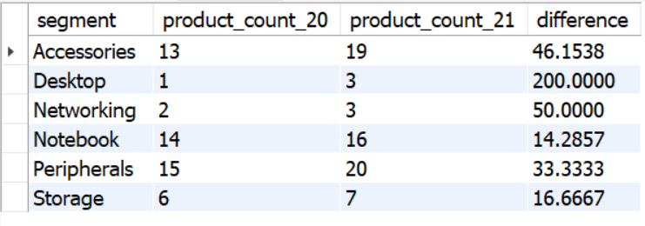
Question 4 Output:
Most Increase ‘unique products’
Follow-up: Which segment had the most increase in unique products in 2021 vs 2020? The final output contains these fields,
segment
product_count_2020
product_count_2021
difference

Slide 8

Insights
Conversion of Output to visual
Overall, there was a 60.07% increase in product count from 2020 to 2021. This is a positive sign that indicates strong growth in product sales.
Consider promotional strategies for growing categories.
Explore customer preferences and market trends.

Slide 9
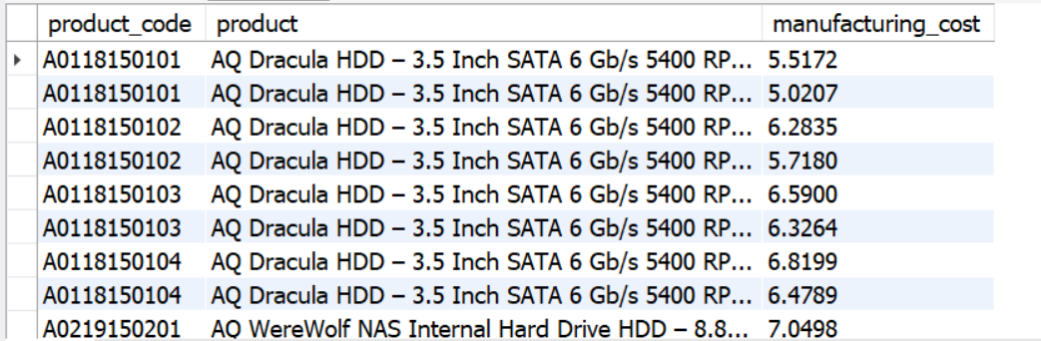
Question 5 Output:
Manufacturing Cost ‘overall’
Get the products that have the highest and lowest manufacturing costs. The final output should contain these fields,
product_code
Product
manufacturing_cost

Slide 10

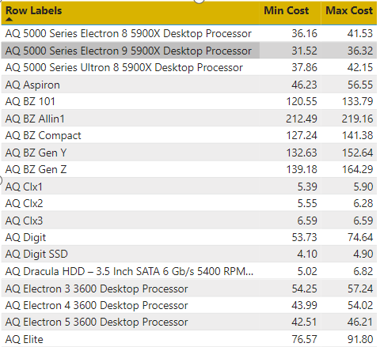
Insights
Conversion of Output to visual
Some product categories, like gaming products or high-performance processors, might have higher manufacturing costs compared to others.
Gaming-related products like "AQ Gamer 1," "AQ Gamer 2," and "AQ Gamer 3" have varying manufacturing costs.

Slide 11
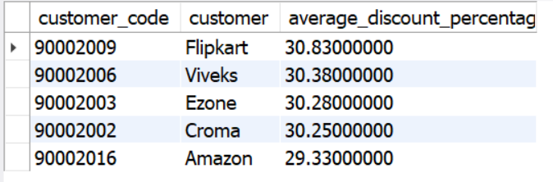
Question 6 Output:
Top Customer ‘2021’
Generate a report which contains the top 5 customers who received an average high pre_invoice_discount_pct for the fiscal year 2021 and in the Indian market. The final output contains these fields,
customer_code
customer
average_discount_percentage

Slide 12
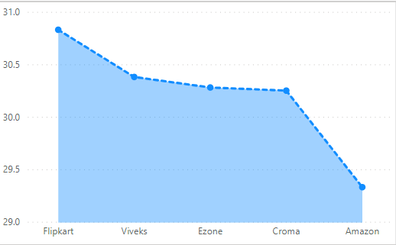
Insights
Conversion of Output to visual
The top four customers (Flipkart, Viveks, Ezone, and Croma) have very similar average discount percentages, indicating a competitive pricing strategy among them.
Amazon, while still offering discounts, seems to have a slightly lower average discount percentage, suggesting a different approach to pricing or possibly a focus on other factors such as service or product variety.

Slide 13
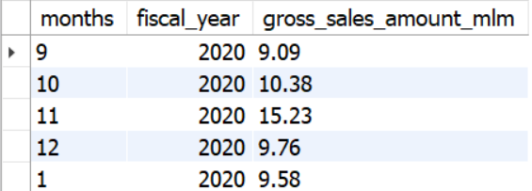
Question 7 Output:
Gross Sales ‘each month ’
Get the complete report of the Gross sales amount for the customer “Atliq Exclusive” for each month . This analysis helps to get an idea of low and high-performing months and take strategic decisions. The final report contains these columns:
Month
Year
Gross sales Amount

Slide 14
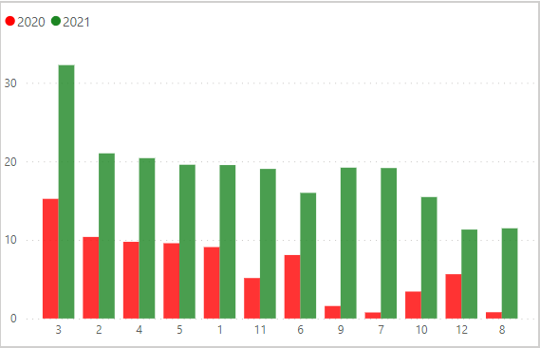
Insights
Conversion of Output to visual
For both fiscal years, there is an increase in sales during the later months of the fiscal year, with November and October showing the highest sales in both years.
There was a significant drop in sales during March and April 2020, which might be attributed to the global impact of the COVID-19 pandemic.

Slide 15
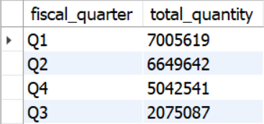
Question 8 Output:
Sold Quantity ‘each quarter ’
In which quarter of 2020, got the maximum total_sold_quantity? The final output contains these fields sorted by the total_sold_quantity,
Quarter
total_sold_quantity

Slide 16
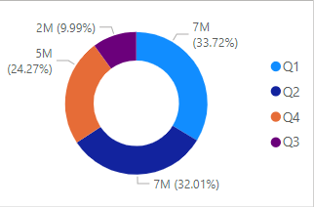
Insights
Conversion of Output to visual
The maximum total sold quantity in 2020 occurred in Q1 (first quarter) with a total of 7,005,619 units. This indicates a significant level of sales activity during the initial months of the fiscal year.
There were variations in sales activity across the different quarters of the fiscal year.

Slide 17
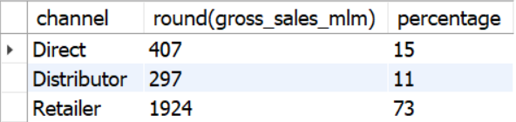
Question 9 Output:
Gross Sales ‘fiscal 2021 ’
Which channel helped to bring more gross sales in the fiscal year 2021 and the percentage of contribution? The final output contains these fields, channel
gross_sales_mln
percentage

Slide 18
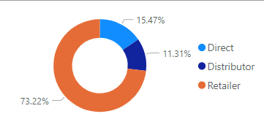
Insights
Conversion of Output to visual
The distribution of gross sales across different channels indicates a reliance on the "Retailer" channel, which significantly dominates the contribution.
The percentage contribution provides a clear understanding of each channel's share in the overall gross sales.

Slide 19
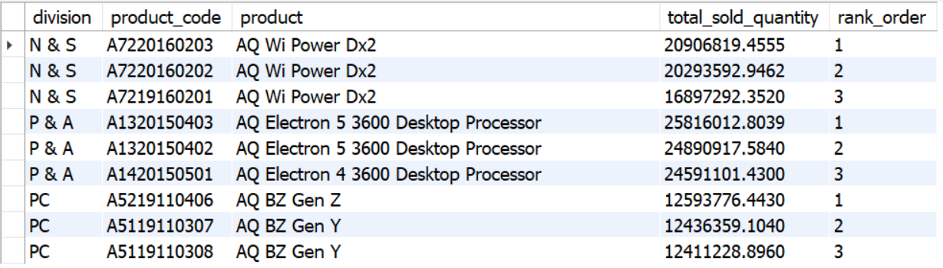
Question 10 Output:
Top Product ‘each division ’
Get the Top 3 products in each division that have a high total_sold_quantity in the fiscal_year 2021? The final output contains these fields,
division
product_code
product
total_sold_quantity
rank_order

Slide 20

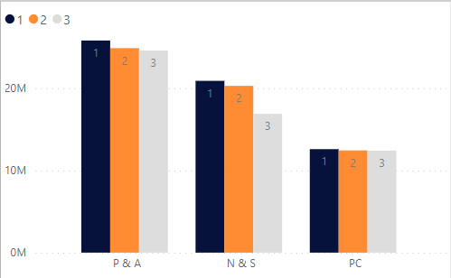
Insights
Conversion of Output to visual
Notice variations in the total sold quantity within each division, suggesting differences in product preferences or market demand.
Analyze the competition and market dynamics within each division. The rank order provides insights into the relative performance of products against each other.

Slide 21
The End
Follow More LinkedIn

