Slide 1
TWITTER SENTIMENT ANALYSIS

Slide 2
Group Members
Muhammad Asif Khan SP20-BCS-130
Hamza Chaudhary SP20-BCS-082
Shahmeer Hameed SP20-BCS-061
Luqman Kareem Butt SP20-BCS-031

Slide 3
What is a Sentiment?
Few Definitions:
Sentiments are feelings, opinions, emotions, likes/dislikes, good/bad
Sentiment Analysis is a study of human behavior in which we extract user opinion and emotion from plain text
Identification of whether the opinion expressed in a text is positive or negative
Twitter Sentiment Analysis is study of emotions hidden in tweets by a user/a topic

Slide 4
Example
User Opinions:
Alia : It’s a great movie (Positive statement)
Hamza : Nah!! I didn’t like it at all (Negative statement)
Asif : The new iOS7 is awesome..!!!(Positive statement)
Polarity:
Positive
Negative
Complex

Slide 5
Need of Sentiment Analysis
Rapid growth of available subjective text on the internet
To make decisions

Slide 6
Applications
Business and Organizations
Brand analysis
New product perception product and service benchmarking
Individuals:
Find mood of person
Finding opinion on political topics, movies, etc.

Slide 7
Our Goal
To determine whether the expressed opinion in the tweets is positive, negative, neutral

Slide 8
Approach
NLP:
Natural Language Toolkit which uses VADER (Valence Aware Dictionary and sentiment Reasoner) Deep Learning Algorithm to analyze Tweets
Machine Learning:
Gaussian Naïve Byes Classifier

Slide 9
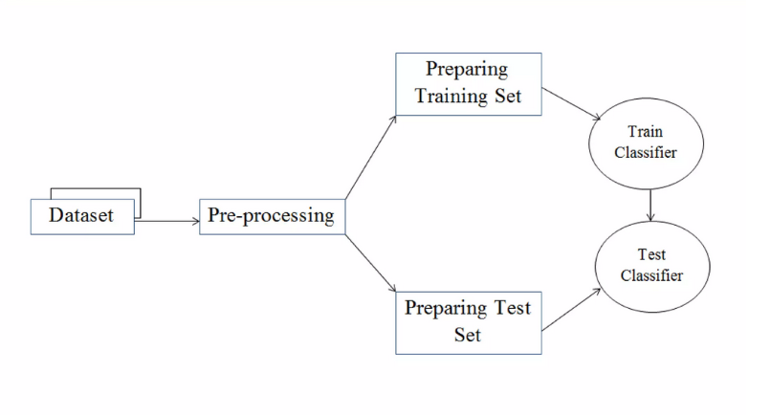
Implementation

Slide 10
Preprocessing
All tweets were converted to lower case
All links and URLs were replaced by generic word URL
All usernames were replaced by generic word USER
Words with hashtags were replaced with the same words without the hashtag
Punctuations and additional white spaces were removed from the tweets.
All the above work was done in python via regular expression matching.

Slide 11
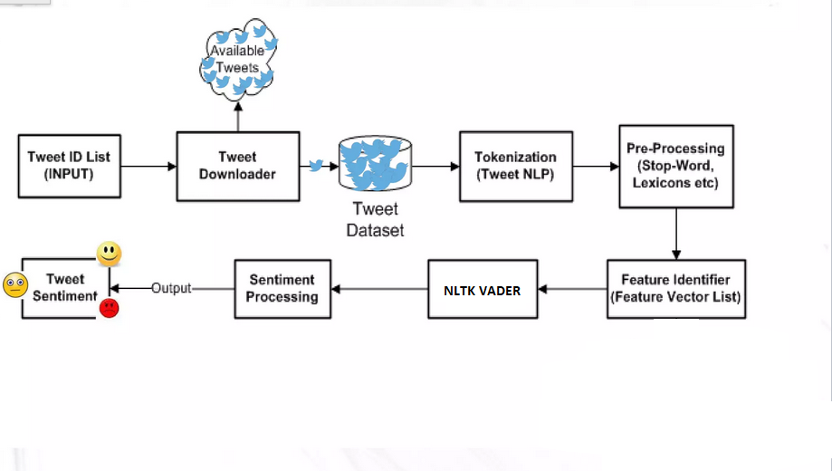
System Design

Slide 12
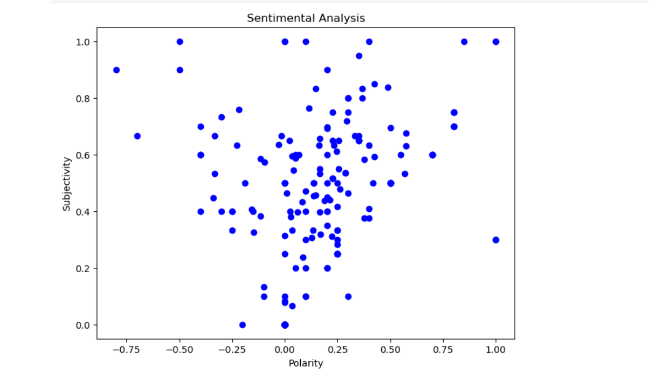
Outputs of Elon Musk Account Analysis

Slide 13
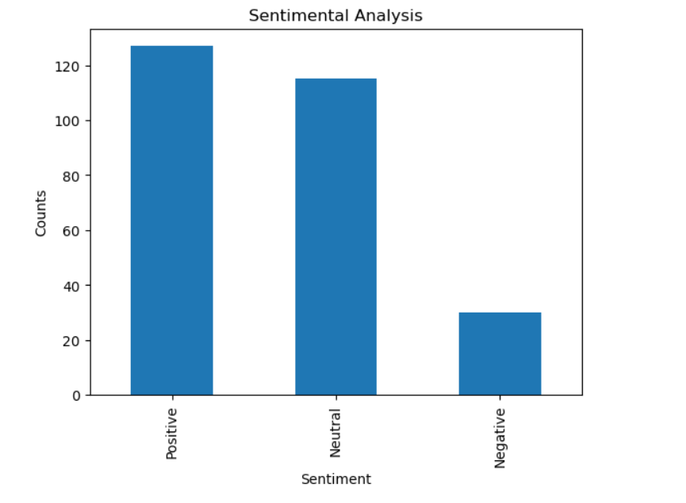
Output Cont.

Slide 14
Conclusion
Twitter sentiment analysis comes under the category of text and opinion mining. It focuses on analyzing the sentiments of the tweets and feeding the data to a machine learning model in order to train it and then check its accuracy, so that we can use this model for future use according to the results.
But it still lacks the dimension of diversity in the data. Along with this it has a lot of application issues with the slang used and the short forms of words. Many analyzers don’t perform well when the number of classes are increased.
Also, it’s still not tested that how accurate the model will be for topics other than the one in consideration. Hence, sentiment analysis has a very bright scope of development in future.

Slide 15
THANKS

