Slide 1

Social Behavioral Styles:

Slide 2

Introduction
The Social Style model categorizes people according to personality and how they interact with others.
Awareness of social style can help improve relationships among co-workers and individual performance.
People like people themselves

Slide 3
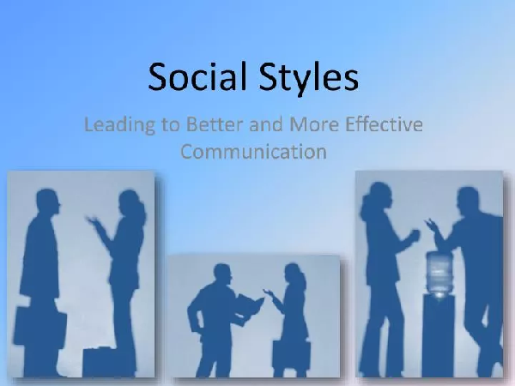
Assertiveness
Responsiveness

Slide 4
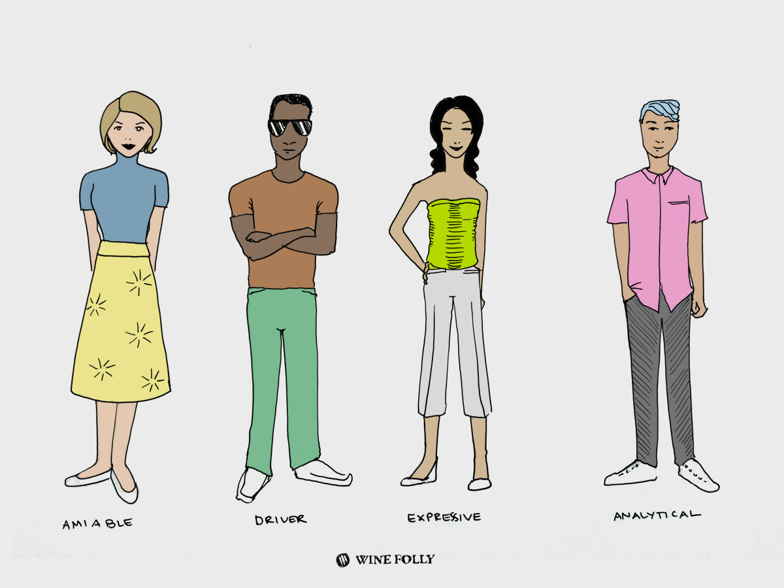

Driver Style
Driver-style people concrete goals and tangible results are essential.
They are motivated by a sense of purpose
action-orientated ▪︎forceful
strong-minded ▪︎discard details
decisive ▪︎problem solver
direct ▪︎competitive

Slide 5
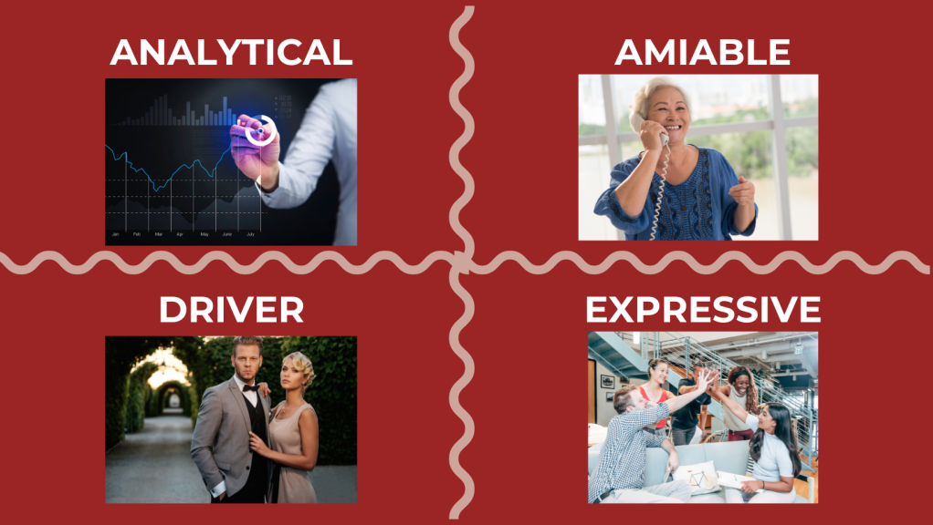
Amiable Style
Consumers with amiable personality types value empathy trust and relationships
Caring ▪︎Related
Encouraging ▪︎cooperates
Sharing ▪︎considerate
Patient ▪︎provides support

Slide 6
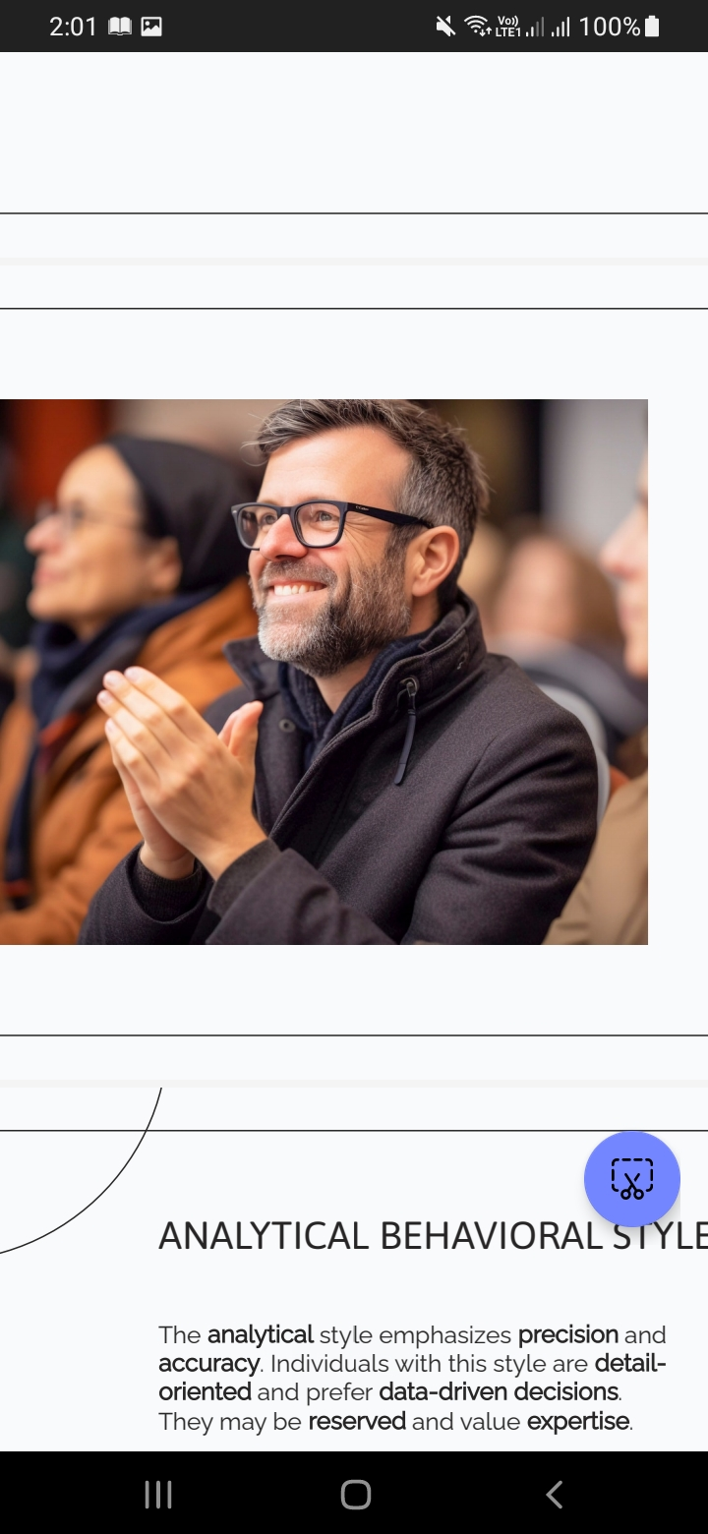

Expressive Style
An expressive style are outgoing and
Enthusiastic & Emotional
They are impatient with details but are happy to focus on the big picture.
▪motivating ▪enthusiastic
▪convincing ▪impulsive
▪influential ▪confident ▪optimistic ▪animated

Slide 7
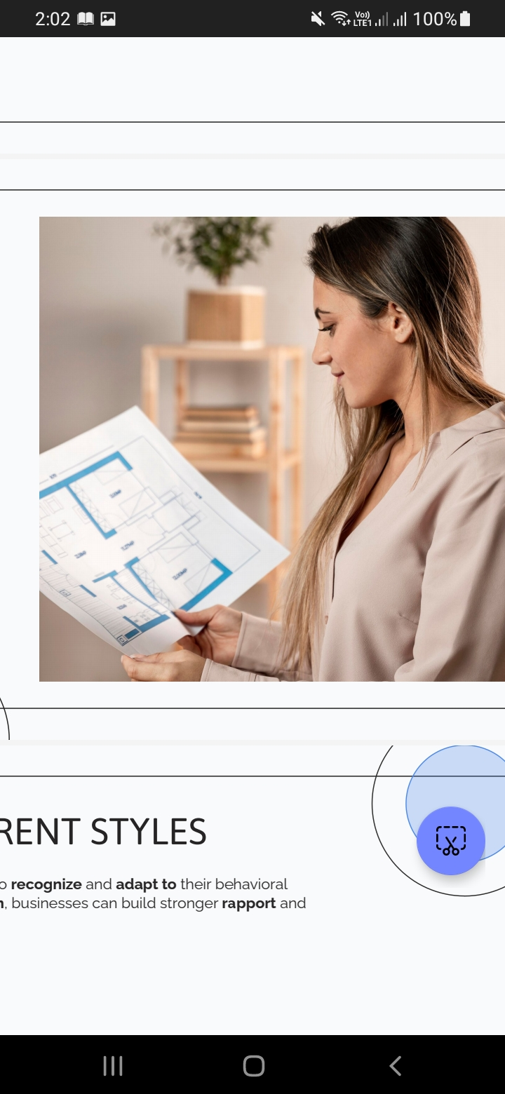
Analytical Style
Analytical people are known for being systematic, well organized and deliberate.
asks questions
wants details and evidence
slow to make a decision
AVOID MISTAKES

Slide 8
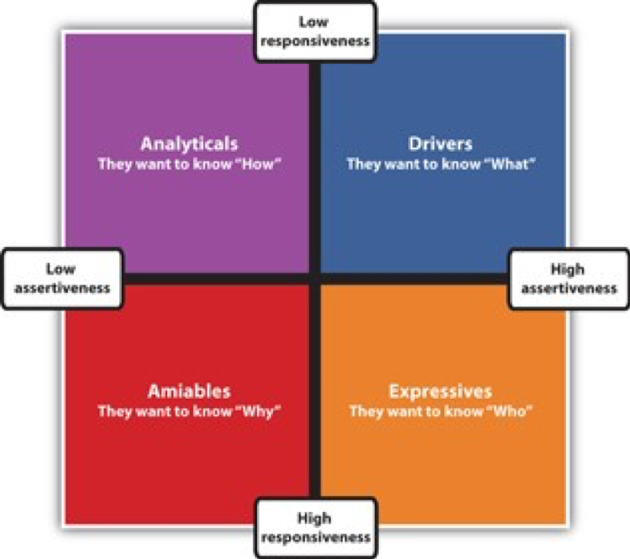

Slide 9

Understanding and adapting to customer behavioral styles is fundamental for fostering positive relationships, enhancing customer satisfaction, and ultimately driving business growth.

Slide 10


