Slide 1

M. Hamza
Employee ID: 5622

Slide 2

What is Angular?
Type-Script Based Framework
A Comprehensive Solution for front end of Single Page Applications (SPAs)
Developed by Google(2010)
New version is released every 6 months
Used for desktop and mobile web applications.

Slide 3

Problem it Solves
Extensive manual code to synchronize data between model and the view.
Dependency management was manual.
Developers relied on multiple third-party tools

Slide 4
Installation and Pre-Reqs
Install npm (Node Package Manager)
Install Node.js
Install Angular CLI using npm install -g @angular/cli
Start the server by running: ng serve.
Navigate to http://localhost:4200 in browser to see running Angular application.
Run: ng new my-first-app, In your desired project directory.

Slide 5
String Interpolation
Property Binding
Purpose: Embed expressions in HTML
Syntax: {{ expression }}
Example: <p>{{ title }}</p>
Purpose: Bind component properties to DOM attributes
Syntax: [property]="expression"
Example: <input [value]="username">

Slide 6
Angular Event Binding
Handle events like clicks, keystrokes, and form submissions in Angular applications.
Connect DOM events to component methods.
(click)="onClick()" binds a click event to the onClick method in the component.
Trigger component logic based on user interactions.
Update the UI or perform actions when events occur.

Slide 7
Parent/Child Communication
Facilitate communication between parent and child components.
Pass data from parent to child using @Input.
<child-component [data]="parentData"></child-component>
Emit events from child to parent using @Output and EventEmitter.
<button (click)="notifyParent()">Notify</button>

Slide 8
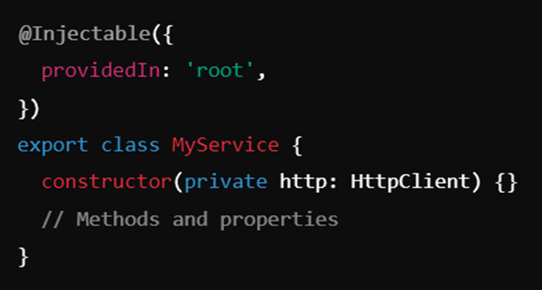
Services
Provide reusable logic and data across components
Manage state, perform HTTP requests, and more
Command: ng generate service service_Name

Slide 9

Injecting Services
ProvidedIn: 'root': Singleton service available app-wide
ProvidedIn: 'any': New instance for each lazy-loaded module

Slide 10
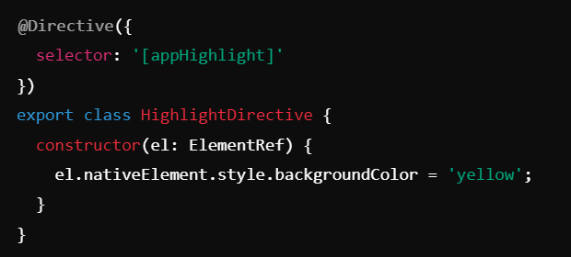
Directives
Modify DOM behavior or appearance
Enhance element and component functionality
Command: ng generate directive directiveName

Slide 11
Types of Directives
Structural Directives
Attribute Directives:
Change Layout: Add /remove elements
*ngIf="condition": Conditionally include/exclude elements
*ngFor="let item of items": Repeat elements
Change Appearance: Style or behavior of elements
[ngClass]="{'active': isActive}": Apply CSS classes
[ngStyle]="{'color': color}": Apply inline styles

Slide 12
Angular Forms
Manage user input, validation, and data in Angular apps.
FormControl: Single input field.
FormGroup: Collection of controls.
FormArray: Array of controls or groups.
Template-Driven Forms: Simple, declarative approach using ngModel.
Usage: Import FormsModule, use ngModel.
Reactive Forms: Structured, programmatic approach using FormGroup and FormControl.
Usage: Import Reactive_ FormsModule, use FormGroup.

Slide 13


Reactive vs Template Driven Forms
 | Template Driven Form | Reactive Forms
Created | In Component | by Directive
Predictability | Sync | Async
Validators | Functions | Directive
Mutability | Immutable | Mutable
Scalability
Testability | easy | Uncomfortable

Slide 14
Routing
Enables dynamic view changes within Single Page Applications (SPAs) without page reloads.
Provides smooth transitions and a seamless interface.
Map URL paths to specific components for rendering.
App
Home
Login
register

Slide 15
HTTP Request
Fetch and send data to server-side applications.
Retrieve data from a server.
Send data to a server
Update existing data on the server
Remove data from the server.
Import {HttpClient} from ‘@angular/common/http’;

Slide 16
Thank You
Q & A

