Slide 1
HCI & Computer Graphics — BS Computer Science 3(2+1)
LECTURE 01 · WEEK 01
What HCI Is, and Why Interfaces Fail
▸ Define human-computer interaction and state the three things it always studies together.
▸ Explain why a usability failure is a design failure and not a user failure.
▸ Distinguish usability from user experience, and both from utility.
▸ Identify, in a real interface, at least three decisions that were made about the human rather than about the machine.
CLO-1 · Bloom C1–C2 · HEC: Introduction to HCI; history; the human, the computer, the context
Reading: Sharp/Rogers/Preece Ch. 1; Dix Ch. 1 · Lab: Lab 1 — Toolchain and first pixels
Notes:
[ Slide 1 of 14 · Lecture 01: What HCI Is, and Why Interfaces Fail ]
SAY:
Welcome to Human-Computer Interaction and Computer Graphics. Read the title slowly, because it is one course with two halves joined by an ampersand, and by the end of the semester you should understand why that ampersand is not an accident.
Here is the shape of the whole subject in two sentences. Computer Graphics studies how a machine turns numbers -- geometry, colour, light -- into pixels. HCI studies what happens after those pixels reach a human being who has limited eyes, limited memory, limited attention and a job to finish. Graphics produces the image; HCI decides whether the image was worth producing.
Today has four goals, printed on the slide so you can mark yourself against them at the end. You should be able to define HCI and name the three things it always studies together; explain why we treat a usability failure as a design failure rather than a user failure; separate three words that industry uses loosely -- utility, usability and user experience -- and use them precisely; and finally, look at a real interface and point to three decisions in it that were made about the human rather than about the machine.
The reading is Sharp, Rogers and Preece chapter 1, supported by Dix chapter 1. Read it before Lab 1. It is short, and it is the vocabulary you will be marked in.

Slide 2
THE ONE IDEA OF THIS COURSE
If many ordinary people fail at the same point,
that point is a design defect.
▸ Not 'users are stupid'.
▸ Not 'they should read the manual'.
▸ The interface did something. Find out what.
Notes:
[ Slide 2 of 14 · Lecture 01: What HCI Is, and Why Interfaces Fail ]
SAY:
If you forget every diagram in this course, keep this sentence: if many ordinary people fail at the same point, that point is a design defect.
Notice the two qualifiers, because both are load-bearing. "Many" -- one person failing tells you almost nothing; it could be tiredness or inexperience. Twenty people failing at the same step is data. And "ordinary" -- we are not talking about people who refuse to look at the screen. We mean competent adults, motivated to finish, failing anyway.
Why open with this? Because the natural instinct when a system fails is to look for a person to blame, and the user is standing right there. That instinct feels like an explanation, but it produces nothing you can act on. You cannot ship a fix called "be less careless." The design reading always produces something you can change, test and measure.
There is also an honesty point. When you become a professional developer, the users who failed will not be in the room to defend themselves. Your job in that meeting is to be the person who asks what the interface actually did.
So for the rest of the semester, three sentences are banned from your reports: "users are stupid," "they should have read the manual," and "the user was confused." The interface did something specific. Find out what.
DELIVERY NOTE:
Open cold with this slide, before any definitions. Ask three students for a device that has defeated them this week. Do not let anyone say 'I was being stupid' — challenge it immediately. This tone-setting is worth more than the rest of the lecture.

Slide 3
Two Disciplines, One Screen
The course title has an ampersand in it for a reason.
• HCI — what can a person perceive, remember, decide and do?
• Computer Graphics — how does a machine turn geometry and light into those pixels?
• They meet at the screen, and they constrain each other.
  – HCI-only graduate: mock-ups nothing can render at 60 fps.
  – Graphics-only graduate: brilliant renderer nobody can operate.
• This course refuses to let you become either one.
Lecture 01 · What HCI Is, and Why Interfaces Fail · BS Computer Science
Notes:
[ Slide 3 of 14 · Lecture 01: What HCI Is, and Why Interfaces Fail ]
SAY:
Let us be concrete about how the two halves of this course constrain each other, because students often assume they are unrelated subjects taught in one slot to save timetable space. They are not.
HCI asks: what can a person perceive, remember, decide and do? How small can text be before it stops being readable? How many items can someone hold in mind while navigating a menu? How long a delay before a click feels broken?
Computer Graphics asks: how does a machine turn geometry and light into the pixels that carry that information? How do you draw a line on a grid of squares? How do you decide which surface is in front?
They meet at the screen and they push against each other. Here is the concrete number, worth writing down: a 60 Hz display gives you 16.7 milliseconds per frame for absolutely everything -- physics, logic, geometry, lighting, rasterisation. That is a graphics fact, but it is also an interaction budget. If your elegant interaction idea needs 40 ms of shading per frame, that interaction does not exist. It was never a design; it was a wish.
That is why the two failure modes on this slide matter. A graduate who only knows HCI produces mock-ups nothing can render in time. A graduate who only knows graphics builds a superb renderer that nobody can operate. This course is built to stop you becoming either one. Week 15 will make you feel the 16.7 ms yourself.
DELIVERY NOTE:
Make the constraint concrete: at 60 Hz you have 16.7 ms per frame for everything — that is a graphics fact that limits an interaction decision. Tell them Week 15 will make them feel it.

Slide 4
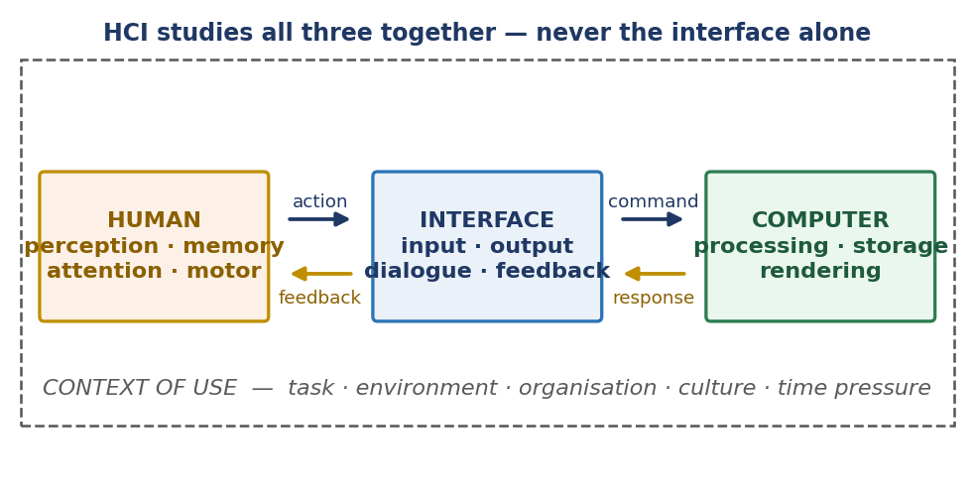
HCI Studies Three Things — Always Together
FIGURE
▸ Redesigning only the middle box is decoration, not design.
▸ The dashed box decides which constraint bites first.
Lecture 01 · What HCI Is, and Why Interfaces Fail · BS Computer Science
Notes:
[ Slide 4 of 14 · Lecture 01: What HCI Is, and Why Interfaces Fail ]
SAY:
Look at the figure. HCI never studies one thing; it studies three things together, and the third is the one students forget.
The human: perception, memory, attention, motor control, prior experience, expectations, emotional state. That is Weeks 2 and 3.
The computer: input devices, displays, resolution, latency, bandwidth, and the software in between. That is Week 4 and, more deeply, the whole graphics half.
And the context -- the dashed box -- which is everything around the interaction. Lighting, noise, hurry, posture, who else is watching, what device, what network, what happens if they get it wrong.
Now the sentence that earns marks: redesigning only the middle box is decoration, not design. If you make the buttons prettier without asking who is pressing them and where, you have done visual styling, not interaction design.
The dashed box decides which constraint bites first. Take one identical app and put it in three contexts. A nurse using it in gloves, in a dim ward, interrupted every ninety seconds -- her constraint is target size and error recovery. A student on a moving bus, one-handed, on patchy data -- his constraint is thumb reach and tolerance of network failure. A clerk on a fifteen-year-old desktop with a small screen -- her constraint is information density and rendering cost. Same interface. Three genuinely different design problems.
In the midterm, the analysis question is marked on whether you noticed the dashed box.
DELIVERY NOTE:
Point at the dashed rectangle and give the three-context example: the same app for a nurse in gloves in a dim ward, a student on a bus, and a clerk on a 15-year-old desktop. Same interface, three different design problems. This is where marks are won in the midterm's analysis section.

Slide 5
The Question to Ask About Any Interface
Three parts. If a design cannot answer all three, it was assembled, not designed.
• Who is the user? (not 'everyone')
• What is the task? (a goal, not a feature)
• Where are they when they do it? (light, noise, hurry, device, network)
Lecture 01 · What HCI Is, and Why Interfaces Fail · BS Computer Science
Notes:
[ Slide 5 of 14 · Lecture 01: What HCI Is, and Why Interfaces Fail ]
SAY:
This is the diagnostic tool for the whole semester, and it fits on one line: who, what task, and where.
Who is the user? "Everyone" is not an answer; it is a refusal to answer. Everyone means nobody in particular, and a design for nobody in particular fails everybody a little. Push until you name a group with properties that constrain the design: first-time users over sixty, expert operators doing this two hundred times a day, parents in a hurry.
What is the task? A task is a goal the person came to achieve, not a feature you happen to have built. "Use the filter panel" is a feature. "Find a flight under twenty thousand rupees that lands before noon" is a task. Features are things your system has; tasks are things people want. When you write requirements from features, you optimise the wrong thing.
Where are they when they do it? Light, noise, hurry, device, network, one hand or two, standing or seated, private or observed. Context turns an acceptable design into an unusable one without changing a single pixel.
Try it now with a food delivery app. Who -- and do not say everyone. What -- give me a goal, not a screen. Where -- be specific about the hand, the light and the hurry.
If a design cannot answer all three questions, it was assembled, not designed. That phrasing is deliberate. Use it.
DELIVERY NOTE:
Drill it. Give them 'a food delivery app' and make the class answer all three out loud. Reject 'everyone' as an answer to the first — push until they name a specific group.

Slide 6
Blame the User, or Read the Design?
Same fact. Two readings. Only one of them produces a fix.
Blame reading — useless
Design reading — actionable
• 'They're careless'
• 'They didn't read the manual'
• 'They can't follow instructions'
• 'They're lazy'
• Produces: a training request
• Produces: no design change
• Two destructive buttons, adjacent, identical
• Feature buried three menus deep
• Free-text date field with no example
• Submit button below the fold, no confirmation
• Produces: a specific change
• Produces: a testable hypothesis
Lecture 01 · What HCI Is, and Why Interfaces Fail · BS Computer Science
Notes:
[ Slide 6 of 14 · Lecture 01: What HCI Is, and Why Interfaces Fail ]
SAY:
The same fact -- "the user deleted the wrong file" -- can be read two ways, and only one of them produces a fix. That is the entire point of this slide.
Look at the left column. Careless, did not read the manual, cannot follow instructions, lazy. Every one is a statement about a person's character. What can you do with it? Request training. Add a warning nobody reads. Write it in the defect log and close it. Nothing on the screen changes, so nothing in the world changes, and the next twenty users make the same mistake.
Now the right column. Two destructive buttons placed adjacent and styled identically. A feature buried three menus deep. A free-text date field with no example format. A submit button below the fold with no confirmation. Every one is a statement about the artefact. And every one produces two things at once: a specific change you can make this afternoon, and a testable hypothesis -- "if I separate these buttons and colour the destructive one, the error rate will fall." You can then measure whether you were right.
That is the difference between an opinion and engineering.
So here is the rule for every report this semester. "The user was confused" is not a finding; it is where thinking stopped. Name what the interface did. This rule carries marks in Assignment 2 and in the midterm, so learn it now rather than in Week 12.
DELIVERY NOTE:
Insist on the phrasing rule now: in every report this semester, 'the user was confused' is not a finding. They must name what the interface did. Say that this rule is worth marks in Assignment 2 and in the midterm.

Slide 7
Utility, Usability, User Experience
Loose words in industry. Precise words in this examination.
Term | Asks | Measured by
Utility | Does it do the needed thing at all? | Feature coverage vs task analysis
Usability | Can the user get it done? | Success rate, time on task, errors
UX | How does the encounter feel? | Satisfaction, engagement, return
Lecture 01 · What HCI Is, and Why Interfaces Fail · BS Computer Science
Notes:
[ Slide 7 of 14 · Lecture 01: What HCI Is, and Why Interfaces Fail ]
SAY:
Three words that industry uses interchangeably. In this examination they are distinct, and mixing them costs marks.
Utility asks: does the system do the needed thing at all? Does the function exist? You measure it by comparing feature coverage against a task analysis -- for every task the user must complete, is there something in the system that can complete it?
Usability asks: can the user actually get it done? The function exists, but can a real person reach it, understand it and finish without help? You measure it with success rate, time on task and error count. These are numbers, not opinions, and Week 7 teaches you to collect them.
User experience asks: how does the encounter feel? Confidence, frustration, trust, delight, willingness to return. You measure it with satisfaction scales, engagement and return rate.
Now the two failure modes. I want both sentences in your notes, because both have appeared in past papers.
Utility without usability is a system that can do the job but nobody can reach the job. Think of powerful enterprise software that needs a three-day training course before you can raise an invoice.
Usability without utility is a smooth, pleasant, frictionless path to the wrong destination. Beautiful, easy and useless -- it does not do the thing you needed.
Good design needs all three. Good examination answers name all three correctly.
DELIVERY NOTE:
Give the two failure modes out loud: utility without usability is a system nobody can reach; usability without utility is a smooth path to the wrong place. Both sentences appear in past papers.

Slide 8
ISO 9241-11 — MEMORISE THIS
Effectiveness · Efficiency · Satisfaction
for specified users, goals and context
▸ Change the users → usability changes.
▸ Change the context → usability changes.
▸ So usability is NOT a property of the interface alone.
Notes:
[ Slide 8 of 14 · Lecture 01: What HCI Is, and Why Interfaces Fail ]
SAY:
This is the formal definition, it is examinable word for word, and you should write it down now.
ISO 9241 part 11 defines usability as the effectiveness, efficiency and satisfaction with which specified users achieve specified goals in a specified context of use.
Take the three measures first. Effectiveness -- did they complete the task, and was the result correct? It is close to a yes-or-no measure. Efficiency -- what did completion cost them in time, effort, clicks or errors? Satisfaction -- how acceptable was the experience? Notice that effectiveness and efficiency are separable: a user can succeed at every task and still hate every second of it, and both facts are usability findings.
Now the part students skip, which is where the marks are: specified users, specified goals, specified context. Change any one of those three and usability changes, even though the interface has not changed at all. Give the same dense dashboard to an expert instead of a novice and it becomes usable. Move the user from a desk to a moving vehicle and it becomes unusable.
Therefore -- and this is the conclusion to memorise -- usability is not a property of the interface alone. It is a property of the interface together with its users, their goals and their context.
Test yourself: is a nuclear reactor control panel usable? The only correct answer is a question back: for whom, doing what, where? If you answered plain yes or plain no, you have not yet understood the definition.
DELIVERY NOTE:
This exact definition is worth marks in the midterm Section A. Make them write it down. Then ask: 'is a nuclear reactor control panel usable?' — the answer must be 'for whom, doing what, where?'

Slide 9
History in One Table — Each Row Moved Work Off the Human
Era | The user had to… | What changed
1940s–50s | Punch cards, wait hours | Nothing interactive
1963–68 | Sketchpad; the mouse; the 1968 demo | Draw directly; point at things
1970s–80s | Learn WIMP | Recognition replaced recall
1990s | Browse the web | Usability went mass-market
2000s+ | Touch, gesture, voice, AR/VR | The interface leaves the screen
Lecture 01 · What HCI Is, and Why Interfaces Fail · BS Computer Science
Notes:
[ Slide 9 of 14 · Lecture 01: What HCI Is, and Why Interfaces Fail ]
SAY:
Do not memorise dates. Memorise the direction of travel, because every row in this table is the same move: work that used to sit on the human was pushed onto the machine.
In the 1940s and 50s you punched cards, handed them to an operator and came back hours later. There was no interaction at all -- there was submission and collection. The human carried the entire burden of getting it right first time.
Then 1963 to 1968. Ivan Sutherland's Sketchpad let a person draw directly on a screen with a light pen and see the result immediately. Engelbart's team gave us the mouse and, in the 1968 demonstration now called "the mother of all demos," windows, hypertext and collaborative editing. Pointing at a thing replaced describing a thing.
The 1970s and 80s brought WIMP -- windows, icons, menus, pointer -- from Xerox PARC into the Star, the Lisa and the Macintosh. The deep change here is cognitive: recognition replaced recall. You no longer had to remember the command; you looked at the menu and recognised it.
The 1990s put a browser in ordinary homes, and usability stopped being a specialist concern and became a mass-market one.
From the 2000s, touch, gesture, voice, AR and VR began moving the interface off the rectangle of glass entirely.
One name to underline: Sutherland, 1963. The first interactive graphics system and the first direct-manipulation interface were the same PhD thesis. That is why this course has one title.
DELIVERY NOTE:
Dates are not examinable; the direction of travel is. Highlight Sutherland 1963: the first interactive graphics system and the first direct-manipulation interface were the same PhD. That is why this course has one title with an ampersand.

Slide 10
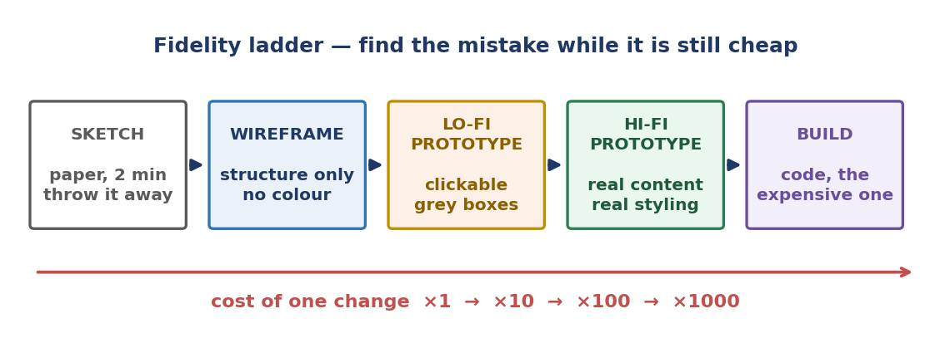
Why We Sketch: The Cost of Being Late
FIGURE
▸ A sketch costs 2 minutes to throw away.
▸ The same change after launch costs ~1000×.
▸ Half this course exists to move discovery leftwards.
Lecture 01 · What HCI Is, and Why Interfaces Fail · BS Computer Science
Notes:
[ Slide 10 of 14 · Lecture 01: What HCI Is, and Why Interfaces Fail ]
SAY:
This curve is the economic argument for everything we do in Weeks 5 and 6, and it answers the question every computer science student asks: why are we drawing on paper?
The vertical axis is the cost of changing a design decision. The horizontal axis is when in the project you discover the problem. The curve is roughly exponential. The exact multipliers quoted in industry studies vary, but the order of magnitude does not: a change costing one unit during sketching costs around ten during detailed design, around a hundred during development, and around a thousand after release.
Why? Because a sketch has nothing attached to it. Throwing away a paper wireframe costs two minutes and no feelings. By the time the same idea is code, it has a database schema attached, tests attached, documentation attached, other teams' work attached, and -- most expensively -- users with habits attached. After launch you are not changing a design; you are changing a design plus everything that grew on it, plus retraining everyone who learned the old one.
So user-centred design is not a plea to "be careful." It is a strategy: move discovery leftwards. Find the problem while it is still cheap to have been wrong.
Notice what this implies about sketching roughly on purpose. A rough sketch invites criticism; a polished mock-up invites approval. Early in a project, criticism is exactly what you want.
DELIVERY NOTE:
This is the slide to use when a student asks 'why are we drawing on paper in a computer science degree?'. Answer with the multiplier, not with taste.

Slide 11
What You Will Do This Semester
ROADMAP
1
Weeks 1–3 — the human: perception, memory, attention
2
Weeks 4–6 — interaction models, styles, user-centred design
3
Weeks 7–8 — usability, accessibility, evaluation → MIDTERM
4
Weeks 9–11 — primitives, scan conversion, 2D transforms, clipping
5
Weeks 12–14 — 3D, camera, projection, pipeline, lighting, texture
6
Weeks 15–16 — animation, interaction, project, viva
Lecture 01 · What HCI Is, and Why Interfaces Fail · BS Computer Science
Notes:
[ Slide 11 of 14 · Lecture 01: What HCI Is, and Why Interfaces Fail ]
SAY:
Here is the whole semester, so you can place any week in context.
Weeks 1 to 3 are the human: vision, colour and Gestalt grouping; hearing, touch, motor control and Fitts's law; then memory, attention and mental models. We start here because every later rule is a consequence of a human limit.
Weeks 4 to 6 are interaction: Norman's stages of action, WIMP and interaction frameworks, interaction styles and dialogue design, design principles, then user-centred design -- personas, scenarios, task analysis, requirements and prototyping.
Weeks 7 and 8 are quality and judgement: usability goals and metrics, heuristic evaluation, accessibility and WCAG, cognitive walkthrough and usability testing. Then the midterm.
Weeks 9 to 11 turn to graphics: output primitives, scan conversion of lines and circles, polygon fill, 2D transformations with homogeneous coordinates, composite transforms, window-to-viewport mapping and clipping.
Weeks 12 to 14 go 3D: 3D transformations and object representation, camera and projection, the rendering pipeline end to end, hidden-surface removal and the depth buffer, colour models, the Phong illumination model, shading and texture mapping.
Weeks 15 and 16 close the loop: animation and the render loop, interactive graphics and picking, evaluating interactive visual systems, then project and viva.
One administrative fact that gets asked in Week 6 every year, so hear it in Week 1: the midterm covers Weeks 1 to 8, plus the graphics foundations from Week 1. Nothing beyond that.
DELIVERY NOTE:
Flag the midterm boundary explicitly: the midterm covers Weeks 1–8 plus Week 1's graphics foundations, and nothing else. Students ask this in week 6 every year; answer it in week 1.

Slide 12
How You Will Be Marked
Read this now, not in week 15.
• Quizzes 10% · Assignments 10% · Labs 15%
• Midterm 20% · Project 20% · Final 25%
• Implementation and interpretation are marked separately.
  – A program that runs but you cannot explain: at most half marks.
  – An explanation with no running program: less.
• Every lab produces an artefact AND a written interpretation.
Lecture 01 · What HCI Is, and Why Interfaces Fail · BS Computer Science
Notes:
[ Slide 12 of 14 · Lecture 01: What HCI Is, and Why Interfaces Fail ]
SAY:
Read this now, not in Week 15, because one of these rules should change how you work from tomorrow.
The weights: quizzes ten per cent, assignments ten, labs fifteen, midterm twenty, semester project twenty, final exam twenty-five.
Now the rule that matters more than the weights. Implementation and interpretation are marked separately. A program that runs but which you cannot explain earns at most half marks. An explanation with no running program earns less than that.
Let me be clear about why this is not bureaucratic cruelty. In graphics especially, it is entirely possible to copy a working code fragment, see a triangle appear, and understand nothing about why it appeared. That is not a learning outcome, and it collapses the moment anything differs -- a different screen size, a different matrix order, a different projection. The viva exists to detect this, and it always does.
So every lab produces two things: an artefact -- a screenshot, a prototype link, a running program, an evaluation table -- and a written interpretation saying what you changed, what happened, and why it happened.
Practically, this means budget the last twenty minutes of every lab for writing, not for one more feature. Students who do this pass comfortably. Students who code for the whole session and write the interpretation from memory a week later lose marks they had already earned in the lab.
DELIVERY NOTE:
Say the half-marks rule twice. It is the single policy that changes student behaviour most, and it is the one they claim not to have heard in week 12.

Slide 13
HOME TASK
Bring one screenshot to Lab 1.
▸ One screen from an app you use every day.
▸ Annotate three decisions made about the HUMAN, not the machine.
▸ You will defend your three in the lab.
Notes:
[ Slide 13 of 14 · Lecture 01: What HCI Is, and Why Interfaces Fail ]
SAY:
Your task before Lab 1 is small, and it is not optional.
Take one screen -- a single screen, not a whole app -- from something you use every day. WhatsApp, a banking app, the university portal, a food delivery app. Screenshot it.
Then annotate three decisions on that screen that were made about the human, not about the machine. That distinction is the whole exercise. "It uses a green colour" is a decision about the machine's output. "It uses green because the user needs to confirm at a glance, without reading, that the message was delivered" is a decision about the human.
Let me do one so you know the standard. WhatsApp's double tick. That mark is not there because the network needs it -- the network already knows. It is there because a human who has sent a message experiences uncertainty, and uncertainty is uncomfortable. The double tick is a decision about the human's need for feedback. And colouring it blue is a second, separate decision about a different human need: knowing whether you have been read, which is a social question, not a technical one.
That is the level of reasoning I want. Three of them. You will defend them out loud in Lab 1, so choose ones you can argue for.
DELIVERY NOTE:
Show one worked example yourself — e.g. WhatsApp's double tick: a decision about the human's need for feedback, not about the network. Then stop; make them find their own.

Slide 14
EXIT QUESTION · WRITE YOUR ANSWER
Name one interface you used today that made you feel stupid, and rewrite the blame as a design defect in one sentence.
▸ Hand in one short paragraph before you leave.
▸ Home task: Bring a screenshot of one screen from an app you use daily. Annotate three decisions on it that were made about the human, not about the machine. You will use this in Lab 1.
Notes:
[ Slide 14 of 14 · Lecture 01: What HCI Is, and Why Interfaces Fail ]
SAY:
Before you leave, write me one short paragraph.
Name one interface you used today that made you feel stupid. Then rewrite the blame as a design defect, in one sentence. So not "I could not find the payment option because I am bad with apps," but "the payment option sits inside an unlabelled hamburger menu, so a first-time user cannot find it without exploring."
That rewriting move -- from a statement about a person to a statement about an artefact -- is the single skill this whole lecture exists to install. If you can do it reliably, the rest of the HCI half of this course is elaboration.
Hand the slip to me on the way out. I read them, and they tell me faster than any quiz who has understood today.
And the home task once more, because it feeds directly into Lab 1: one screenshot of one screen from an app you use daily, with three annotated decisions made about the human rather than about the machine. Paper or laptop, either is fine, as long as you can put it in front of another student and argue for it.
Next lecture we cross to the other side of the ampersand: what is physically inside the machine that puts those pixels on the glass, and what it costs.
DELIVERY NOTE:
Collect the exit slips; they are your fastest signal of who has understood the lecture.

