Slide 1
HCI & Computer Graphics — BS Computer Science 3(2+1)
LECTURE 02 · WEEK 01
Computer Graphics: Systems, Displays and the Frame Buffer
▸ Describe the components of a raster graphics system and the path from an application draw call to a lit pixel.
▸ Explain the difference between raster and vector representations and state when each is preferable.
▸ Compute frame-buffer size, refresh bandwidth and aspect ratio from resolution and colour depth.
▸ Explain why double buffering is required for animation.
CLO-2 · Bloom C1–C2 · HEC: CG history and applications; graphics systems; raster displays
Reading: Hearn/Baker Ch. 1–2; Angel Ch. 1 · Lab: Lab 1 — Toolchain and first pixels
Notes:
[ Slide 1 of 14 · Lecture 02: Computer Graphics: Systems, Displays and the Frame Buffer ]
SAY:
This is the graphics half of Week 1, and its purpose is to give you an accurate mental model of what physically happens between your program and the glass in front of you. Almost every confusion later in this course -- why draw order sometimes matters and sometimes does not, why animation flickers, why a "small" increase in resolution costs so much -- traces back to not having this model.
Four objectives. First, describe the components of a raster graphics system and follow the path from an application draw call to a lit pixel. Second, explain the difference between raster and vector representations and say when each is preferable. Third -- and this is arithmetic you will be examined on -- compute frame-buffer size, refresh bandwidth and aspect ratio from resolution and colour depth. Fourth, explain why double buffering is required for animation.
The reading is Hearn, Baker and Carithers chapters 1 and 2, with Angel chapter 1 as an alternative treatment. Both are readable in an evening.
One framing thought. The previous lecture said usability is a property of interface plus user plus context. This lecture is about the machine side of that pairing, and you will see that the machine imposes hard deadlines -- 16.7 milliseconds at 60 Hz -- that constrain what an interaction designer is allowed to imagine.

Slide 2
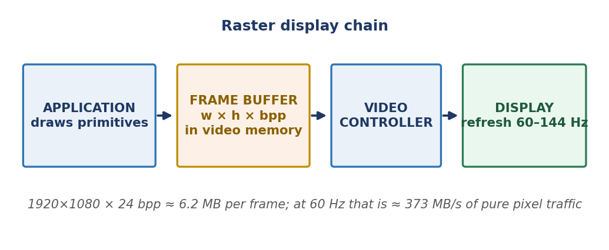
A Graphics System Is Four Boxes
FIGURE
▸ The display never asks your program for anything.
▸ The controller sweeps memory 60–144×/s regardless.
▸ That single fact forces double buffering and v-sync.
Lecture 02 · Computer Graphics: Systems, Displays and the Frame Buffer · BS Computer Science
Notes:
[ Slide 2 of 14 · Lecture 02: Computer Graphics: Systems, Displays and the Frame Buffer ]
SAY:
A raster graphics system is four boxes, and the arrows between them point one way. Follow the figure.
Your application decides what should appear and issues draw calls -- draw this triangle, use this texture, apply this transform.
The graphics processor and its display processor take that geometry and convert it into pixel values. That conversion is called rasterisation, and Weeks 9 to 14 are essentially a detailed study of this one box.
The frame buffer is just memory. It is a block of RAM holding one colour value for every pixel on screen. Nothing more mysterious than a very large array.
The video controller reads that memory and drives the display, sweeping across it row by row, sixty to a hundred and forty-four times a second.
Now the sentence that matters most here: the display never asks your program for anything. The video controller does not wait, does not request, does not check whether you are ready. It sweeps the frame buffer on its own clock, forever, whether or not you have finished drawing.
Ask yourself the obvious consequence: what happens if the controller reads the buffer halfway through your drawing? It shows half the old image and half the new one, joined by a visible horizontal seam. That artefact has a name -- tearing -- and avoiding it is exactly why double buffering and v-sync exist. We come back to it on slide 9.
DELIVERY NOTE:
Draw the consequence out loud before they see it on a later slide: 'if the controller reads whenever it likes, what happens if it reads halfway through your drawing?' Let someone say 'flicker' — then name it: tearing.

Slide 3
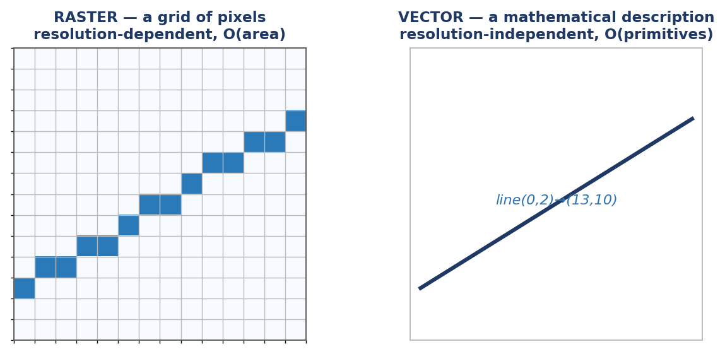
Raster or Vector? Two Ways to Mean 'A Line'
FIGURE
▸ Raster: O(area). Vector: O(primitives).
▸ Every 3D scene is vector until the very last stage.
Lecture 02 · Computer Graphics: Systems, Displays and the Frame Buffer · BS Computer Science
Notes:
[ Slide 3 of 14 · Lecture 02: Computer Graphics: Systems, Displays and the Frame Buffer ]
SAY:
There are two fundamentally different ways to represent the same picture, and the difference is not a file-format detail; it decides how the picture behaves.
A raster representation stores the picture as a grid of pixel values. A line is not "a line" -- it is a set of coloured cells that happen to look like a line. The representation knows nothing about lines; it knows about squares.
A vector representation stores the picture as a description: a line from this point to that point, of this width, in this colour. There is no grid. The picture is a recipe, not a result.
The cost consequence is on the slide and is worth writing as a rule. Raster storage is order of area: double the width and height and you quadruple the memory, however simple the picture. Vector storage is order of primitives: a plain white page costs almost nothing, and a picture with ten thousand shapes costs ten thousand shapes' worth -- at any size.
The zoom demonstration makes this permanent. Open a logo as a PNG and as an SVG and zoom both to eight hundred per cent. The PNG turns into visible blocks, because there is no more information in the file -- you are seeing the actual squares. The SVG stays crisp, because the recipe is re-cooked at the new size.
Last line, and remember it: every 3D scene is vector right up until the final stage. Vertices, matrices and light directions are all descriptions. Pixels arrive last.
DELIVERY NOTE:
Zoom demo works better than words: open any logo as PNG and as SVG, zoom both to 800%. Twenty seconds, permanent memory.

Slide 4
When To Use Which
 | Raster | Vector
Scaling | Degrades | Perfect at any size
Storage | O(w × h) | O(primitives)
Good for | Photos, textures, output | Diagrams, fonts, CAD, icons
Today's displays | All raster | Rasterised at the end
Lecture 02 · Computer Graphics: Systems, Displays and the Frame Buffer · BS Computer Science
Notes:
[ Slide 4 of 14 · Lecture 02: Computer Graphics: Systems, Displays and the Frame Buffer ]
SAY:
Take this table as a decision rule, not as trivia.
Scaling. Raster degrades when enlarged, because the information simply is not there; the renderer can only interpolate a guess. Vector is perfect at any size, because it recomputes from the description.
Storage. Raster is width times height, fixed, whatever the content. Vector is proportional to the number of primitives.
What each is good for. Raster wins for photographs, textures and any final output, because photographic detail genuinely is per-pixel information -- there is no shorter recipe for a human face. Vector wins for diagrams, fonts, CAD drawings and icons, precisely because those things were designed as shapes and must appear at many sizes.
And now the row that explains the rest of this course: today's displays are all raster. Every one of them. Whatever you started with, the last step is always a grid of pixels. Vector formats are rasterised at the end, at the size and resolution actually needed.
So here is the punchline, and it explains Weeks 9 to 14 in advance: the entire rendering pipeline is a machine for delaying the vector-to-raster conversion until the last possible moment. Keep geometry as geometry through transformation, viewing, clipping and projection, because geometry can be transformed exactly and cheaply -- and only then commit to pixels, once, at the correct size.
DELIVERY NOTE:
Land the punchline: the whole rendering pipeline is a machine for delaying the vector→raster conversion until the last possible moment. That sentence explains Weeks 9–14 in advance.

Slide 5
FRAME BUFFER ARITHMETIC — EXAMINABLE
size = w × h × bpp ÷ 8
bandwidth = size × refresh
▸ bpp is BITS per pixel. Divide by 8 first.
▸ Write the units on every line.
▸ Marks are lost on bits-vs-bytes every single year.
Notes:
[ Slide 5 of 14 · Lecture 02: Computer Graphics: Systems, Displays and the Frame Buffer ]
SAY:
These two formulas are examinable, they appear in some form every year, and the marks lost on them are almost never lost on the concept.
Frame-buffer size equals width times height times bits per pixel, divided by eight. The division by eight converts bits to bytes.
Refresh bandwidth equals that size multiplied by the refresh rate, giving bytes per second -- the rate at which the video controller must read memory just to keep a still image on the screen.
Now the warning. "bpp" means bits per pixel, not bytes. Twenty-four bits per pixel is three bytes per pixel. Every year a group of students writes "24 bytes per pixel," produces a number eight times too large, and does not notice, because the number had no units attached to it.
So the discipline is: write the units on every single line. If a line reads 2,073,600 with nothing after it, you cannot check it. If it reads 2,073,600 px, and the next line reads 3 B/px, then the product is obviously in bytes and the arithmetic checks itself. Units are not decoration; they are a free error detector.
One more habit worth building. Know the difference between a megabyte -- ten to the sixth bytes -- and a mebibyte -- two to the twentieth. Either is acceptable in an answer, as long as you say which one you used.
DELIVERY NOTE:
Say 'bits' and 'bytes' slowly and separately. Then do the next slide on the board, not from the deck — they must watch a human write units down.

Slide 6
Worked Example — 1920 × 1080, 24 bpp, 60 Hz
WORK IT ON THE BOARD
pixels = 1920 x 1080 = 2,073,600 px
bytes/pixel = 24 bpp / 8 = 3 B
frame buffer = 2,073,600 x 3 = 6,220,800 B ~ 5.93 MiB
bandwidth = 6,220,800 x 60 = 373,248,000 B/s ~ 356 MiB/s
▸ A third of a gigabyte per second to show a still image.
Lecture 02 · Computer Graphics: Systems, Displays and the Frame Buffer · BS Computer Science
Notes:
[ Slide 6 of 14 · Lecture 02: Computer Graphics: Systems, Displays and the Frame Buffer ]
SAY:
Let us do this properly, on the board rather than off a slide, because you need to watch a human write the units down.
A standard 1920 by 1080 display at 24 bits per pixel, refreshing 60 times a second.
Step one, pixel count. 1920 times 1080 equals 2,073,600 pixels. Two million pixels -- that alone is worth pausing on, because it tells you why any per-pixel work is expensive.
Step two, bytes per pixel. 24 bits per pixel divided by 8 equals 3 bytes per pixel. Say it out loud, so the bits-to-bytes conversion becomes a reflex.
Step three, frame-buffer size. 2,073,600 pixels times 3 bytes per pixel equals 6,220,800 bytes -- about 5.93 mebibytes, or 6.2 megabytes if you prefer powers of ten.
Step four, refresh bandwidth. 6,220,800 bytes times 60 per second equals 373,248,000 bytes per second, roughly 356 mebibytes per second.
Read that last line again. A third of a gigabyte per second of memory traffic, and the image is not even moving. That is the cost of merely existing on screen.
Now your turn, ninety seconds: 2560 by 1440, 32 bits per pixel, 144 hertz. Show every line with units. I will walk round, and I am specifically looking for anyone who writes "32 bytes."
DELIVERY NOTE:
Then ask for 2560×1440 at 32 bpp and 144 Hz as a 90-second class exercise. Walk the room. The two students who write '32 bytes' are the reason this slide exists.

Slide 7
And a Real 3D App Needs Three of Them
MEMORY BUDGET
colour front 1920 x 1080 x 4 B = 8,294,400 B
colour back 1920 x 1080 x 4 B = 8,294,400 B
depth 1920 x 1080 x 4 B = 8,294,400 B
------------
total ~24.9 MB, before textures
▸ 'Just add another full-screen buffer' is never free.
Lecture 02 · Computer Graphics: Systems, Displays and the Frame Buffer · BS Computer Science
Notes:
[ Slide 7 of 14 · Lecture 02: Computer Graphics: Systems, Displays and the Frame Buffer ]
SAY:
A real 3D application does not allocate one frame buffer. It allocates at least three full-screen buffers, and this slide exists so that "just add another buffer" never sounds free to you again.
At 1920 by 1080 with 4 bytes per pixel -- that is 32 bits, eight each for red, green, blue and alpha -- each buffer costs 8,294,400 bytes, about 8.3 megabytes.
The front colour buffer is the one currently being displayed. The back colour buffer is the one you are drawing into. And the depth buffer stores, for every pixel, how far away the nearest surface drawn there so far is.
Three buffers, roughly 24.9 megabytes, and that is before a single texture, mesh or shader has been loaded.
Two lessons. First, whenever someone proposes an effect that needs "one more full-screen render target" -- shadows, reflections, post-processing, anti-aliasing -- you now know the unit price, and you should multiply it by the resolution people actually use. At 4K it is four times worse.
Second, plant this and do not explain it yet: the depth buffer is what makes draw order stop mattering. Without it, whatever you draw last wins, so you must sort your scene by distance yourself. With it, each pixel remembers its own nearest surface and rejects anything further away. We build that properly in Week 13. For now, just notice that it costs a full-screen buffer -- and that this memory is what buys you the freedom to draw in any order.
DELIVERY NOTE:
Forward-reference Week 13: the depth buffer is what makes draw order stop mattering. Do not explain it yet — just plant it.

Slide 8
Colour Depth
Depth | Colours | Where
8 bpp indexed | 256 via a palette | GIF, retro, embedded
16 bpp (5-6-5) | 65,536 | Low-power mobile
24 bpp (8-8-8) | 16.7 M — 'true colour' | Desktop standard
32 bpp (8-8-8-8) | 16.7 M + alpha | What GPUs allocate
Lecture 02 · Computer Graphics: Systems, Displays and the Frame Buffer · BS Computer Science
Notes:
[ Slide 8 of 14 · Lecture 02: Computer Graphics: Systems, Displays and the Frame Buffer ]
SAY:
Colour depth is how many bits you spend per pixel, and it is a straight trade between fidelity, memory and bandwidth.
Eight bits per pixel, indexed: the pixel stores a number from 0 to 255, which is an index into a palette of 256 chosen colours. Small, and still used in GIFs, retro rendering and embedded displays. Changing the palette changes the whole image instantly, which used to be a cheap animation trick.
Sixteen bits per pixel in 5-6-5 layout: five bits red, six green, five blue, giving 65,536 colours. Green gets the extra bit because the human eye is most sensitive to green -- a fact of human perception baked directly into a hardware format, which is exactly the kind of overlap this course exists to point out. Common on low-power mobile and embedded screens.
Twenty-four bits per pixel, eight per channel: 16.7 million colours, called true colour, because it exceeds what the eye can distinguish in a smooth gradient. The desktop standard.
Thirty-two bits per pixel: 16.7 million colours plus an eight-bit alpha channel. This is what GPUs actually allocate.
Now the misconception, and answer before I tell you. Does 32 bpp show more colours than 24 bpp? No. It shows exactly the same 16.7 million. The extra byte is alpha -- transparency -- plus memory alignment, because hardware reads four-byte-aligned values much faster than three-byte ones. More bits, same colours, different purpose.
DELIVERY NOTE:
Correct the standard misconception here: 32 bpp is not more colours than 24 bpp — the extra byte is alpha and alignment. Ask the class before you tell them; most will get it wrong.

Slide 9
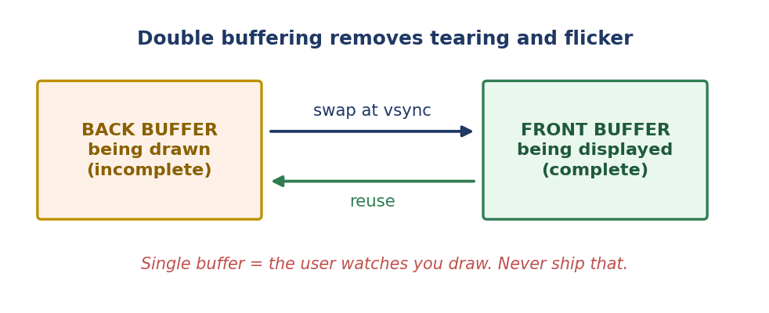
Why Animation Needs Two Buffers
FIGURE
▸ Draw into the hidden buffer, swap when finished.
▸ Swap at the vertical blank (v-sync) → no tearing.
▸ Cost: one extra full-screen buffer, and a frame-rate cap.
Lecture 02 · Computer Graphics: Systems, Displays and the Frame Buffer · BS Computer Science
Notes:
[ Slide 9 of 14 · Lecture 02: Computer Graphics: Systems, Displays and the Frame Buffer ]
SAY:
Now we resolve the tension set up on slide 2. The video controller sweeps the frame buffer on its own schedule and never asks your permission. So what happens if you draw into the buffer it is currently reading?
It shows you a mixture. The top of the screen was read before your update, the bottom after. The result is a visible horizontal seam that jumps around as the two clocks drift against each other. That artefact is tearing, and once you have noticed it you cannot un-notice it.
The fix is double buffering. Allocate two colour buffers. The front buffer is displayed; the back buffer is where you draw. When the frame is complete you swap them -- and in modern systems the swap is often just exchanging two pointers, which is effectively instantaneous. The user never sees a partially drawn frame, because a frame only becomes visible when it is already finished.
Then one refinement: perform the swap during the vertical blanking interval, the short pause after the controller finishes the last row and before it begins the next sweep. Swapping in that window means the swap happens between reads rather than during one, so there is no seam at all. That is v-sync.
Both costs are real. You pay one extra full-screen buffer -- 8.3 megabytes from the previous slide -- and you cap your frame rate at the refresh rate, because you can only swap when the display is ready.
DELIVERY NOTE:
If you can, demo it: disable v-sync in any game or in the starter code and let them see a real tear. Nothing else teaches this as fast.

Slide 10
Where Graphics Actually Gets Used
• Interfaces — every glyph and icon was rasterised (the bridge to the first half of this course)
• Visualisation — CT/MRI volume rendering, weather, fluids, molecules
• CAD / architecture — parametric solids, precise geometry
• Entertainment — games at 16.7 ms/frame; film at hours/frame; same maths, opposite constraints
• Simulation — flight, surgical, driving; believable enough to transfer skill
• AR / VR — two eyes, 90+ Hz, <20 ms motion-to-photon or the user is ill
Lecture 02 · Computer Graphics: Systems, Displays and the Frame Buffer · BS Computer Science
Notes:
[ Slide 10 of 14 · Lecture 02: Computer Graphics: Systems, Displays and the Frame Buffer ]
SAY:
Where does this actually get used? Six domains, and notice that each has a different binding constraint.
Interfaces. Every glyph you have ever read on a screen was rasterised from vector outlines, hinted onto a pixel grid, and composited. This is the direct bridge to the first half of the course: text legibility is simultaneously a typography question, a perception question and a rasterisation question.
Visualisation. CT and MRI volume rendering, weather models, fluid simulation, molecular structure. Constraint: the image must be truthful, because a doctor will make a decision from it.
CAD and architecture. Parametric solids and precise geometry. Constraint: numerical accuracy -- a wall that looks fine but is geometrically wrong is a building defect.
Entertainment. Games have 16.7 milliseconds per frame; film has hours per frame. Same mathematics, opposite constraints. Games trade accuracy for speed; film does the reverse.
Simulation. Flight, surgical, driving. Constraint: it must be believable enough that skill learned in the simulator transfers to reality.
And AR/VR, which is the strongest single argument for this course having one title. Two eyes, ninety hertz or more, and under about twenty milliseconds from head motion to photons. Miss that deadline and the user does not say "the frame rate is poor" -- they become physically nauseated. It is a graphics problem and an interaction problem with a physiological deadline attached.
DELIVERY NOTE:
Dwell on the last one: it is a graphics problem AND an interaction problem with a physiological deadline. That is the clearest single argument for why this course has one title.

Slide 11
THE ONE NAME TO REMEMBER
Sketchpad, Ivan Sutherland, MIT 1963
▸ First interactive computer-graphics system.
▸ First direct-manipulation interface.
▸ Same PhD thesis. Both halves of this course start here.
Notes:
[ Slide 11 of 14 · Lecture 02: Computer Graphics: Systems, Displays and the Frame Buffer ]
SAY:
One name, one year, one thesis: Ivan Sutherland, Sketchpad, MIT, 1963.
Sketchpad let a user draw directly on a display with a light pen. Lines followed the pen as it moved -- rubber-banding, which we now take entirely for granted. You could apply constraints: tell the system that these two lines must remain perpendicular, or that this length must equal that one, and the drawing rearranged itself to obey. You could define a master shape and place instances of it, and editing the master updated every instance -- object-oriented thinking, years before the term existed.
Two claims, both true at once. It was the first interactive computer-graphics system: a picture generated by a computer that a human changed in real time. And it was the first direct-manipulation interface: you acted on the object itself rather than typing a description of an action.
Those are the founding moments of the two halves of this course, and they are the same document. That is not a coincidence of history; it is a statement about the subject. Interactive graphics is what happens when you can change a picture fast enough for a human to feel they are touching it. Which requires a graphics system fast enough, and an interaction design worth touching.
If the room has network, watch ninety seconds of the Sketchpad film. It is from 1963 and it still looks modern, and that is exactly the point.
DELIVERY NOTE:
Show 90 seconds of the Sketchpad film if the room has network. The light-pen rubber-banding still looks modern, and that is the point.

Slide 12
The Toolchain for Weeks 9–16
Layer | We use | Why
Window + input | GLFW | One small cross-platform library
Loader | GLAD | Modern GL entry points aren't static
API | OpenGL 3.3 core | Programmable, matches the textbook
Maths | GLM / NumPy | 4×4 matrices without writing your own
Fallback | PyOpenGL or WebGL | If C++ won't build in one lab
History | Git, from Lab 1 | Your commits are marked
Lecture 02 · Computer Graphics: Systems, Displays and the Frame Buffer · BS Computer Science
Notes:
[ Slide 12 of 14 · Lecture 02: Computer Graphics: Systems, Displays and the Frame Buffer ]
SAY:
Here is what you will actually install and use from Week 9 onwards, and why each piece is on the list.
GLFW gives you a window, a graphics context and keyboard and mouse input, in one small cross-platform library. Without it you would write different code for Windows, Linux and macOS before drawing anything at all.
GLAD is a loader. Modern OpenGL entry points are not statically linked; they are looked up from the driver at run time. GLAD generates that lookup code so you can call the functions normally.
OpenGL 3.3 core profile is the API. Core profile means the old fixed-function pipeline is gone and you write shaders, which matches both modern hardware and the textbook treatment.
GLM in C++, or NumPy in Python, gives you 4x4 matrix and vector mathematics. You will learn to derive these matrices by hand in Weeks 10 and 12 -- that is examinable -- but in code you should use a tested library rather than your own.
The fallback is PyOpenGL or WebGL, and the rule is explicit: if your machine will not build the C++ toolchain within one lab session, switch to the Python fallback and carry on. Same concepts, same marks. Installing a compiler is not a learning outcome.
And Git from Lab 1 onwards. Your commit history is marked, because it is evidence of process -- and because a single commit at 3 a.m. before the deadline tells its own story.
DELIVERY NOTE:
State the rule out loud: if your machine will not build the C++ toolchain within one lab session, switch to the Python fallback and carry on. Same concepts, same marks. Installing a compiler is not a learning outcome.

Slide 13
HOME TASK
Measure your own screen.
▸ Find its resolution, colour depth and refresh rate.
▸ Compute frame-buffer size and refresh bandwidth.
▸ Units on every line. Bring the working to Lab 1.
Notes:
[ Slide 13 of 14 · Lecture 02: Computer Graphics: Systems, Displays and the Frame Buffer ]
SAY:
Measure your own screen. This is short, and it makes the arithmetic personal instead of abstract.
Find three numbers for the display you are reading this on. Its resolution in pixels -- on Windows, Settings, then System, then Display; on a phone, the specifications page. Its colour depth in bits per pixel. And its refresh rate in hertz, which on modern phones and laptops may well be 90 or 120 rather than 60.
Then compute two things using the formulas from slide 5. The frame-buffer size, in bytes and in mebibytes. And the refresh bandwidth, in bytes per second and in mebibytes per second.
Units on every single line. That is not a style preference; it is how you catch your own errors.
Two optional extras if you want to push further. First, work out the aspect ratio and check whether it is 16:9, 16:10 or something else. Second, compute what three buffers would cost at your resolution -- front, back and depth, at four bytes per pixel -- and compare that number with the total memory available to your machine's graphics chip.
I will ask two of you to put your working on the board at the start of Lab 1. So do it.
DELIVERY NOTE:
Tell them you will ask two students to put their working on the board at the start of Lab 1. That converts the task from optional to done.

Slide 14
EXIT QUESTION · WRITE YOUR ANSWER
In one sentence, explain why the video controller's independence from your program forces you to use two buffers.
▸ Hand in one short paragraph before you leave.
▸ Home task: Look up the resolution, colour depth and refresh rate of the screen you are reading this on. Compute its frame-buffer size and refresh bandwidth, showing units on every line. Bring the working to Lab 1.
Notes:
[ Slide 14 of 14 · Lecture 02: Computer Graphics: Systems, Displays and the Frame Buffer ]
SAY:
One paragraph before you leave.
In one sentence, explain why the video controller's independence from your program forces you to use two buffers.
A complete answer contains three linked ideas: the controller sweeps the frame buffer on its own clock, so it can read while you are still writing; a partially written frame is therefore visible as a torn image; and the fix is to draw into a hidden buffer and expose it only when complete. If your sentence contains all three links, you have understood today.
Home task again: find the resolution, colour depth and refresh rate of your own screen, compute frame-buffer size and refresh bandwidth, and show units on every line. Bring the working to Lab 1.
Where we go next. Weeks 2 and 3 return to the human -- vision and colour, then hearing, touch and motor control, then memory and attention. It may feel like we are abandoning graphics, but keep today's numbers in your head, because the human chapters are what tell you which of those pixels and which of those milliseconds actually matter. A display pushing 356 megabytes per second is worth nothing if what it shows cannot be perceived.
Collect the exit slips on the way out.
DELIVERY NOTE:
Collect the exit slips; they are your fastest signal of who has understood the lecture.

