Slide 1
Hospital Management System
Group Members:
Names: Registration numbers:
Hamza Jadoon FA22-BCE-012
Abdur Rehman Shinwari FA22-BCE-027
Ibad Ur Rehman FA22-BCE-032

Slide 2
Outline
Introduction
Aim and motivation.
Algorithm.
Proposed Solution
Impact of Proposed solution
Results
Teamwork / Tasks Division
Learning
Conclusion

Slide 3
Introduction
The Purpose of this CEP is ;
As patients come ,so we have to store their data like name gender age and which doctor they want to refer
So in order to do that hms is made .
To develop a user-friendly system that facilitates efficient management of various hospital processes.
By implementing this system, hospitals can improve their overall efficiency, enhance patient care.

Slide 4
Motivation ,Aims Objectives:
Motivation behind this project;
Manual systems are often prone to errors, delays which leading to compromised patient care and increased administrative burdens.
Aims and objectives include;
Enable patients to access their medical records, schedule appointments, and interact with healthcare providers more efficiently, improving the overall patient experience.
Integrate secure user access control mechanisms to protect sensitive patient data and ensure that only authorized personnel have access to specific functionalities.

Slide 5
ALGORITHM:
USED SWITCH STATEMENT FOR MENU
2 STRUCTURE NAMED PATIENT AND DOCTOR TO ADD THEIR DATA
1 CLASS NAMED HOSPITALMANAGEMENTSYSTEM TO MAKE DATA SECURE BY MAKING STRUCTURE VARIABLES PRIVATE.

Slide 6
Proposed Solution/Methodology
Class Definition:
The program defines a class Hospitalmanagementsystem with private member variables, including a memory variable.
Display Menu:
The display Menu function presents a menu of available operations to the user, with corresponding choices.
User Input and Switch Statement:
Inside the loop, the program prompts the user to enter their choice.
The user's choice is processed using a switch statement, calling the appropriate method like adding a patient or a doctor etc.
Continuous Operation:
This program allows users to add remove any patient or a doctor until 0 is pressed or the condition is reached.

Slide 7
Impact of proposed solution:
Societal Impact:
The implementation of an efficient HMS allows healthcare providers to access and manage patient information .
Patient flow through an HMS can contribute to reduced waiting times.

Slide 8
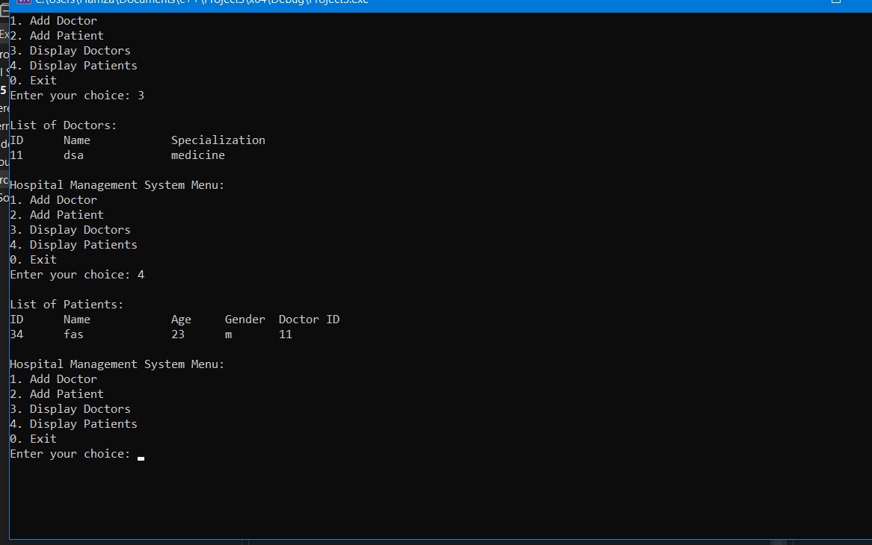
Results

Slide 9
Teamwork/Tasks Division
WE WORKED AS A TEAM TO COMPLETE THIS PROJECT .
IBAD WORKED ON THE ERRORS OCCURRED IN EXECUTING THE PROGRAM .
ABDUR REHMAN WORKED ON THE REPORT OF THE PROJECT.
HAMZA JADOON WORKED ON THE PRESENTATION OF PROJECT.

Slide 10
Learning from this project
We learned a lot of things by working on this project like teamwork and task division.
Learned error solving.
Time management.
How to make data secure using classes.
Store different types of variables using structures.

Slide 11
Conclusion
This project successfully addresses the need and working of a basic hospital management system
User-friendly implementation in C++.

Slide 12
THE END THANKS

